Slide 1
AN URGENT MESSAGE
ON EVANGELISM
MATTHEW 28:18-20

Slide 2
GOD'S DESIRE! IS IT OURS?
He wants all to be saved! (2 Pet. 3:9)
This is the church’s responsibility! (Eph. 3:10; 1 Tim. 3:15)
Why should this be our strong desire?
Romans 1:14
1 Corinthians 9:16
1 Timothy 1:12-16
Romans 5:6-8

Slide 3
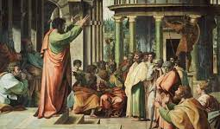
DOING THE JOB THE CHURCH
1st Century Evangelism
(ACTS)
(2:41, 47) 3000 souls
(4:4) 5000 souls
(5:14) “multitudes”
(5:28, 42; 8:4) all Jerusalem
(11:19-24) “a large number”
Completed in 35 years!
^{Acts 1:8} but you will receive power when the Holy Spirit has come upon you; and you shall be My witnesses both in Jerusalem, and in all Judea and Samaria, and even to the remotest part of the earth.”

Slide 4
The Great Commission 1st Century to 21st Century
MATTHEW 28:18-20
WHEN: “to the end of the age” Never-ending
WHERE: “all nations” Every Contact
HOW: “all that I commanded” The Gospel (Best & Only Method)
WHY: How could we not?

