Slide 2
We Will Glorify
69
_
_
_
Hymn: Twila Paris (1982)
Tune: PARIS • Twila Paris (1982)
© 1982 New Spring (admin. by Brentwood-Benson Music Publishing, Inc.)

Slide 3
WeWillGlorify_st1_a
Vs 1
© 2014 Sumphonia Productions, LLC

Slide 4
WeWillGlorify_st1_b
Vs 1
© 2014 Sumphonia Productions, LLC

Slide 5
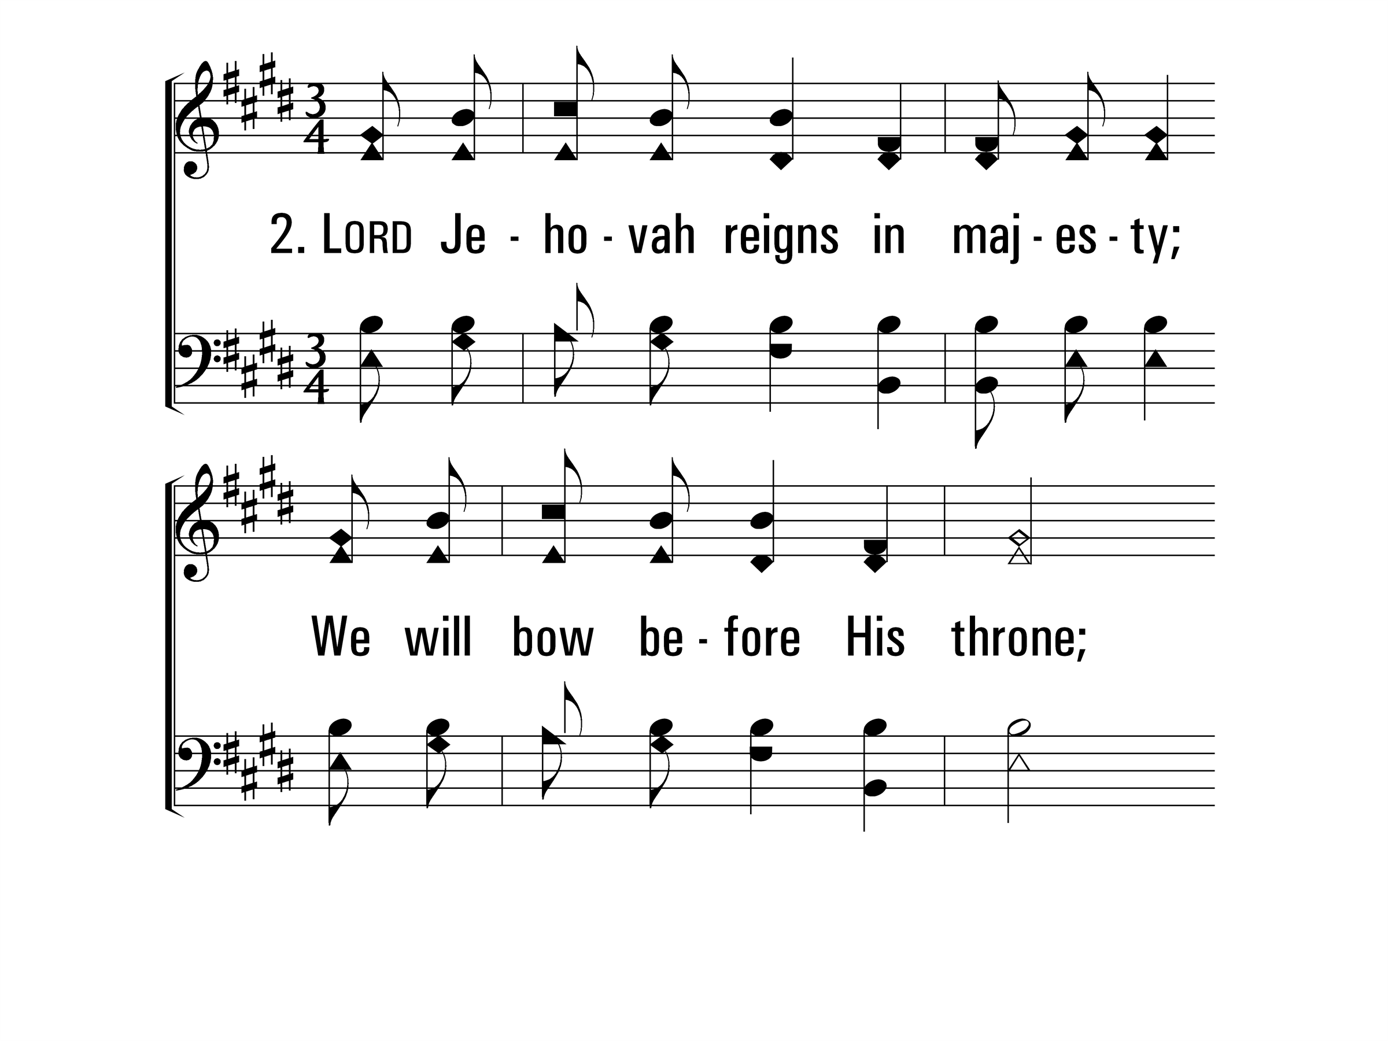
WeWillGlorify_st2_a
Vs 2
© 2014 Sumphonia Productions, LLC

Slide 6
WeWillGlorify_st2_b
Vs 2
© 2014 Sumphonia Productions, LLC

Slide 7
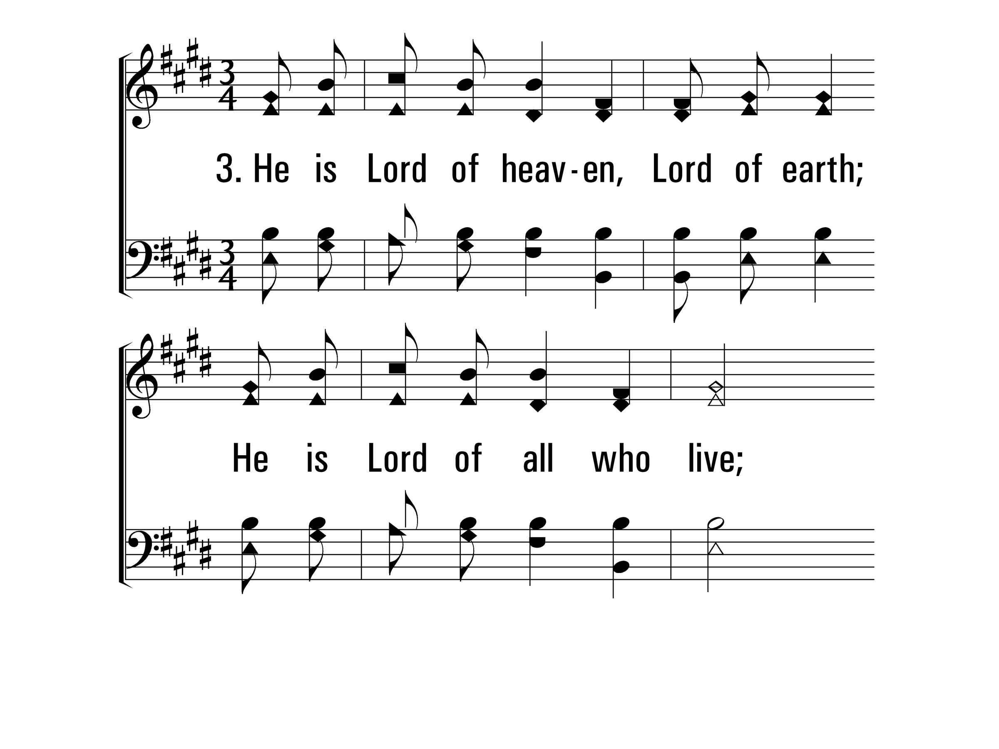
WeWillGlorify_st3_a
Vs 3
© 2014 Sumphonia Productions, LLC

Slide 8
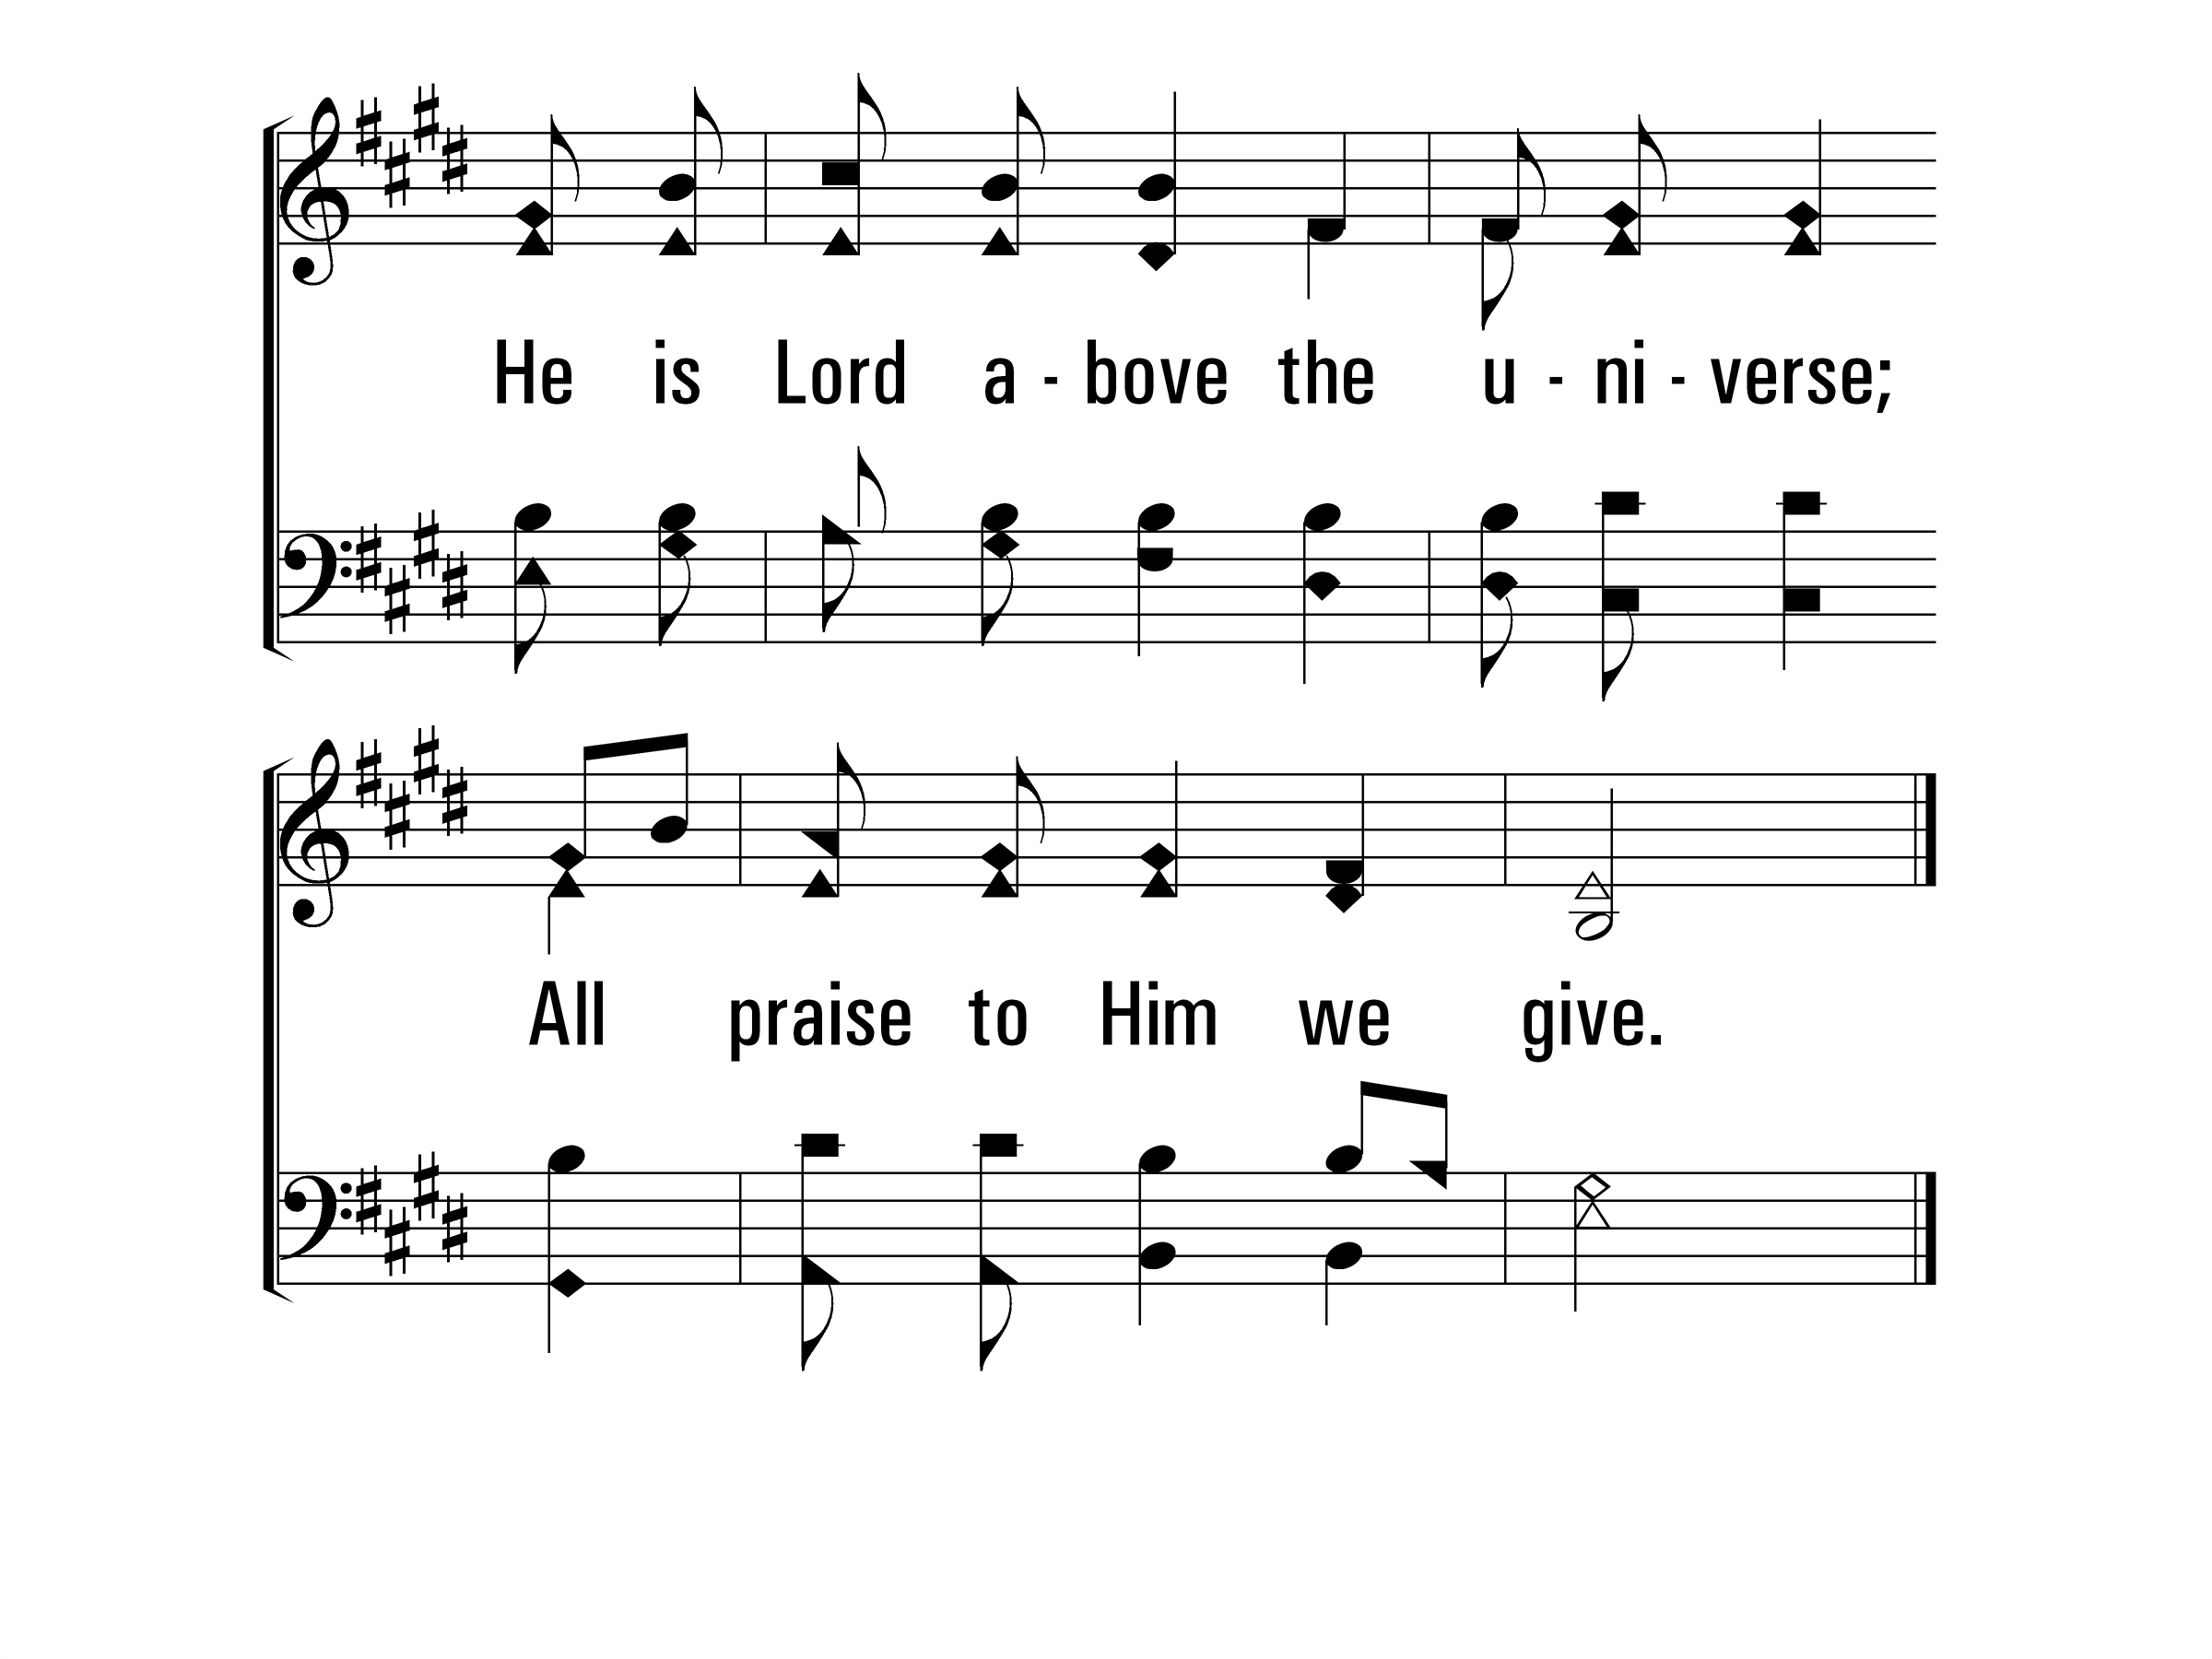
WeWillGlorify_st3_b
Vs 3
© 2014 Sumphonia Productions, LLC

Slide 9
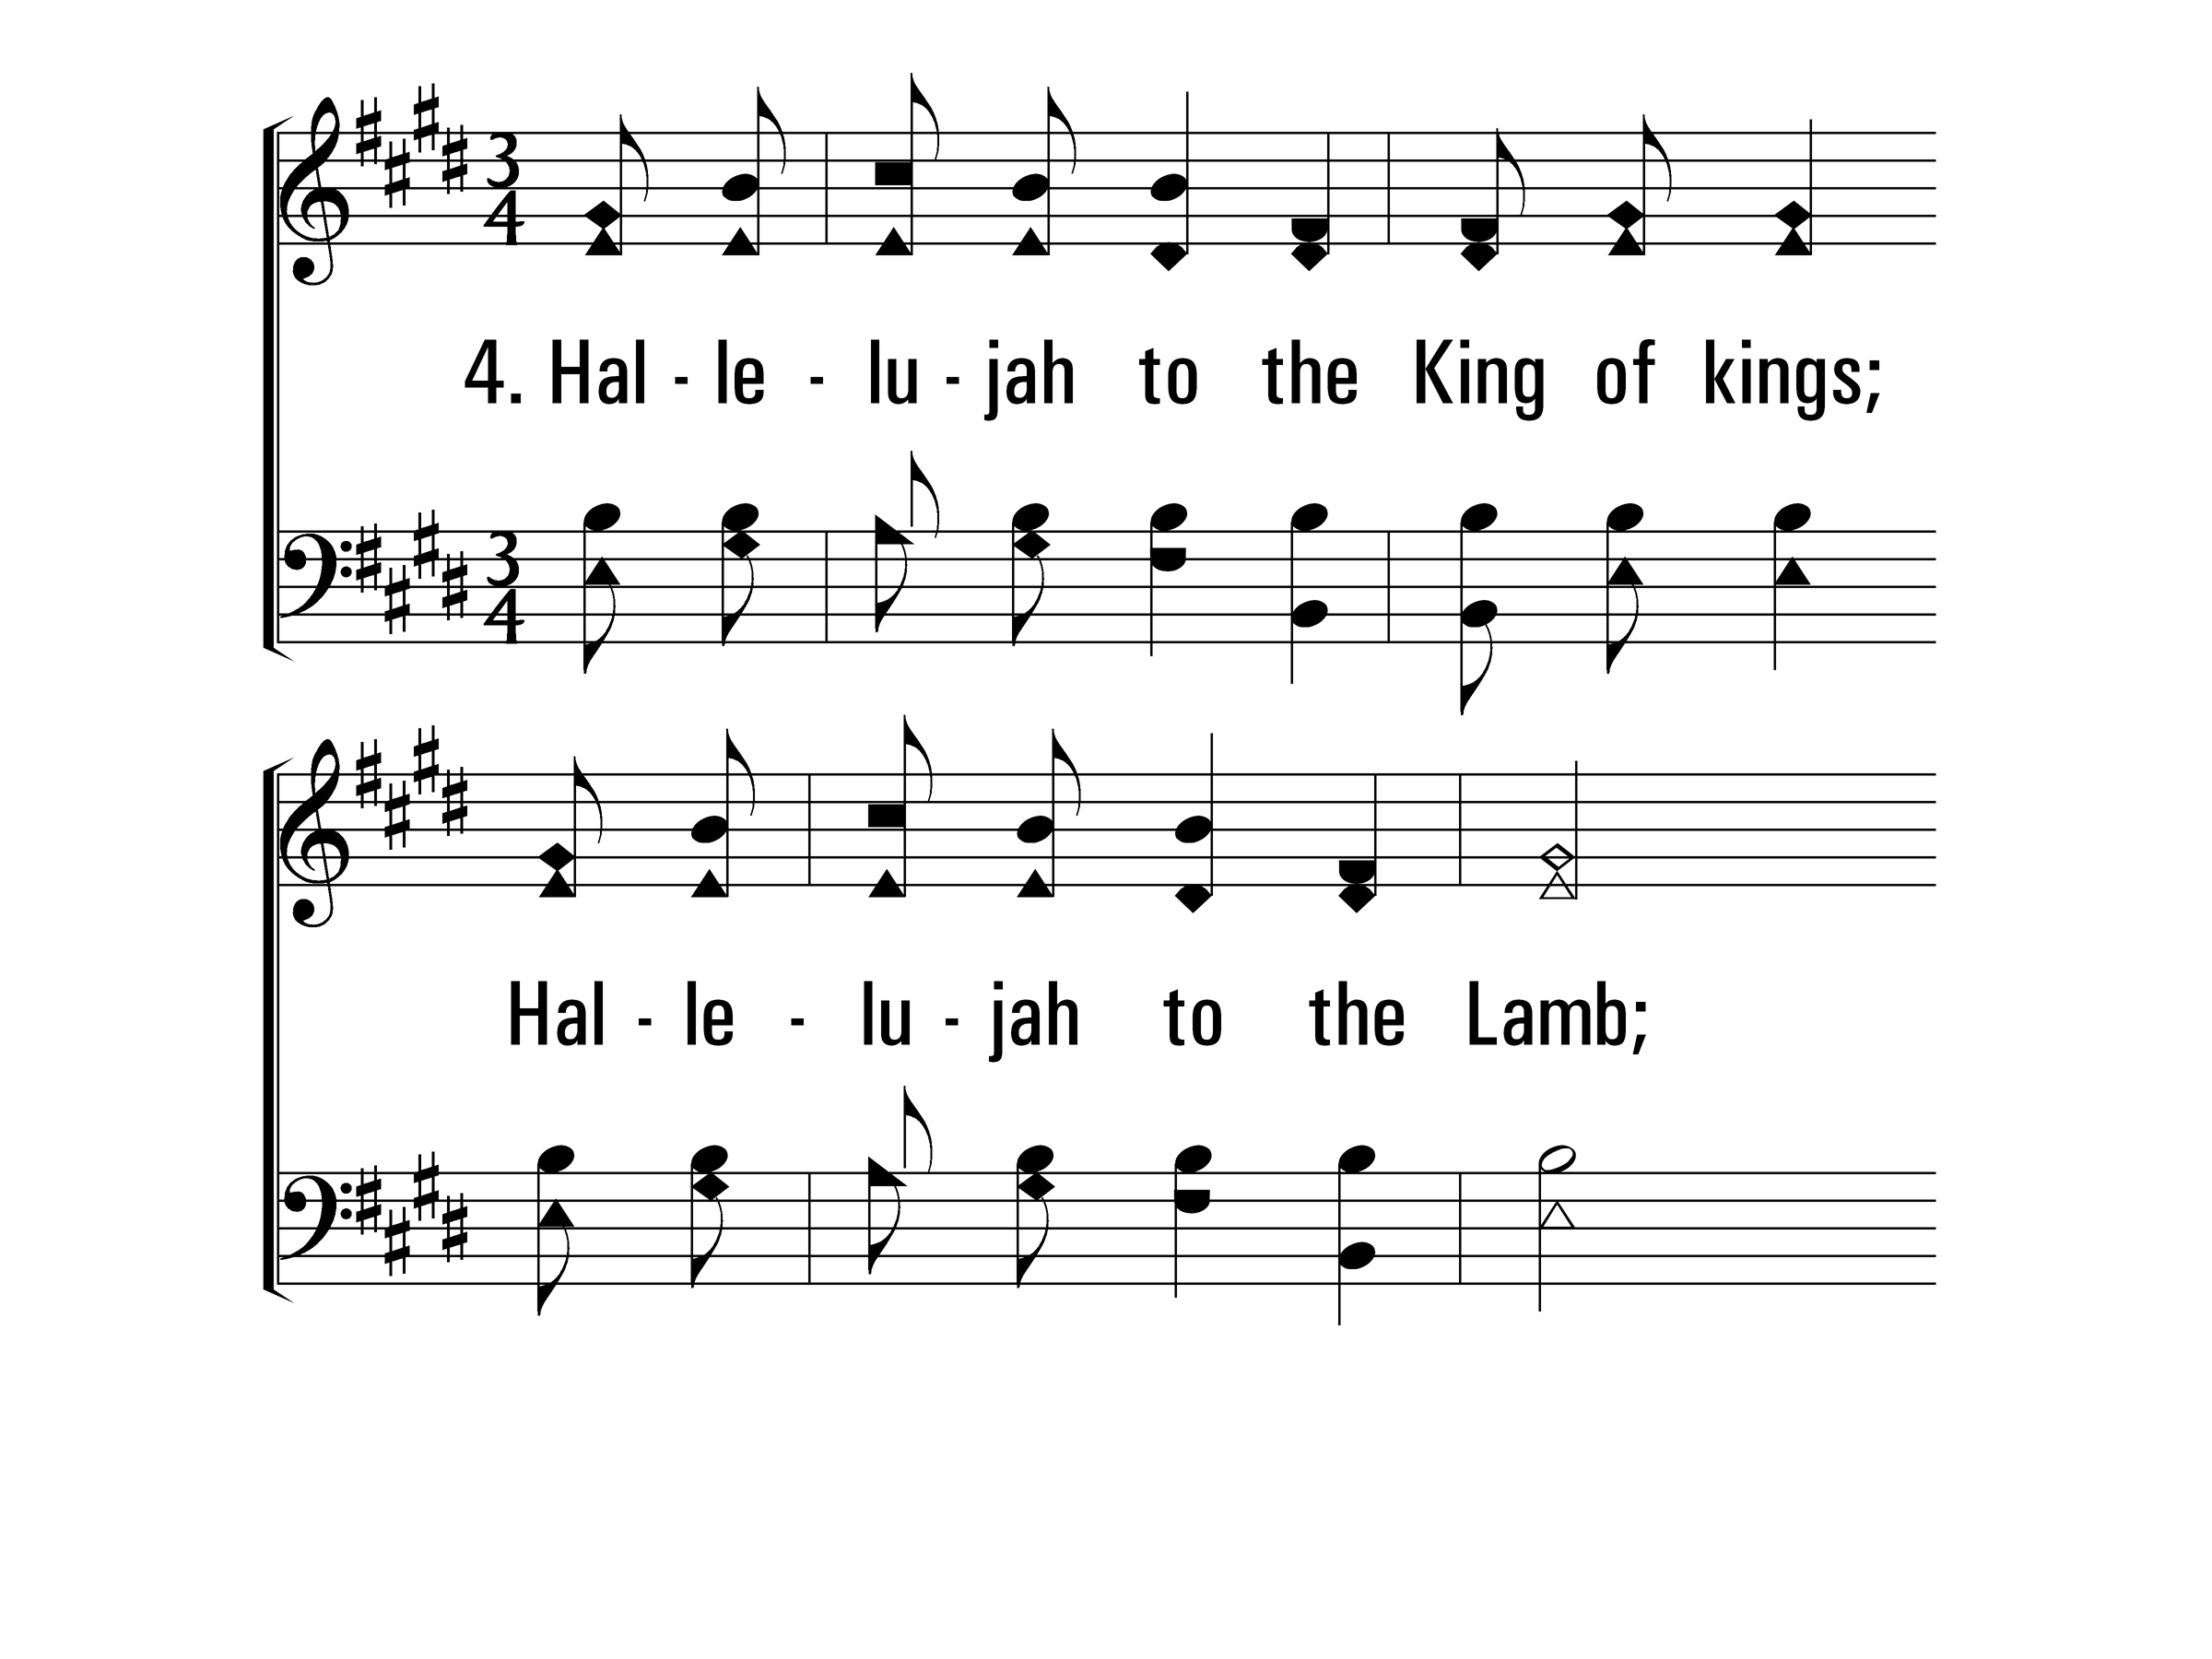
WeWillGlorify_st4_a
Vs 4
© 2014 Sumphonia Productions, LLC

Slide 10
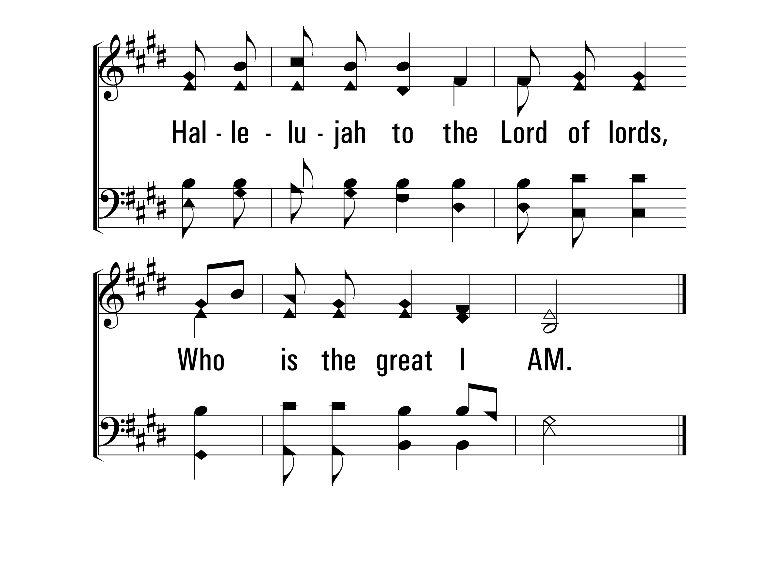
WeWillGlorify_st4_b
Vs 4
© 2014 Sumphonia Productions, LLC
End

Slide 11
My Eyes Have Seen Your Glory
316
_
_
_
Hymn: Ken Young (1997)
Tune: Ken Young (1997)
© 1997 Hallal Music, Inc.

Slide 12
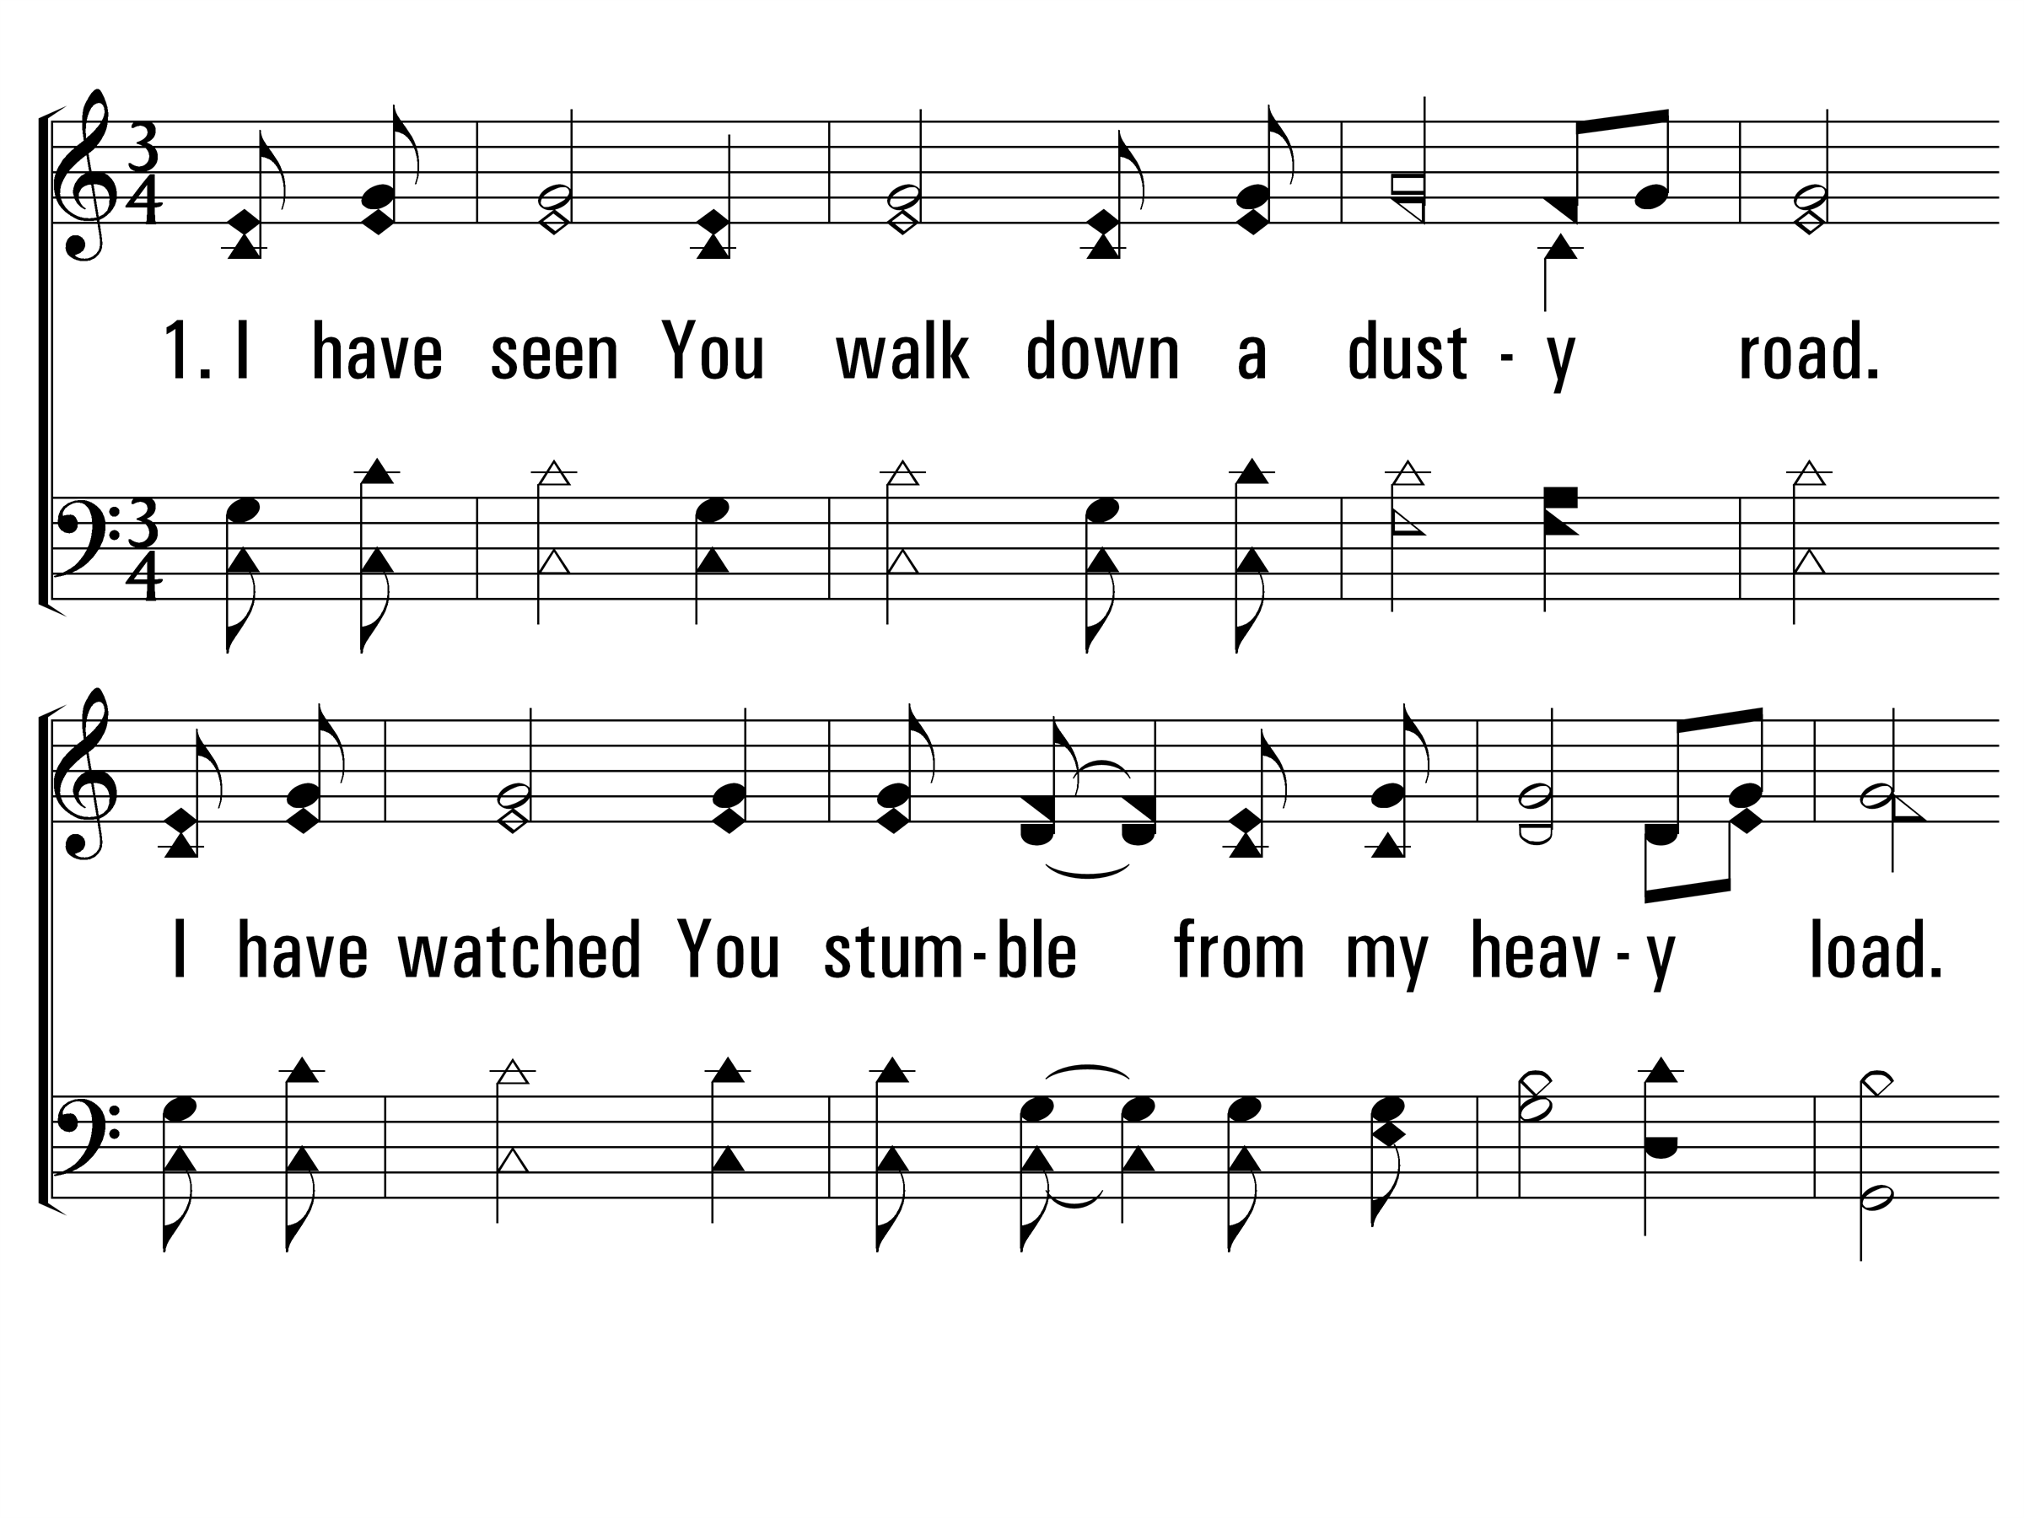
MyEyesHaveSeenYourGlory_st1_a
Vs 1
© 2014 Sumphonia Productions, LLC

Slide 13
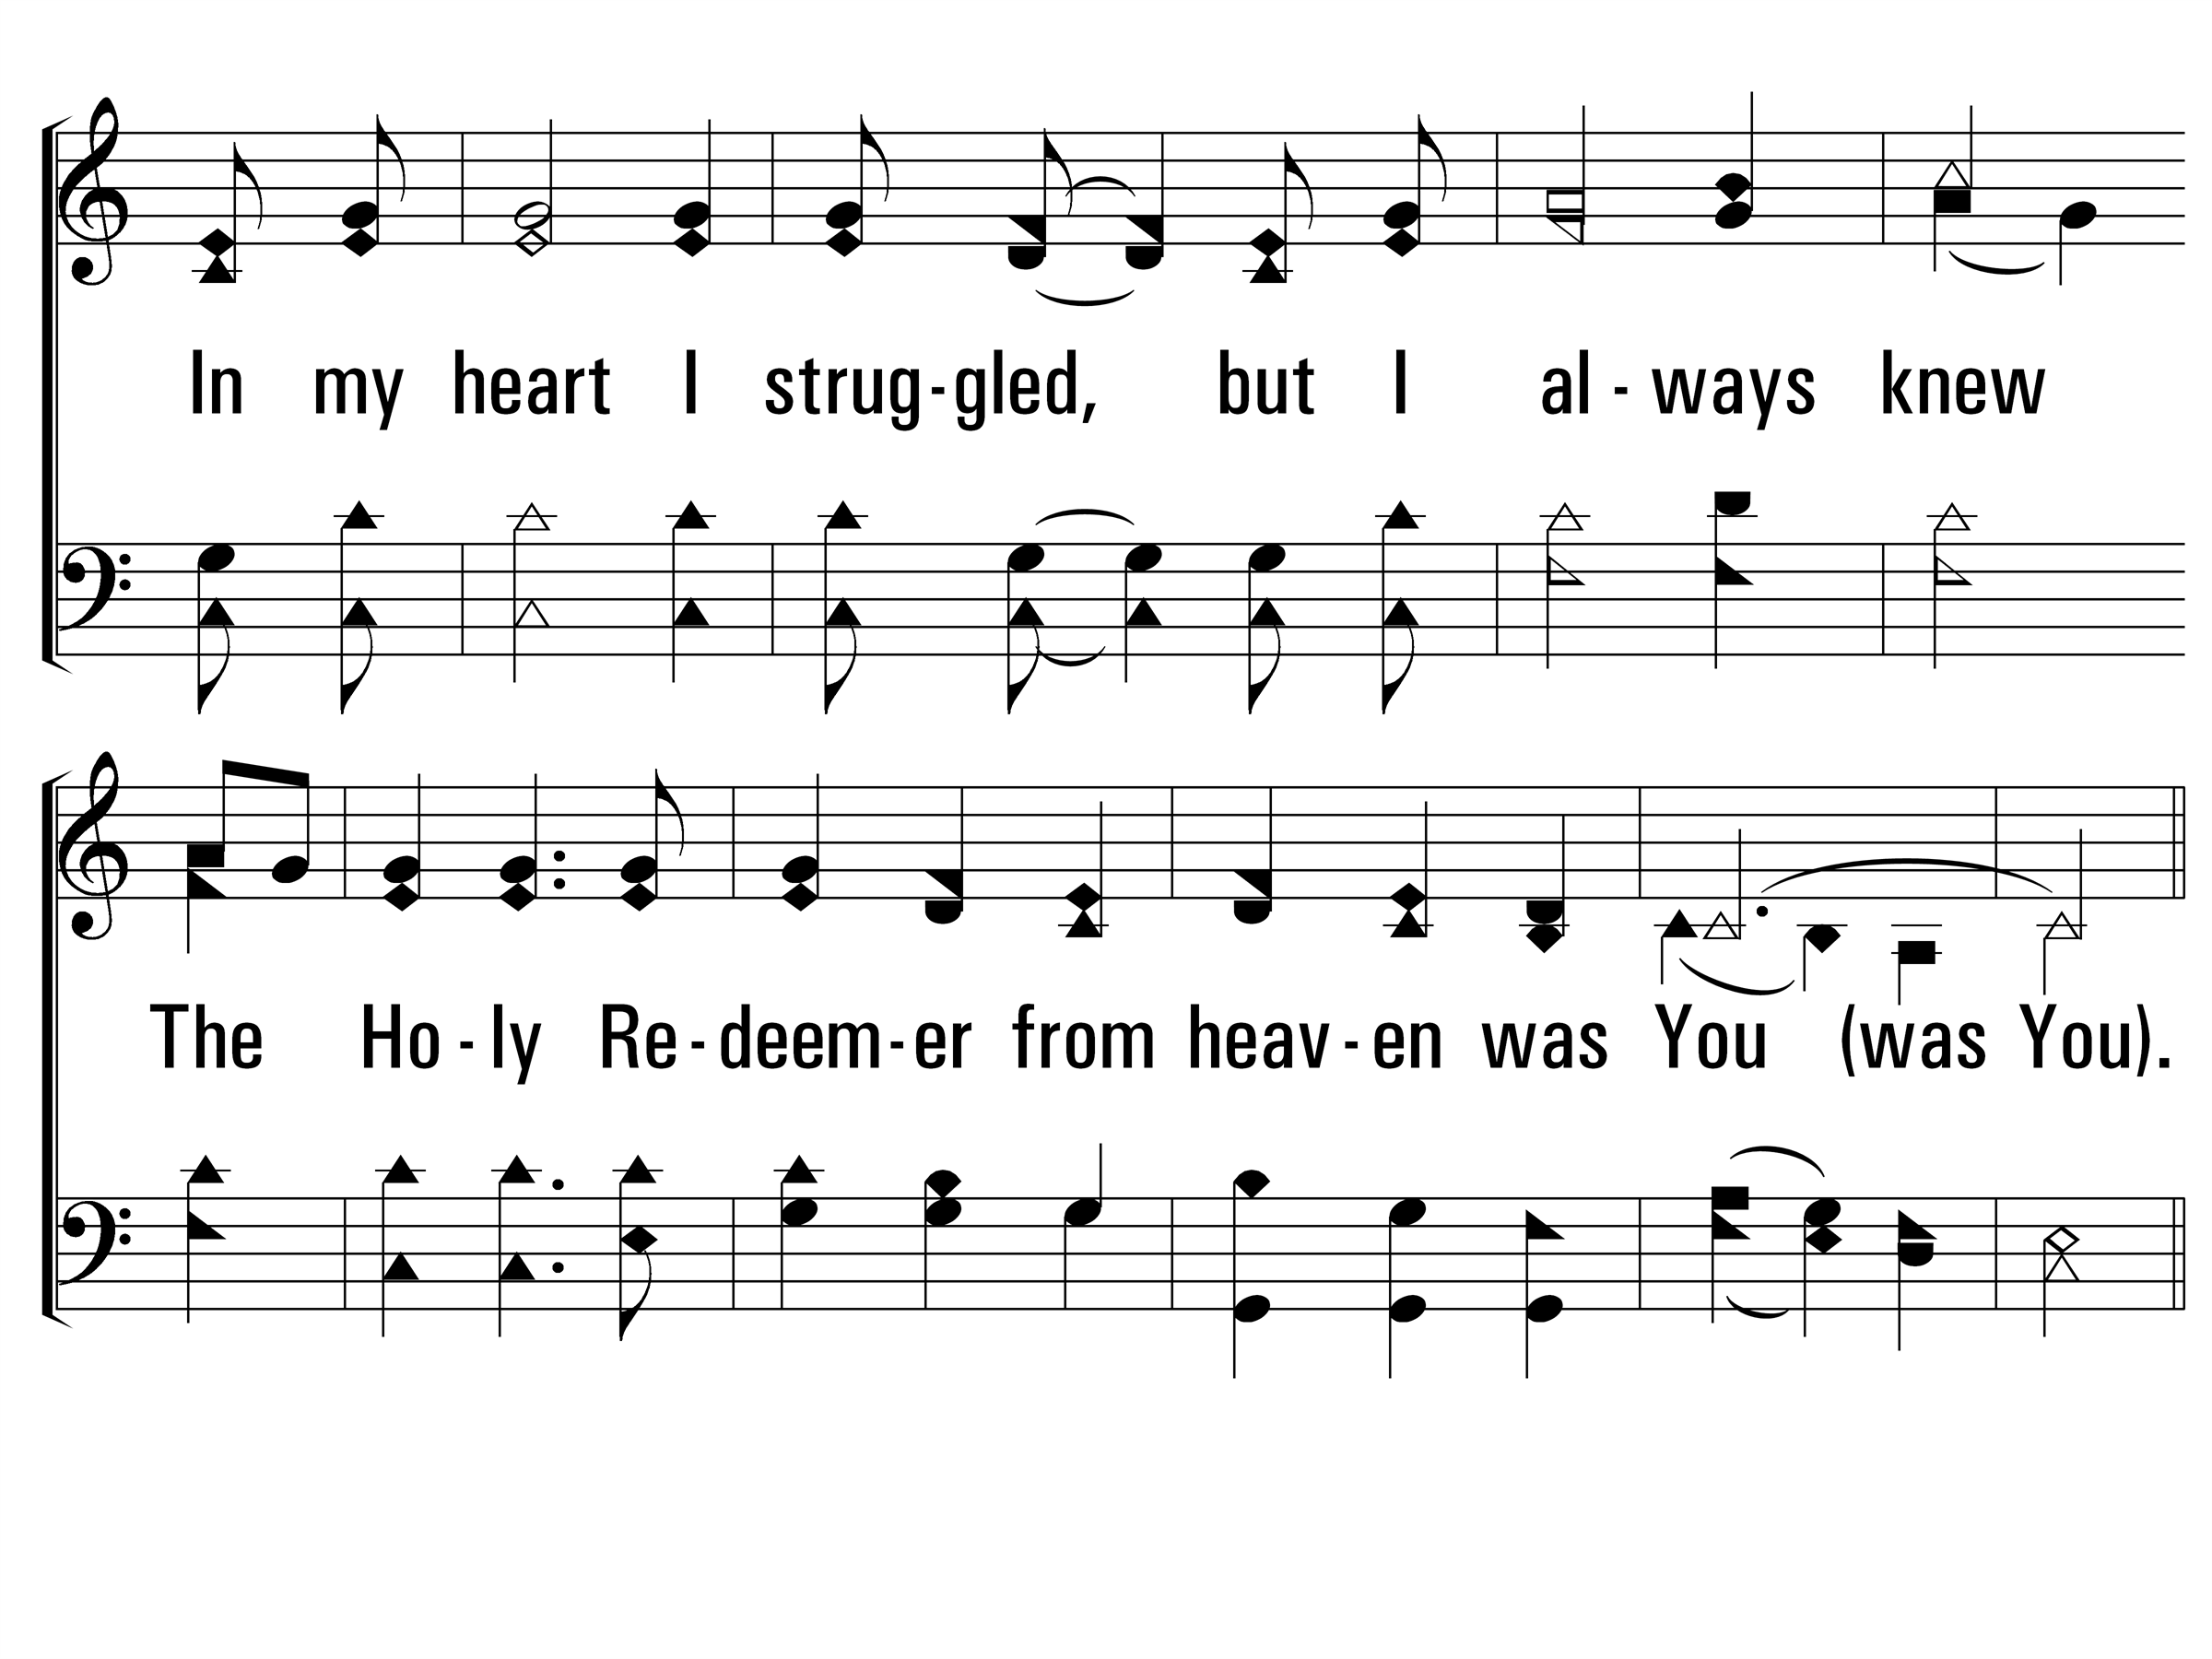
MyEyesHaveSeenYourGlory_st1_b
Vs 1
© 2014 Sumphonia Productions, LLC

Slide 14
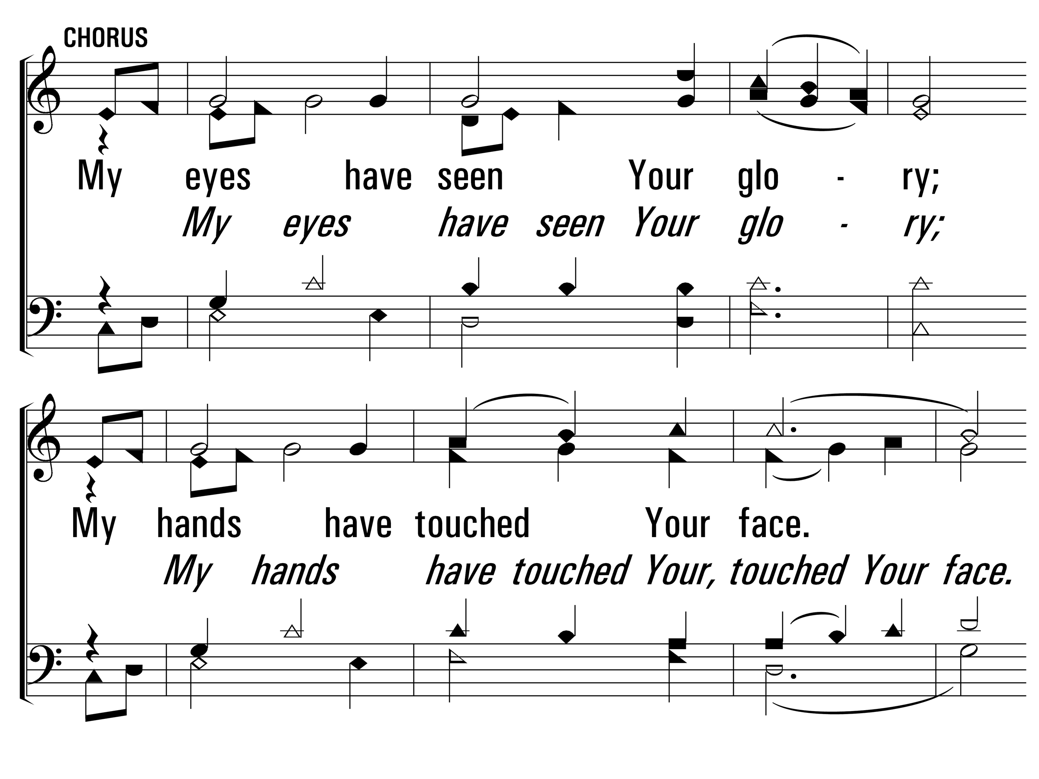
MyEyesHaveSeenYourGlory_cho_a
Chorus
© 2014 Sumphonia Productions, LLC

Slide 15
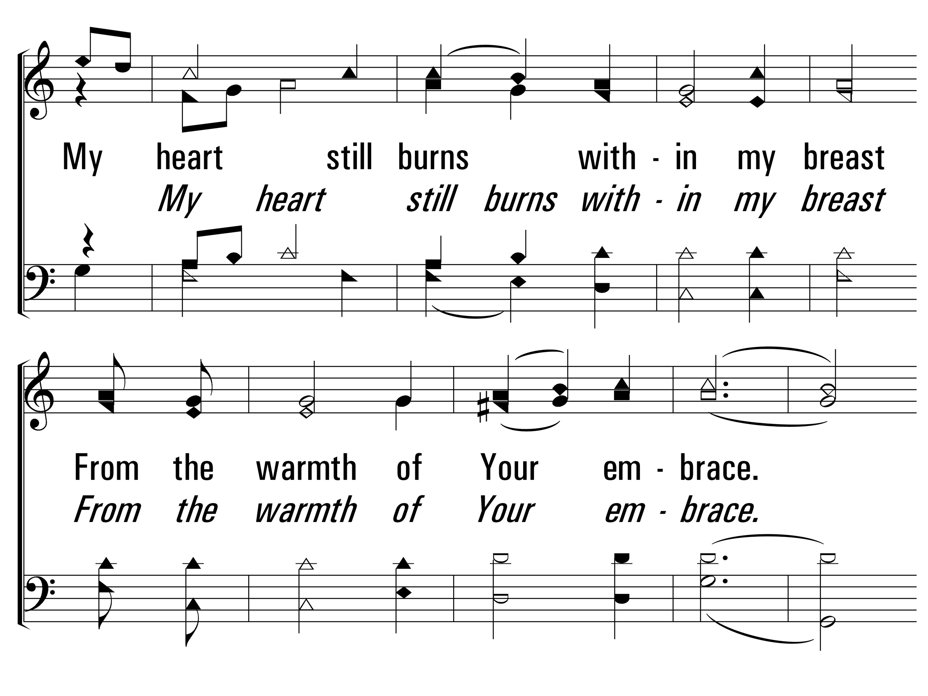
MyEyesHaveSeenYourGlory_cho_b
Chorus
© 2014 Sumphonia Productions, LLC

Slide 16
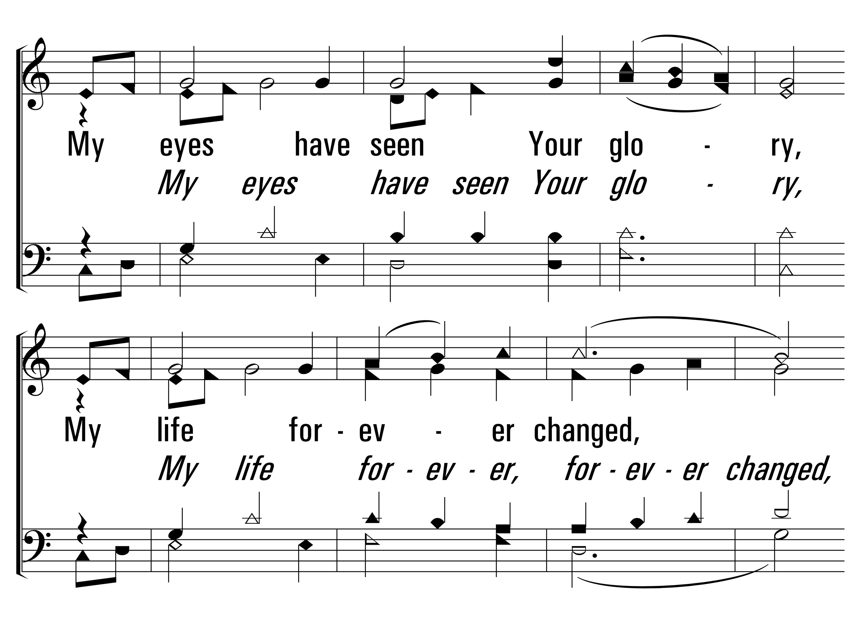
MyEyesHaveSeenYourGlory_cho_c
Chorus
© 2014 Sumphonia Productions, LLC

Slide 17
MyEyesHaveSeenYourGlory_cho_d
Chorus
© 2014 Sumphonia Productions, LLC

Slide 18
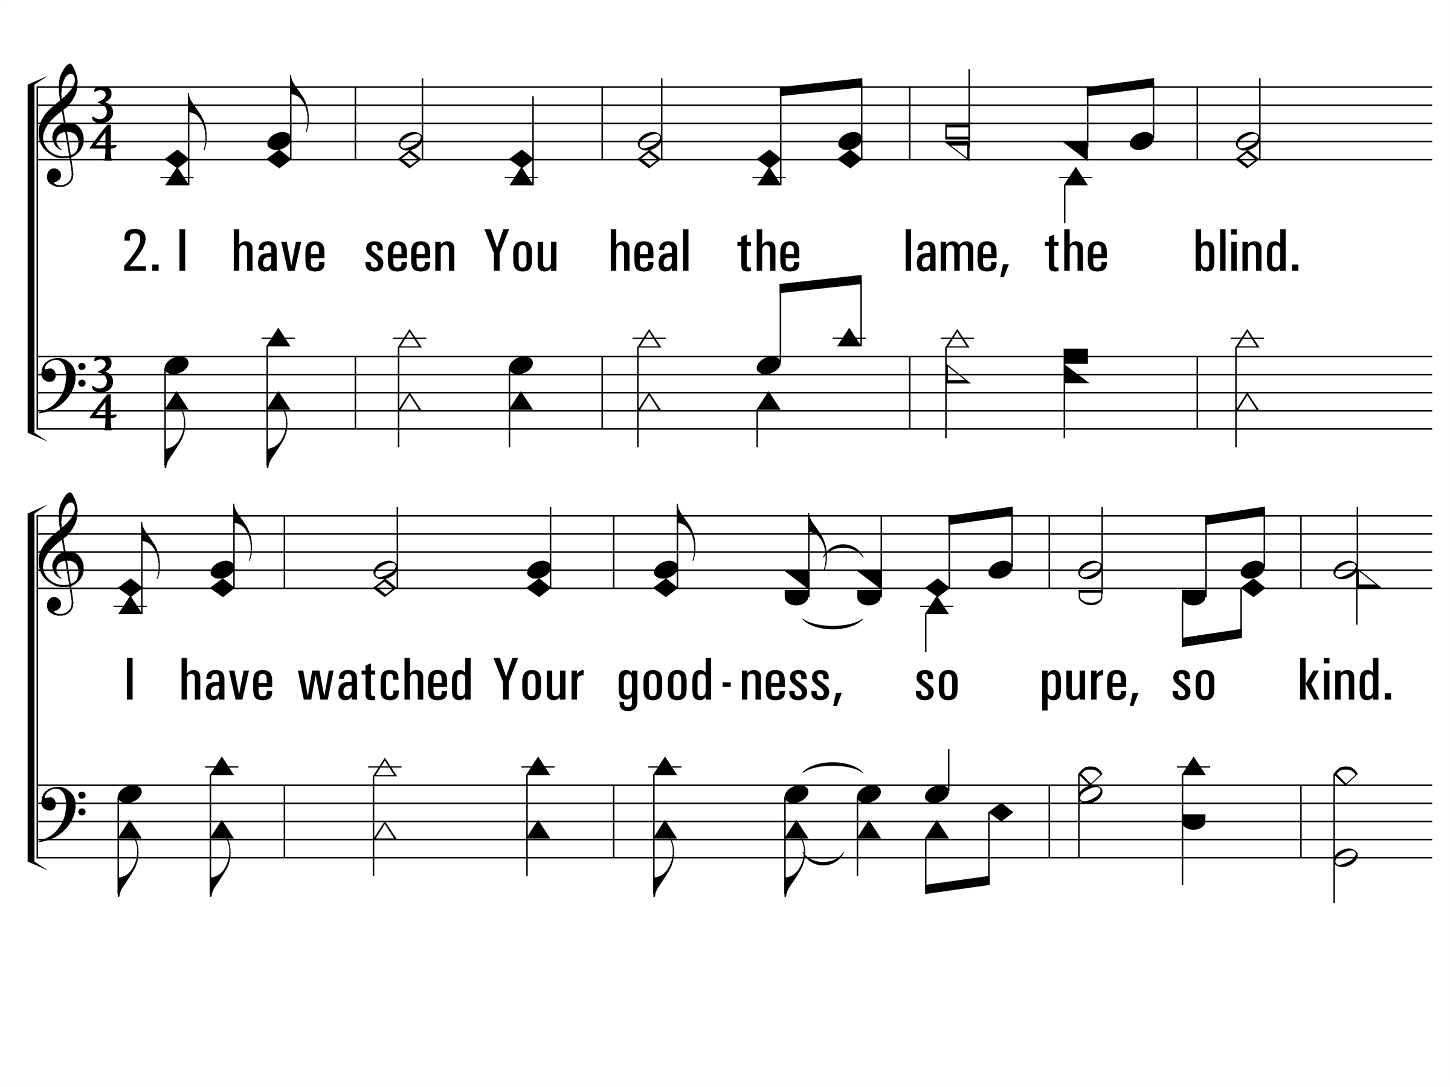
MyEyesHaveSeenYourGlory_st2_a
Vs 2
© 2014 Sumphonia Productions, LLC

Slide 19
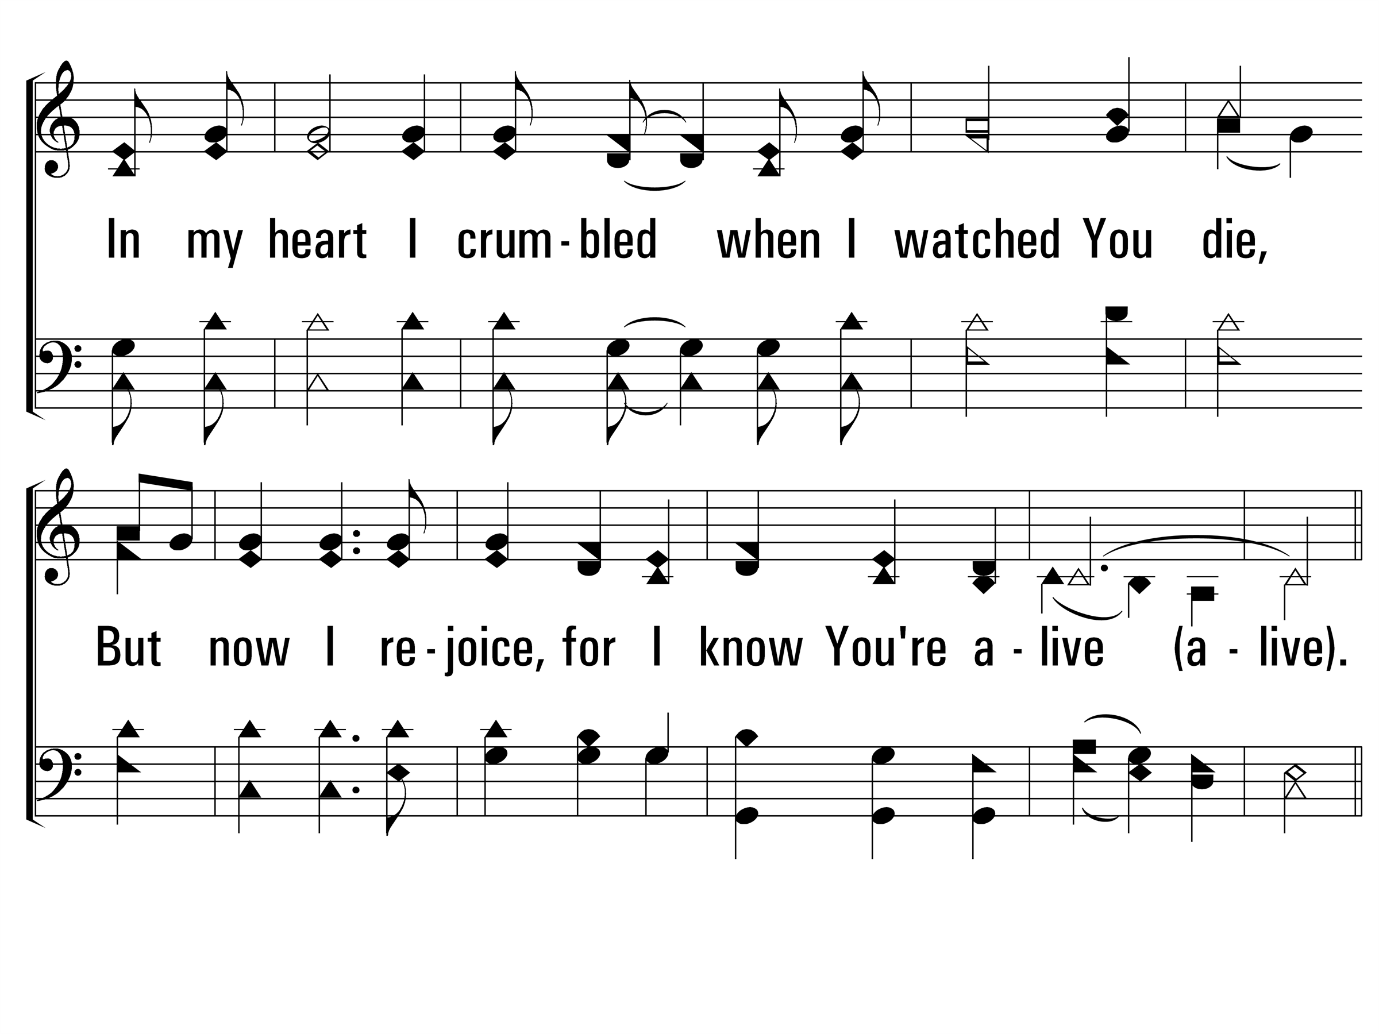
MyEyesHaveSeenYourGlory_st2_b
Vs 2
© 2014 Sumphonia Productions, LLC

Slide 20
MyEyesHaveSeenYourGlory_cho_a
Chorus
© 2014 Sumphonia Productions, LLC

Slide 21
MyEyesHaveSeenYourGlory_cho_b
Chorus
© 2014 Sumphonia Productions, LLC

Slide 22
MyEyesHaveSeenYourGlory_cho_c
Chorus
© 2014 Sumphonia Productions, LLC

Slide 23
MyEyesHaveSeenYourGlory_cho_d
Chorus
© 2014 Sumphonia Productions, LLC
End

Slide 25
In Gethsemane Alone
221
_
_
_
_
Hymn: Samuel E. Reed (1912)
Tune: Samuel E. Reed (1912)

Slide 26
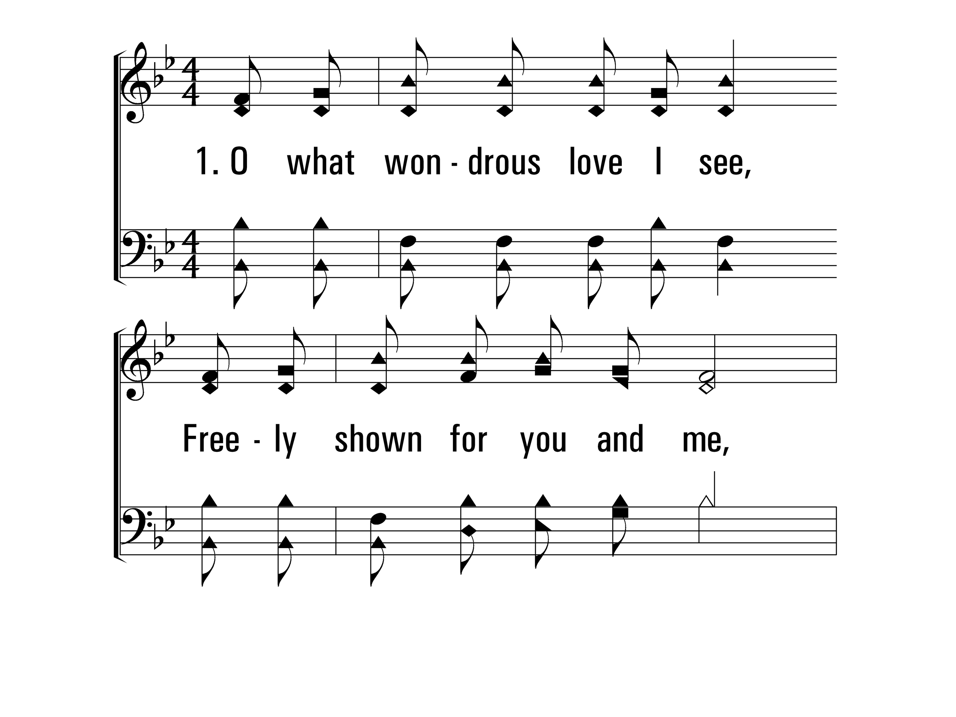
InGethsemaneAlone_st1_a
Vs 1
© 2014 Sumphonia Productions, LLC

Slide 27
InGethsemaneAlone_st1_b
Vs 1
© 2014 Sumphonia Productions, LLC

Slide 28
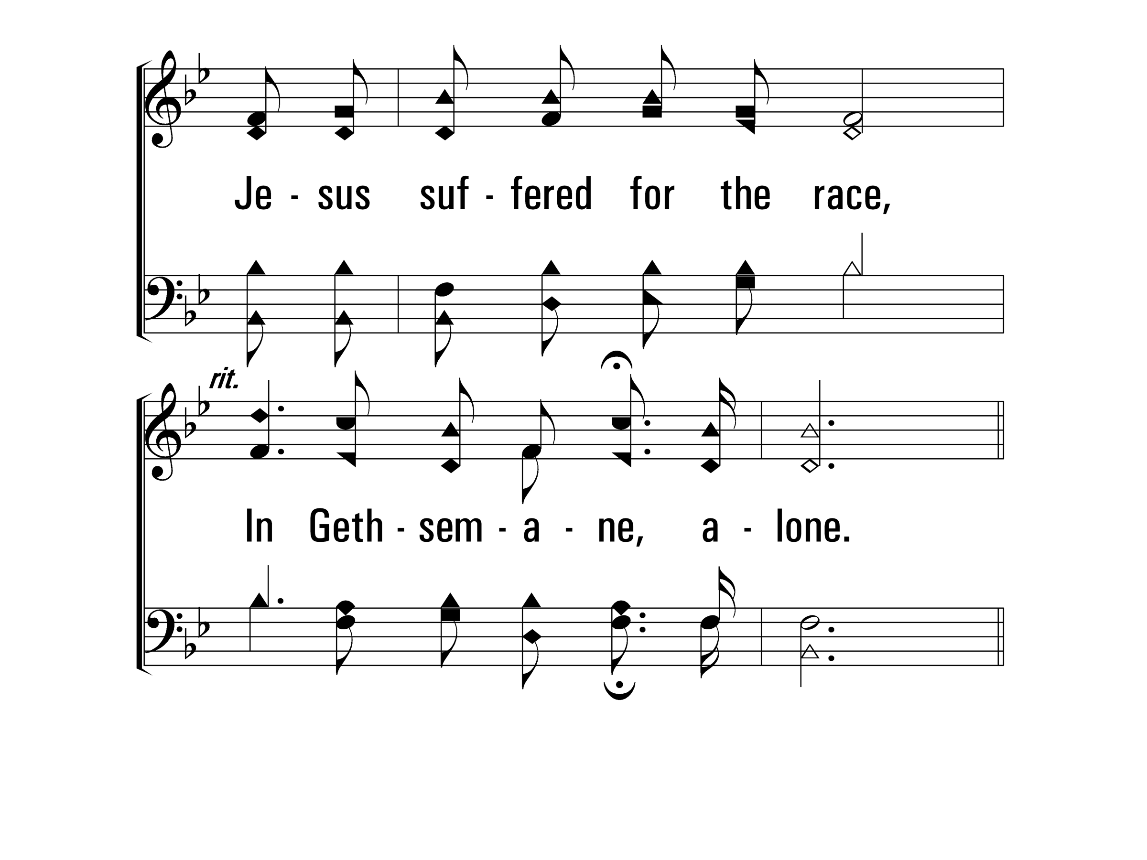
InGethsemaneAlone_st1_c
Vs 1
© 2014 Sumphonia Productions, LLC

Slide 29
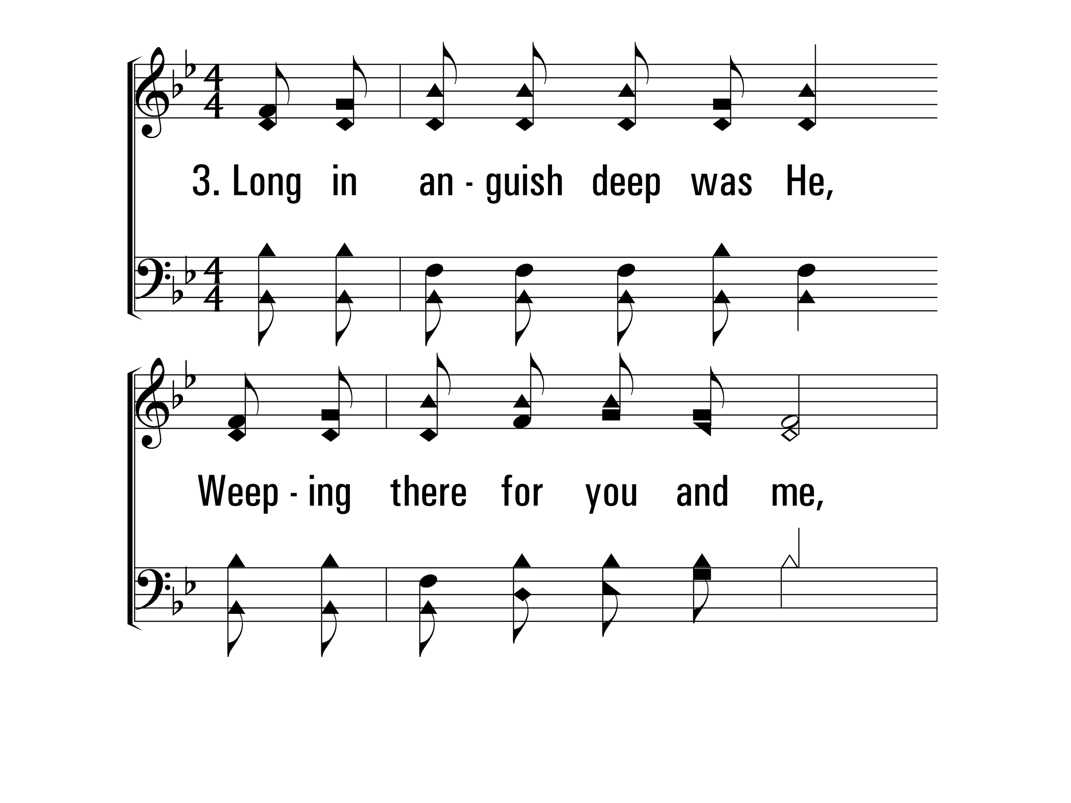
InGethsemaneAlone_st3_a
Vs 3
© 2014 Sumphonia Productions, LLC

Slide 30
InGethsemaneAlone_st3_b
Vs 3
© 2014 Sumphonia Productions, LLC

Slide 31
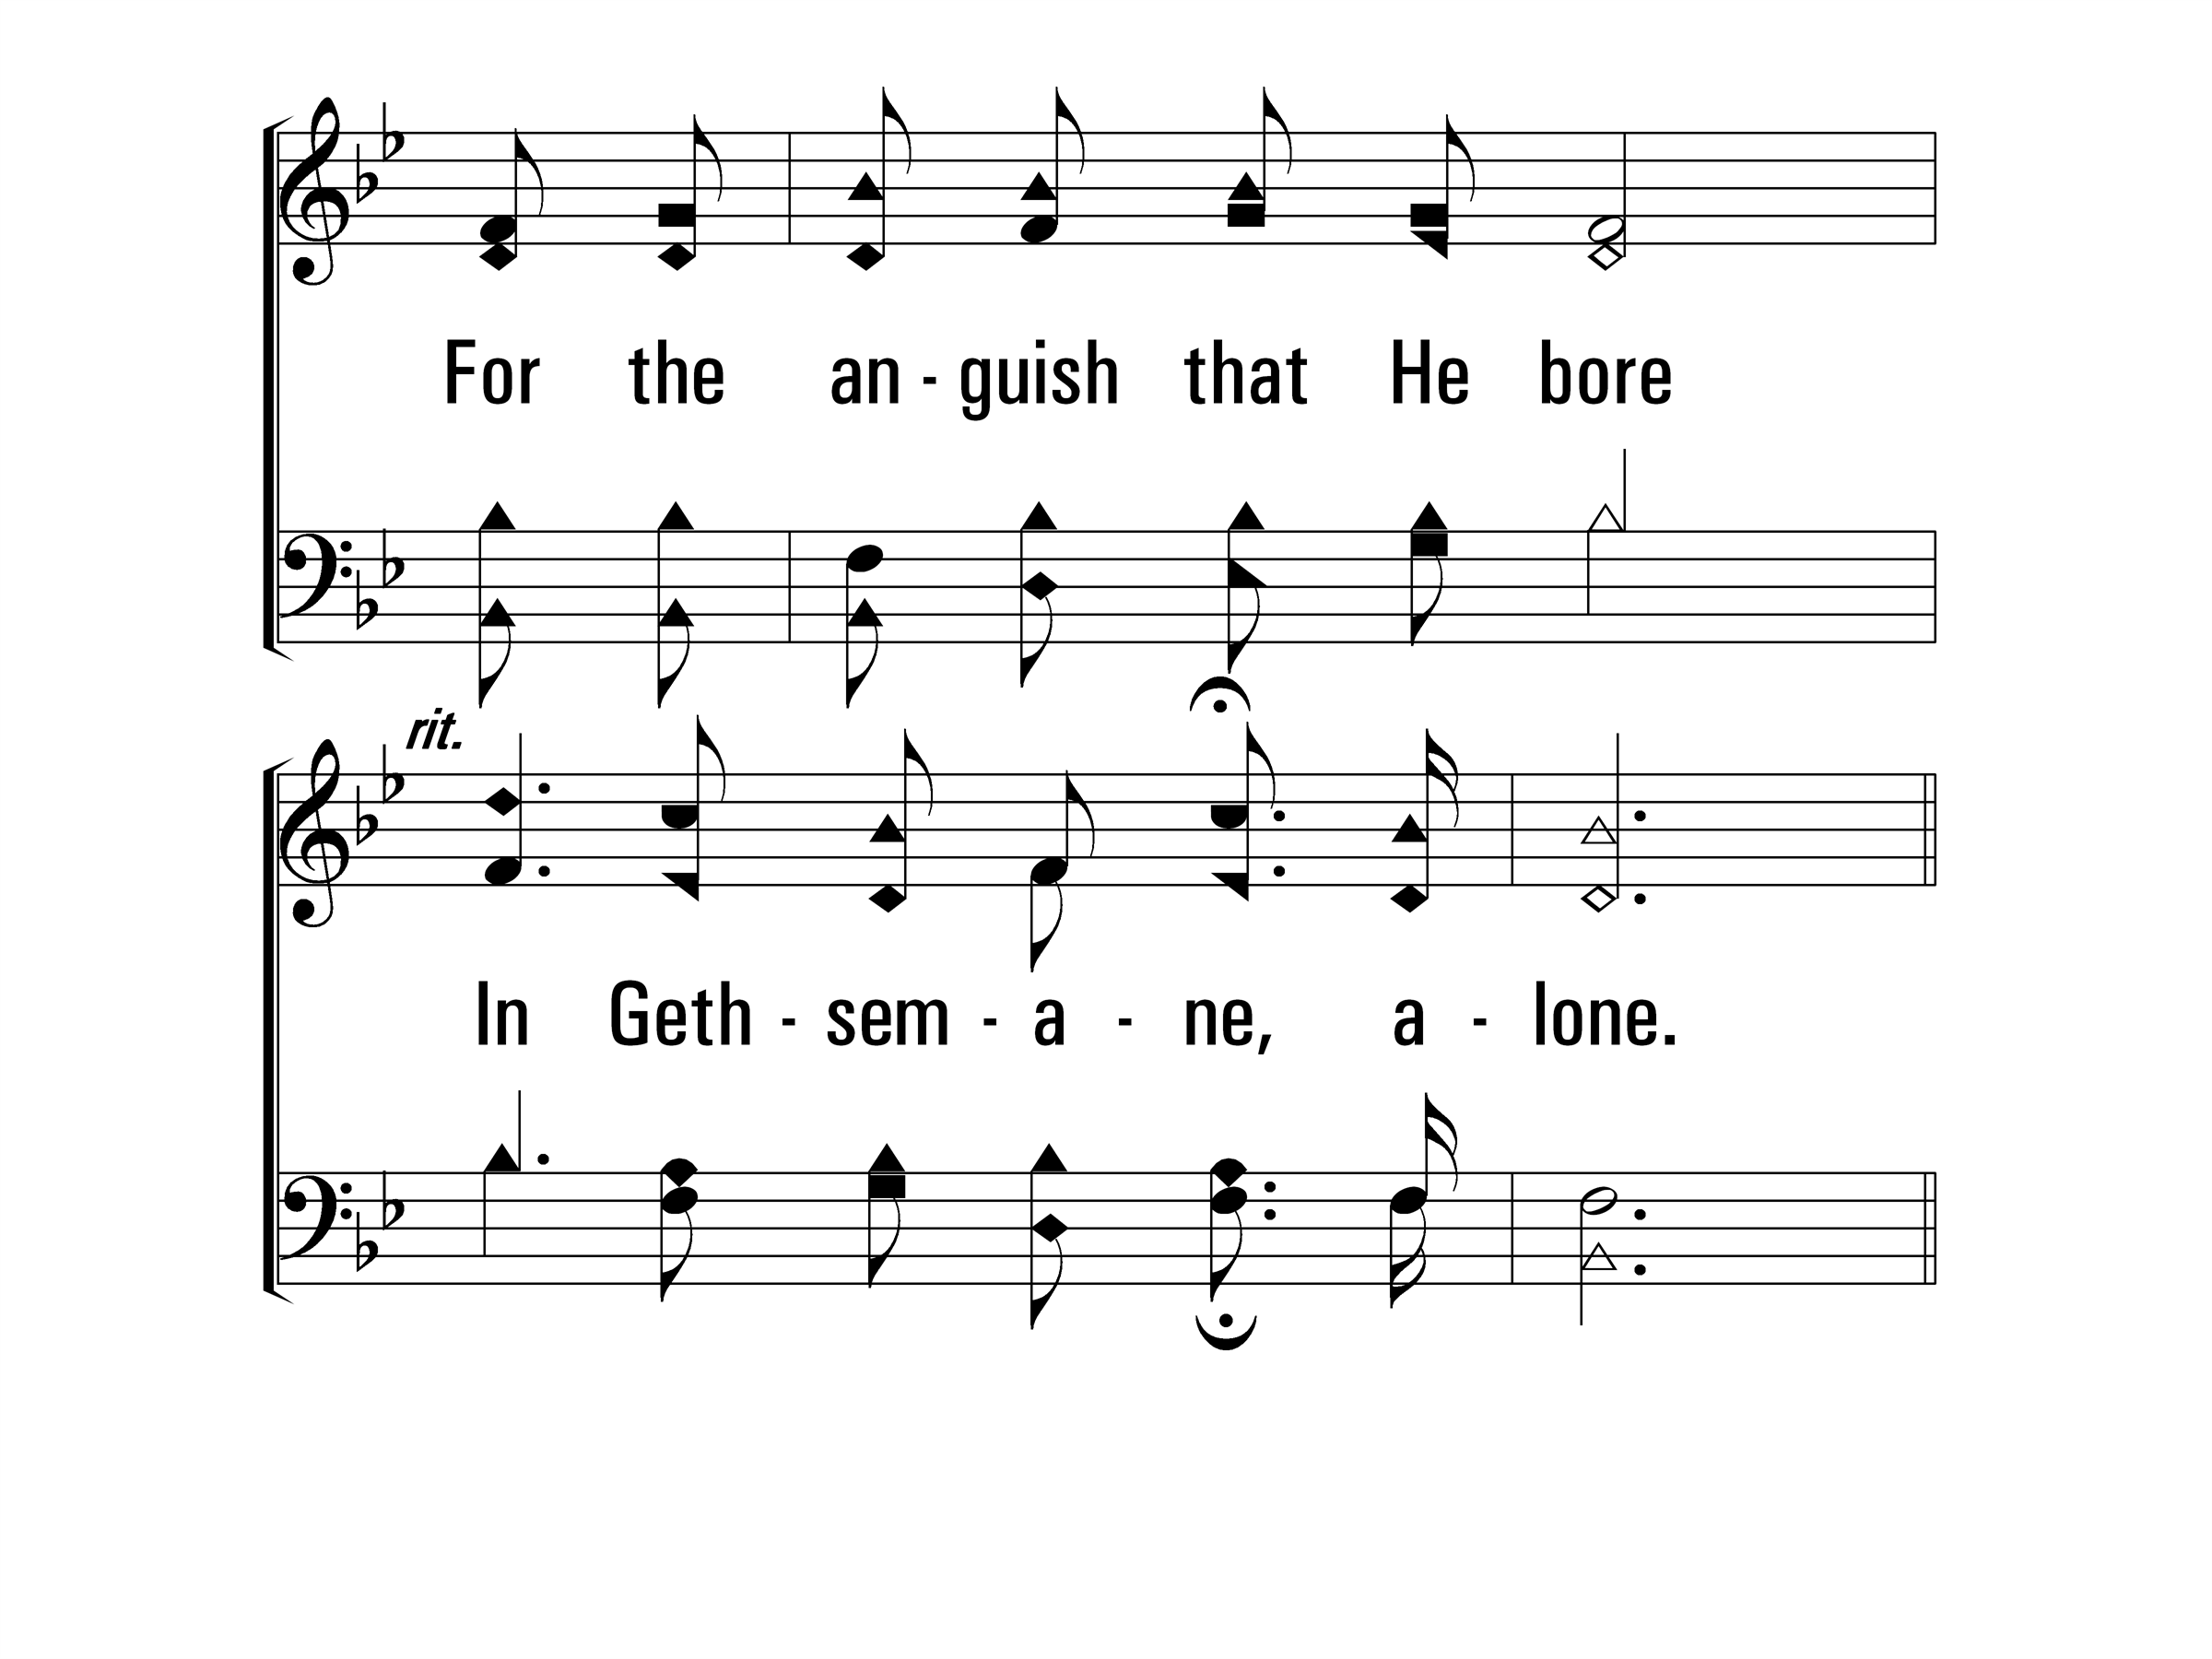
InGethsemaneAlone_st3_c
Vs 3
© 2014 Sumphonia Productions, LLC

Slide 32
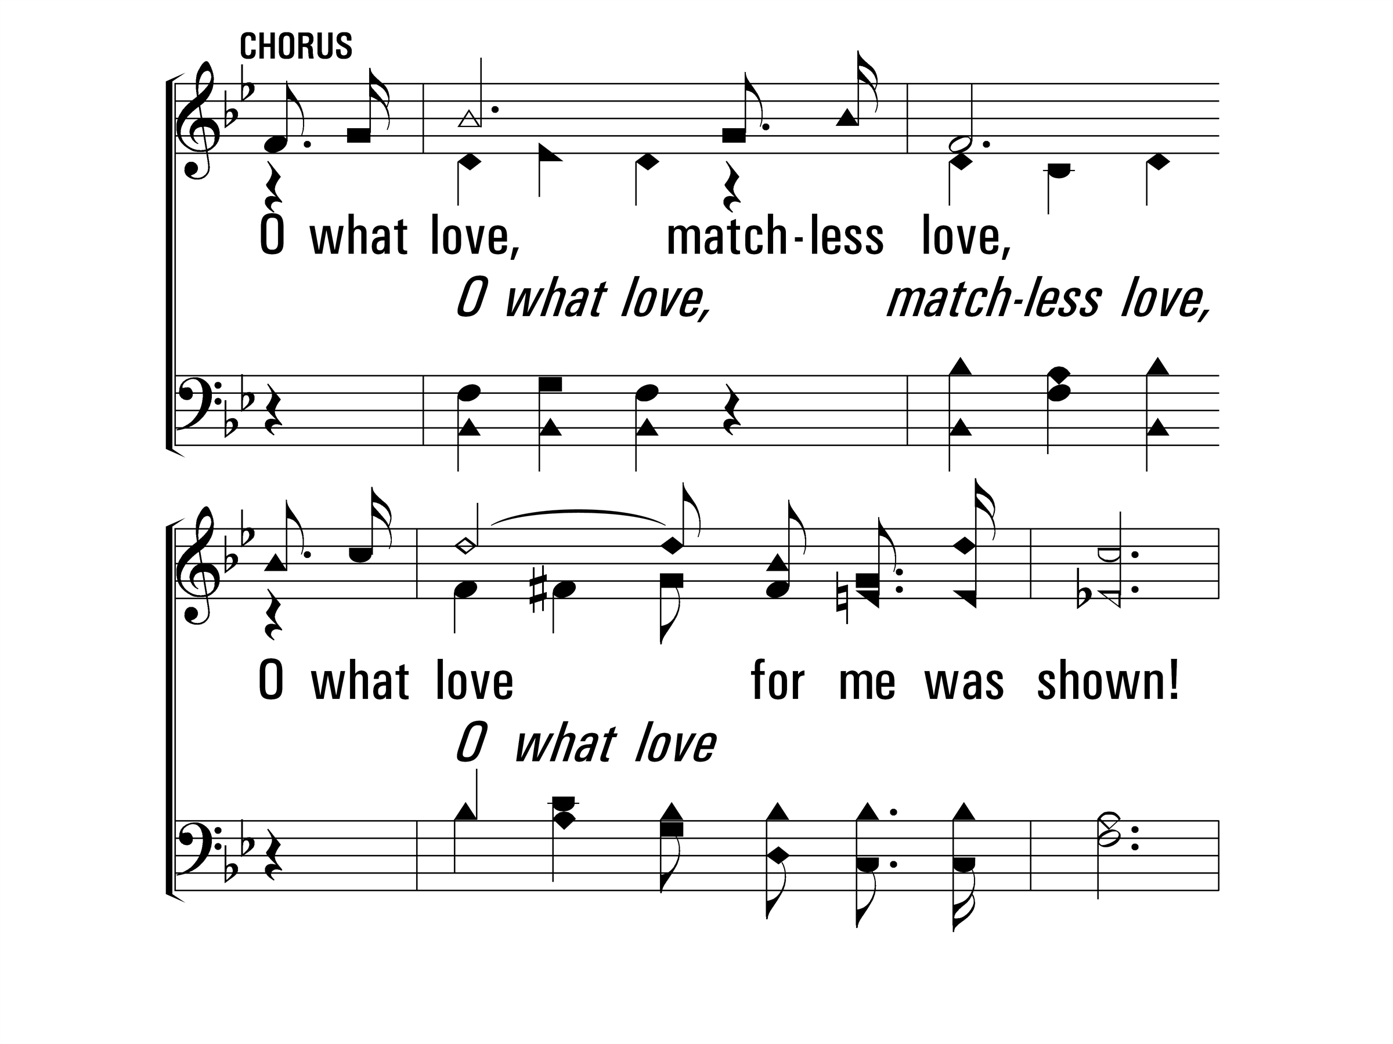
InGethsemaneAlone_cho_a
Chorus
© 2014 Sumphonia Productions, LLC

Slide 33
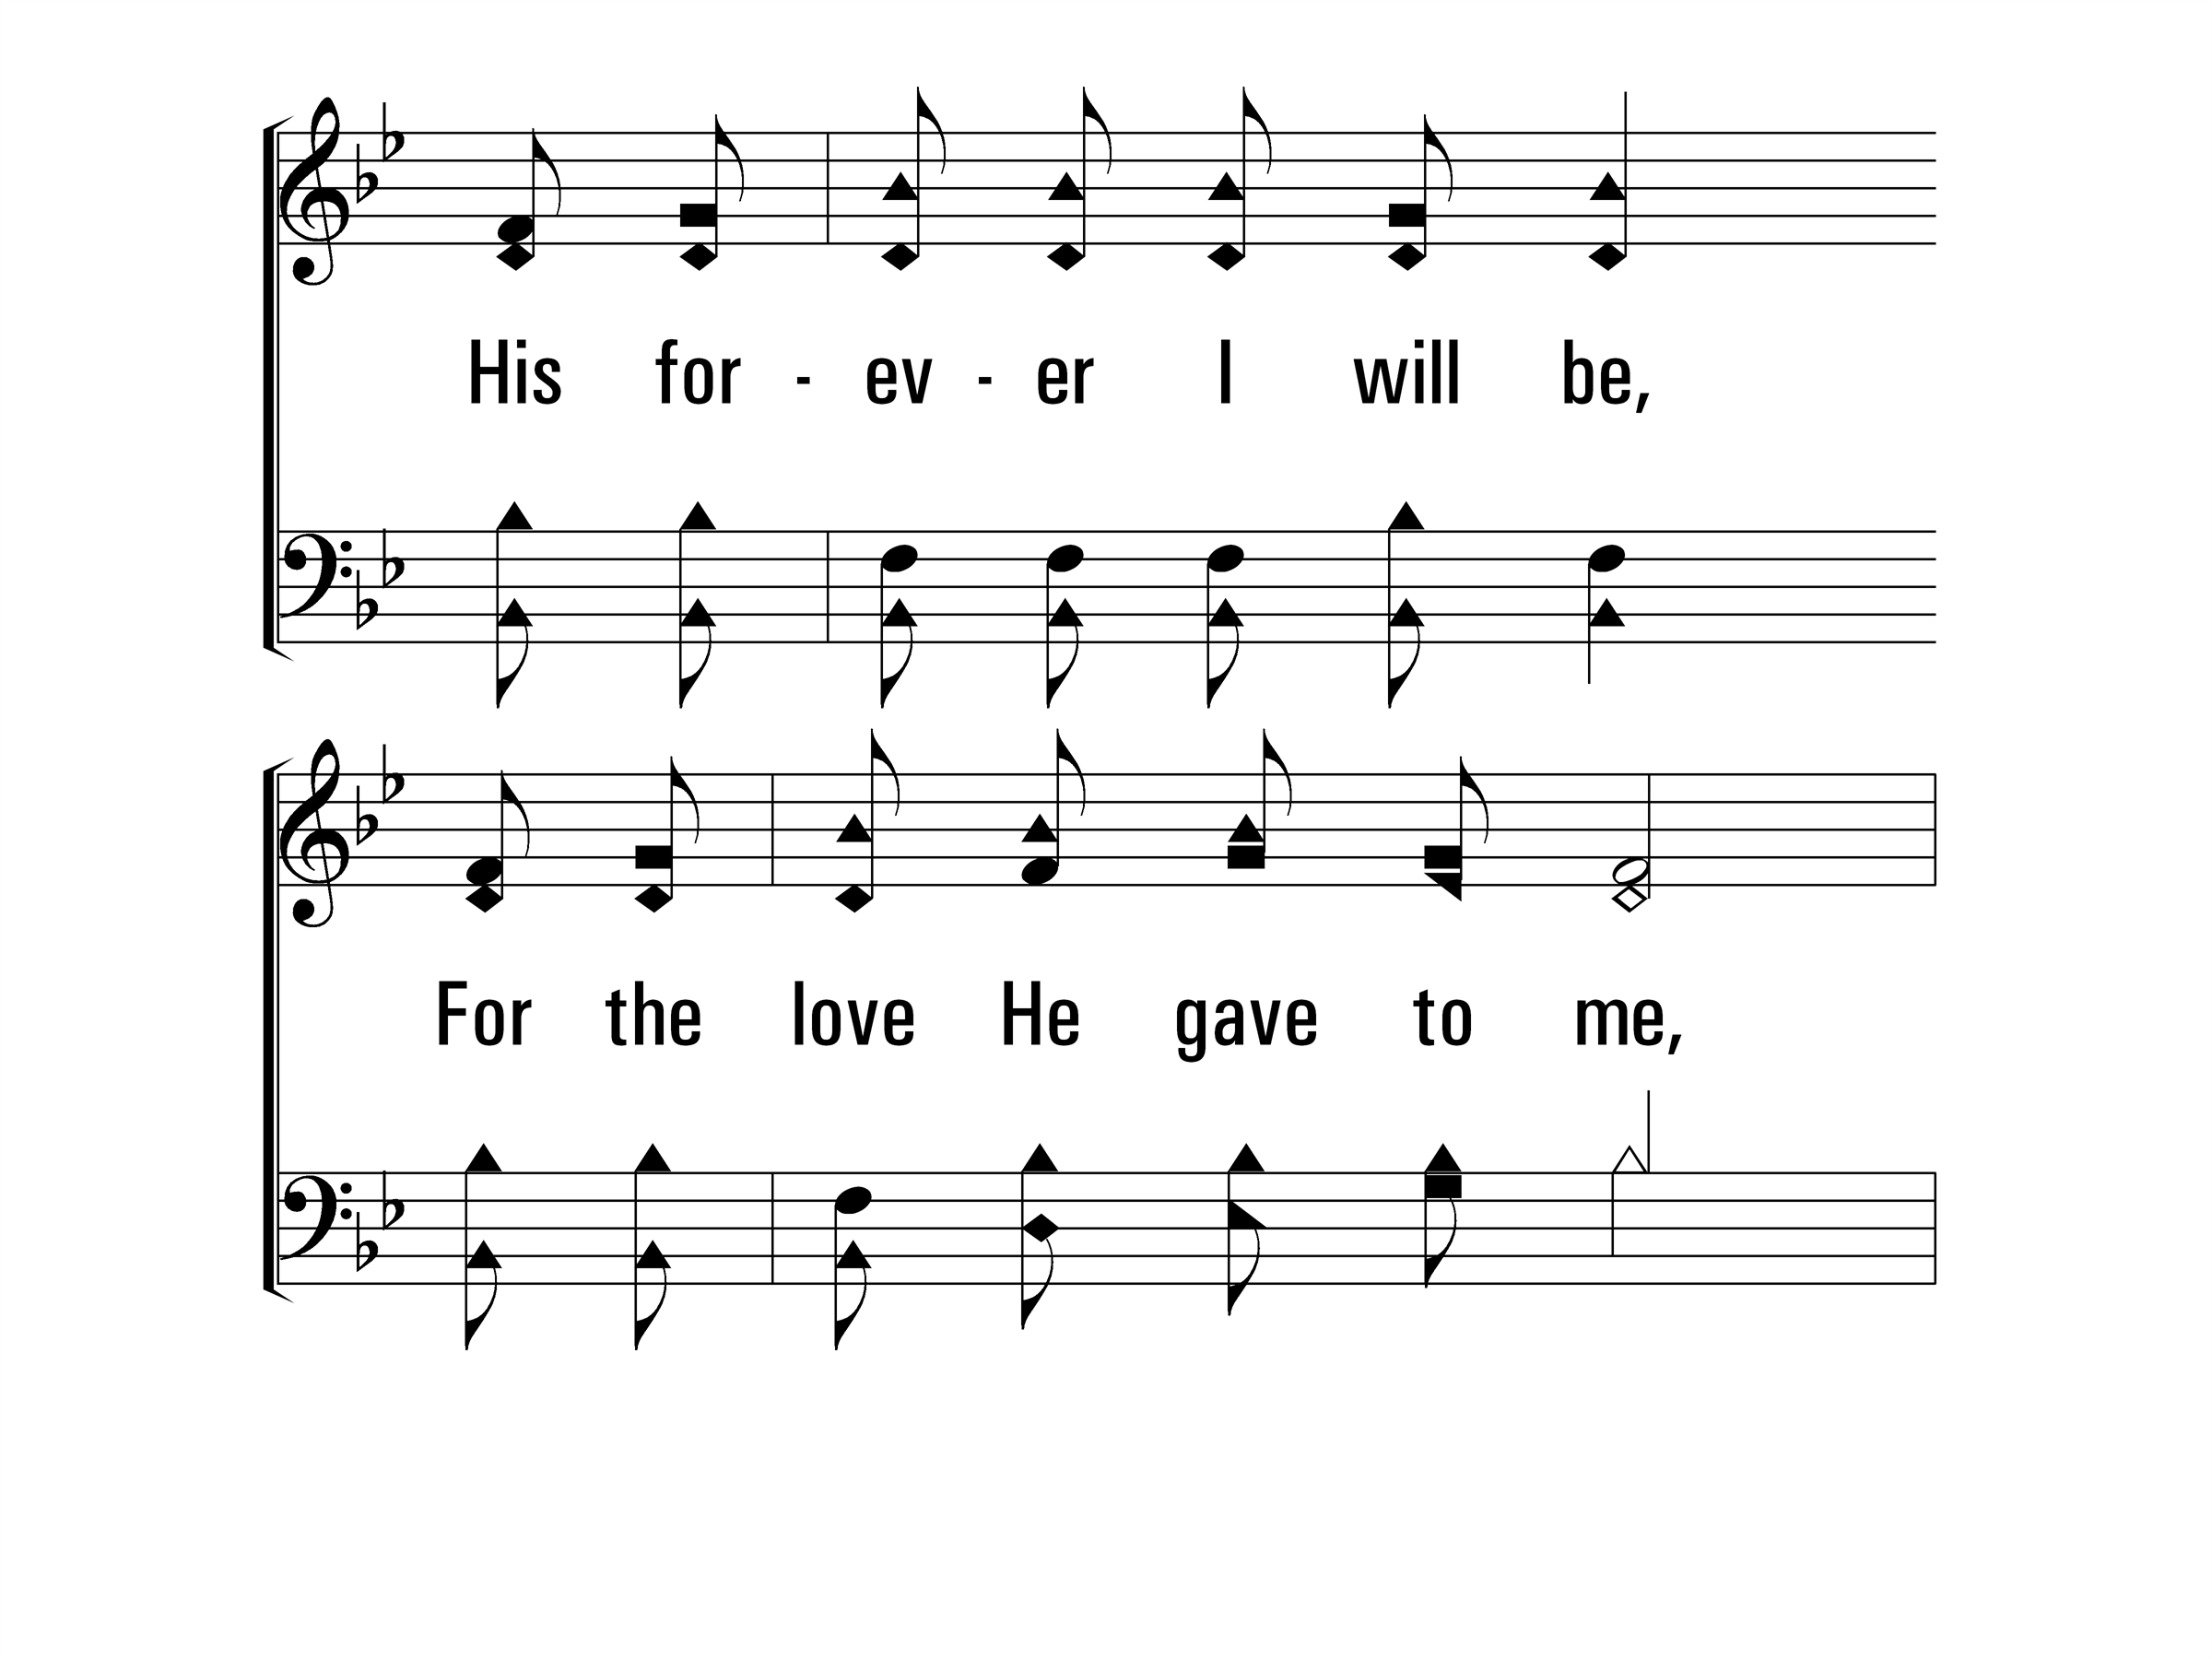
InGethsemaneAlone_cho_b
Chorus
© 2014 Sumphonia Productions, LLC

Slide 34
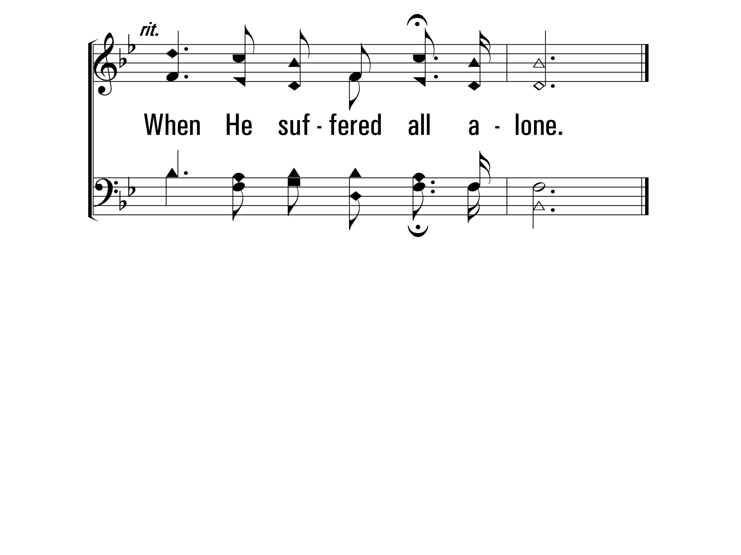
InGethsemaneAlone_cho_c
Chorus
© 2014 Sumphonia Productions, LLC
End

Slide 36
Scripture Reading: Acts 2:40-47
And they continued steadfastly in the apostles’ doctrine and fellowship, in the breaking of bread, and in prayers. ⁴³ Then fear came upon every soul, and many wonders and signs were done through the apostles. ⁴⁴ Now all who believed were together, and had all things in common, ⁴⁵ and sold their possessions and goods, and divided them among all, as anyone had need. ⁴⁶ So continuing daily with one accord in the temple, and breaking bread from house to house, they ate their food with gladness and simplicity of heart, ⁴⁷ praising God and having favor with all the people. And the Lord added to the church daily those who were being saved.

Slide 37
Walking Alone at Eve
457
_
_
_
_
Hymn: Thomas R. Sweatman (1917)
Tune: ALONE AT EVE • Will W. Slater (1917)

Slide 38
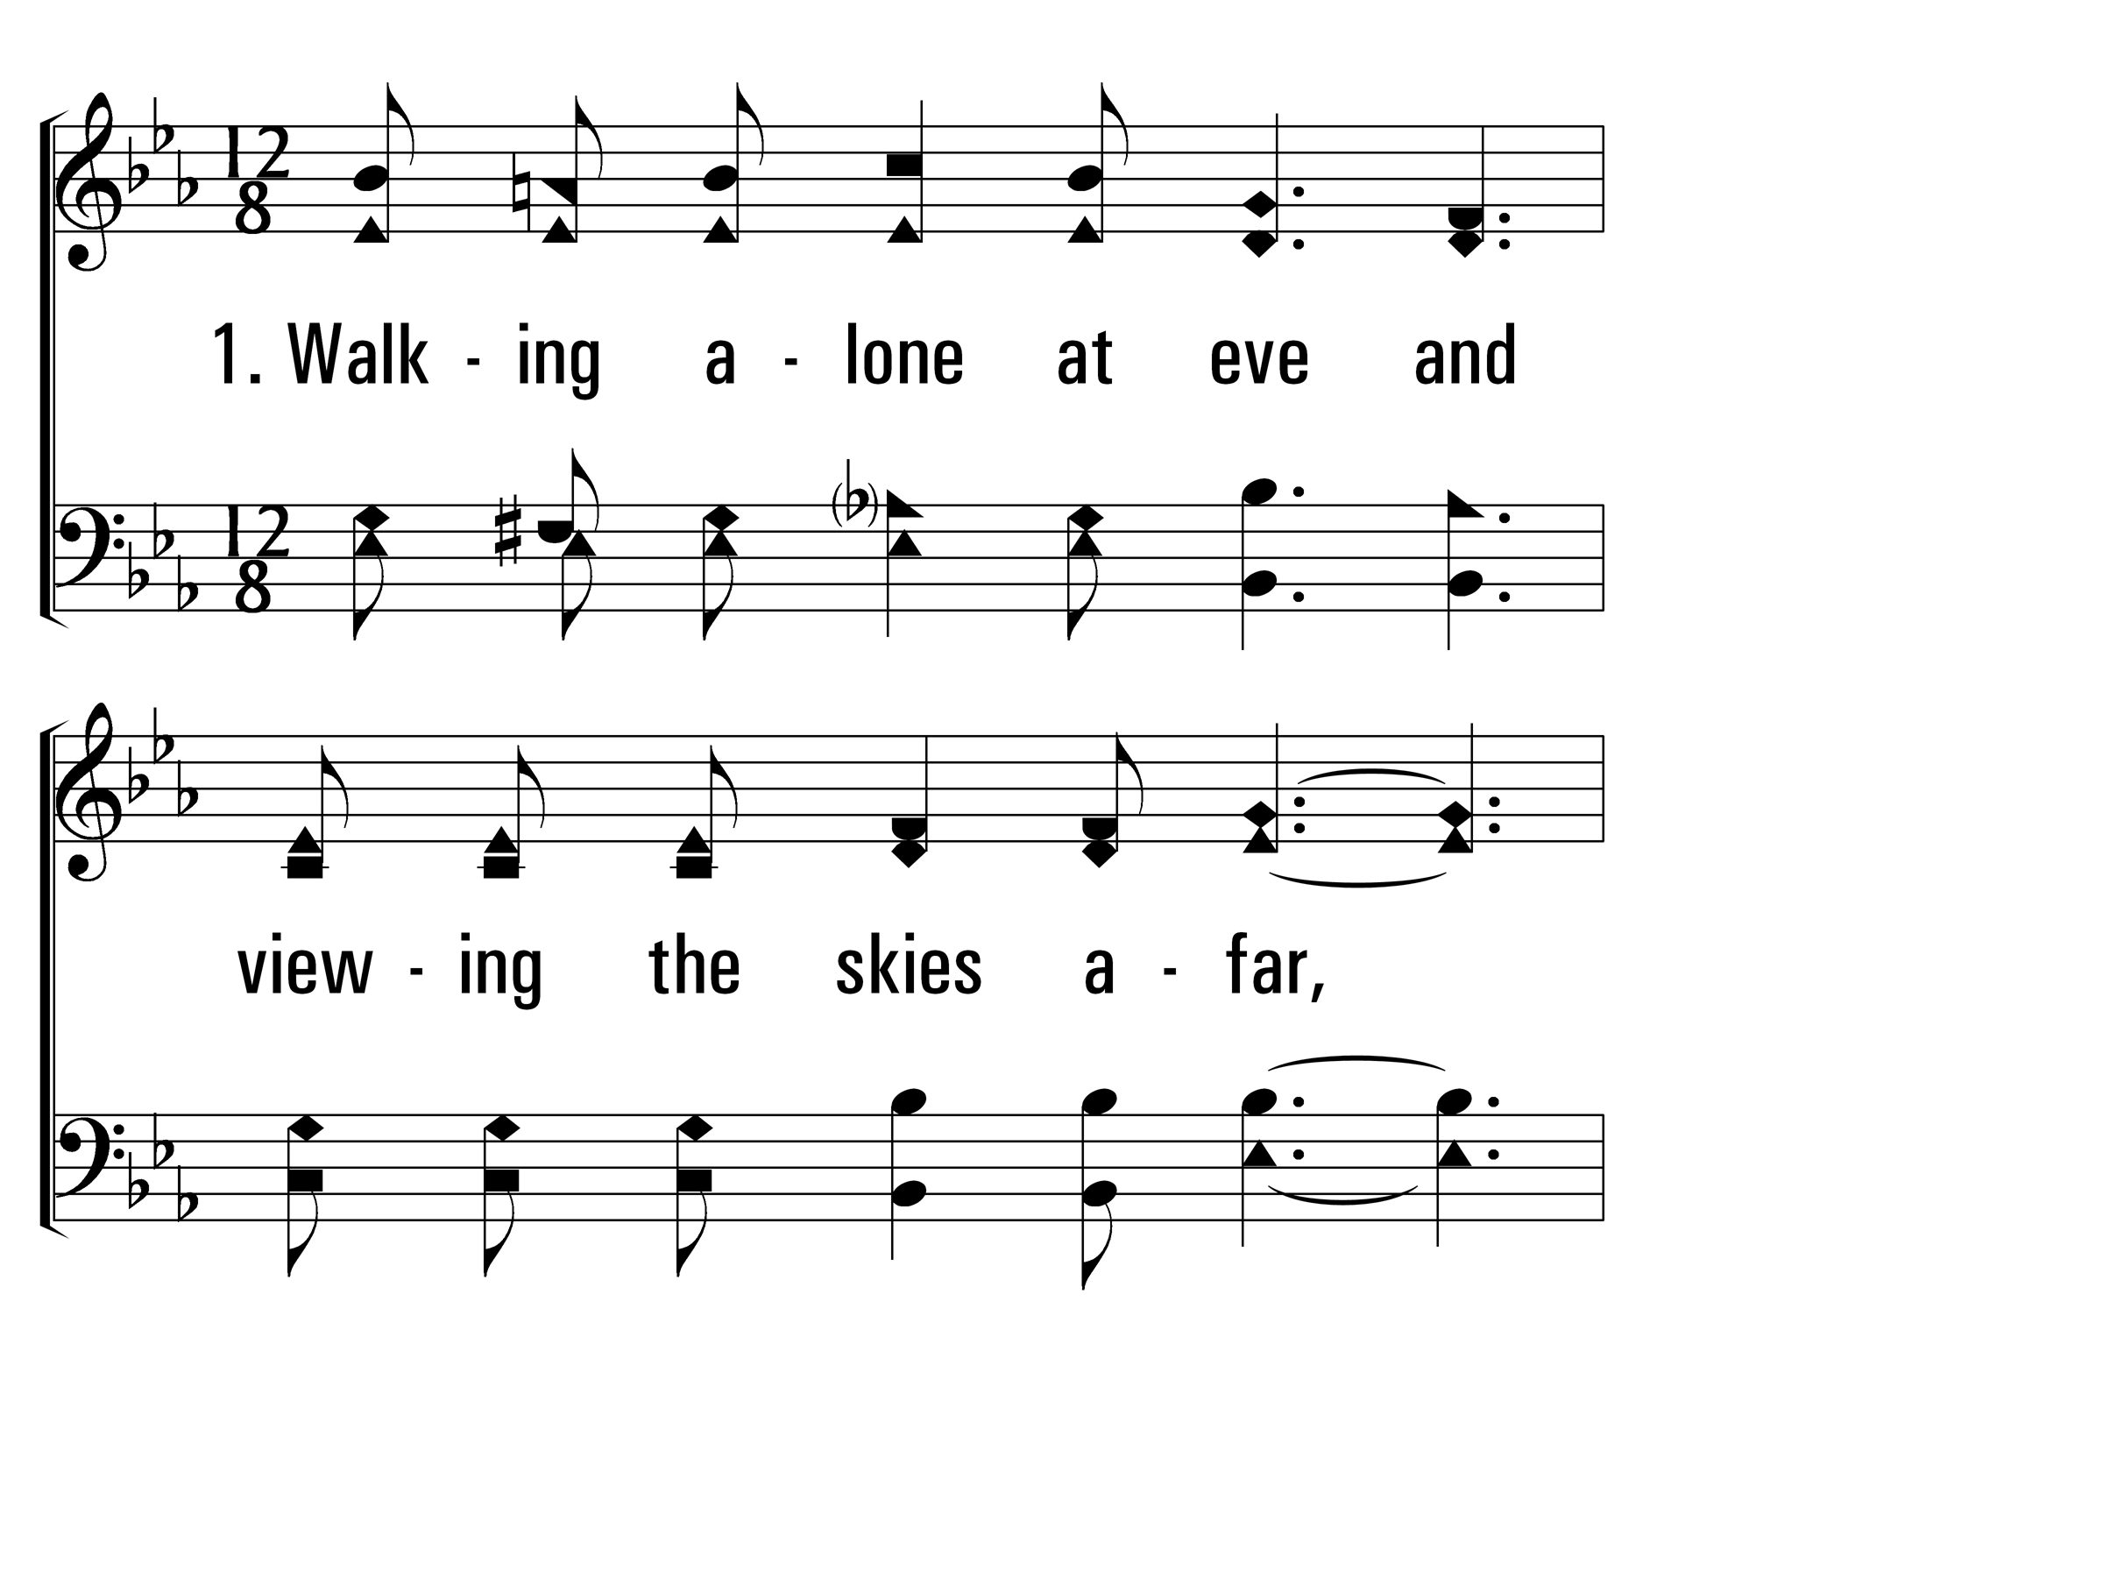
WalkingAloneAtEve_st1_a
Vs 1
© 2014 Sumphonia Productions, LLC

Slide 39
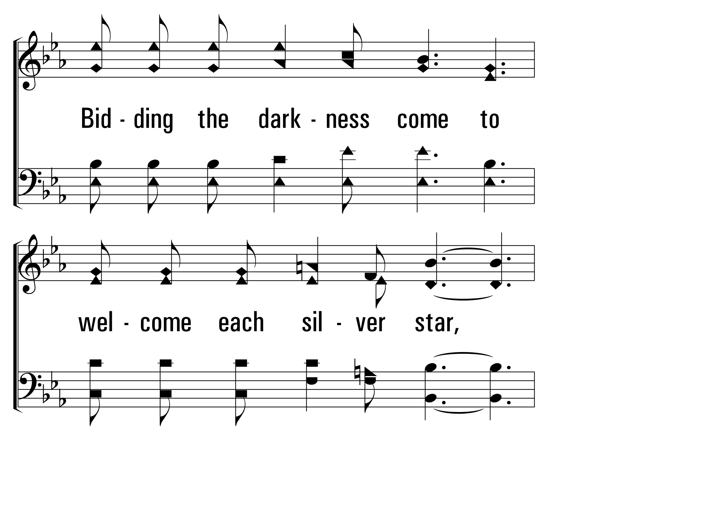
WalkingAloneAtEve_st1_b
Vs 1
© 2014 Sumphonia Productions, LLC

Slide 40
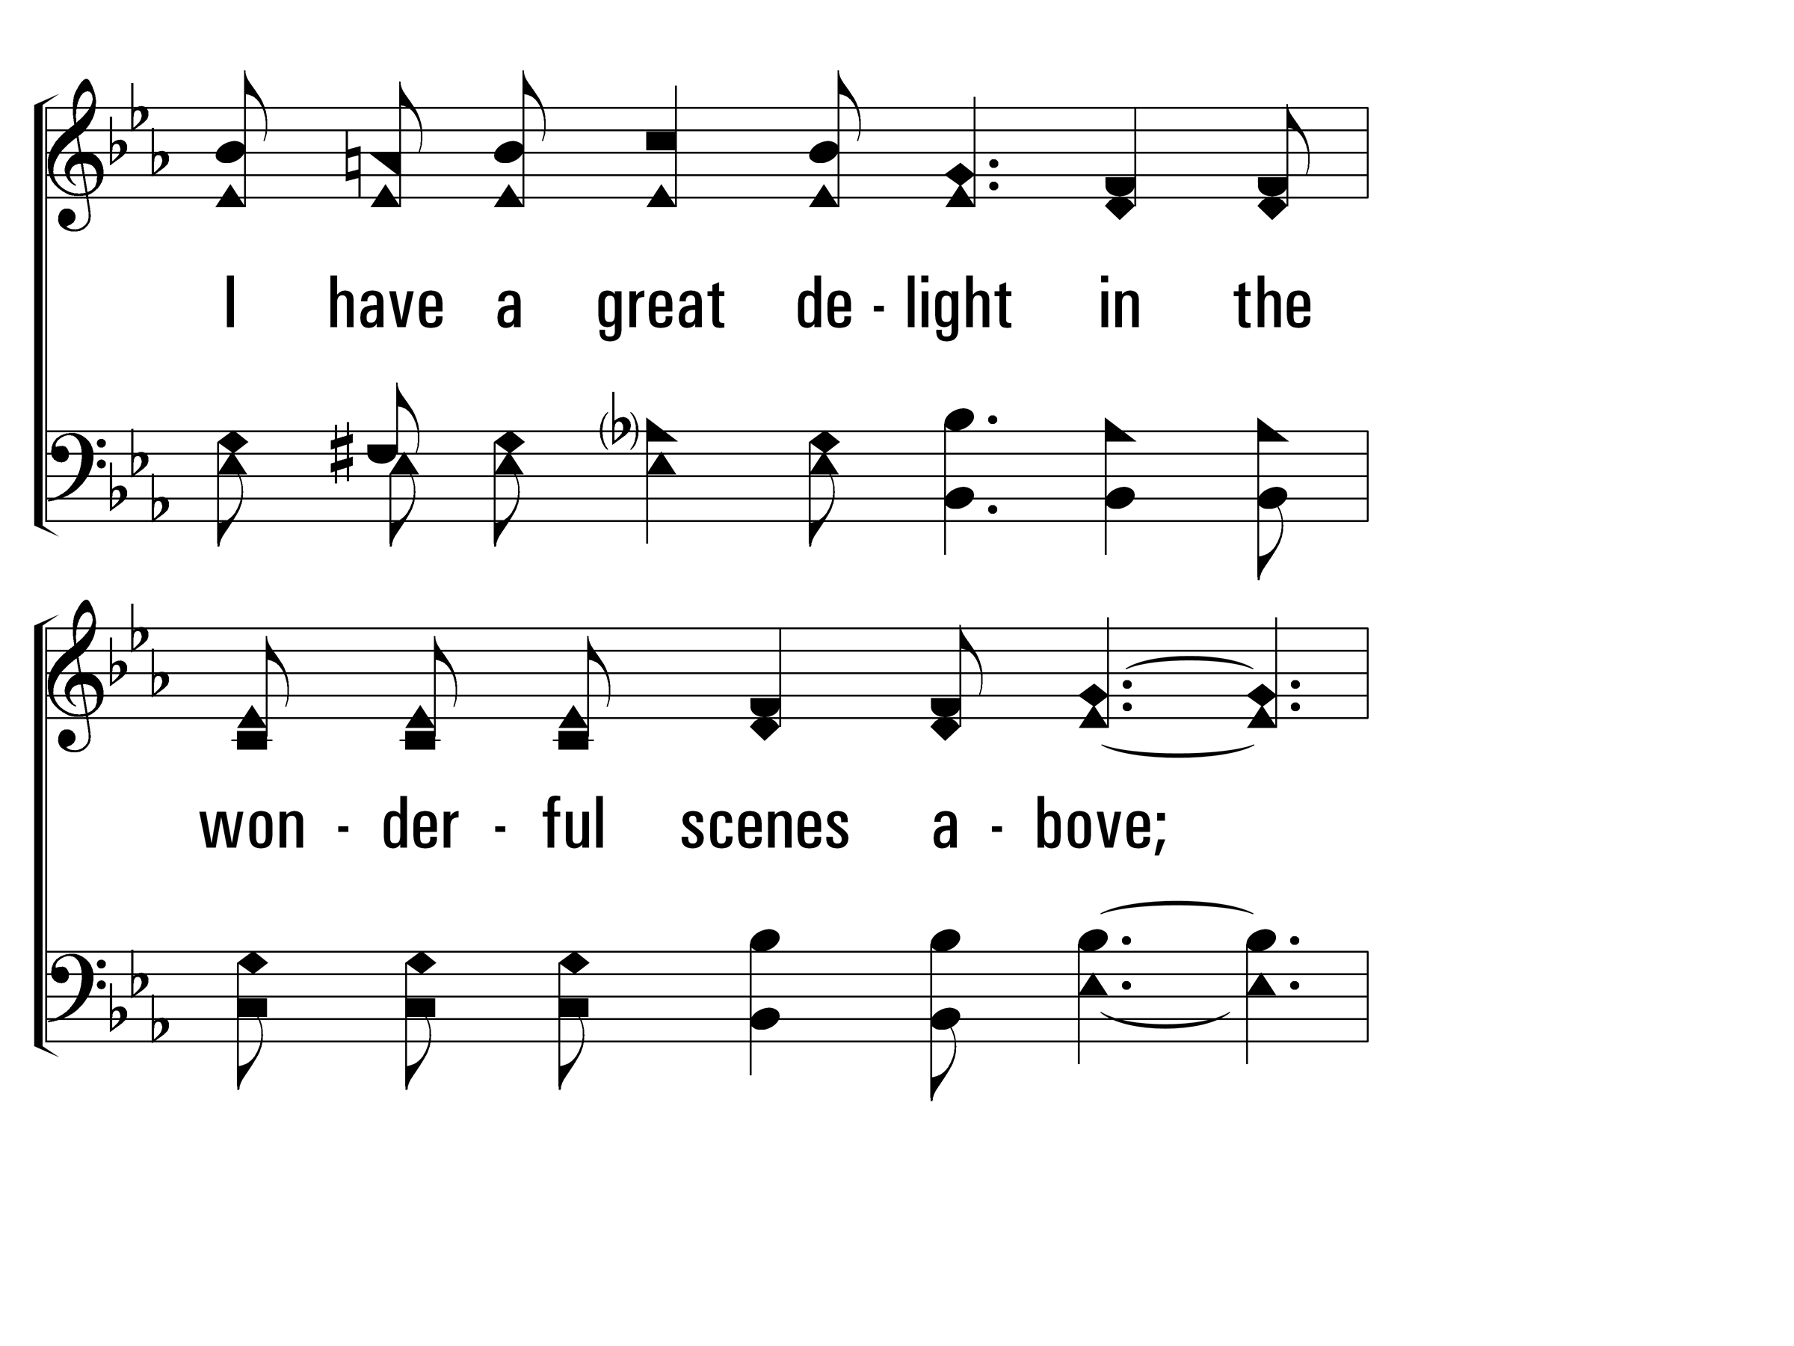
WalkingAloneAtEve_st1_c
Vs 1
© 2014 Sumphonia Productions, LLC

Slide 41
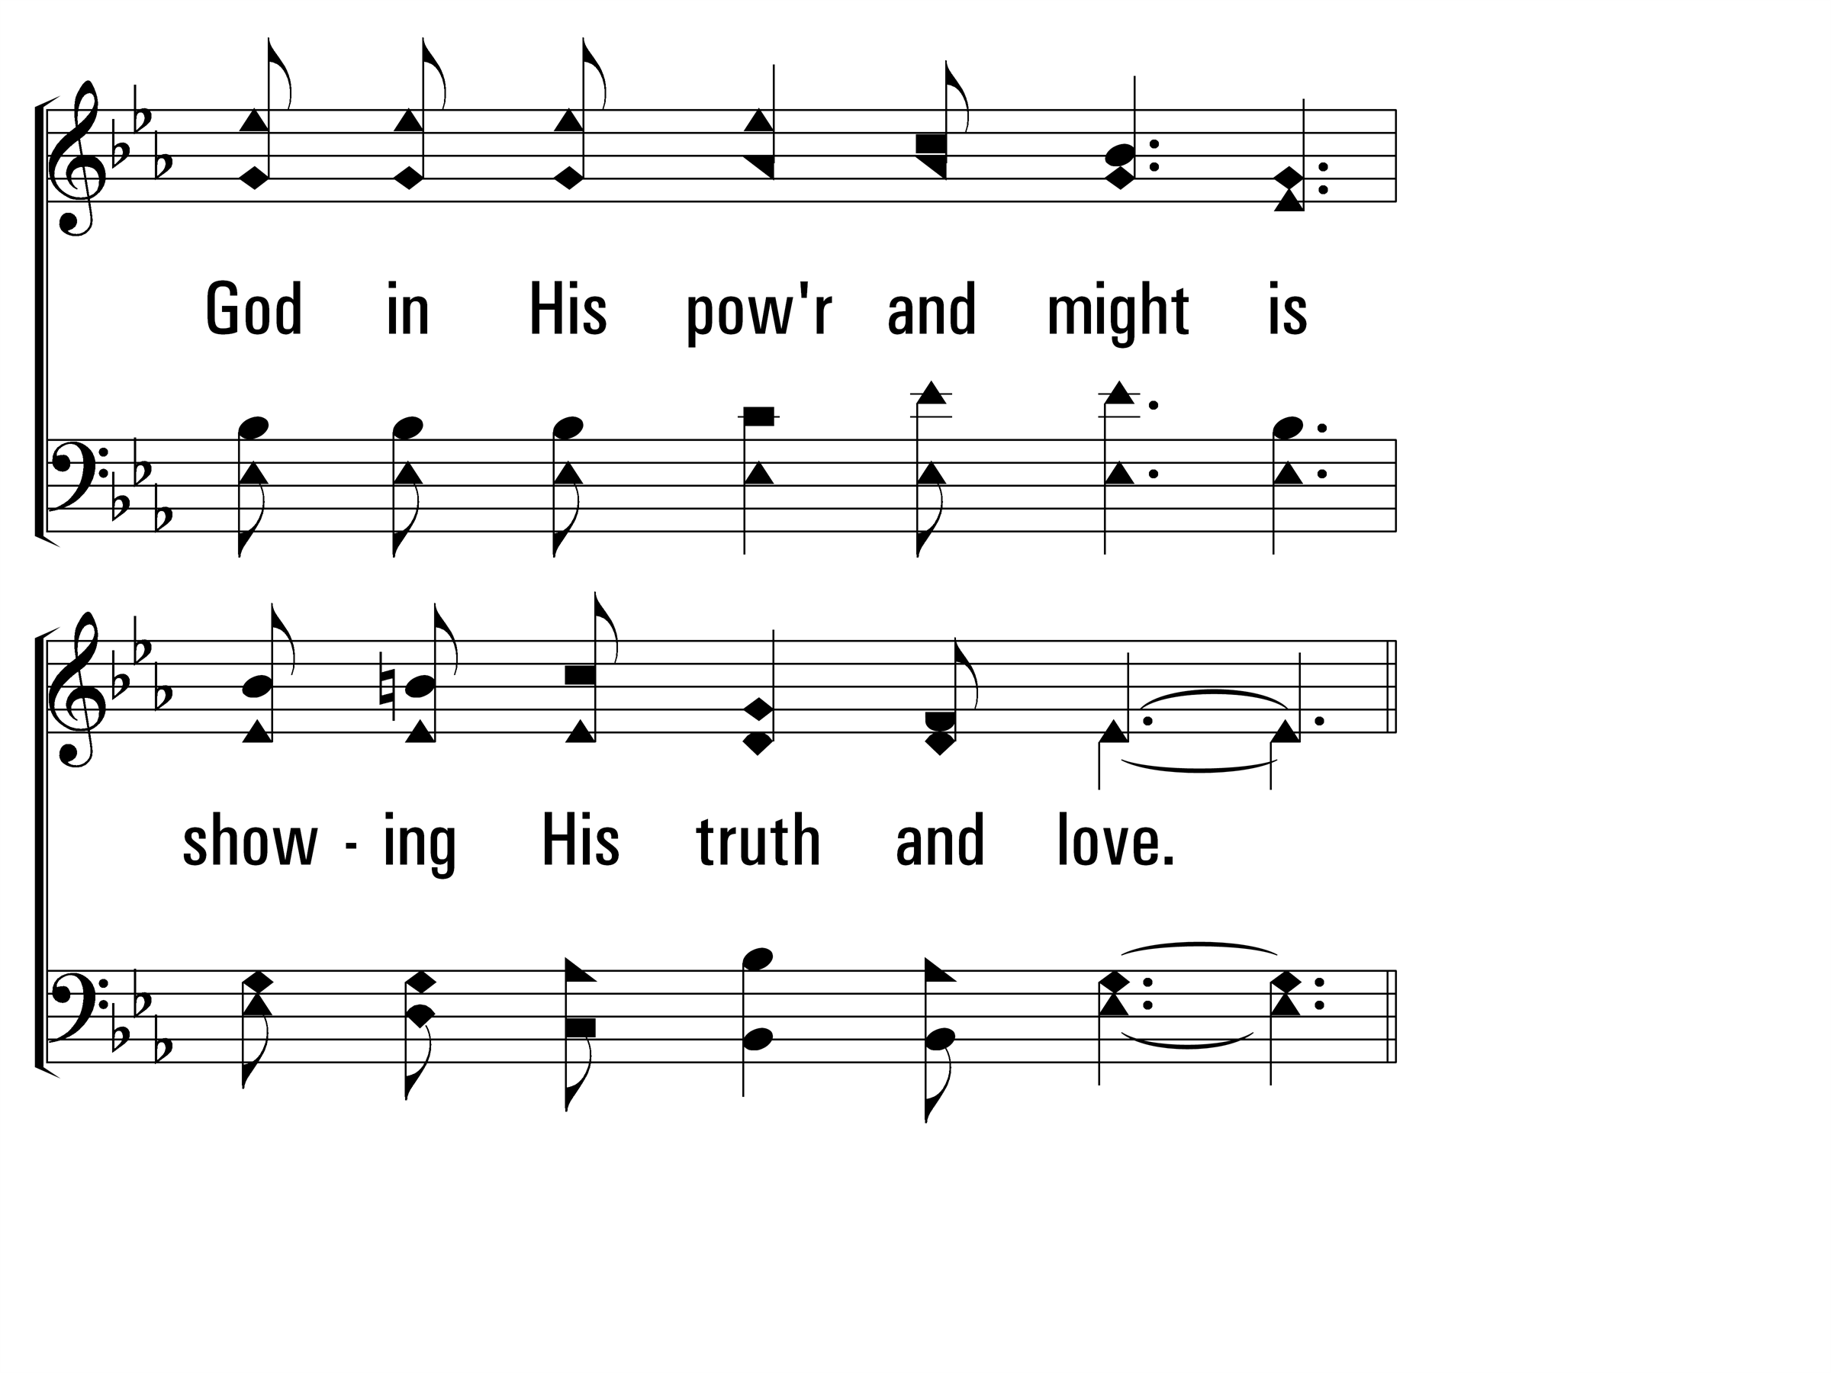
WalkingAloneAtEve_st1_d
Vs 1
© 2014 Sumphonia Productions, LLC

Slide 42
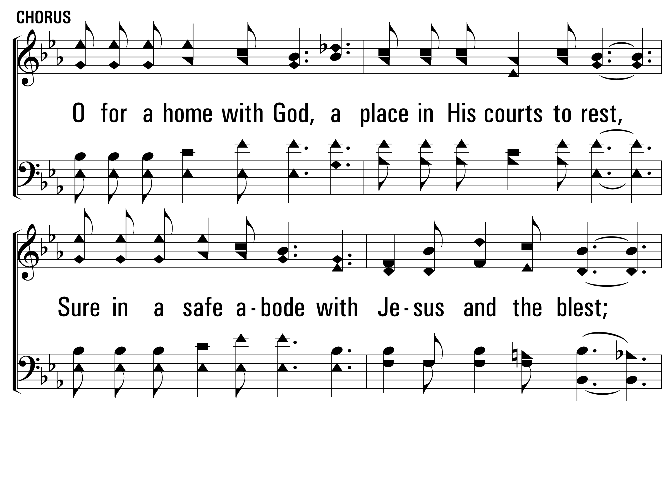
WalkingAloneAtEve_cho_a
Chorus
© 2014 Sumphonia Productions, LLC

Slide 43
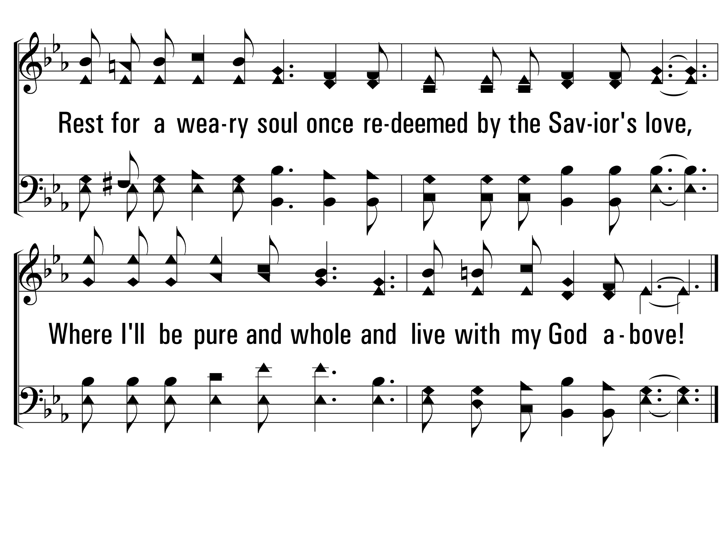
WalkingAloneAtEve_cho_b
Chorus
© 2014 Sumphonia Productions, LLC

Slide 44
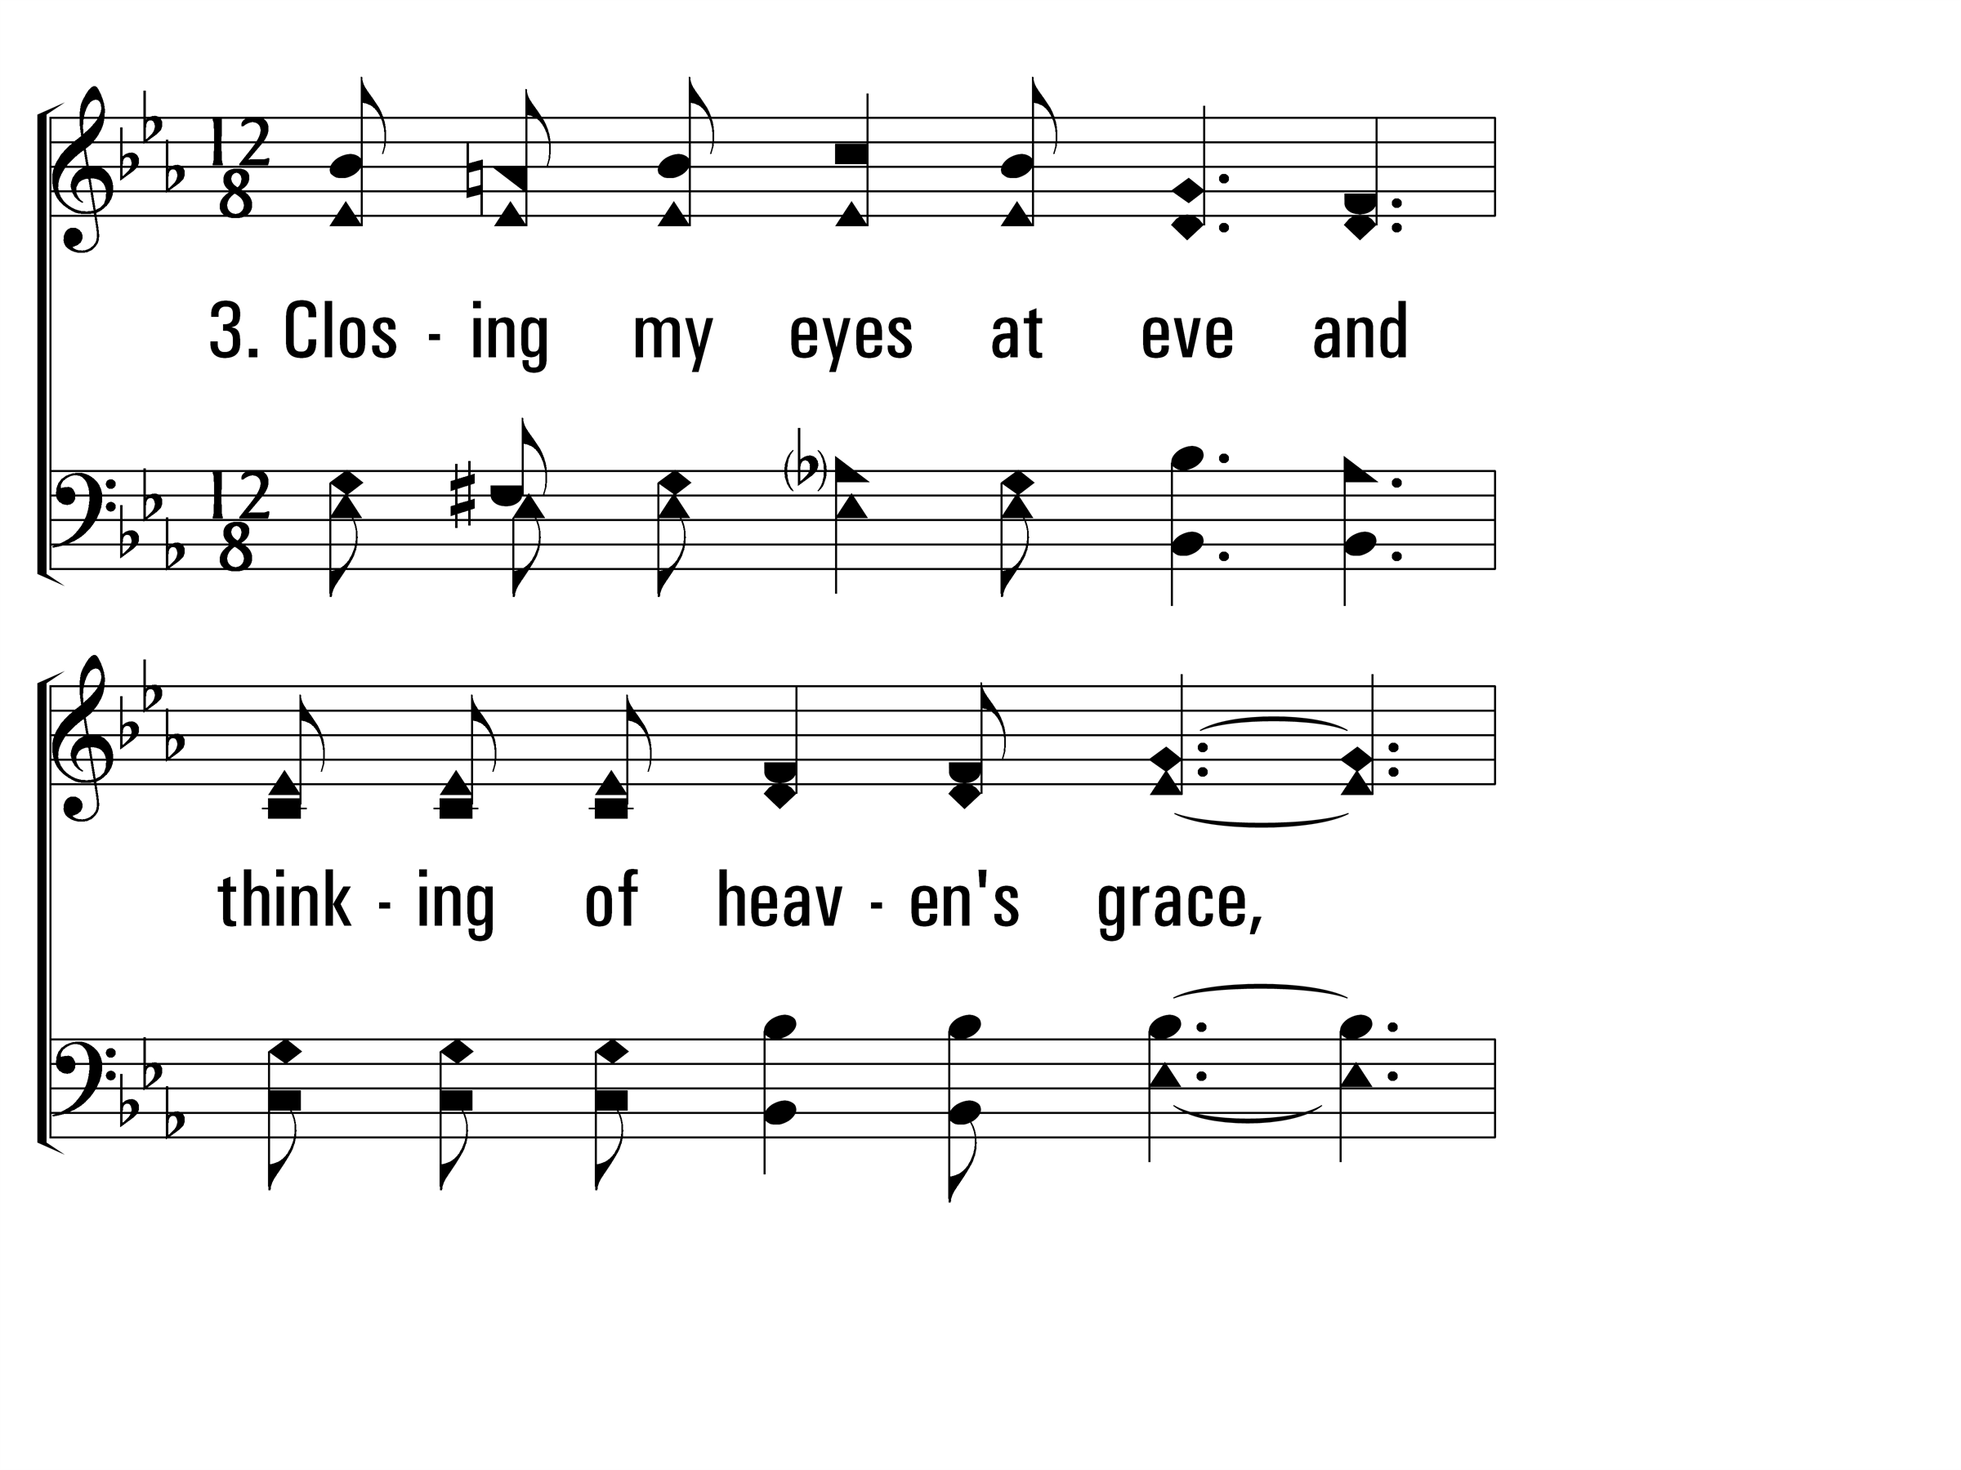
WalkingAloneAtEve_st3_a
Vs 3
© 2014 Sumphonia Productions, LLC

Slide 45
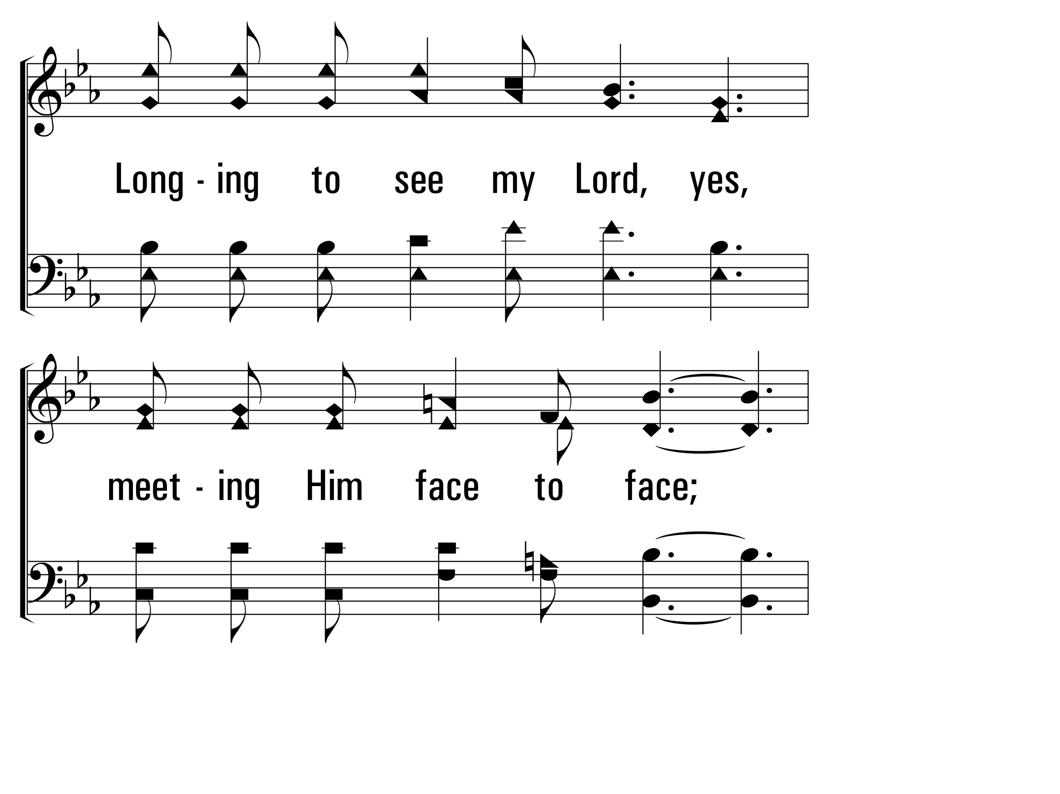
WalkingAloneAtEve_st3_b
Vs 3
© 2014 Sumphonia Productions, LLC

Slide 46
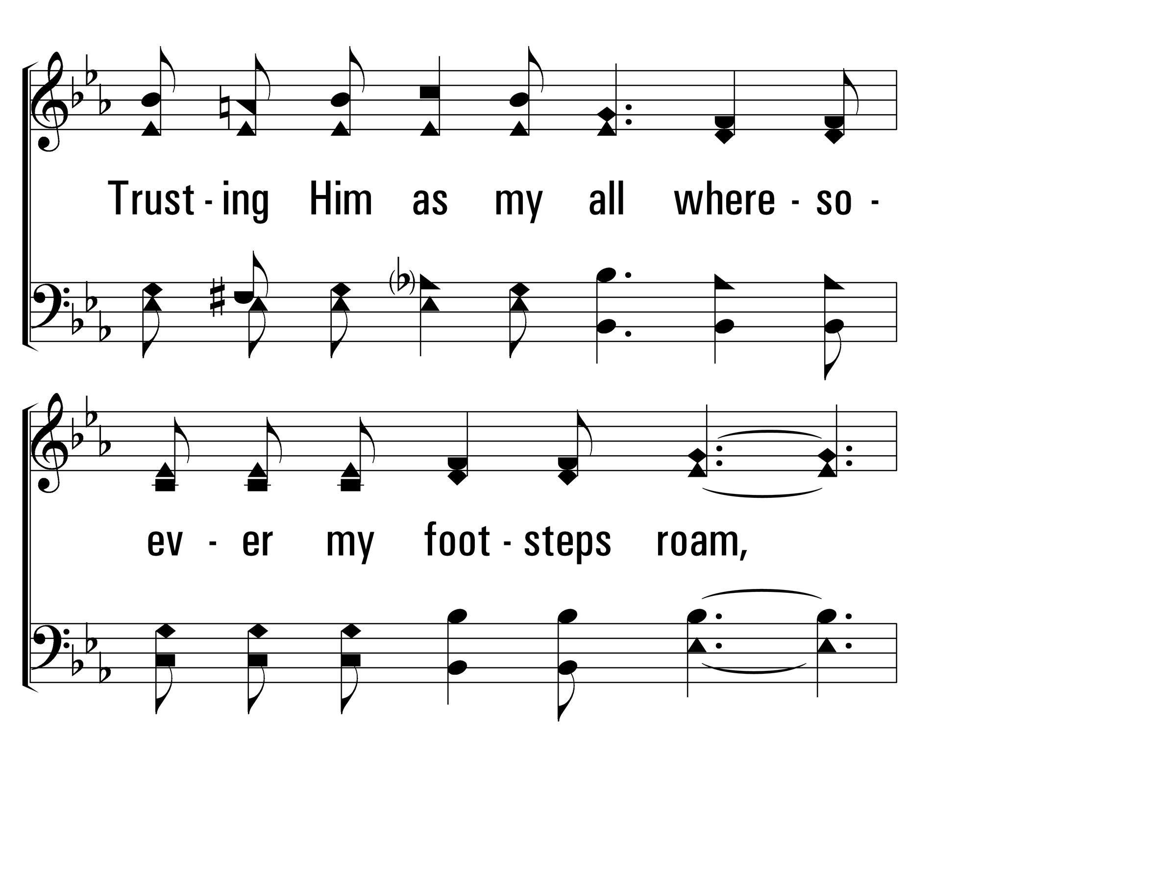
WalkingAloneAtEve_st3_c
Vs 3
© 2014 Sumphonia Productions, LLC

Slide 47
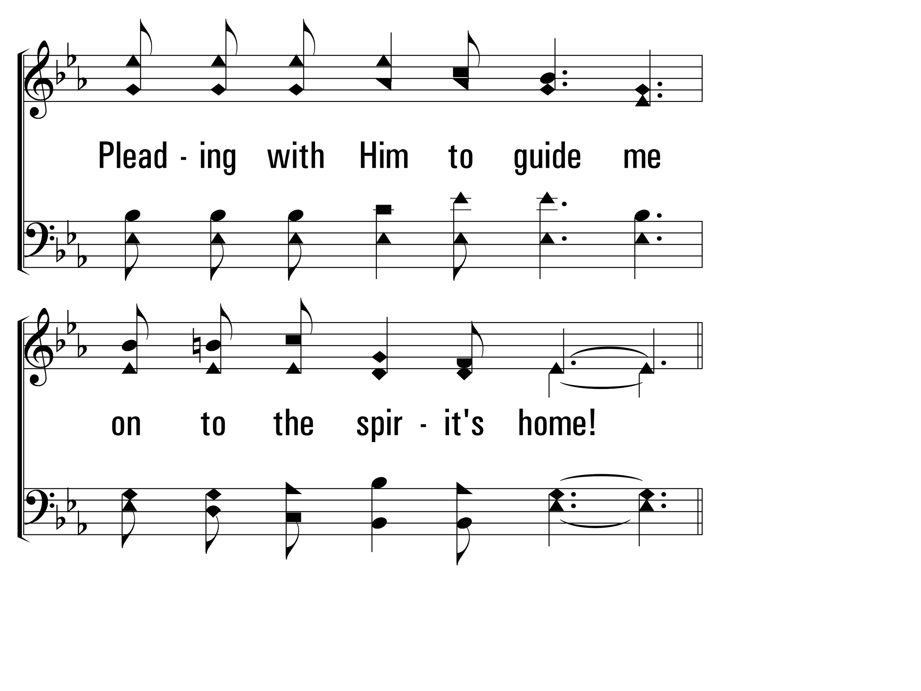
WalkingAloneAtEve_st3_d
Vs 3
© 2014 Sumphonia Productions, LLC

Slide 48
WalkingAloneAtEve_cho_a
Chorus
© 2014 Sumphonia Productions, LLC

Slide 49
WalkingAloneAtEve_cho_b
Chorus
© 2014 Sumphonia Productions, LLC
End

Slide 69
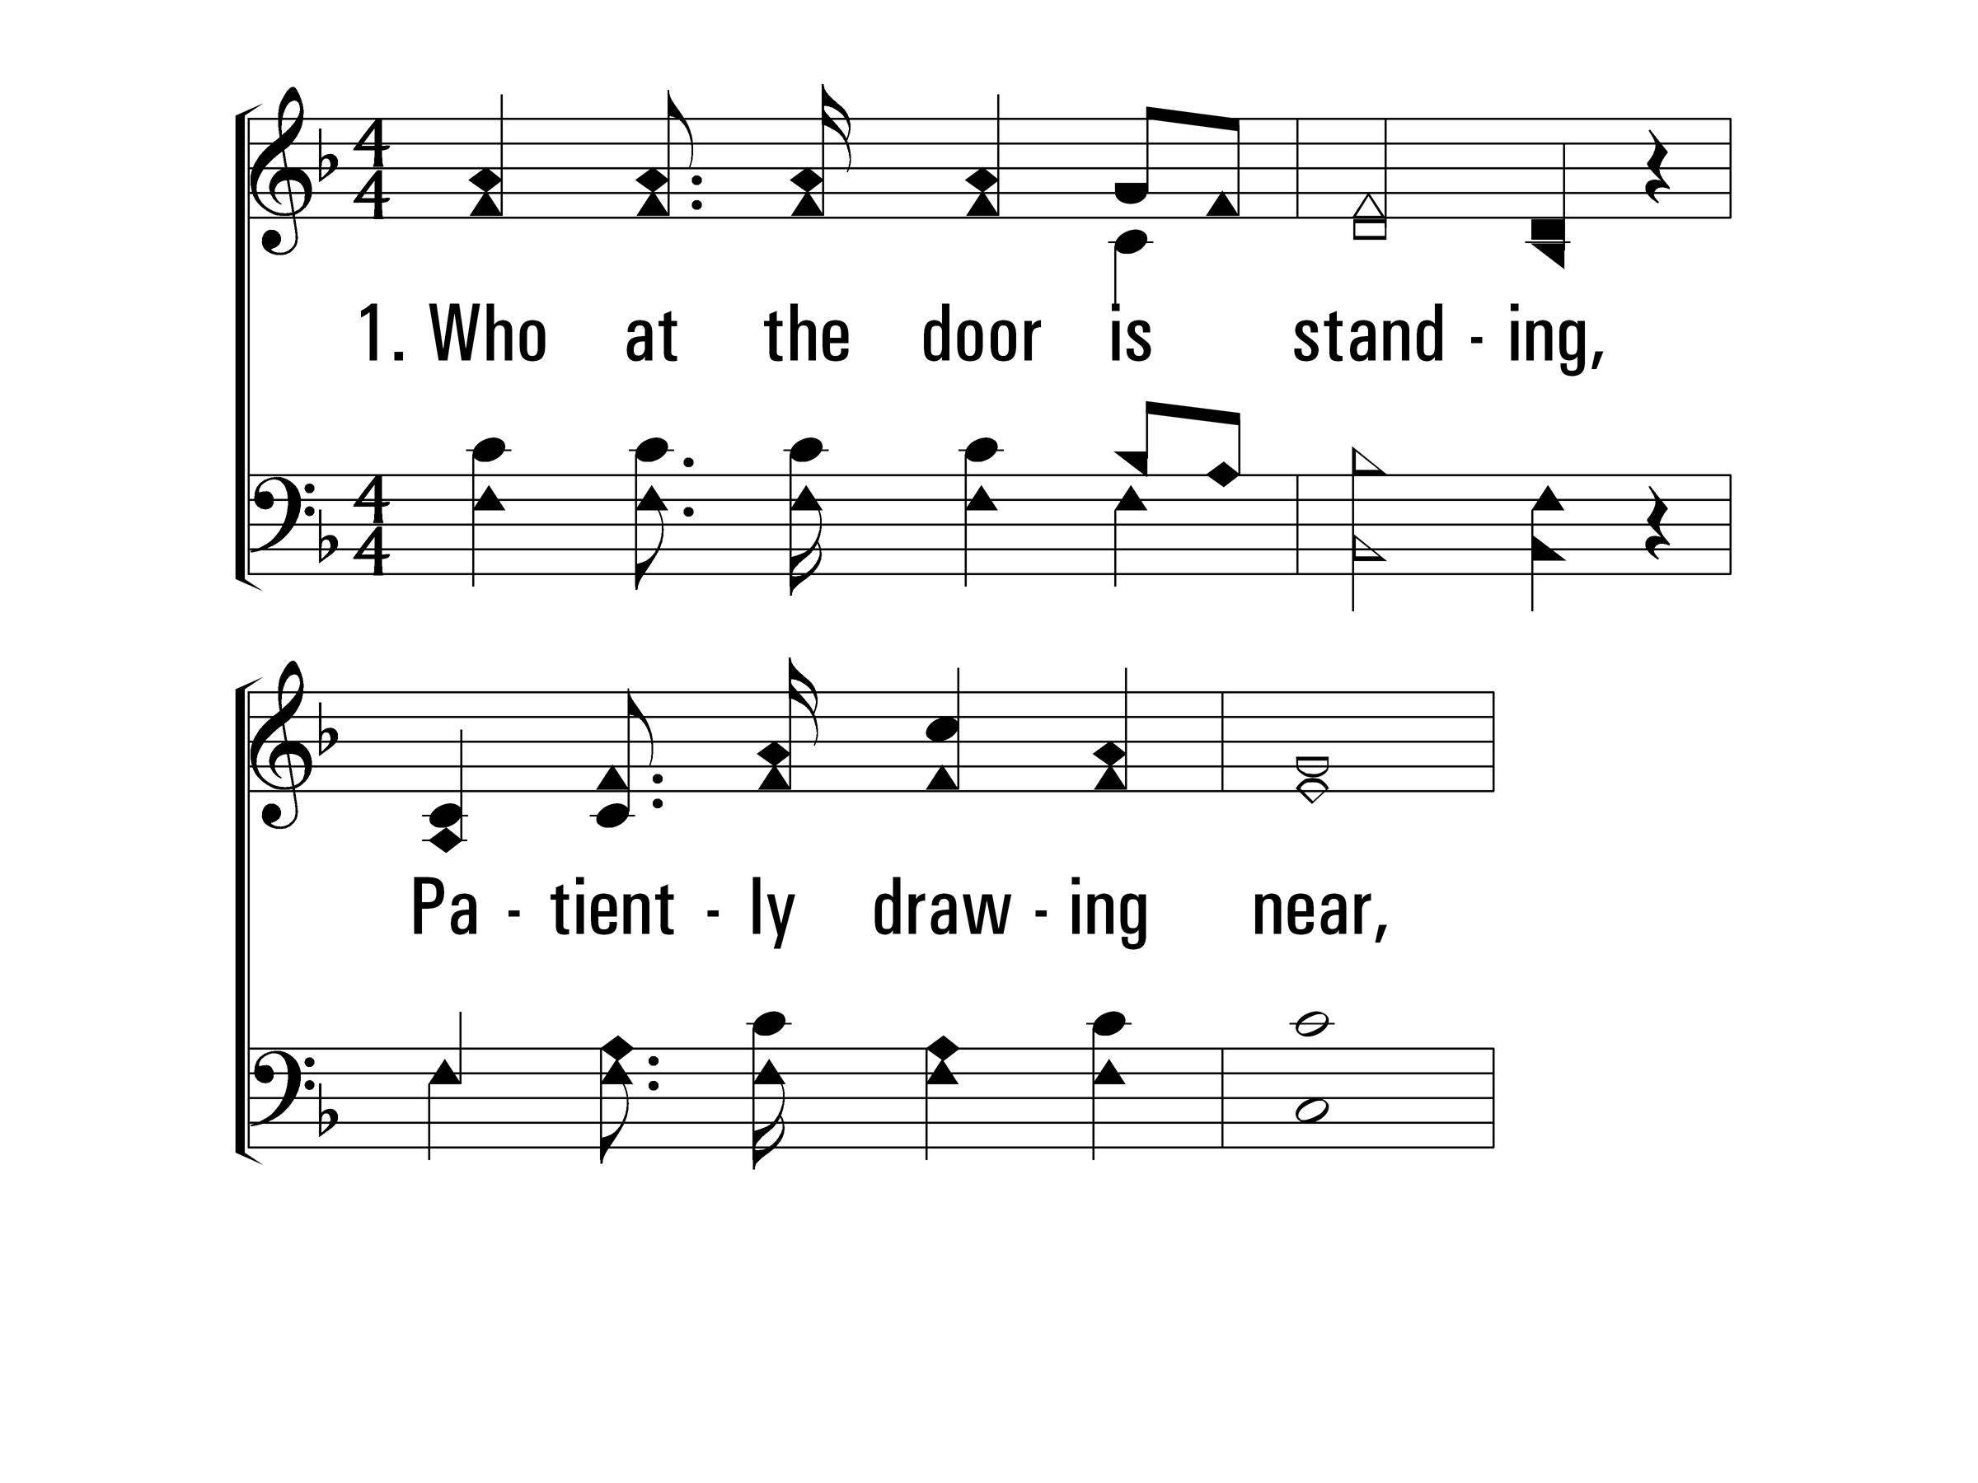
WhoAtTheDoorIsStanding_st1_a
Vs 1
© 2014 Sumphonia Productions, LLC

Slide 70
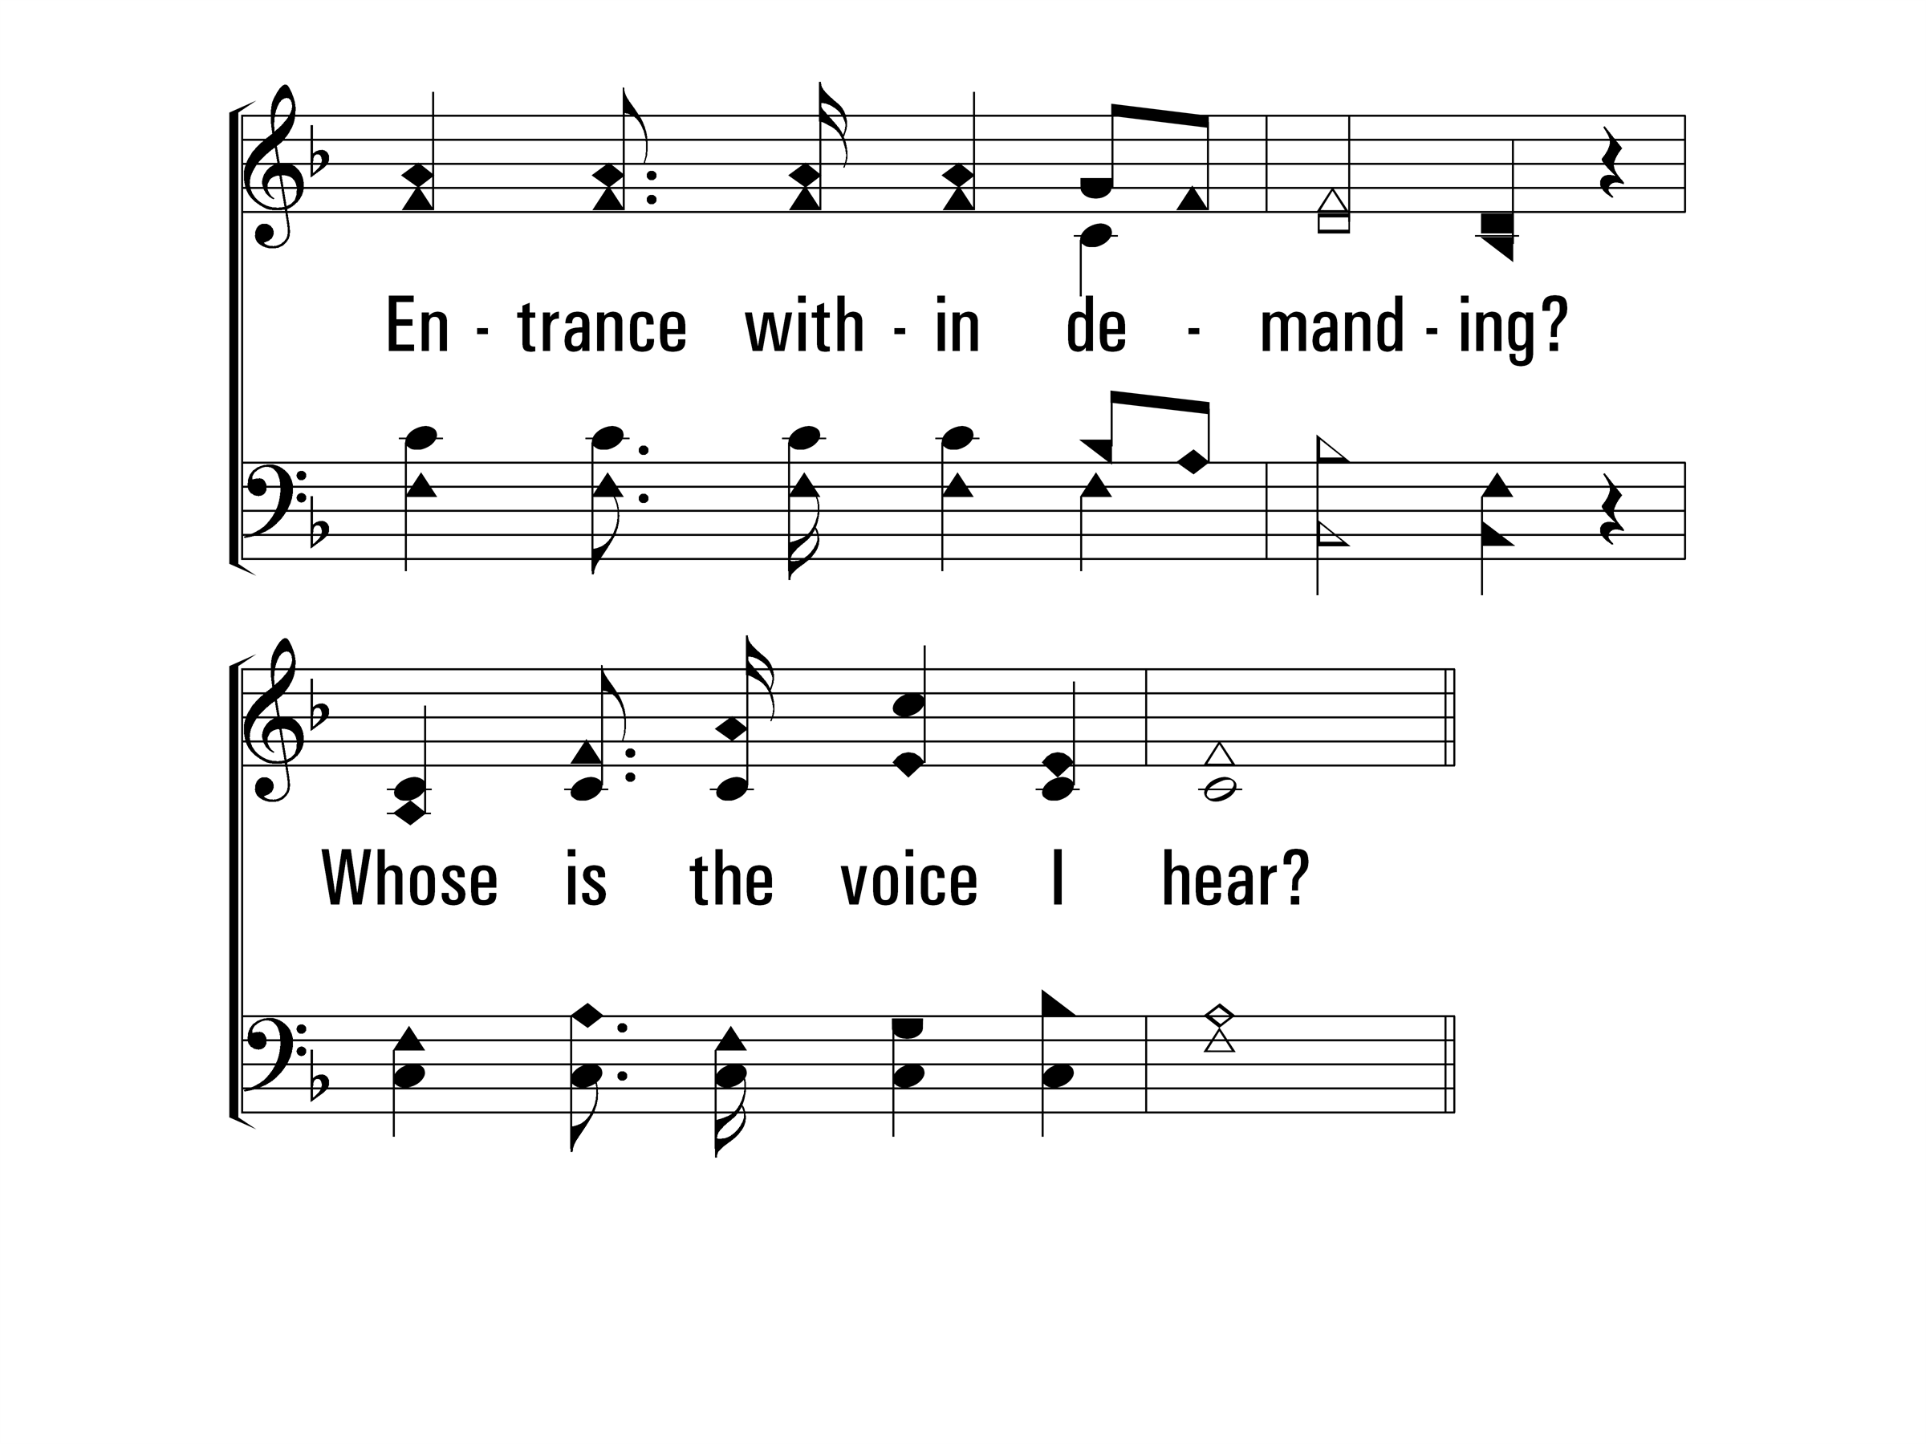
WhoAtTheDoorIsStanding_st1_b
Vs 1
© 2014 Sumphonia Productions, LLC

Slide 71
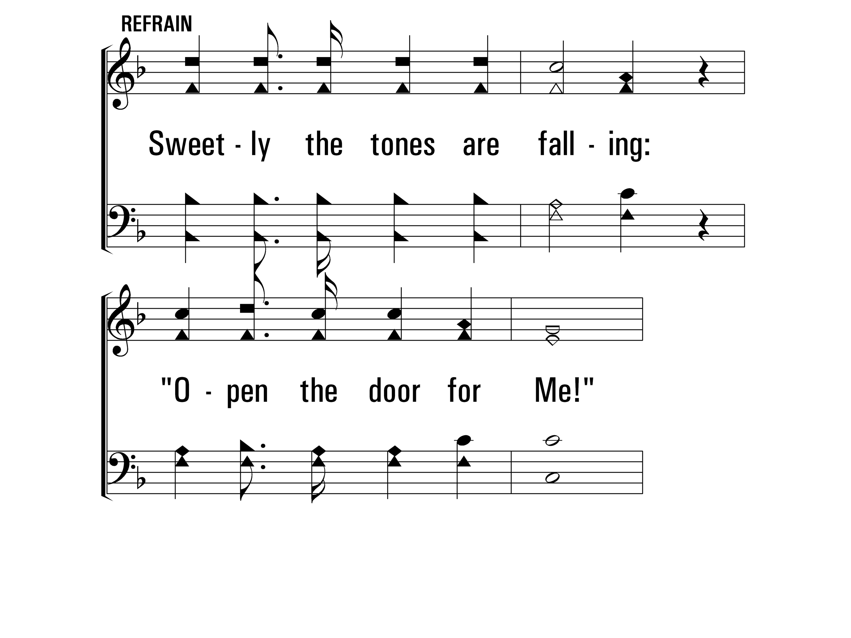
WhoAtTheDoorIsStanding_ref_a
Refrain
© 2014 Sumphonia Productions, LLC

Slide 72
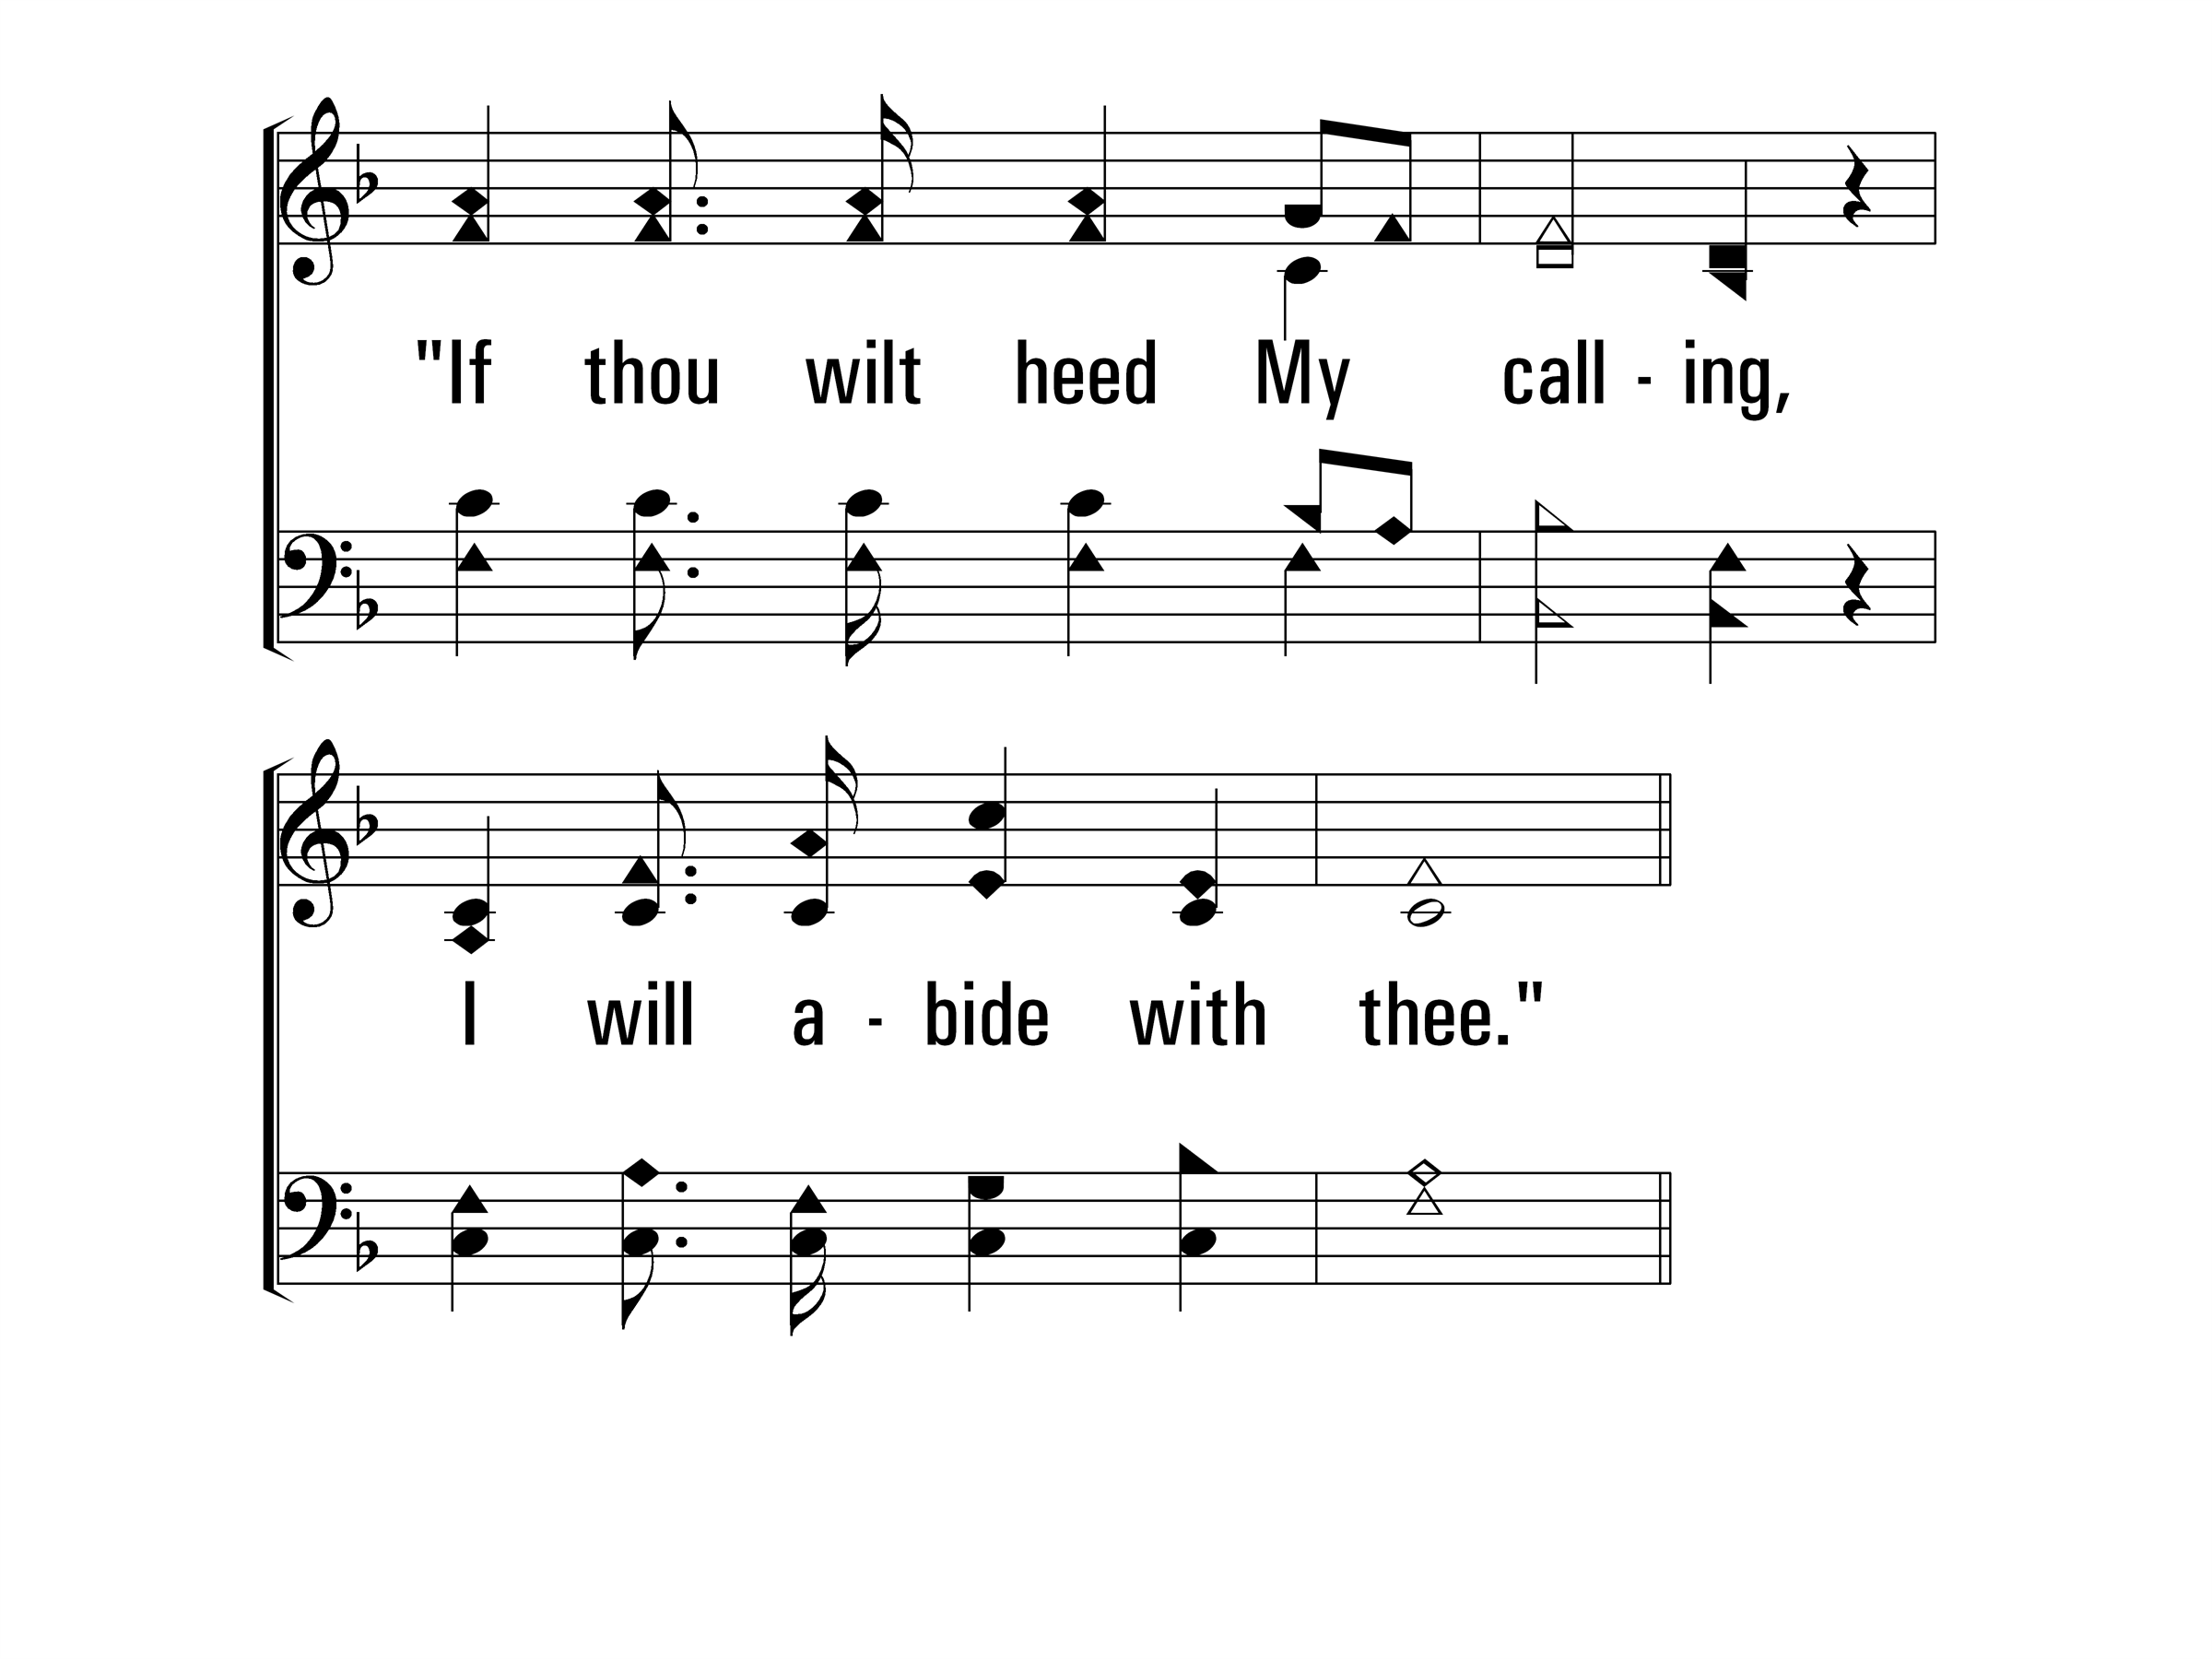
WhoAtTheDoorIsStanding_ref_b
Refrain
© 2014 Sumphonia Productions, LLC

Slide 73
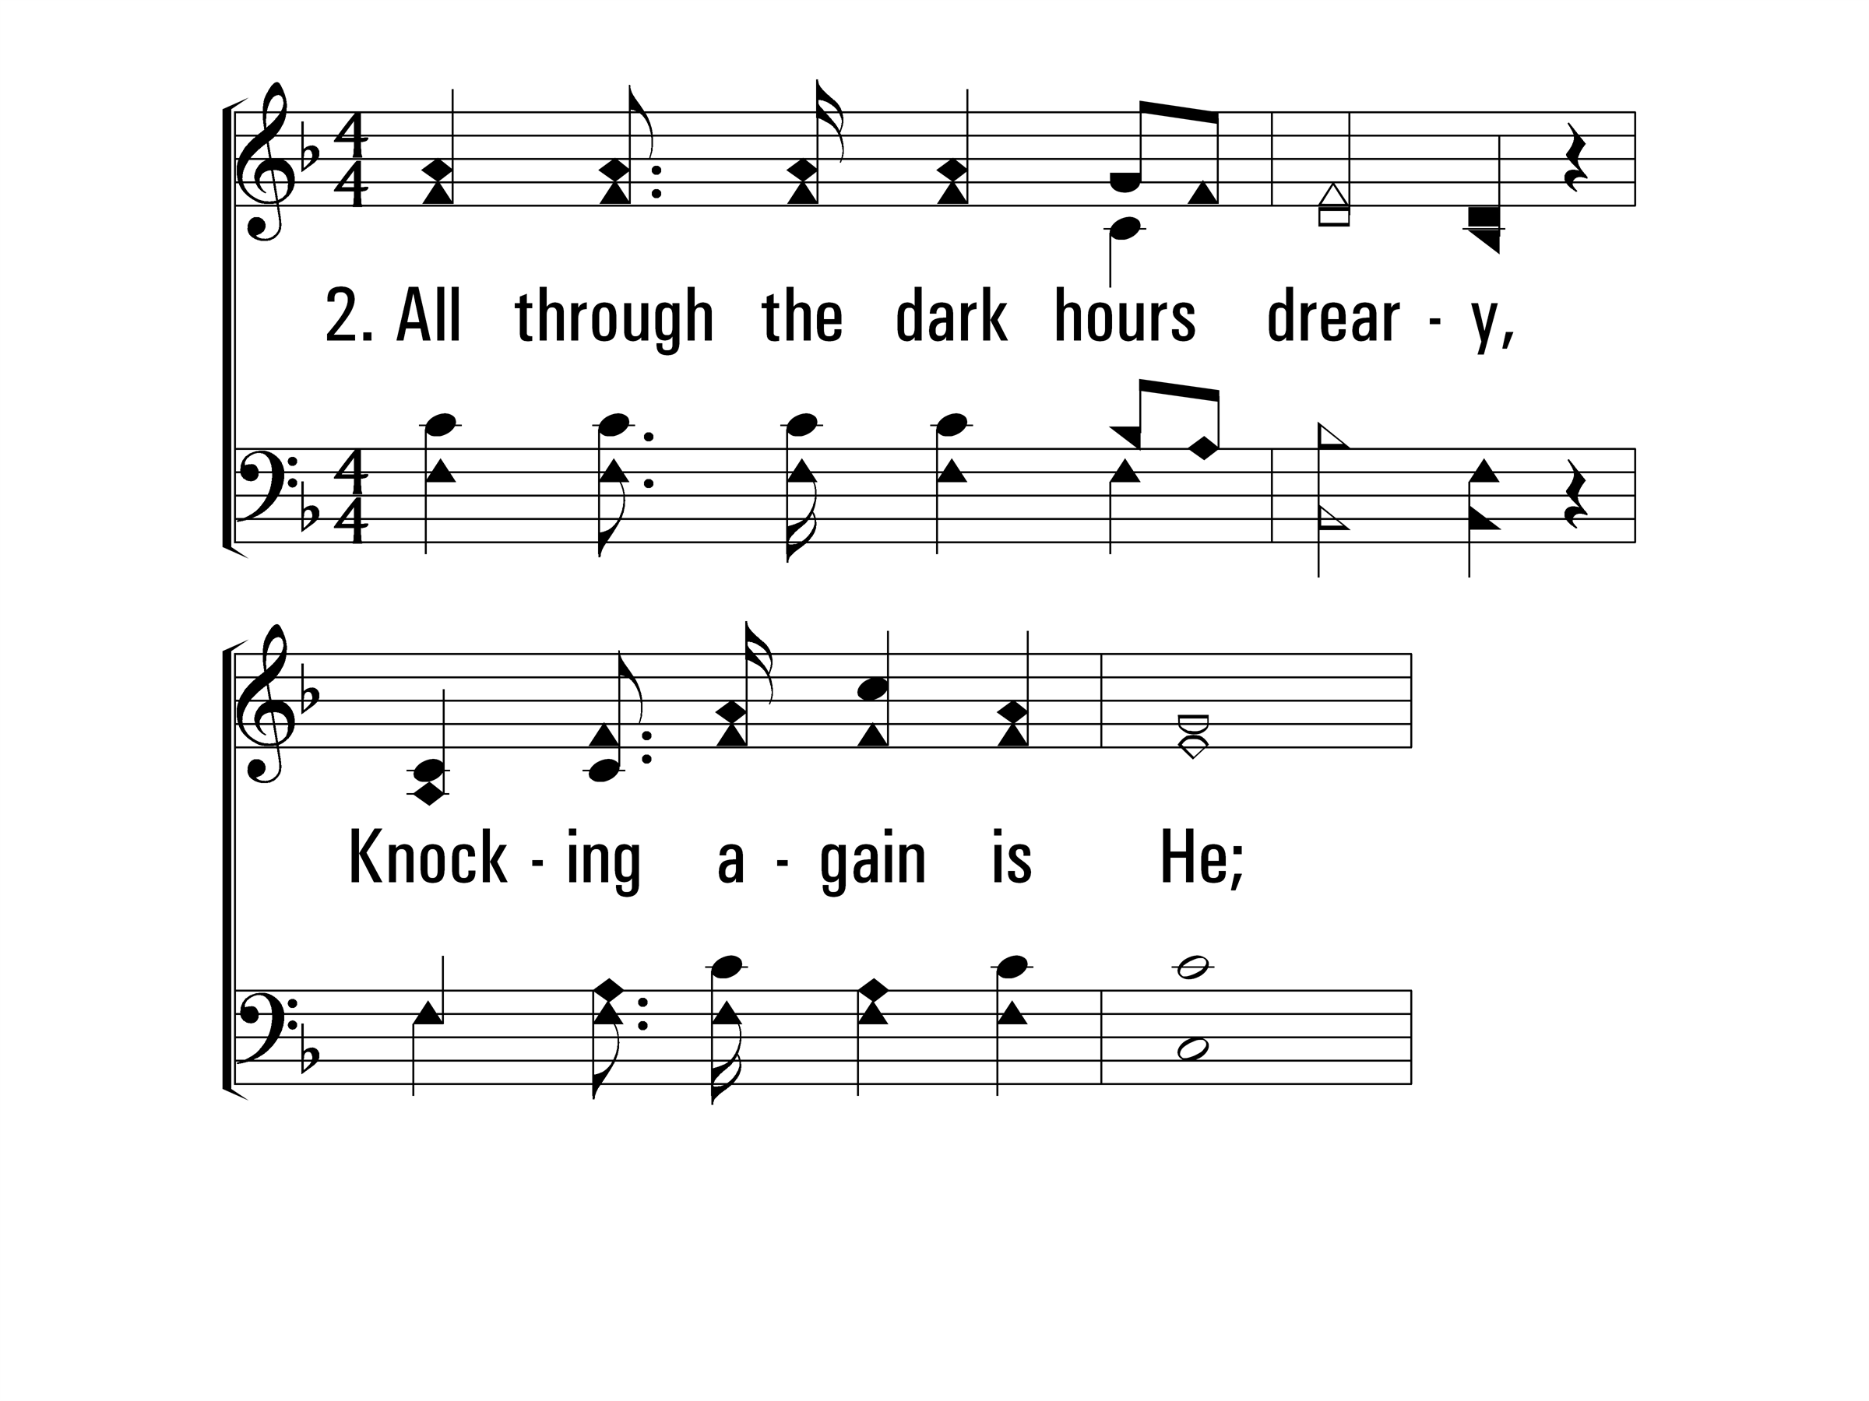
WhoAtTheDoorIsStanding_st2_a
Vs 2
© 2014 Sumphonia Productions, LLC

Slide 74
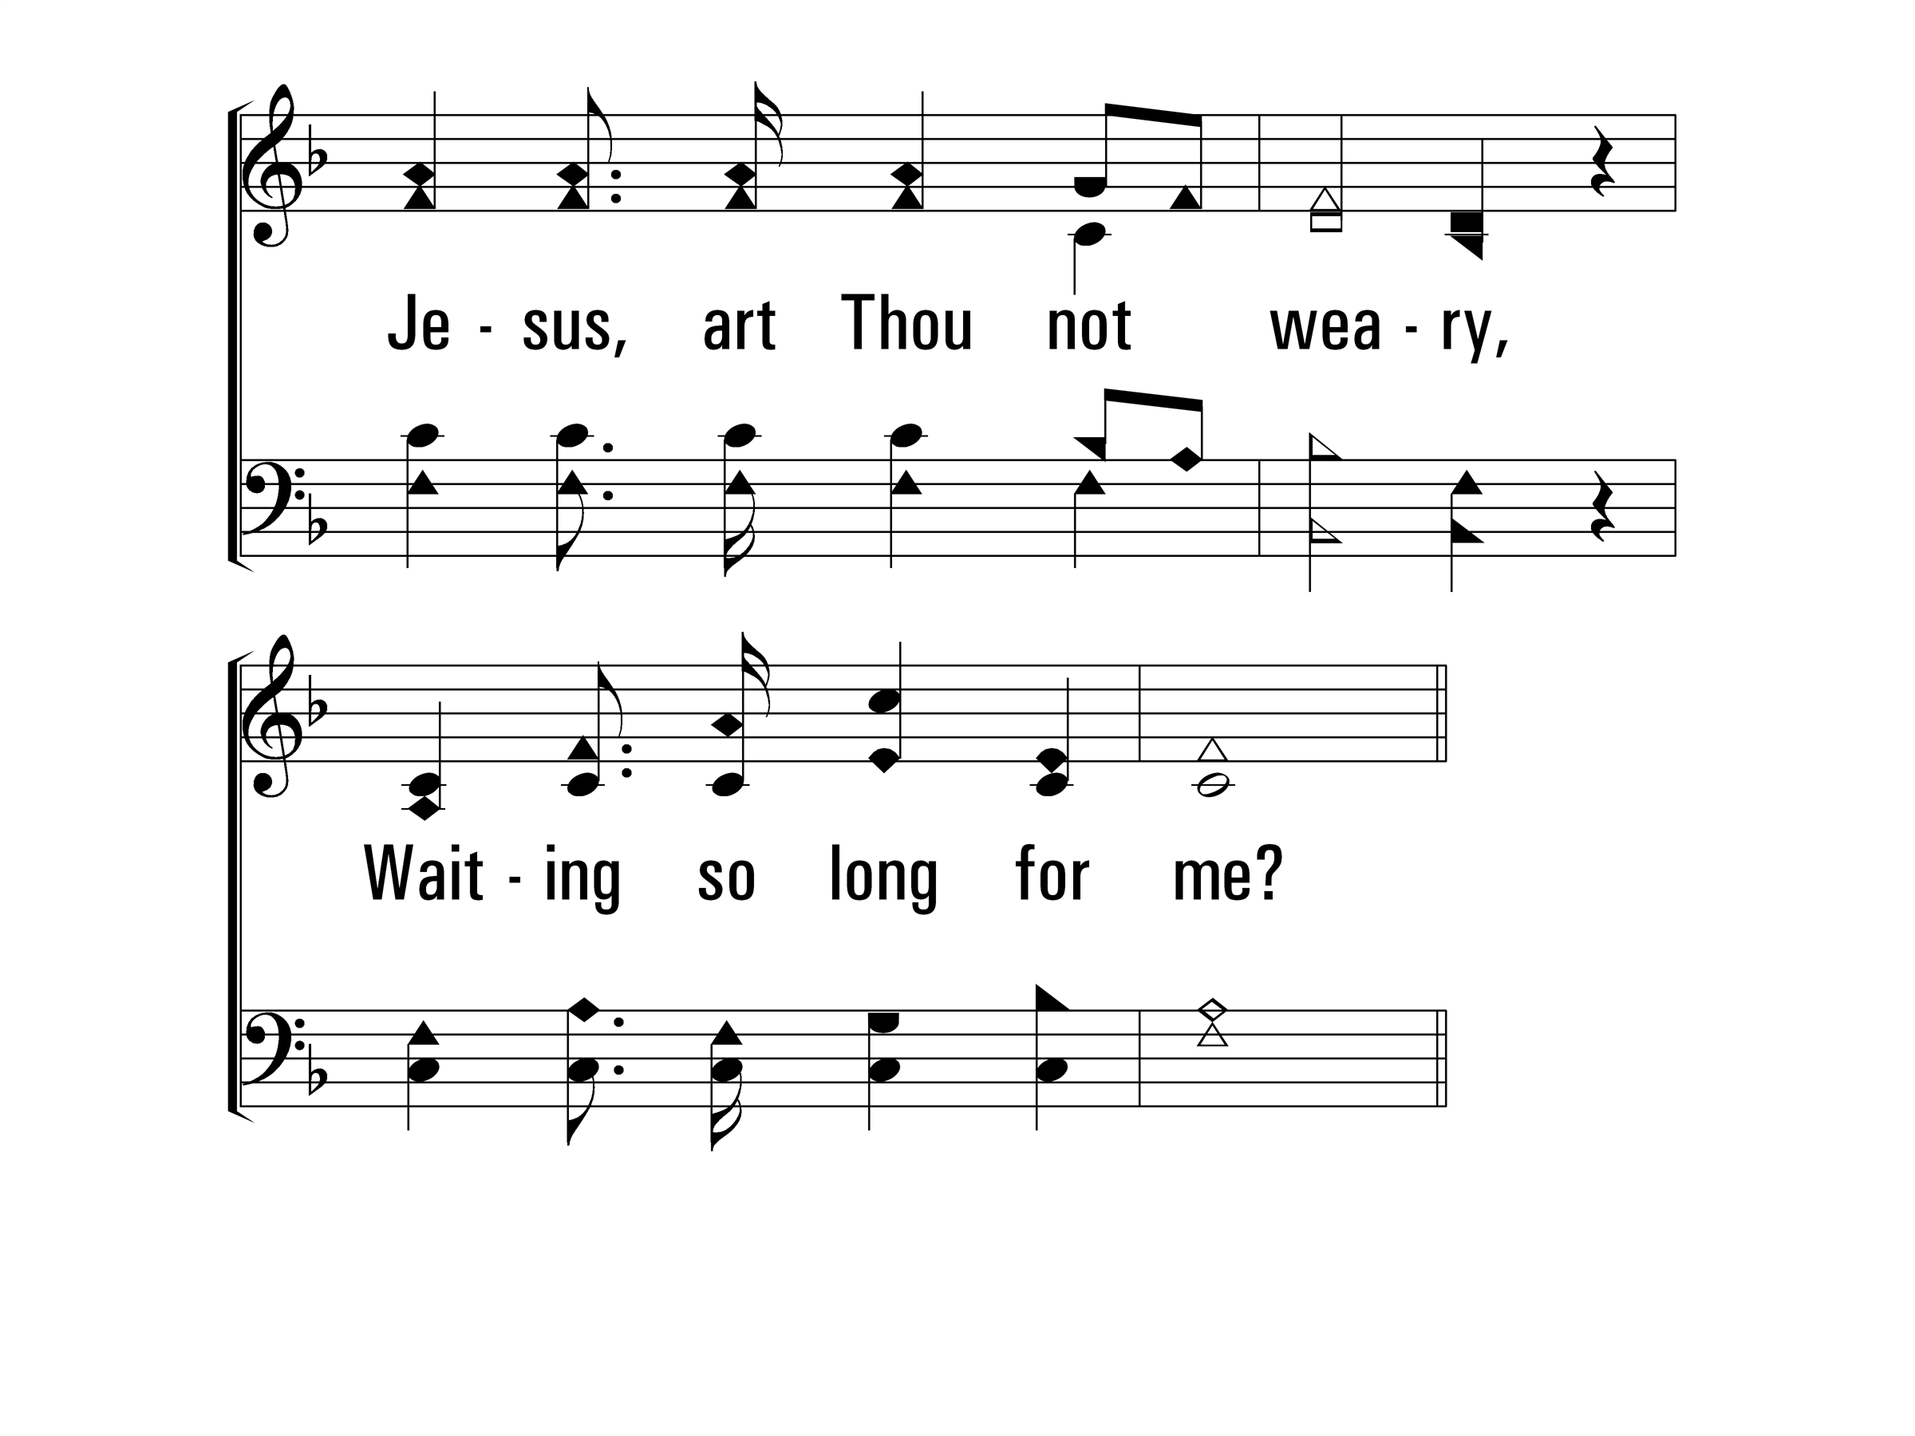
WhoAtTheDoorIsStanding_st2_b
Vs 2
© 2014 Sumphonia Productions, LLC

Slide 75
WhoAtTheDoorIsStanding_ref_a
Refrain
© 2014 Sumphonia Productions, LLC

Slide 76
WhoAtTheDoorIsStanding_ref_b
Refrain
© 2014 Sumphonia Productions, LLC

Slide 77
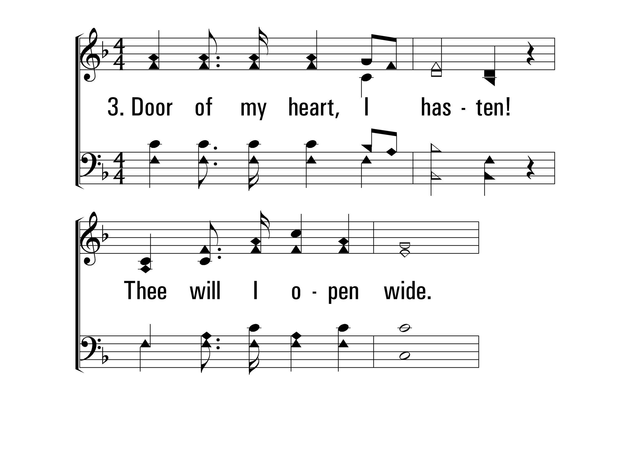
WhoAtTheDoorIsStanding_st3_a
Vs 3
© 2014 Sumphonia Productions, LLC

Slide 78
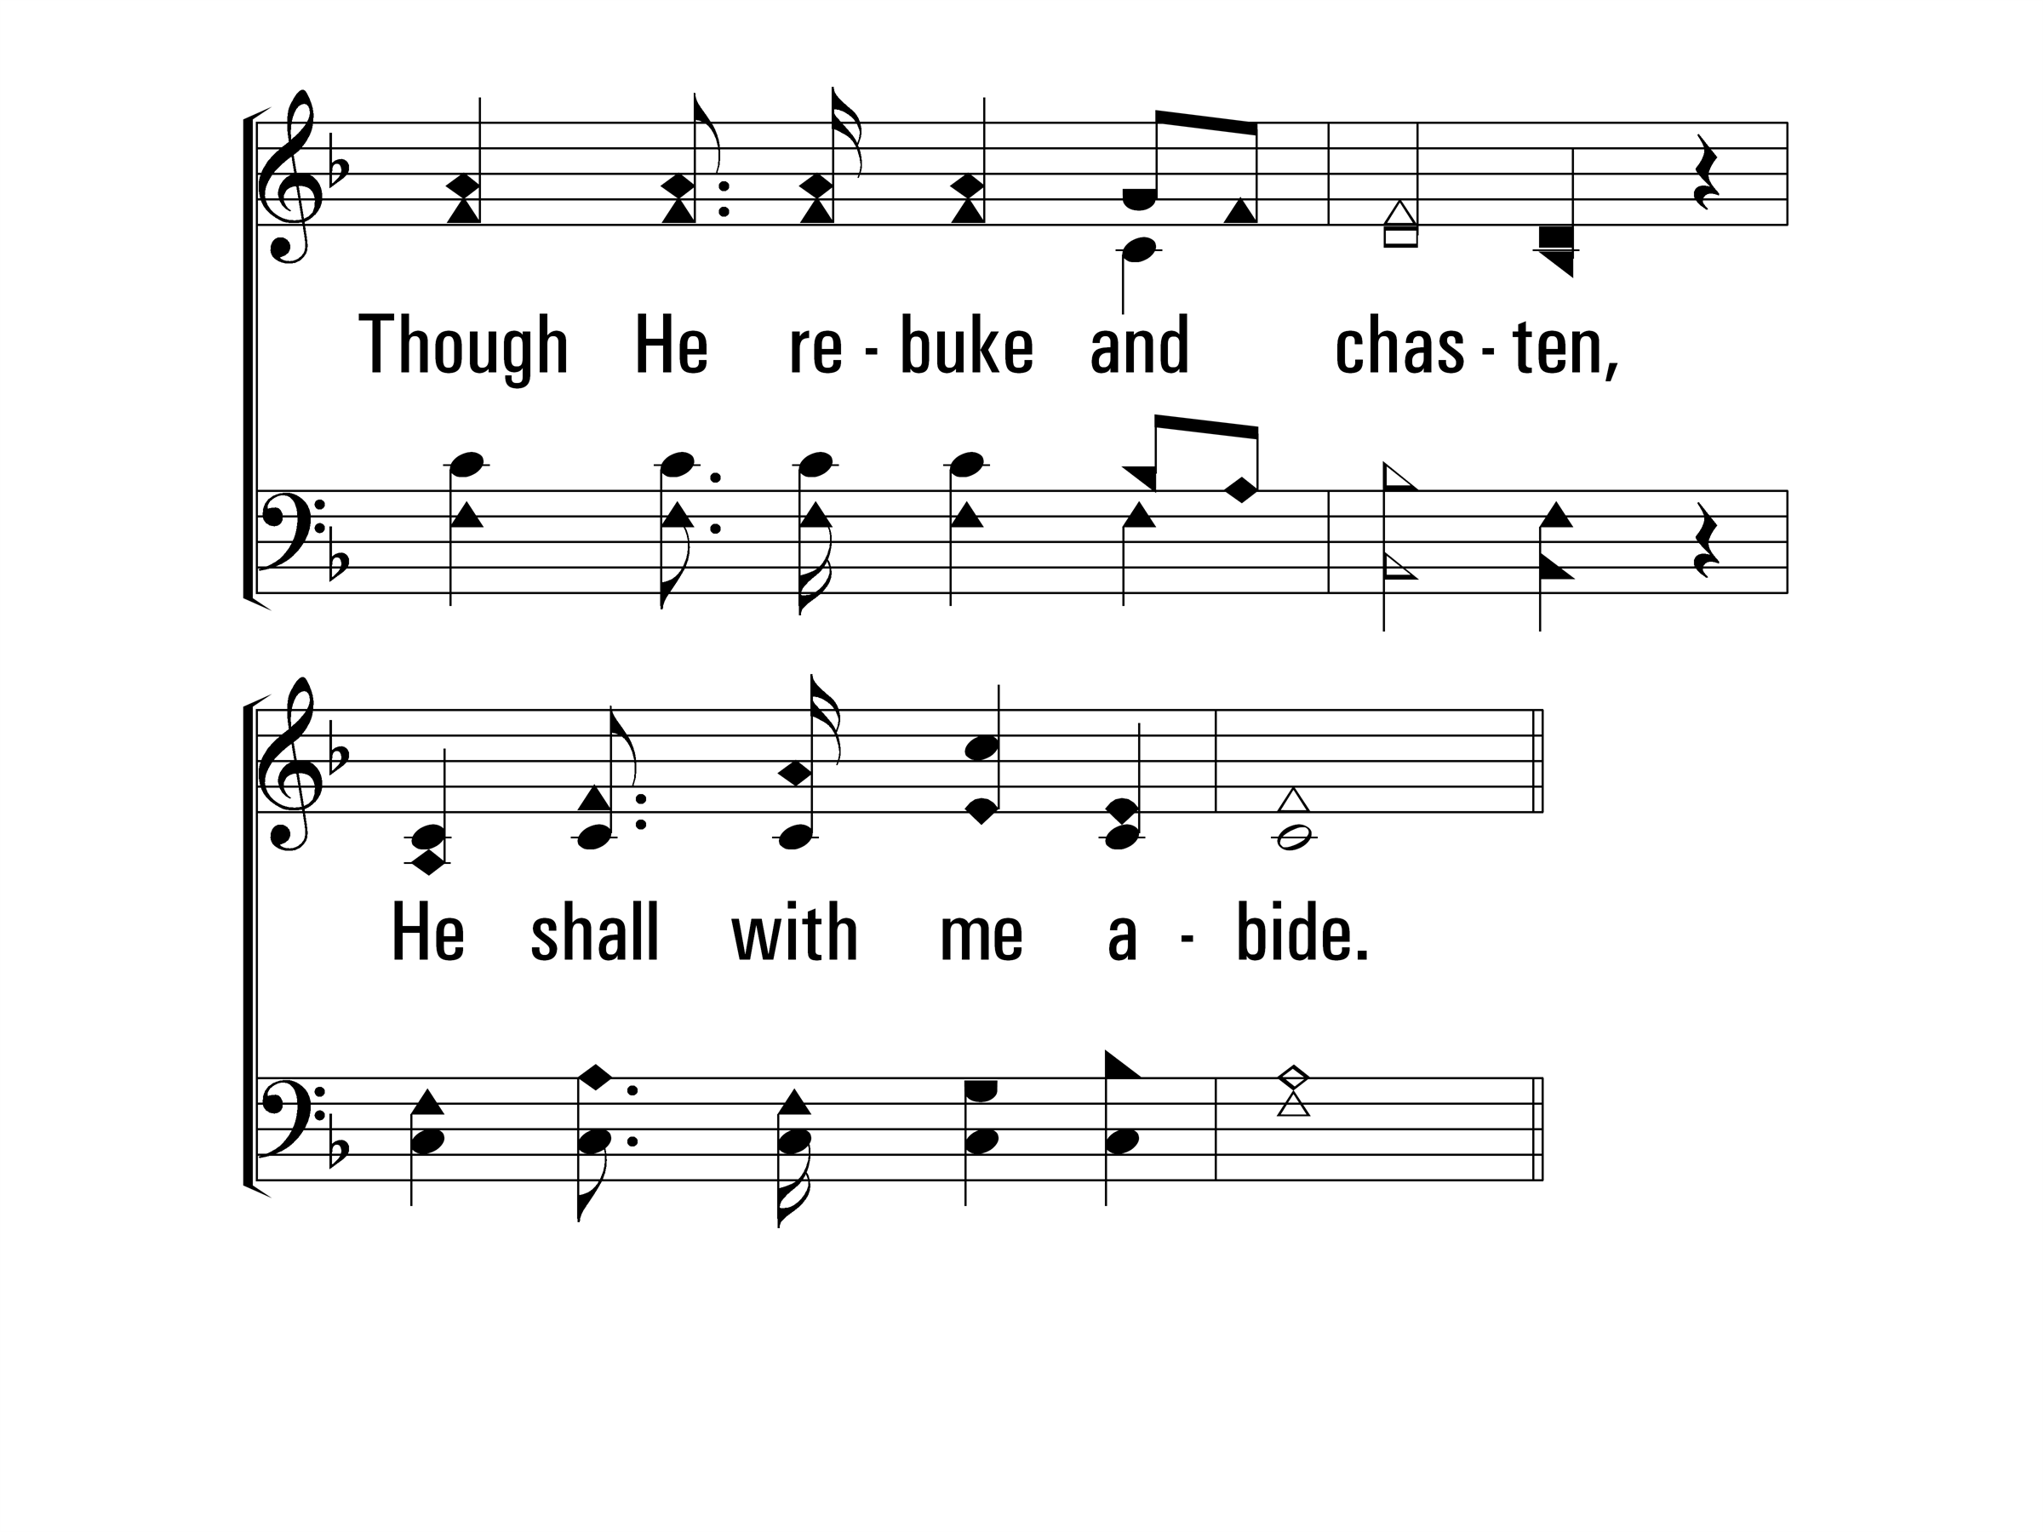
WhoAtTheDoorIsStanding_st3_b
Vs 3
© 2014 Sumphonia Productions, LLC

Slide 79
WhoAtTheDoorIsStanding_ref_a
Refrain
© 2014 Sumphonia Productions, LLC

