Slide 2
The Solid Rock
412
_
_
_
_
Hymn: Edward Mote (1836)
Tune: SOLID ROCK • William B. Bradbury (1863)

Slide 3
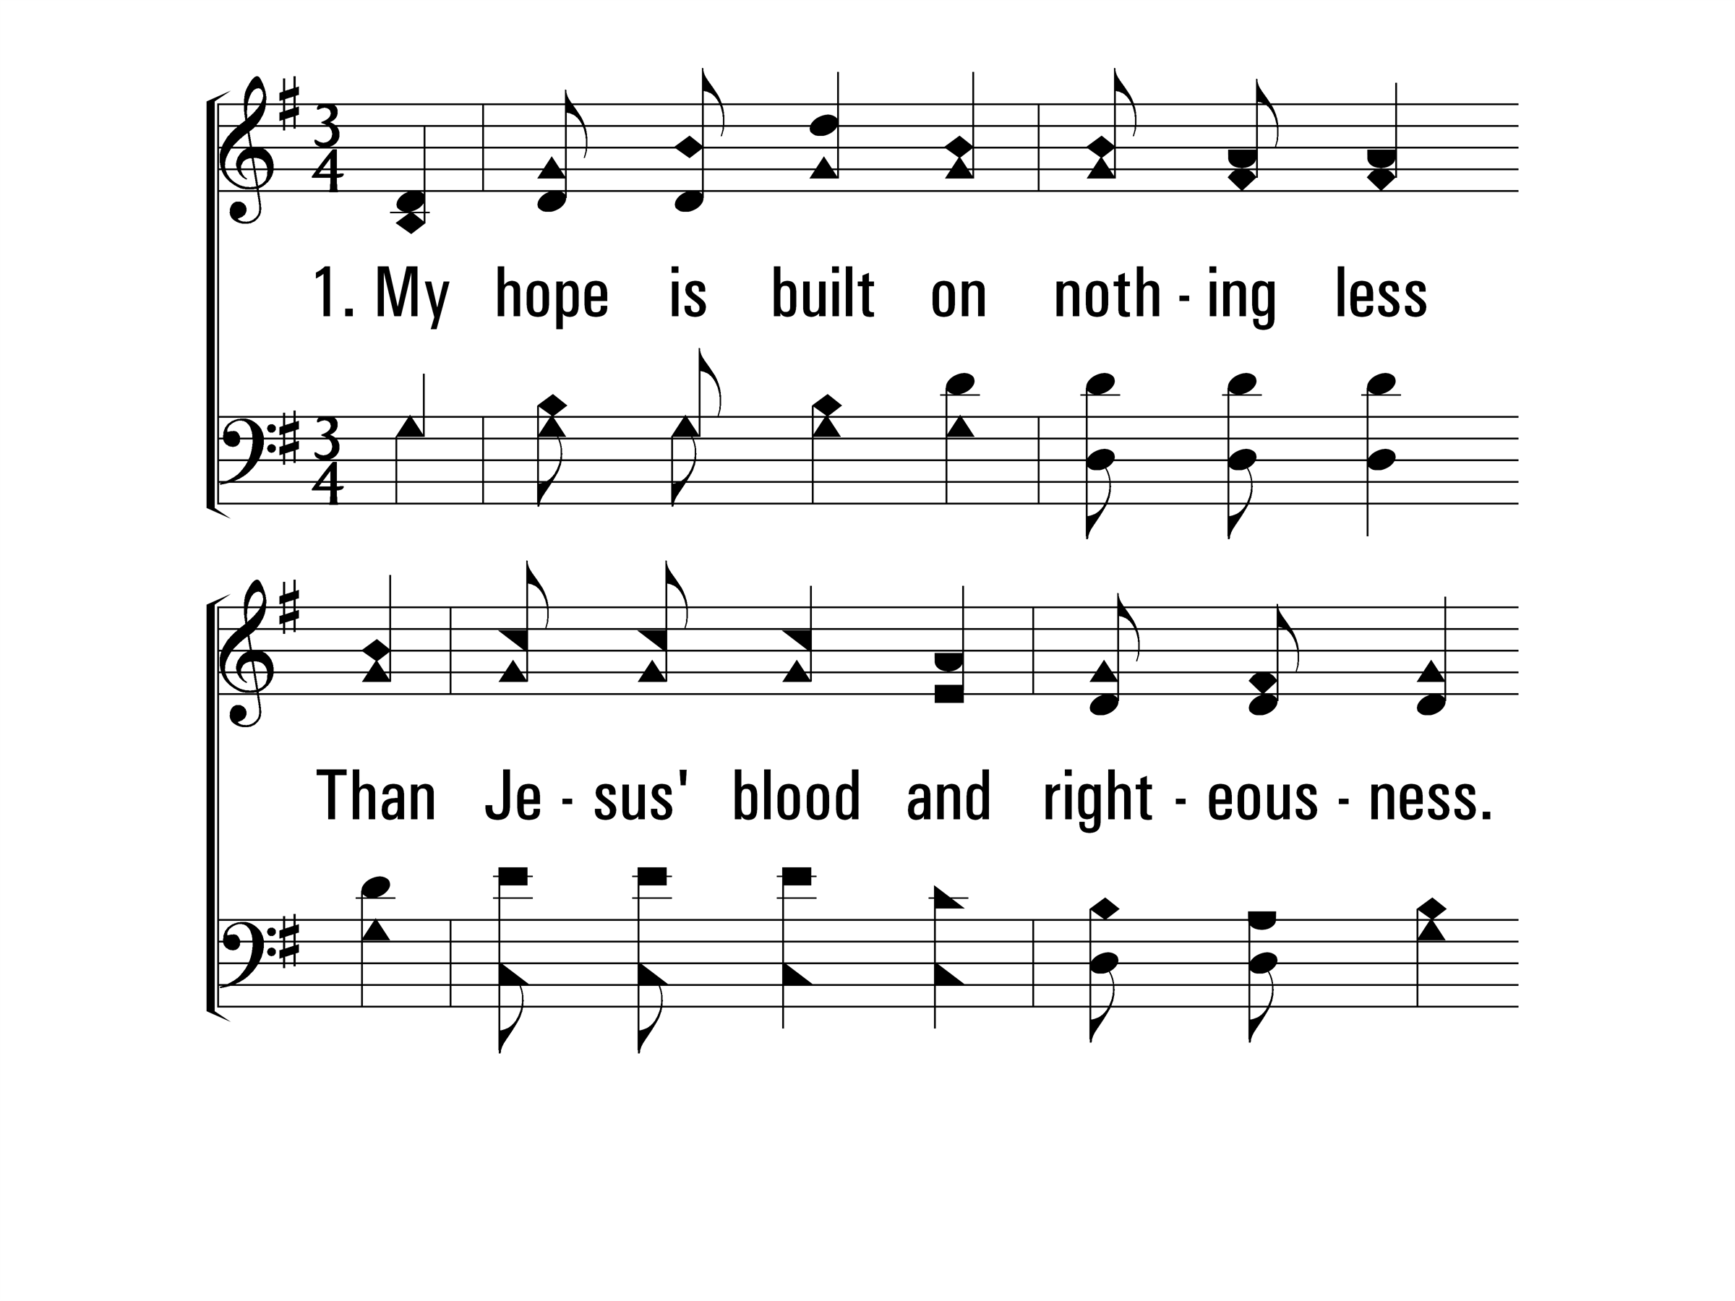
TheSolidRock_st1_a
Vs 1
© 2014 Sumphonia Productions, LLC

Slide 4
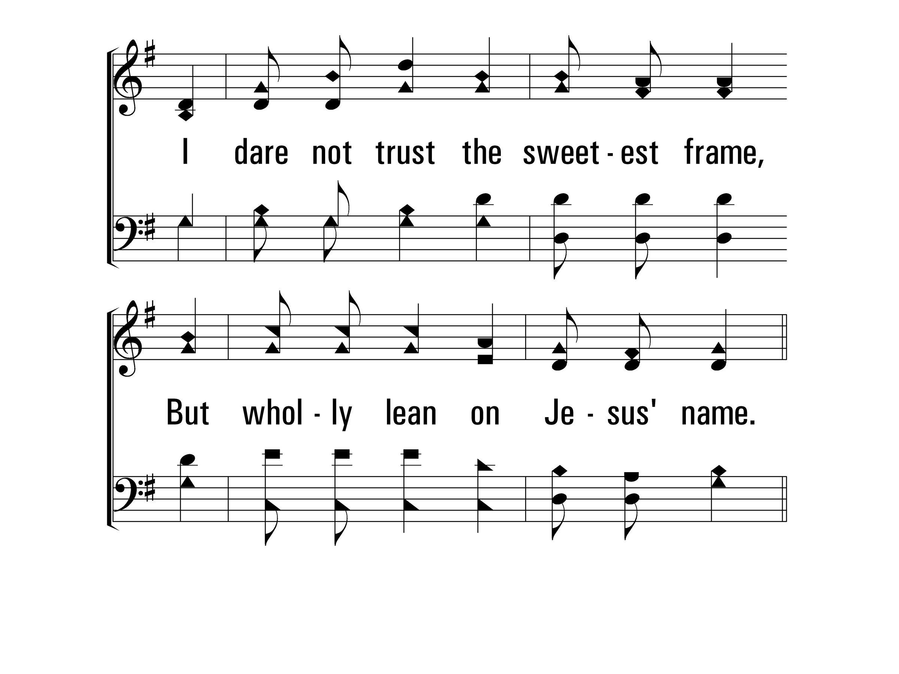
TheSolidRock_st1_b
Vs 1
© 2014 Sumphonia Productions, LLC

Slide 5
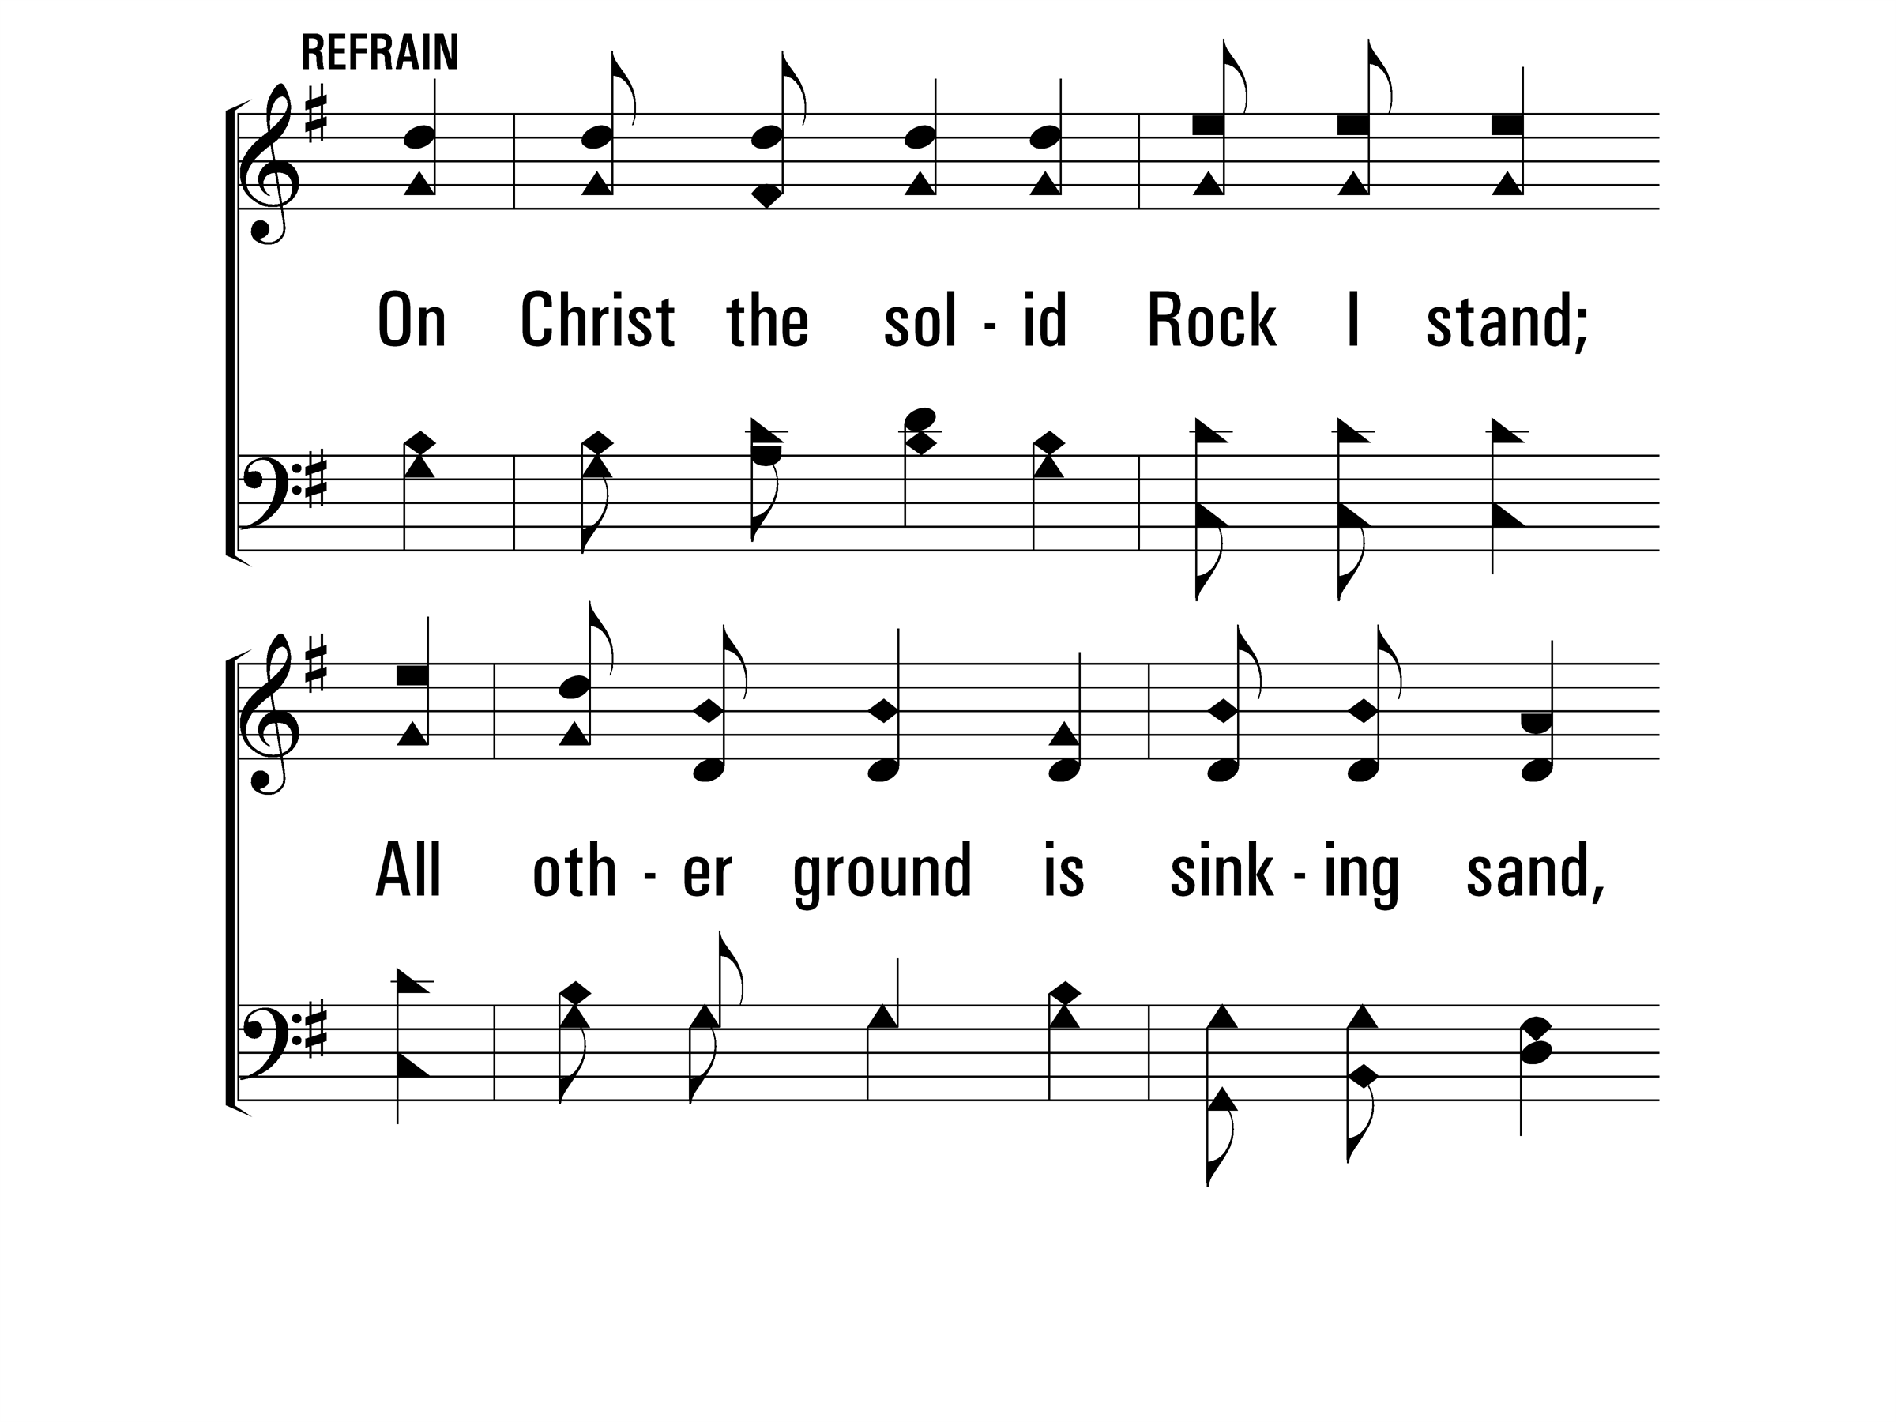
TheSolidRock_ref_a
Refrain
© 2014 Sumphonia Productions, LLC

Slide 6
TheSolidRock_ref_b
Refrain
© 2014 Sumphonia Productions, LLC

Slide 7
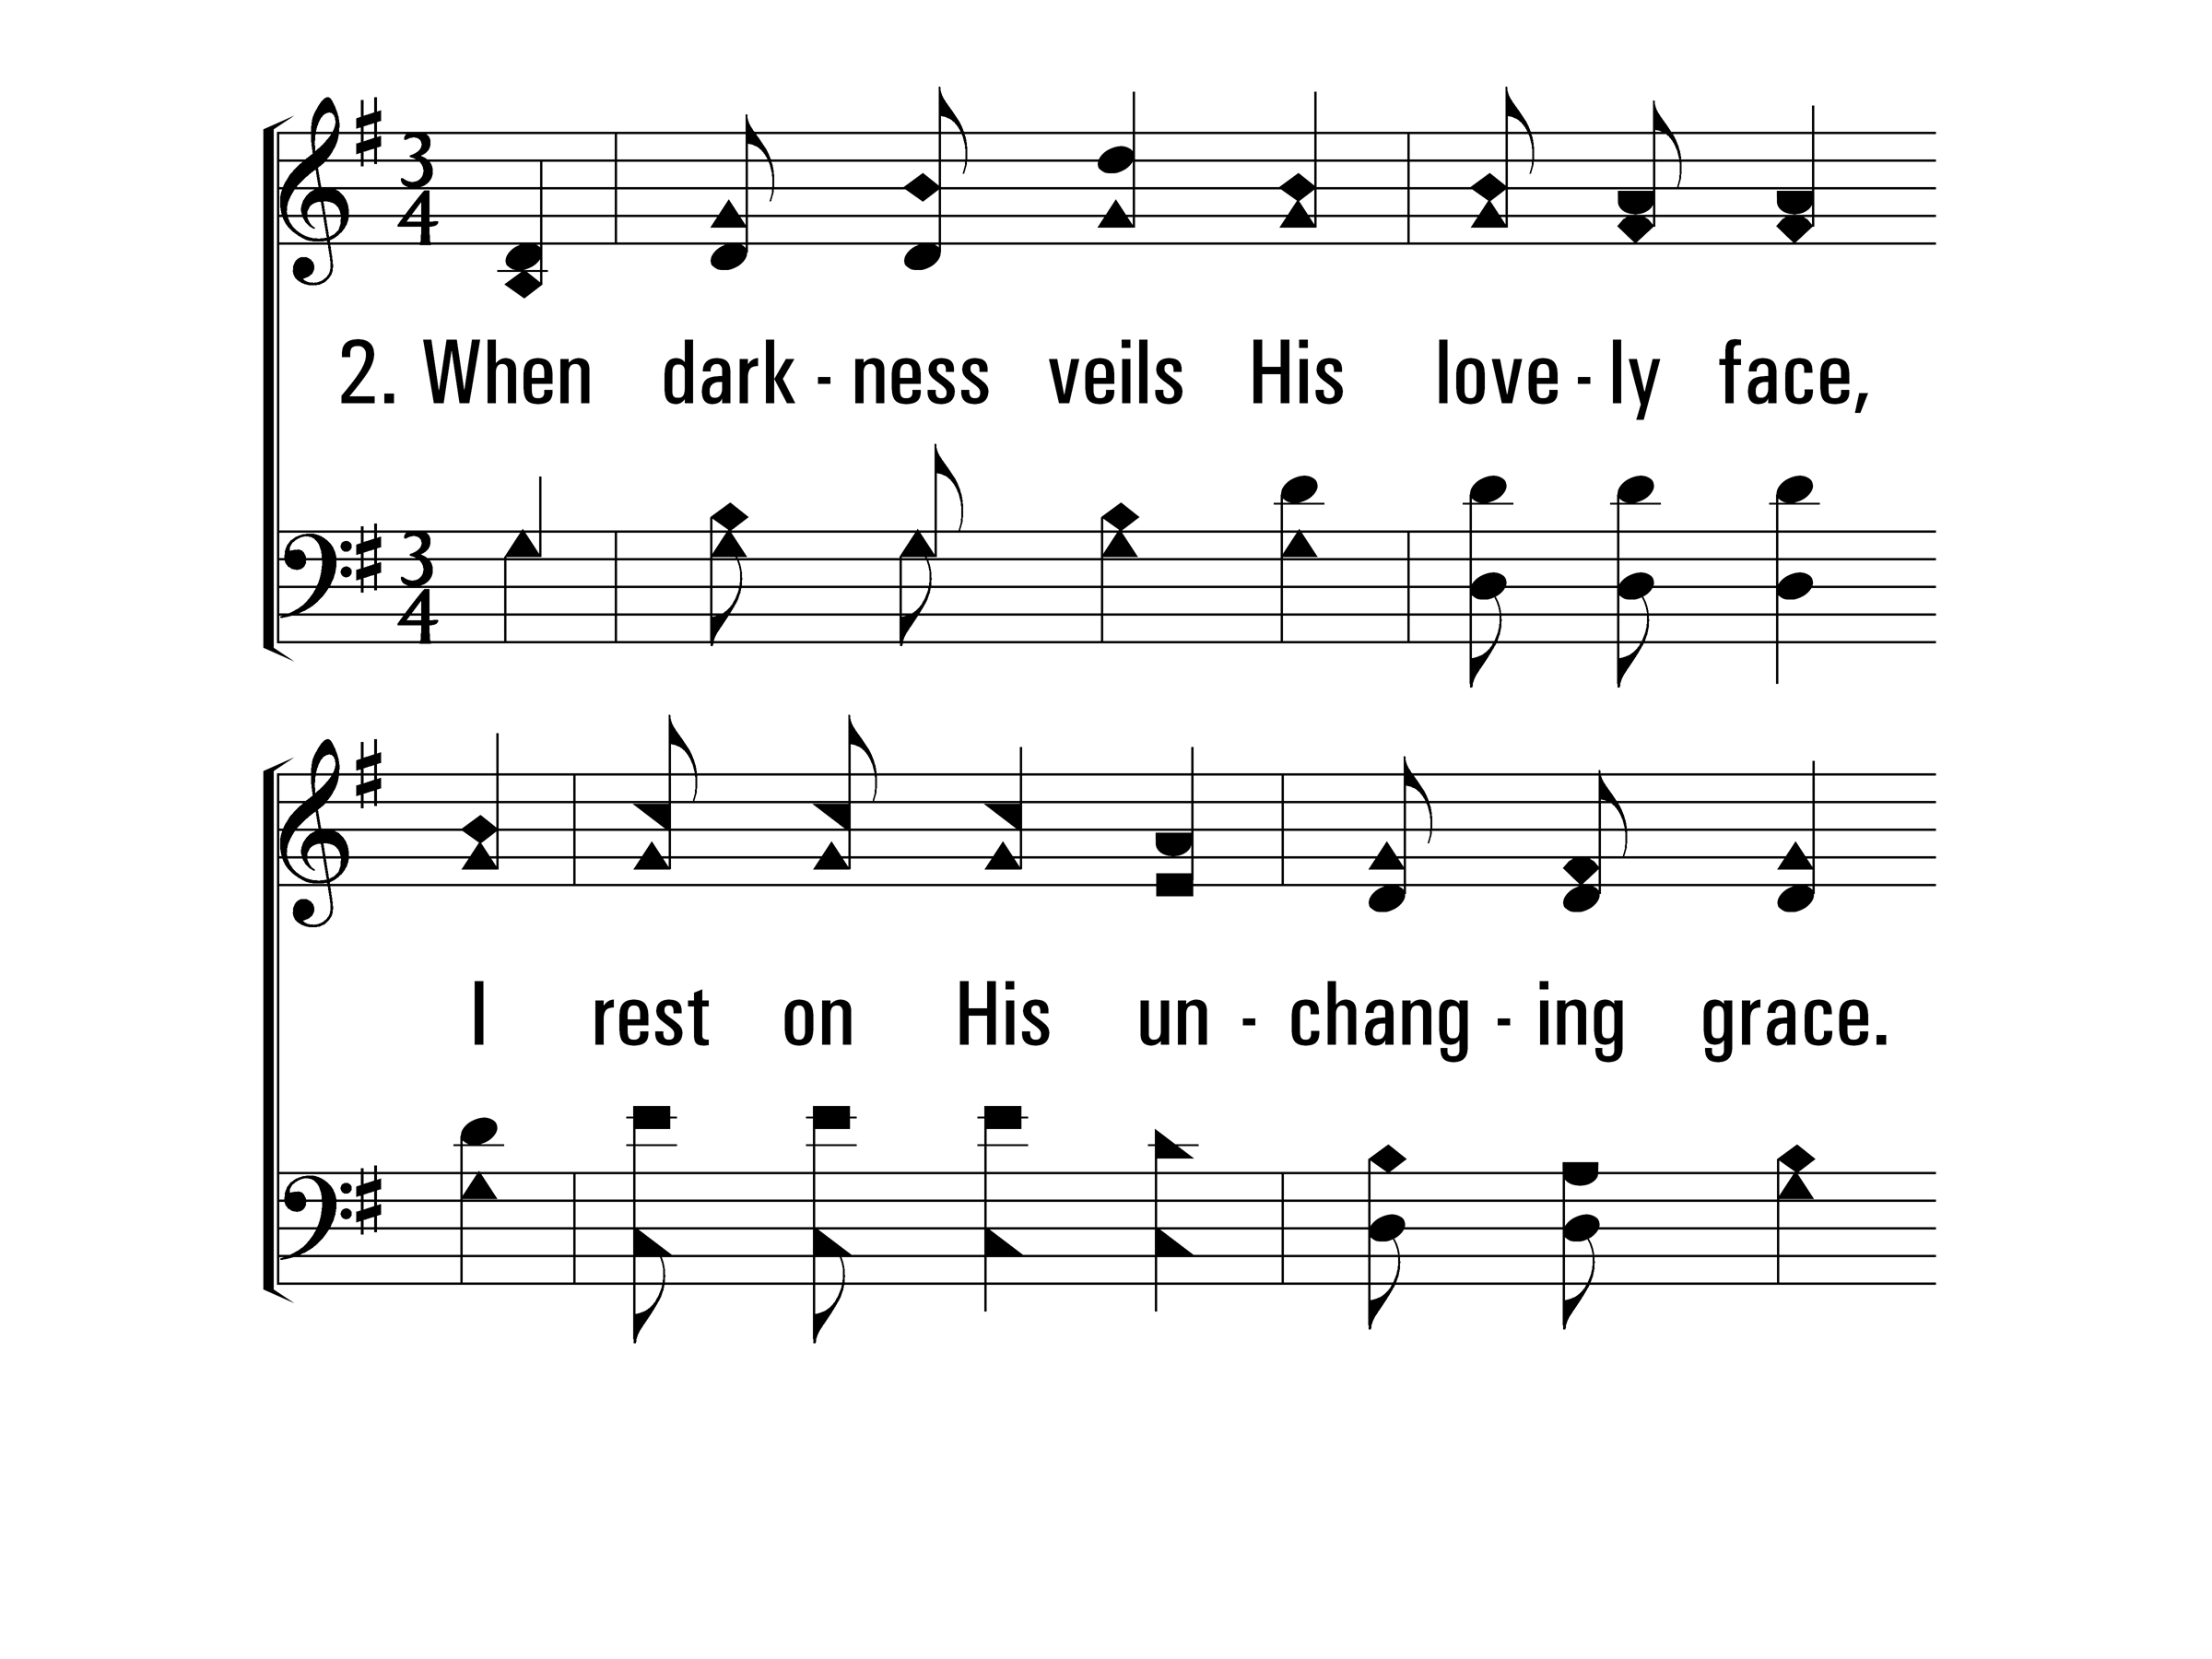
TheSolidRock_st2_a
Vs 2
© 2014 Sumphonia Productions, LLC

Slide 8
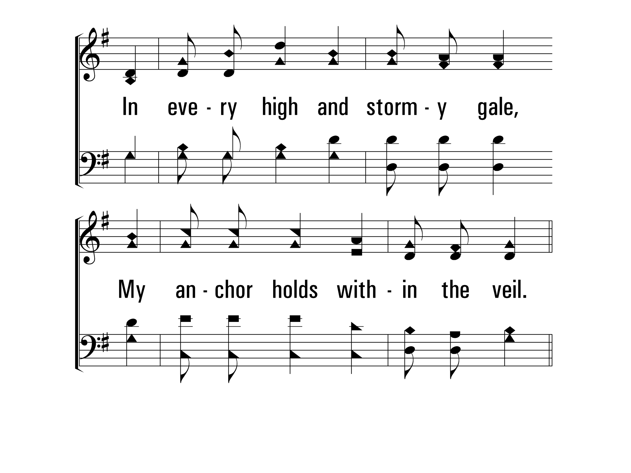
TheSolidRock_st2_b
Vs 2
© 2014 Sumphonia Productions, LLC

Slide 9
TheSolidRock_ref_a
Refrain
© 2014 Sumphonia Productions, LLC

Slide 10
TheSolidRock_ref_b
Refrain
© 2014 Sumphonia Productions, LLC

Slide 11
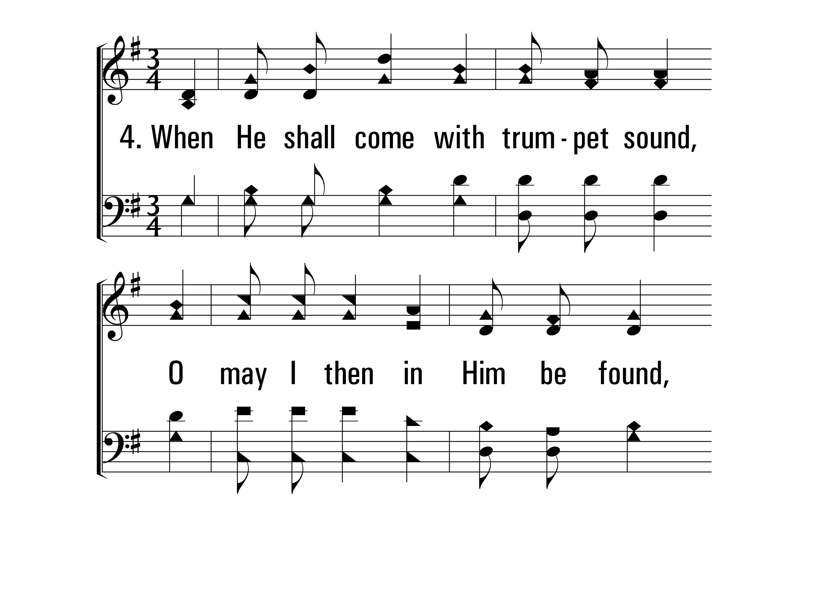
TheSolidRock_st4_a
Vs 4
© 2014 Sumphonia Productions, LLC

Slide 12
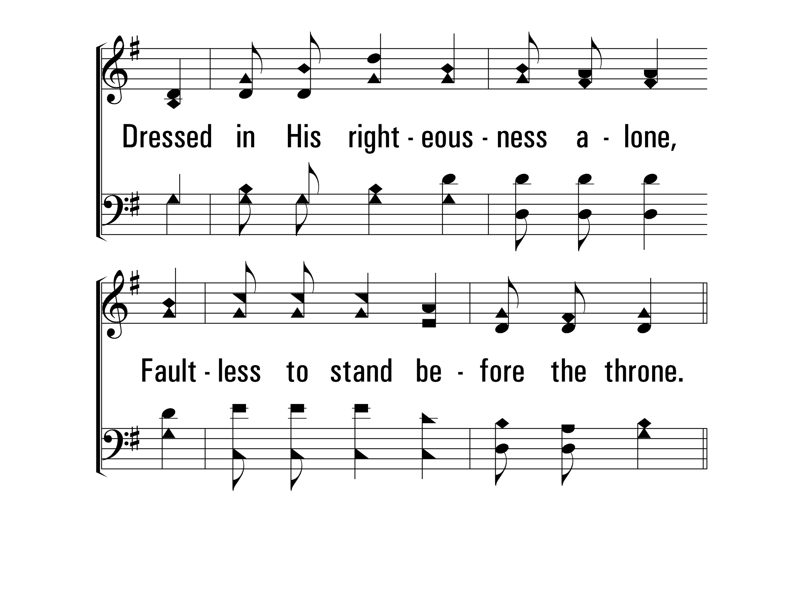
TheSolidRock_st4_b
Vs 4
© 2014 Sumphonia Productions, LLC

Slide 13
TheSolidRock_ref_a
Refrain
© 2014 Sumphonia Productions, LLC

Slide 14
TheSolidRock_ref_b
Refrain
© 2014 Sumphonia Productions, LLC
End

Slide 15
Beyond This Land of Parting
774
_
_
_
_
Hymn: Mary B. C. Slade (1876)
Tune: Asa B. Everett (1876)

Slide 16
BeyondThisLandOfParting_st1_a
Vs 1
© 2014 Sumphonia Productions, LLC

Slide 17
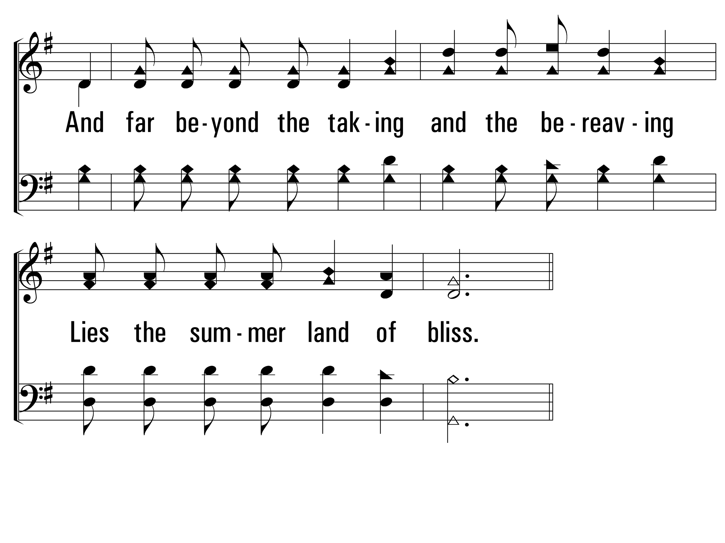
BeyondThisLandOfParting_st1_b
Vs 1
© 2014 Sumphonia Productions, LLC

Slide 18
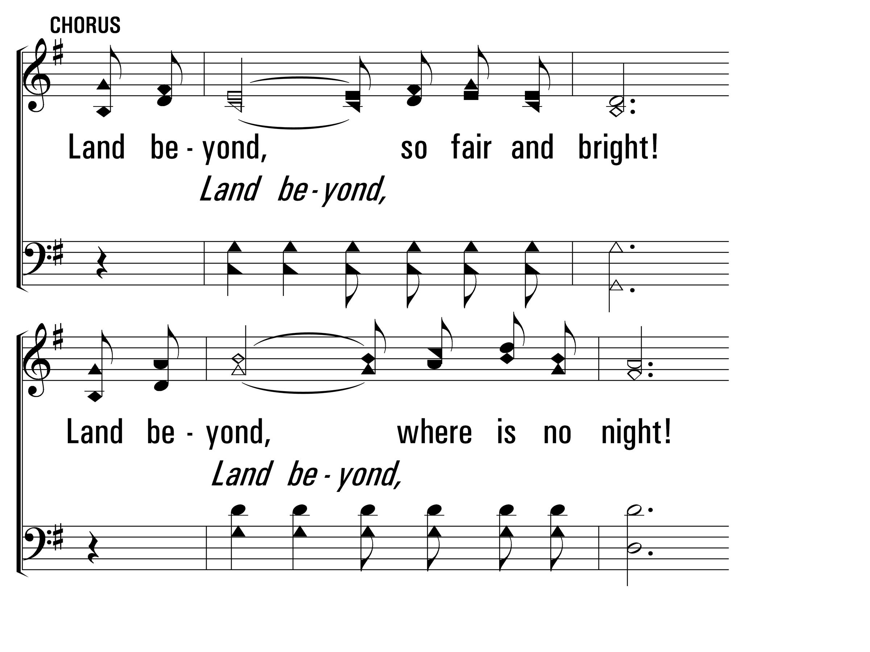
BeyondThisLandOfParting_cho_a
Chorus
© 2014 Sumphonia Productions, LLC

Slide 19
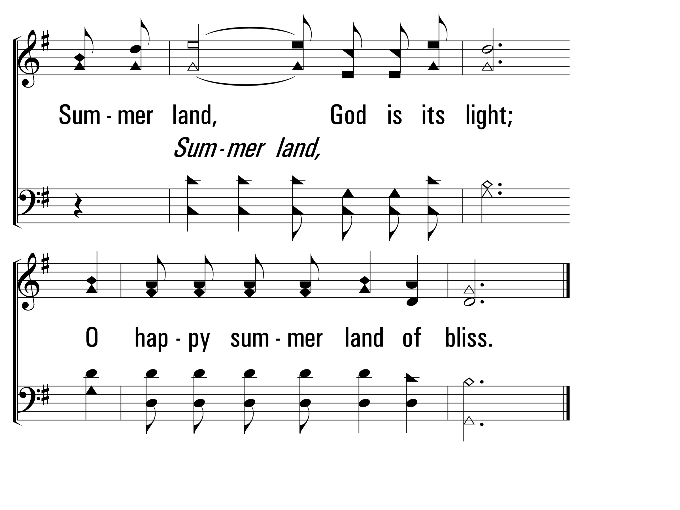
BeyondThisLandOfParting_cho_b
Chorus
© 2014 Sumphonia Productions, LLC

Slide 20
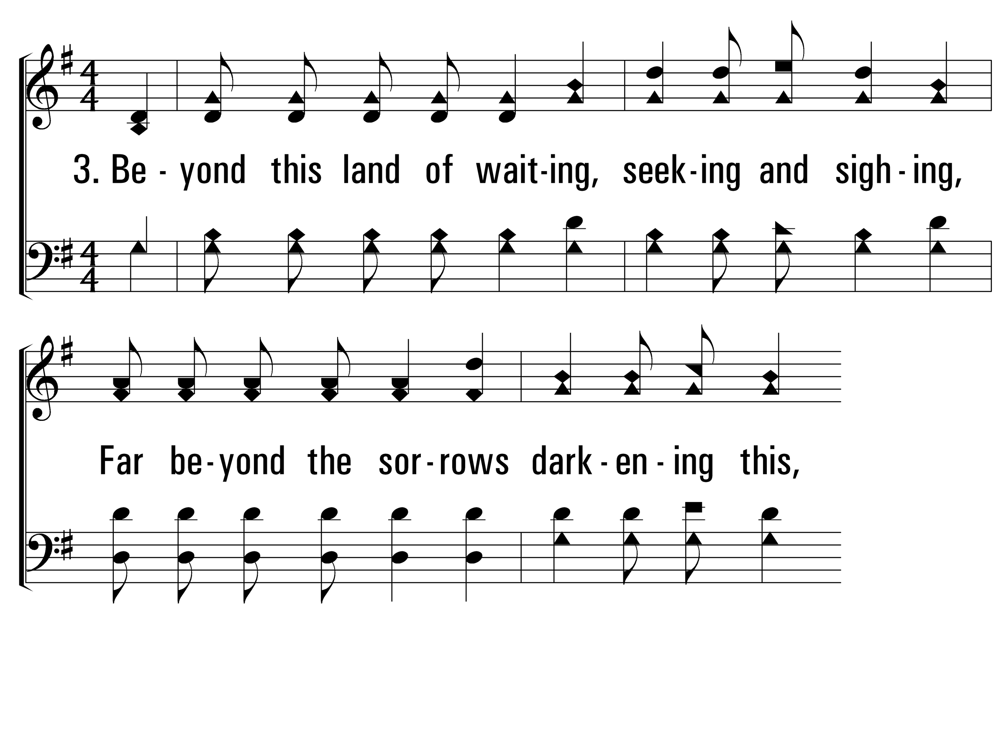
BeyondThisLandOfParting_st3_a
Vs 3
© 2014 Sumphonia Productions, LLC

Slide 21
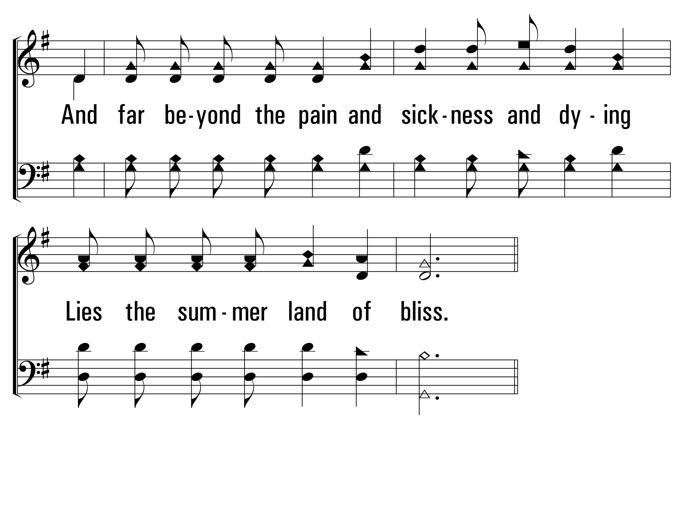
BeyondThisLandOfParting_st3_b
Vs 3
© 2014 Sumphonia Productions, LLC

Slide 22
BeyondThisLandOfParting_cho_a
Chorus
© 2014 Sumphonia Productions, LLC

Slide 23
BeyondThisLandOfParting_cho_b
Chorus
© 2014 Sumphonia Productions, LLC
End

Slide 25
The Breaking of Bread
357
_
_
_
Hymn: Ellis J. Crum (1956)
Tune: BREAD OF LIFE • William F. Sherwin (1877)
Words © 1956 Ellis J. Crum (admin. by Sacred Selections)

Slide 26
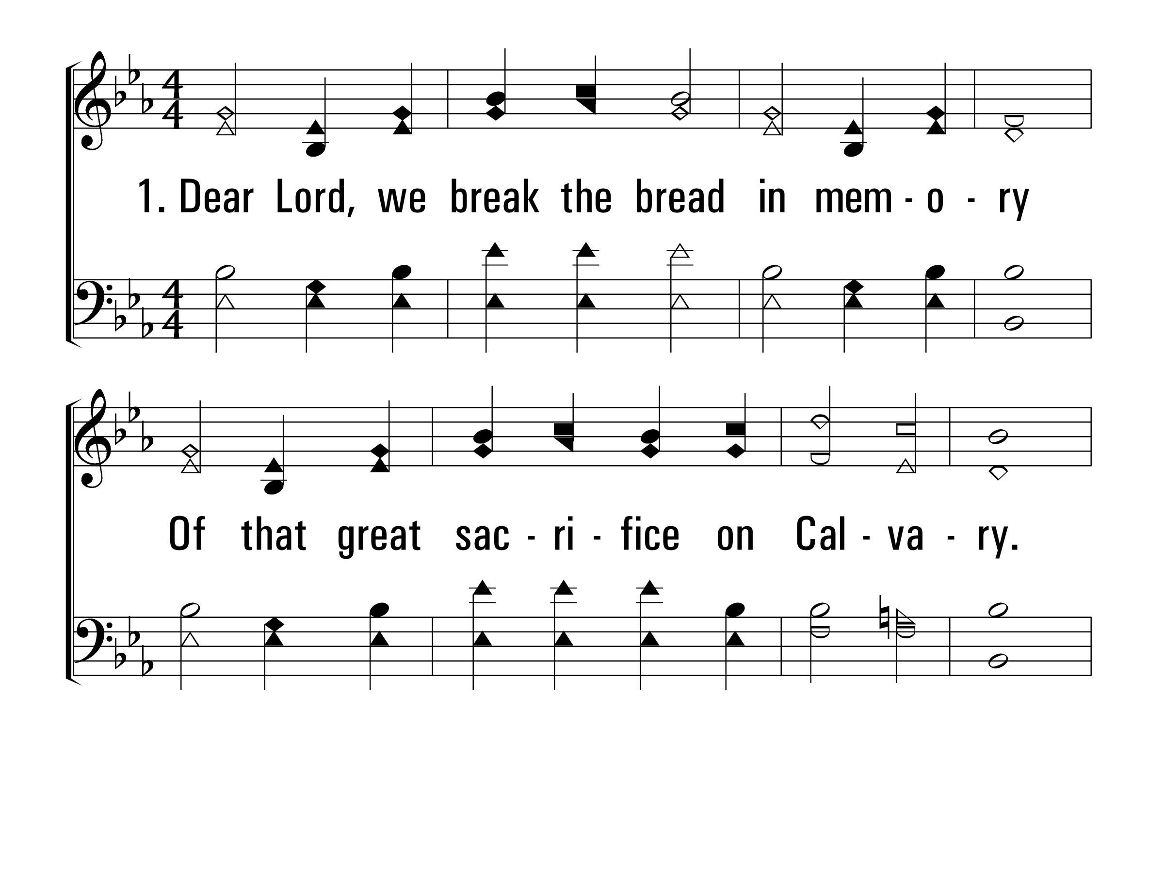
TheBreakingOfBread_st1_a
Vs 1
© 2014 Sumphonia Productions, LLC

Slide 27
TheBreakingOfBread_st1_b
Vs 1
© 2014 Sumphonia Productions, LLC

Slide 28
TheBreakingOfBread_st2_a
Vs 2
© 2014 Sumphonia Productions, LLC

Slide 29
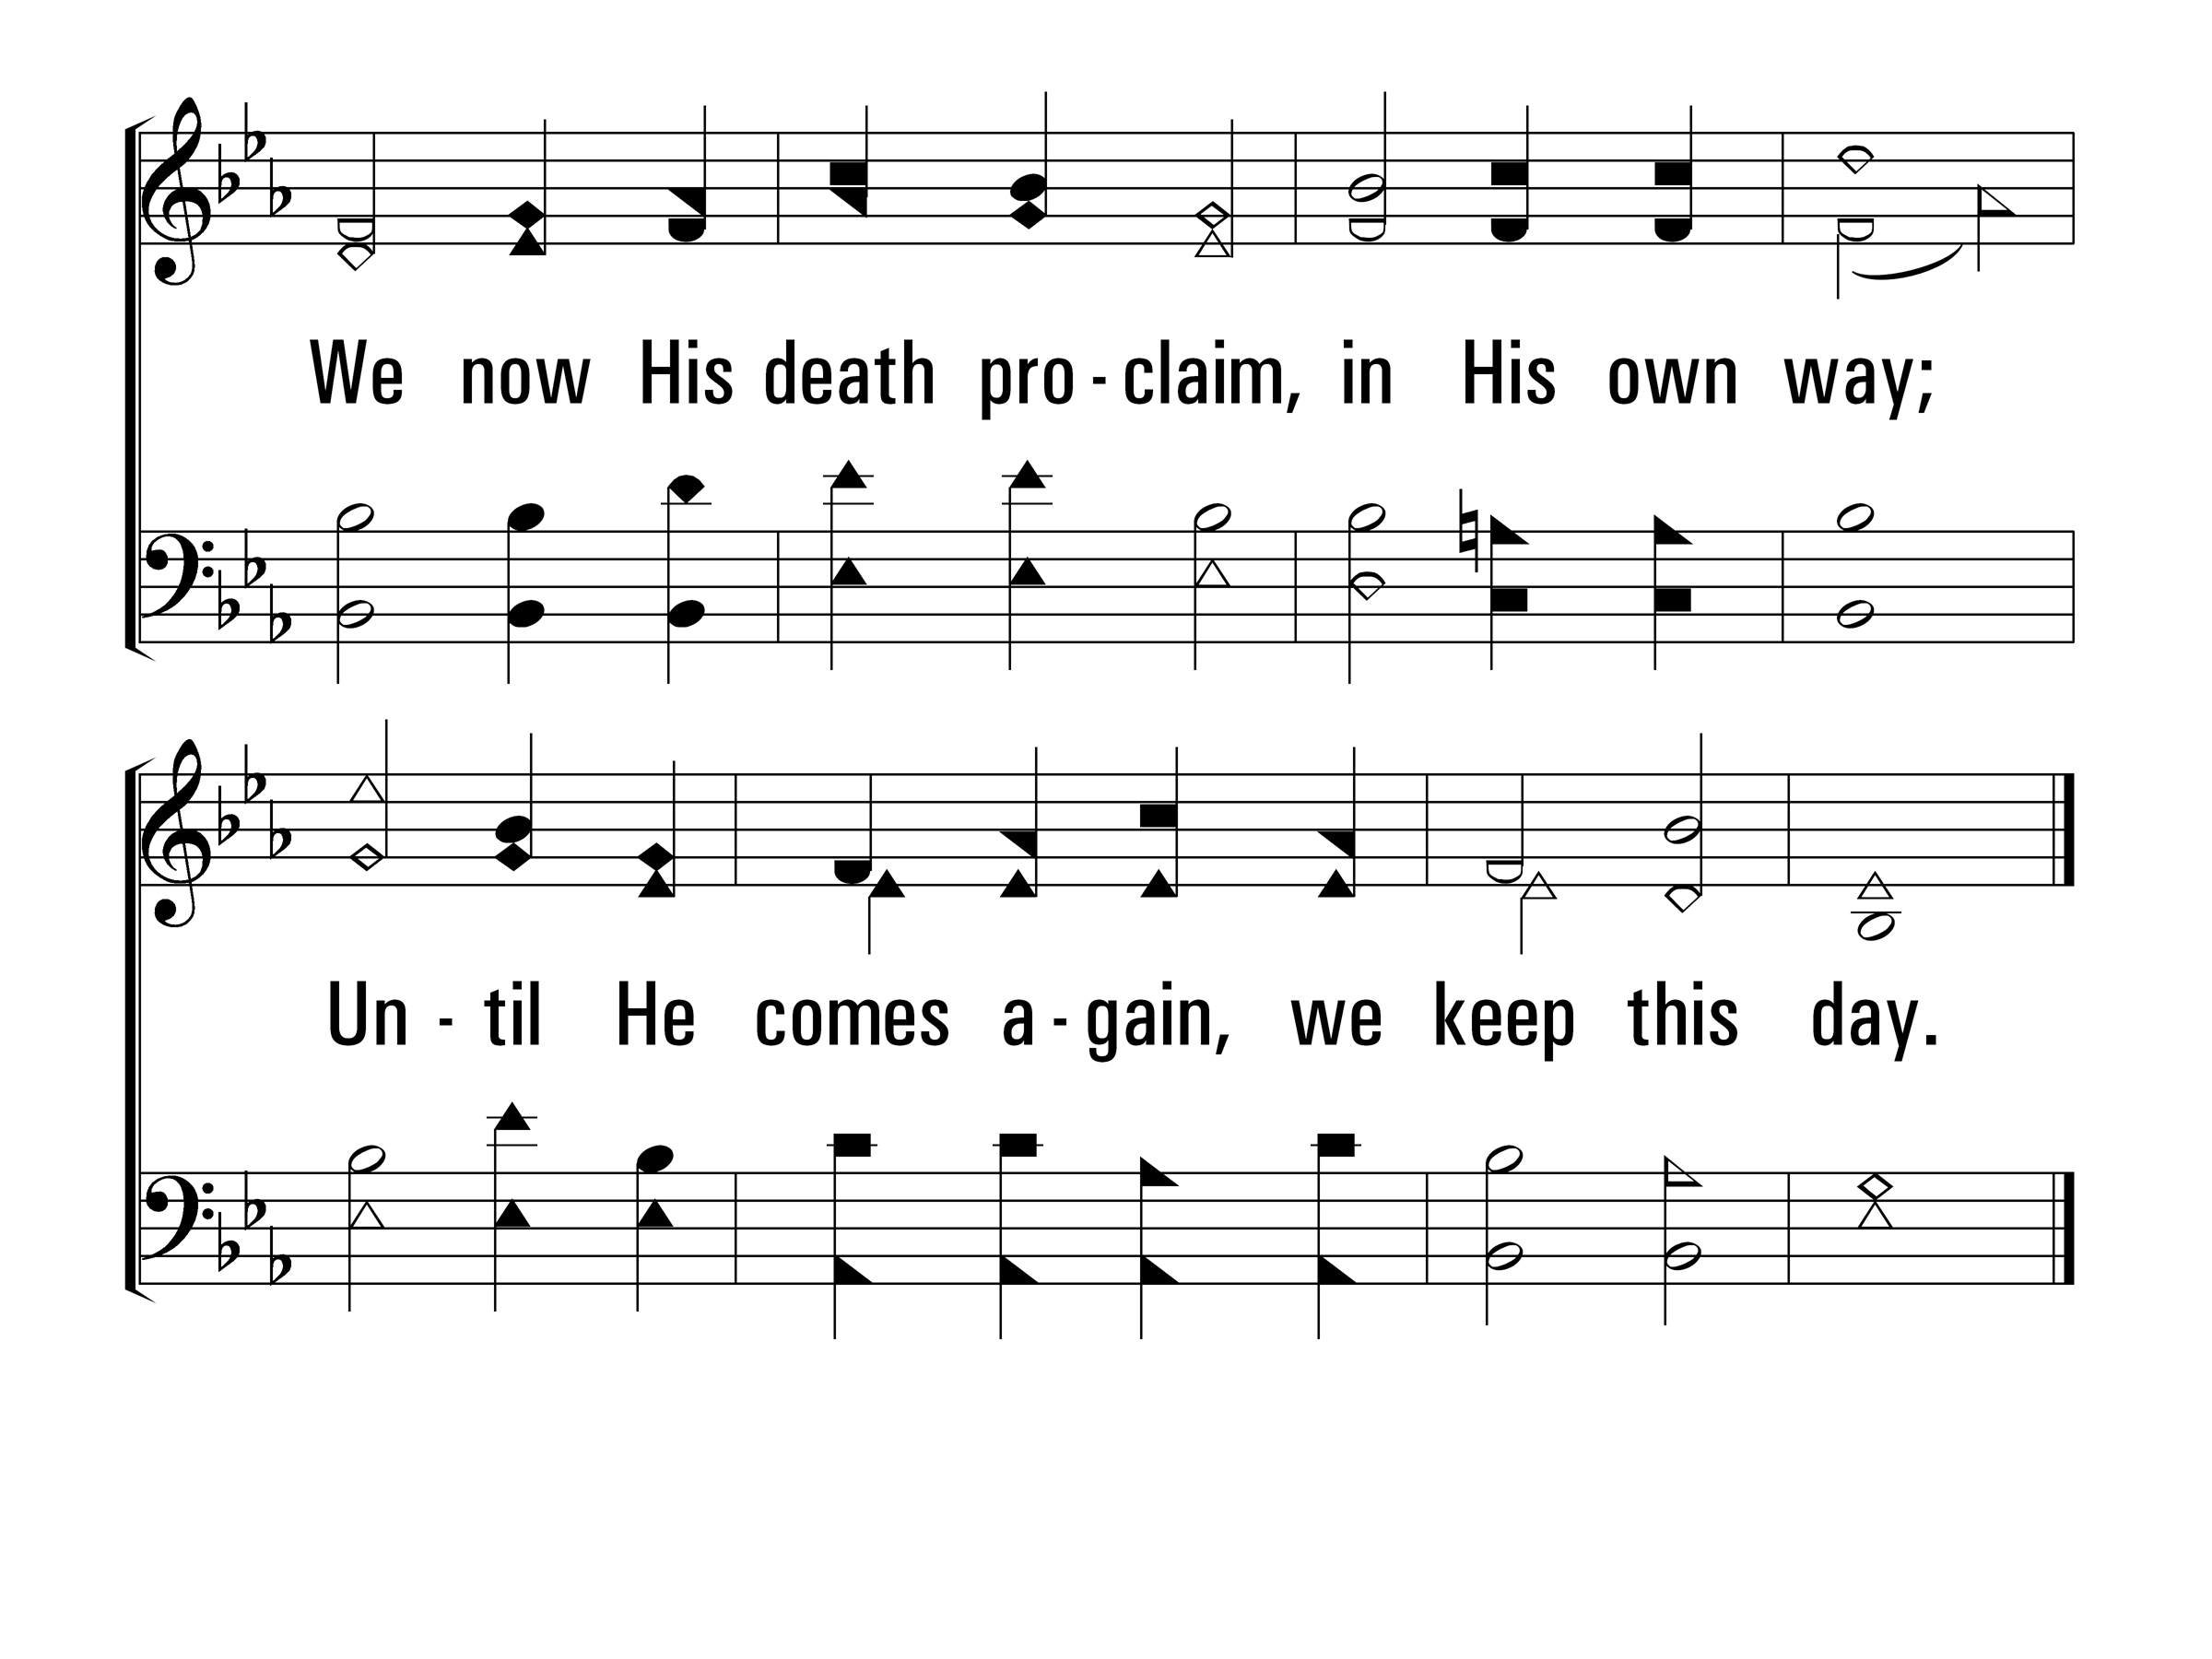
TheBreakingOfBread_st2_b
Vs 2
© 2014 Sumphonia Productions, LLC
End

Slide 31
Scripture Reading: Psalm 46:1-3
¹ God is our refuge and strength, A very ready help in trouble. ² Therefore we will not fear, though the earth shakes And the mountains slip into the heart of the sea; ³ Though its waters roar and foam, Though the mountains quake at its swelling pride.

Slide 32
Sowing the Seed of the Kingdom
783
_
_
_
_
Hymn: Fred A. Fillmore (1903)
Tune: Fred A. Fillmore (1903)

Slide 33
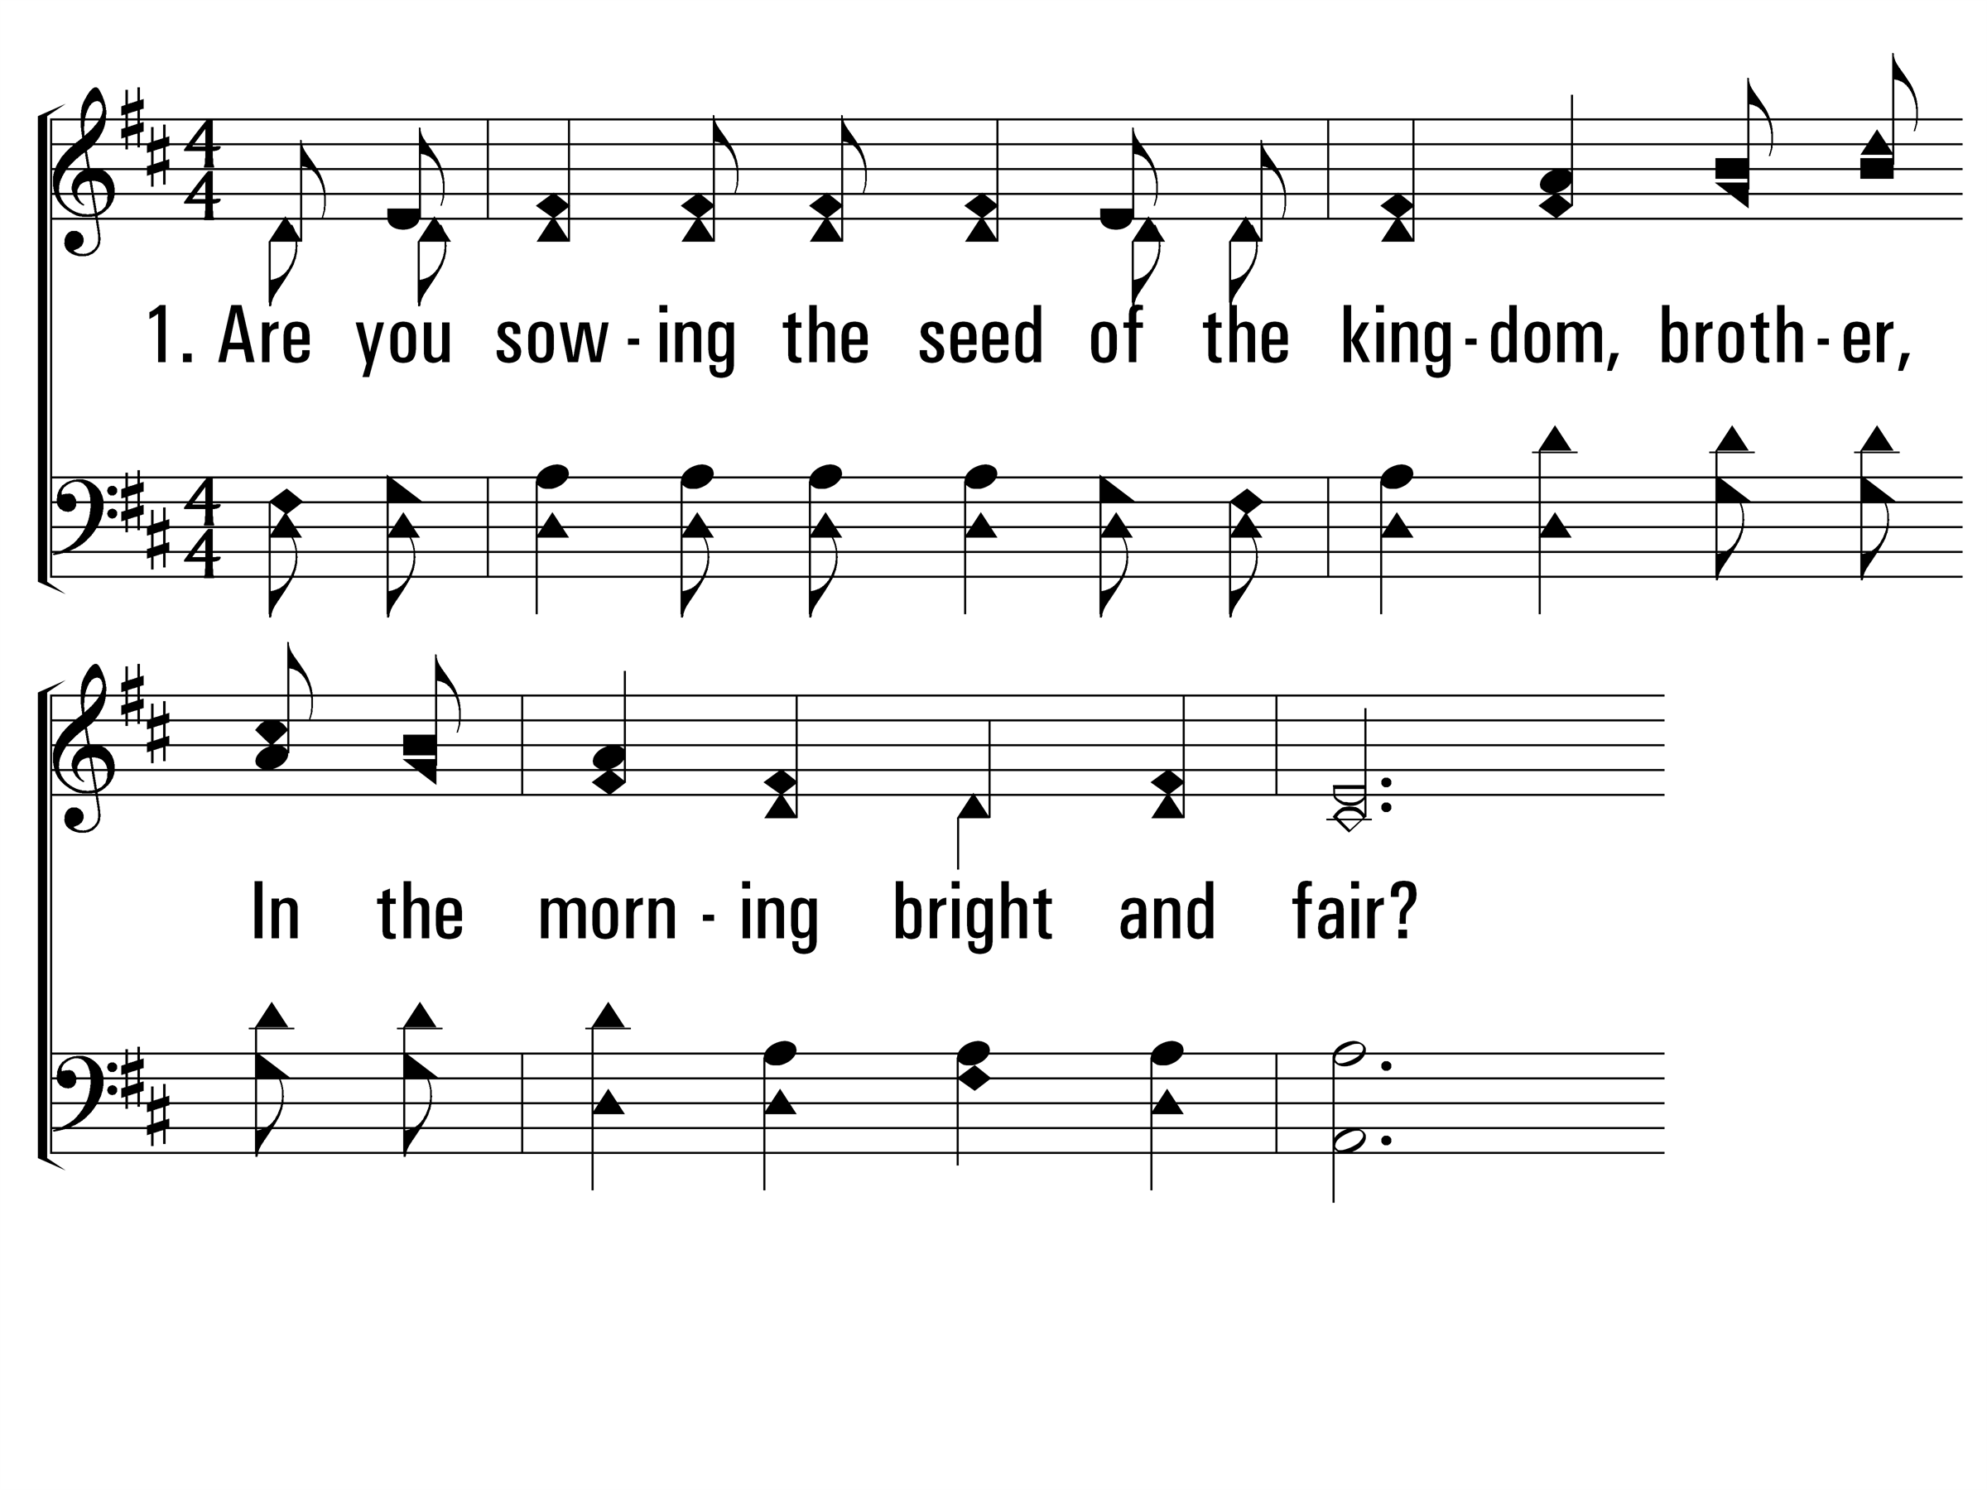
SowingTheSeedOfTheKingdom_st1_a
Vs 1
© 2014 Sumphonia Productions, LLC

Slide 34
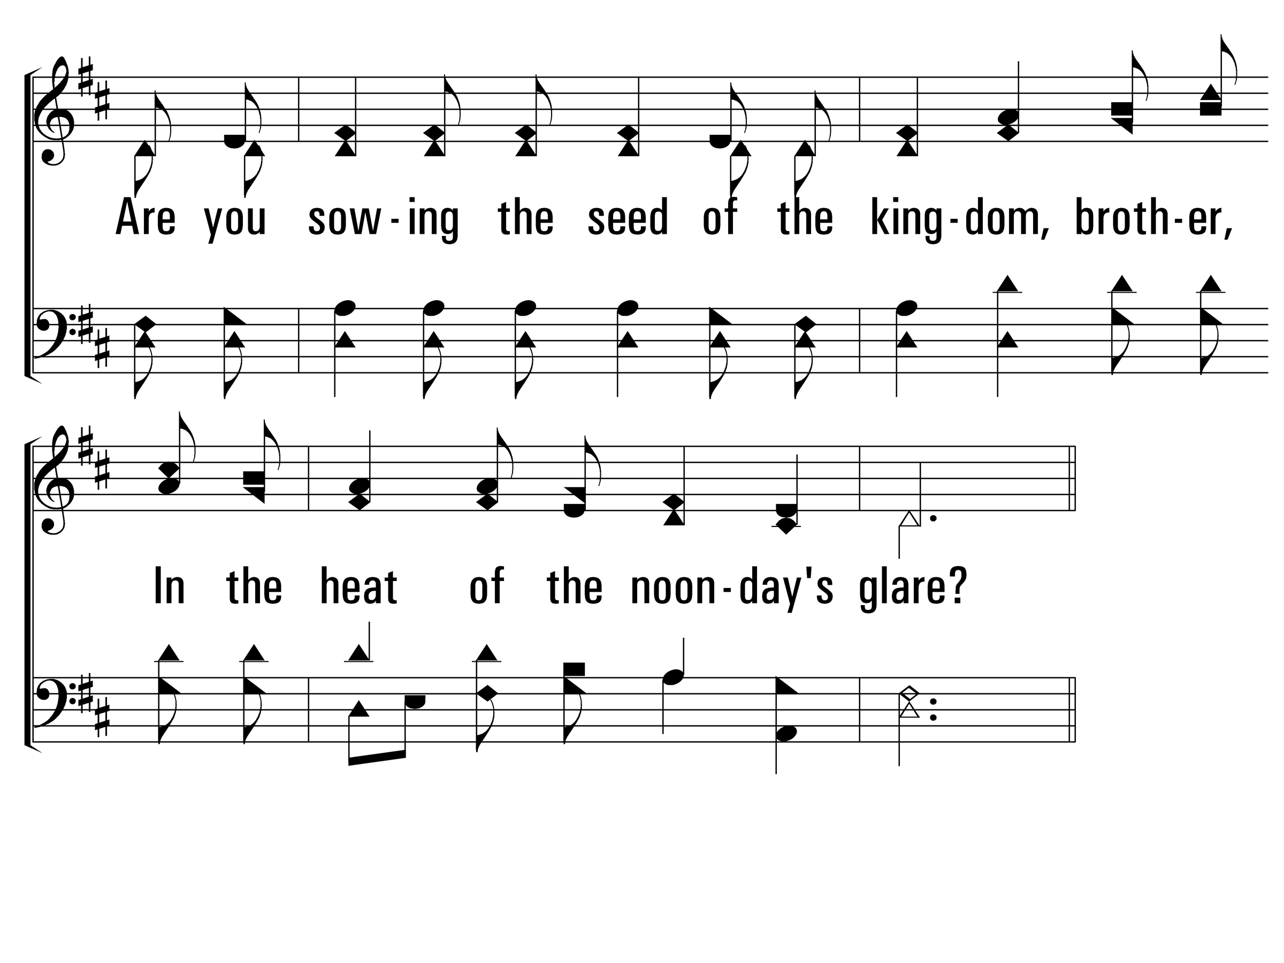
SowingTheSeedOfTheKingdom_st1_b
Vs 1
© 2014 Sumphonia Productions, LLC

Slide 35
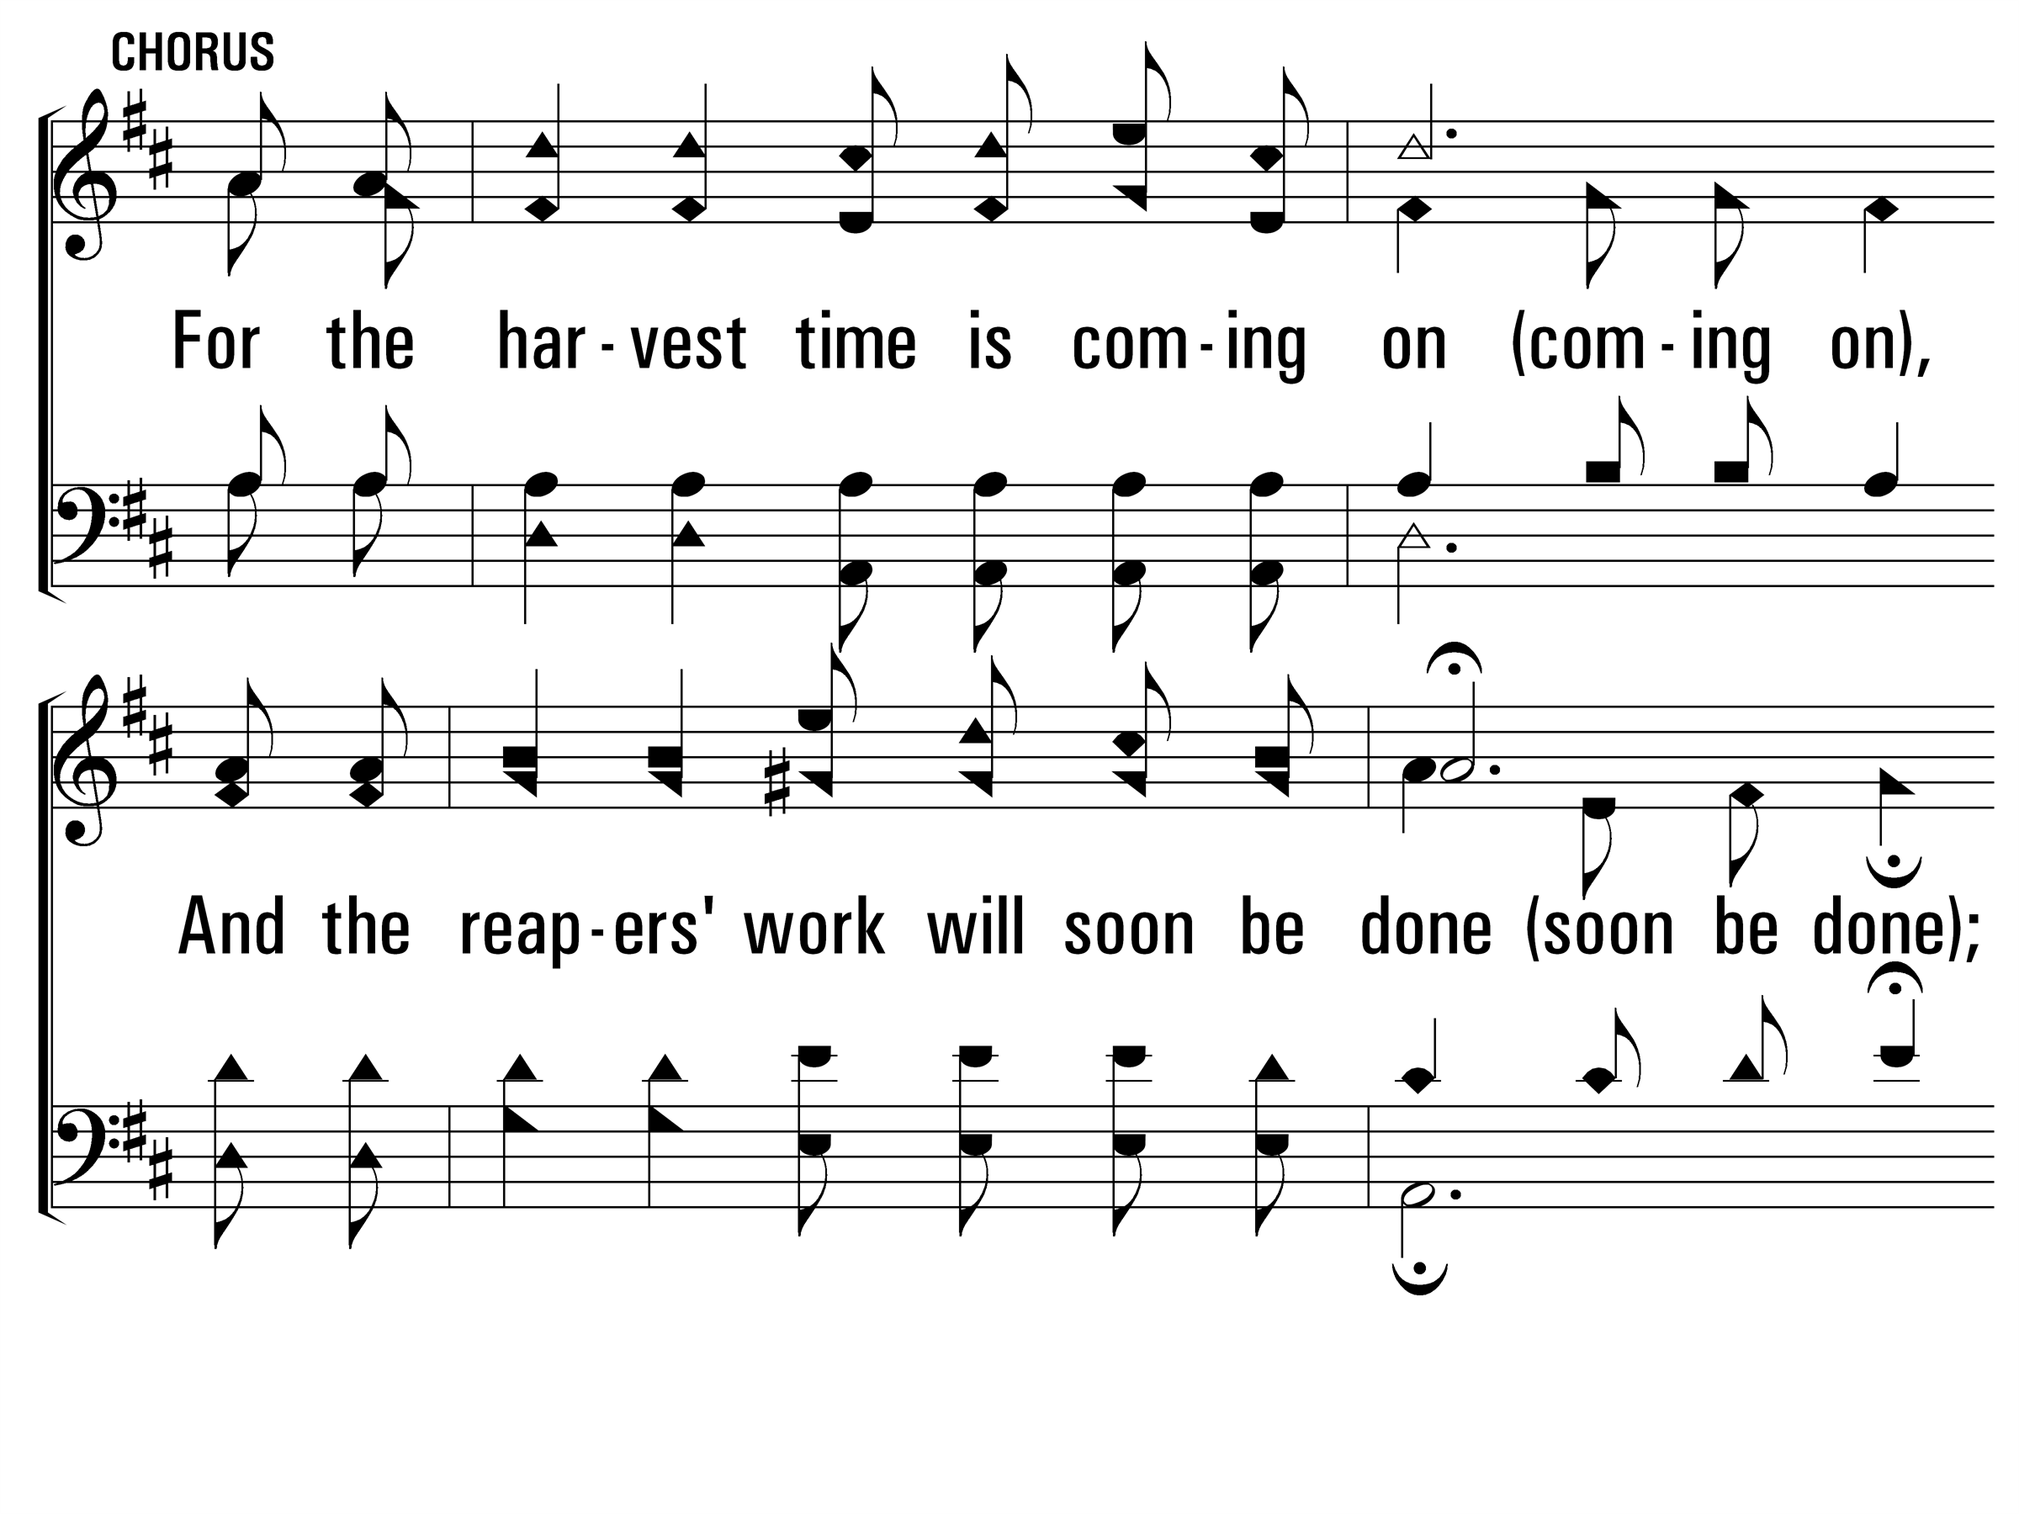
SowingTheSeedOfTheKingdom_cho_a
Chorus
© 2014 Sumphonia Productions, LLC

Slide 36
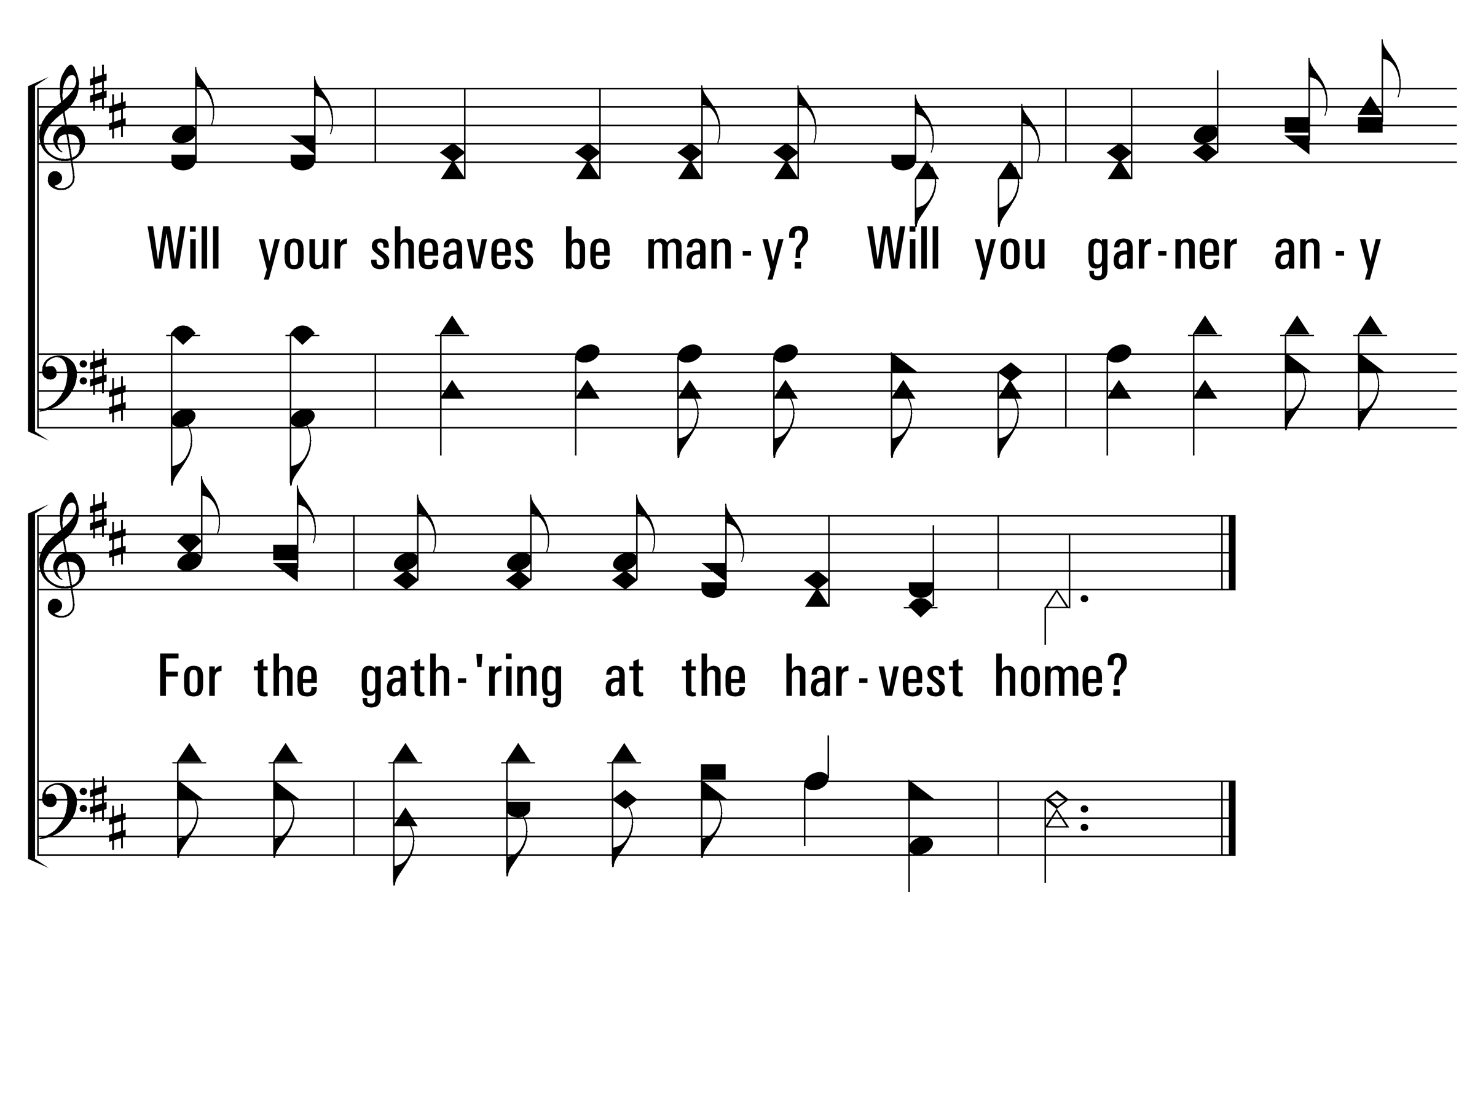
SowingTheSeedOfTheKingdom_cho_b
Chorus
© 2014 Sumphonia Productions, LLC

Slide 37
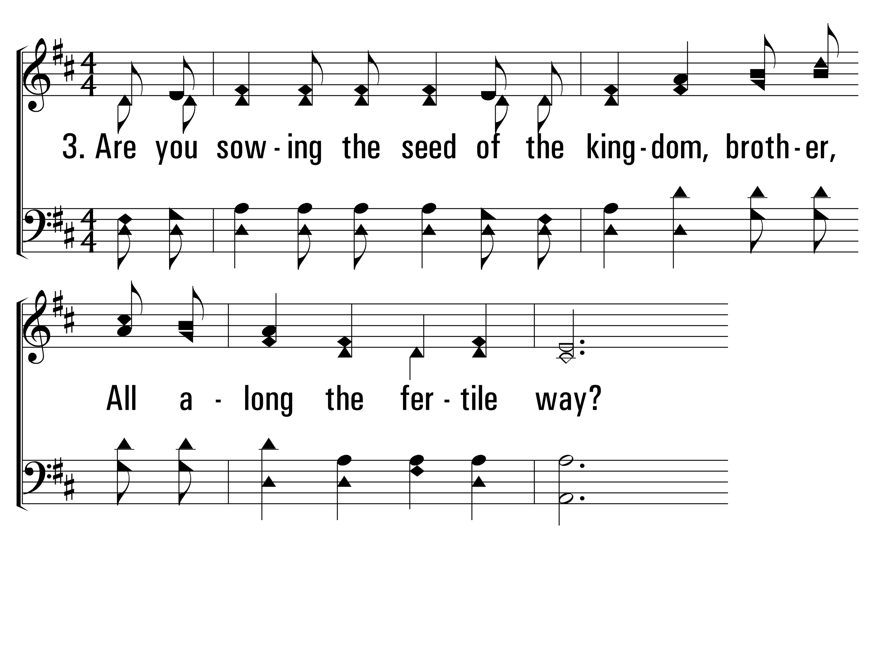
SowingTheSeedOfTheKingdom_st3_a
Vs 3
© 2014 Sumphonia Productions, LLC

Slide 38
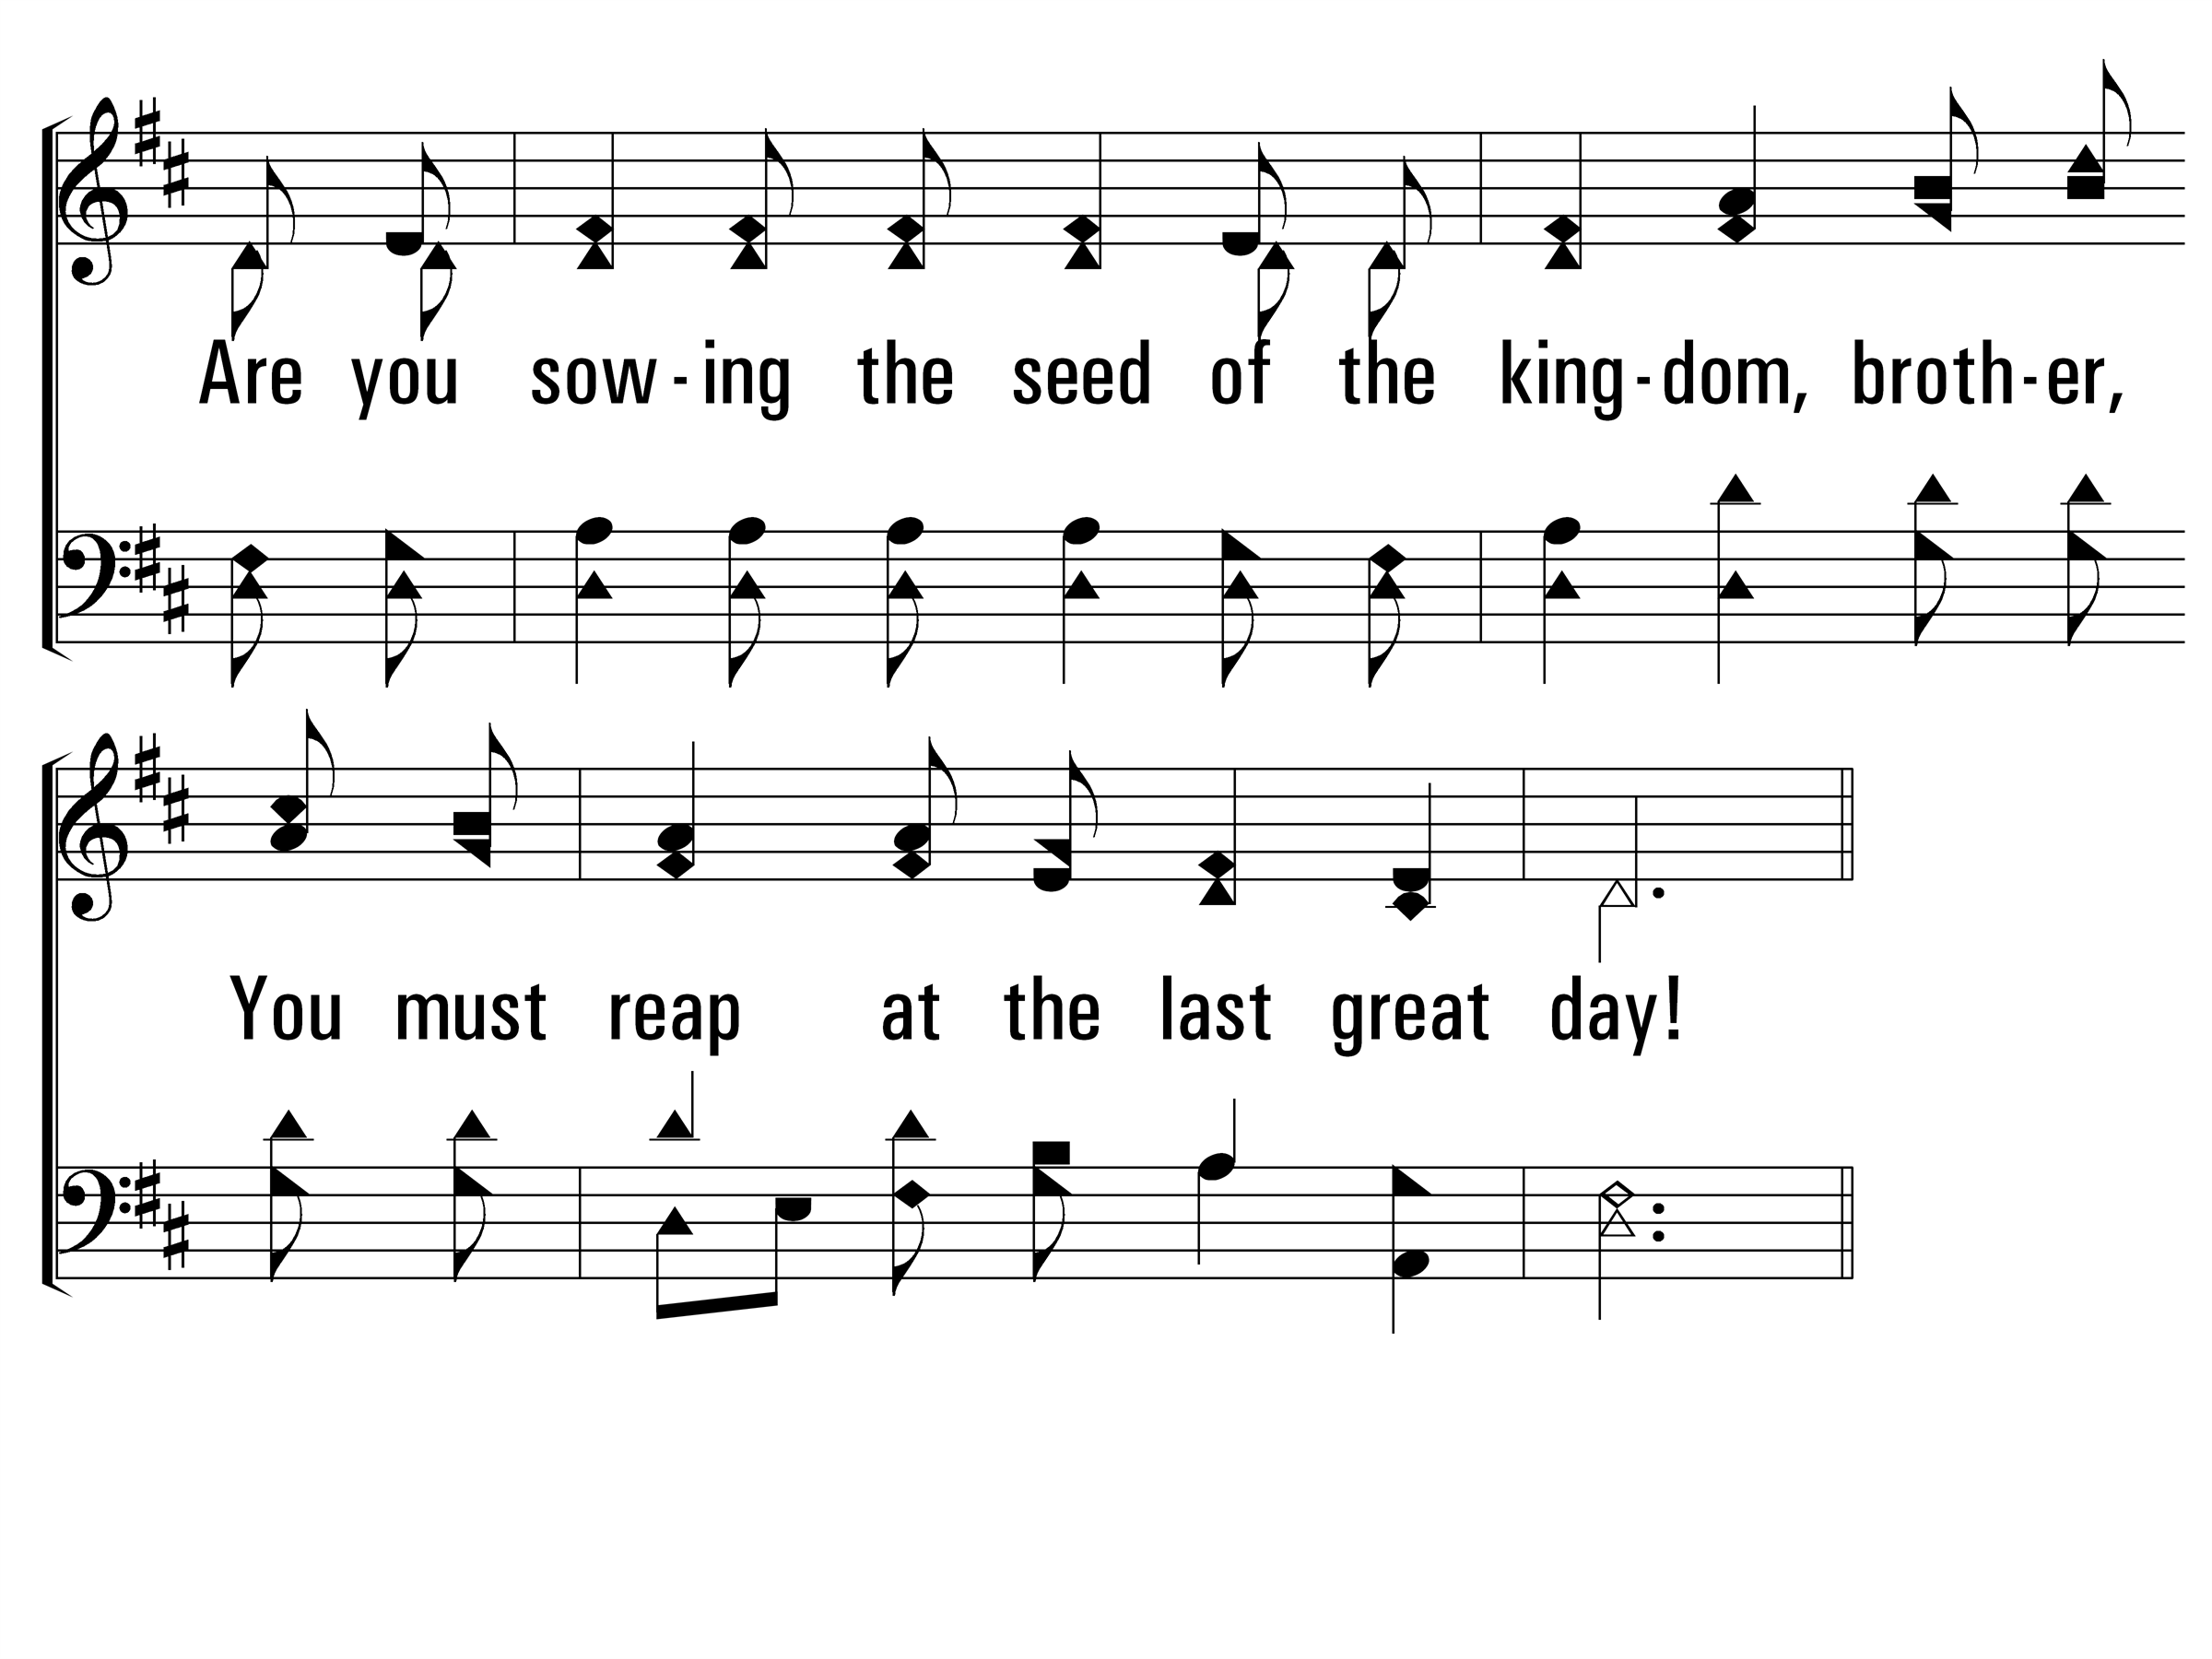
SowingTheSeedOfTheKingdom_st3_b
Vs 3
© 2014 Sumphonia Productions, LLC

Slide 39
SowingTheSeedOfTheKingdom_cho_a
Chorus
© 2014 Sumphonia Productions, LLC

Slide 40
SowingTheSeedOfTheKingdom_cho_b
Chorus
© 2014 Sumphonia Productions, LLC
End

Slide 55
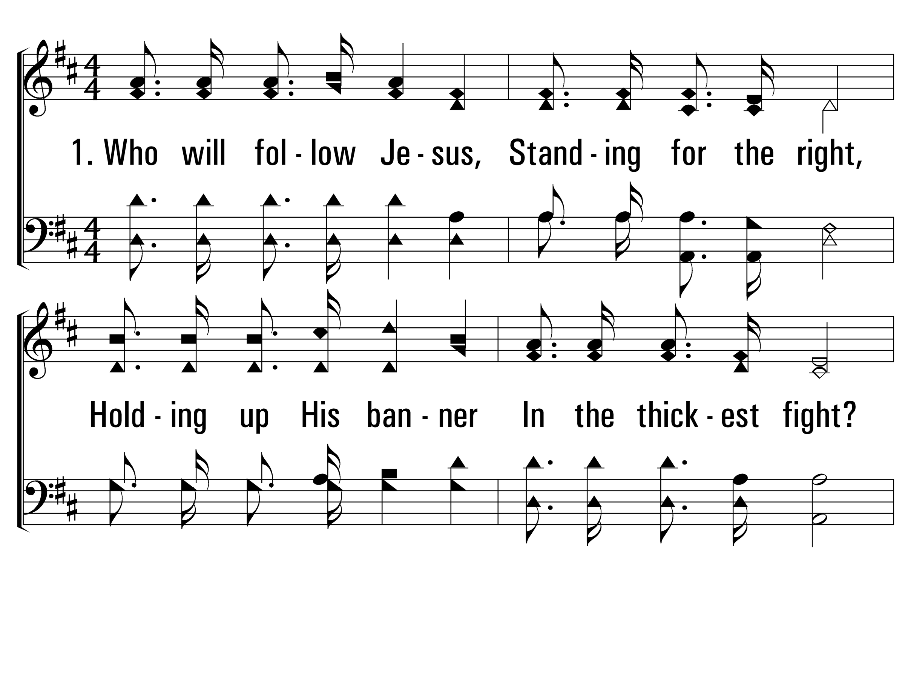
WhoWillFollowJesus_st1_a
Vs 1
© 2014 Sumphonia Productions, LLC

Slide 56
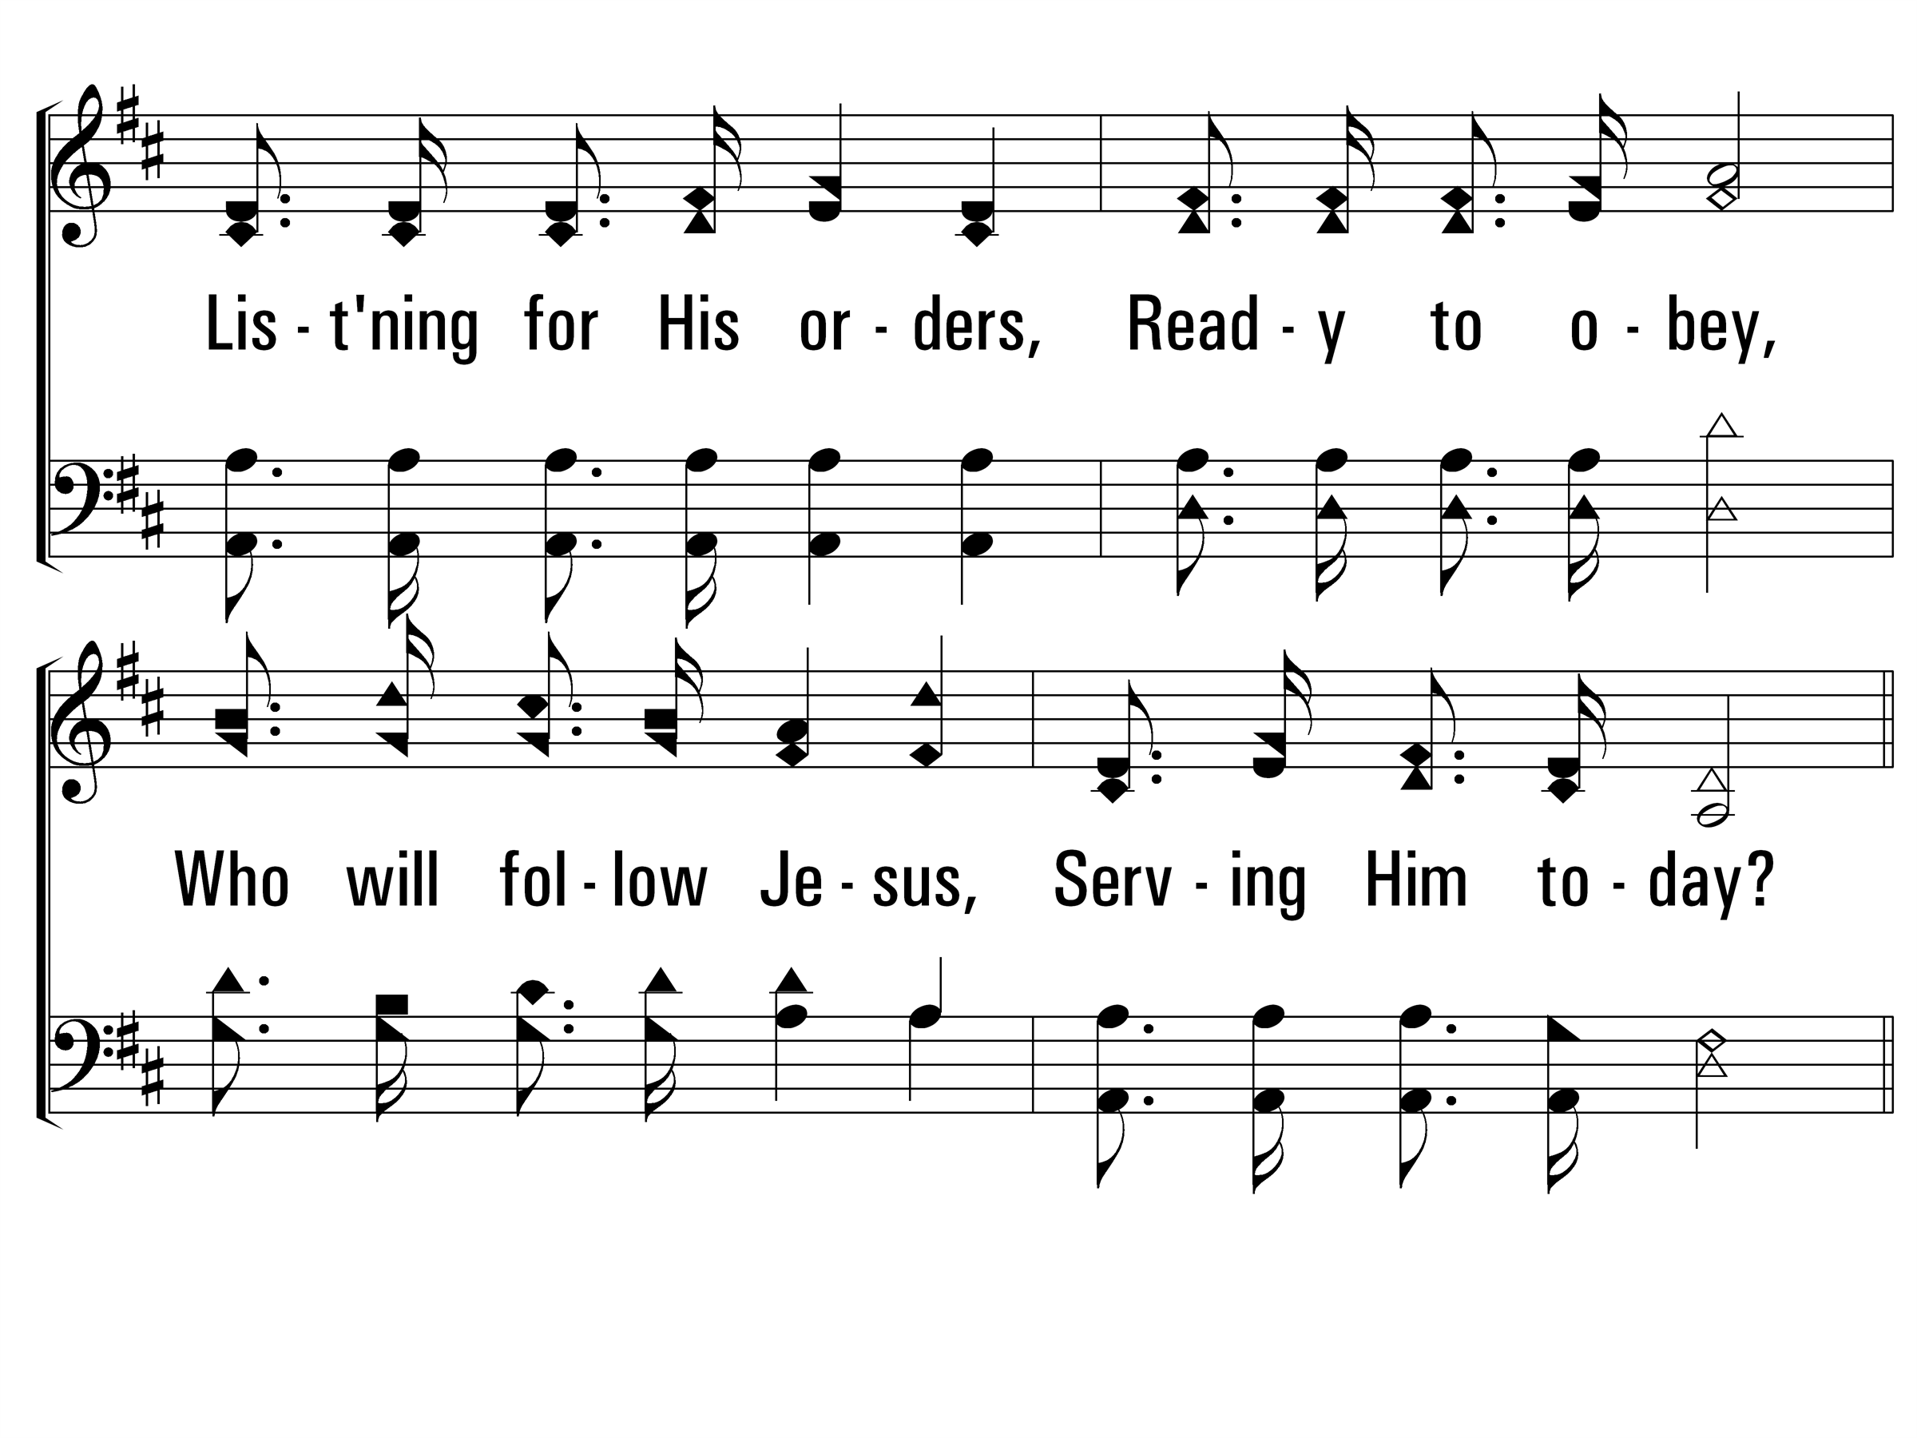
WhoWillFollowJesus_st1_b
Vs 1
© 2014 Sumphonia Productions, LLC

Slide 57
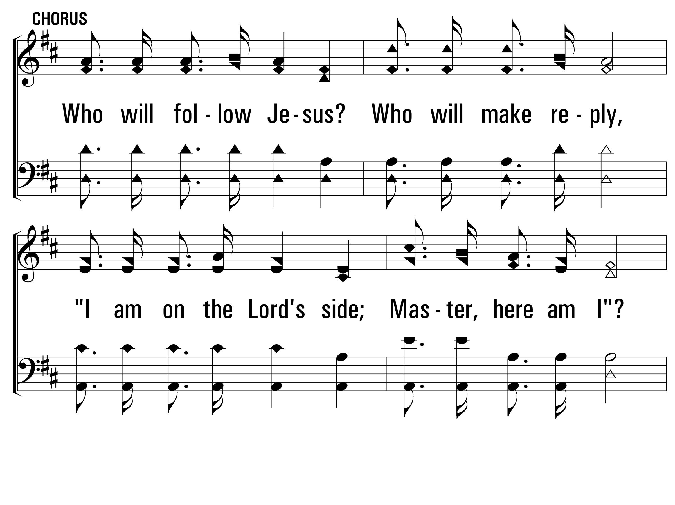
WhoWillFollowJesus_cho_a
Chorus
© 2014 Sumphonia Productions, LLC

Slide 58
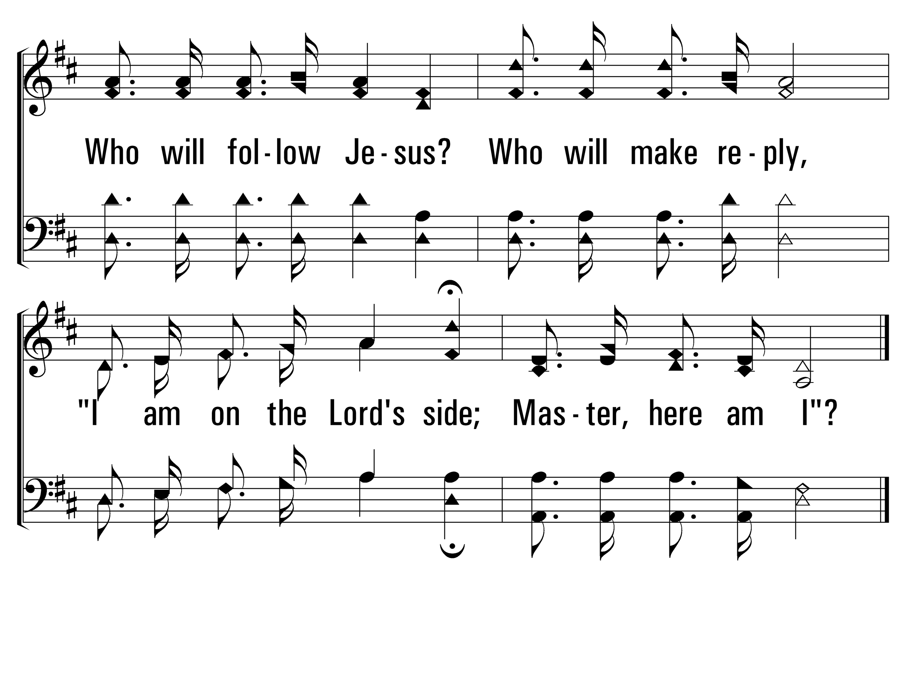
WhoWillFollowJesus_cho_b
Chorus
© 2014 Sumphonia Productions, LLC

Slide 59
WhoWillFollowJesus_st4_a
Vs 4
© 2014 Sumphonia Productions, LLC

Slide 60
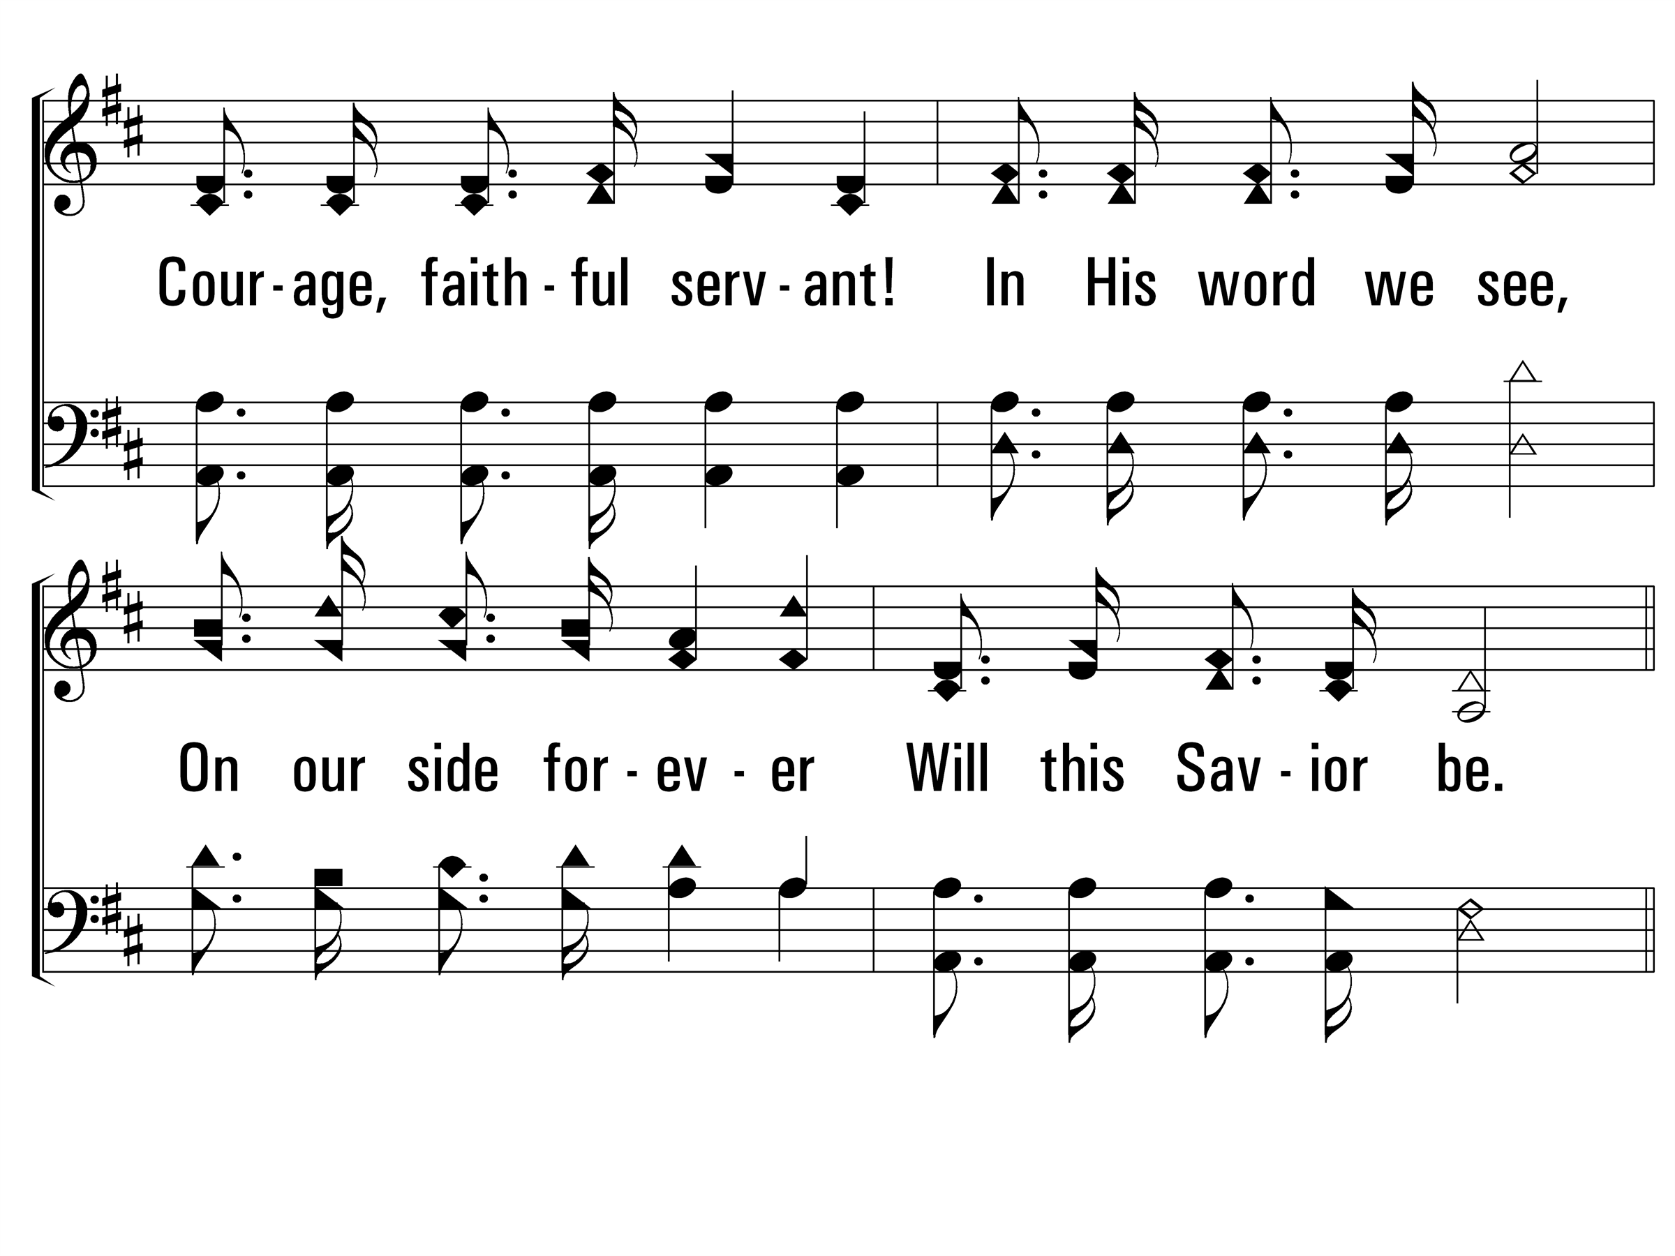
WhoWillFollowJesus_st4_b
Vs 4
© 2014 Sumphonia Productions, LLC

Slide 61
WhoWillFollowJesus_cho_a
Chorus
© 2014 Sumphonia Productions, LLC

Slide 62
WhoWillFollowJesus_cho_b
Chorus
© 2014 Sumphonia Productions, LLC
End

