Slide 1
TODAY’S READING: Daniel 1:1-4

Slide 2
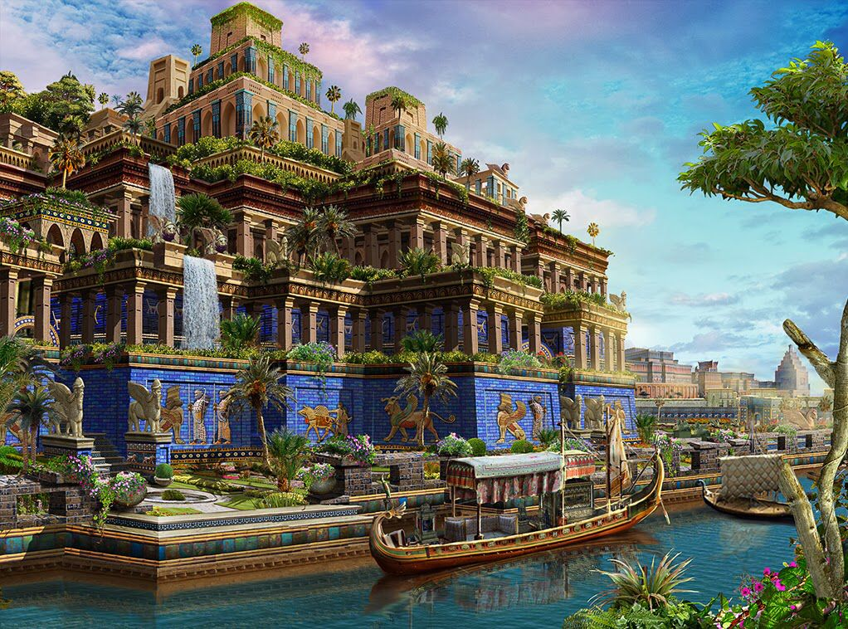
One of the oldest cities on record.
Founded on the Euphrates River.
A beautiful and Prosperous city.
Hanging Gardens was one of the Seven Wonders of the ancient world.

Slide 3
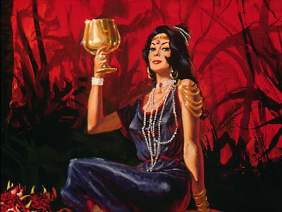
And I heard another voice from heaven saying, come out of her, my people, lest you share in her sins, and lest you receive of her plagues. For her sins have reached to heaven, and God has remembered her iniquities, (Revelation 18:4-5).

Slide 4
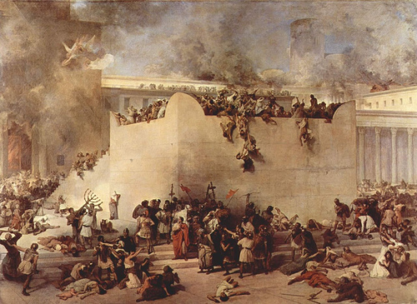
How Daniel came to be in Babylon
605 B.C. Nebuchadnezzar becomes king of Babylon.
605 The Babylonians invade Judah (First deportation of captives, Daniel, Hananiah, Mishael, Azariah).
597 Babylonians invade Jerusalem (Second deportation, Ezekiel).
593 Ezekiel begins to prophesy while in captivity.
586 The Babylonians destroy Jerusalem and the Temple marking the end of Judah.

Slide 5
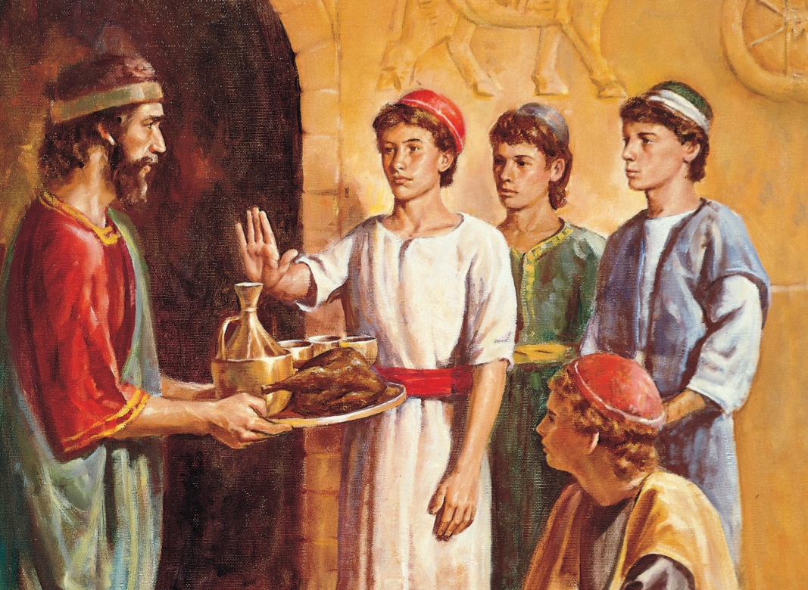
Teach the language and literature of the Chaldeans (vs 4).
Tried to feed them food the Babylonians ate (food fit for a king) (vs 5).
Gave them Babylonian names (vs 7).
But Daniel purposed in his heart that he would not defile himself with the portion of the king’s delicacies, nor with the wine which he drank . . .
Daniel 1:8

Slide 6
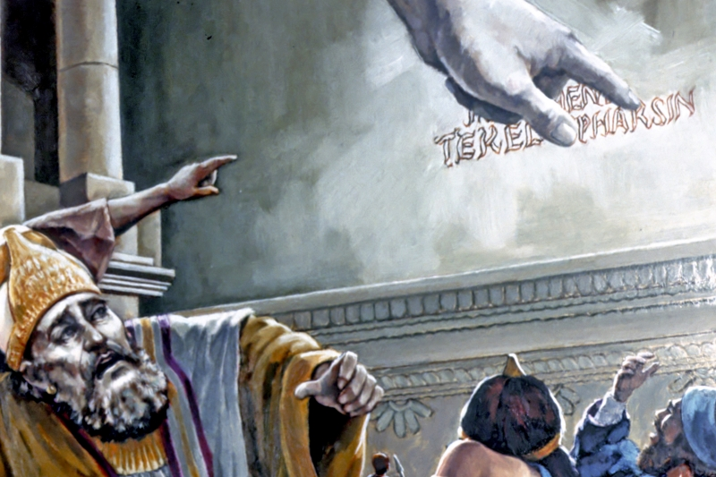
A drunken, blasphemous orgy (vss 2-4).
Handwriting on the wall (vss 5-6).
MENE, MENE, TEKEL, UPHARSIN (vs 25).
Wise men could not interpret (vss 7-8).
There is a man in your kingdom in whom is the Spirit of the Holy God . . .
Daniel 1:8

Slide 7
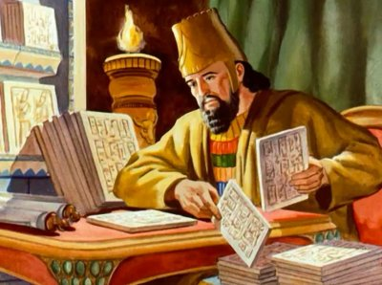
Daniel given authority in the new government Persia (vss 1-2).
Jealousy led to hatred and a plot (vss 4-5).
A royal statute and firm decree—no prayer to any god but
Darius (vs 7).
Now when Daniel knew that the writing was signed . . . he knelt down on his knees three times that day, and prayed . . . as was his custom since early days.
Daniel 1:8

