Slide 1
Today’s Scripture Reading: Hebrews 12:12-17

Slide 2
. . . regret is just a memory written on my brow, and there's nothing I can do about it now.
And I could cry for the time I've wasted but that's a waste of time and tears, and I know just what I'd change if I went back in time somehow but there's nothing I can do about it now.

Slide 3
How did Esau administer his firstborn birthright?
How many years did Moses live in the Promised Land?
When King David died, how old was his firstborn son with Bathsheba?

Slide 4
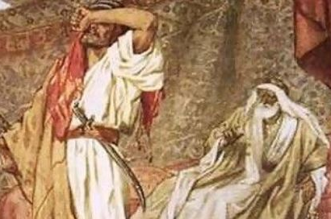
How did Esau administer his firstborn birthright?
NOTHING HE COULD DO ABOUT IT
. . . lest there be any fornicator or profane person like Esau, who for one morsel of food sold his birthright. For you know that afterward, when he wanted to inherit the blessing, he was rejected, for he found no place for repentance, though he sought it diligently with tears.
(Hebrews 12:16-17).

Slide 5
How many years did Moses live in the Promised Land?
NOTHING HE COULD DO ABOUT IT
Because you did not believe Me, to hallow Me in the eyes of the children of Israel, therefore you shall not bring this assembly into the land which I have given them, (Num 20:12).
. . . this is the land . . . I will give it to your descendants. I have caused you to see it with your eyes, but you shall not cross over there, (Deut 34:4).

Slide 6
When King David died, how old was his firstborn son with Bathsheba?
NOTHING HE COULD DO ABOUT IT
Now therefore, the sword shall never depart from your house, because you have despised Me . . ., (2 Sam 12:10).
However, because by this deed you have given great occasion to the enemies of the Lord to blaspheme, the child also who is born to you shall surely die, (2 Sam 12:14)

Slide 7
REMORSE IS A HEAVY BURDEN TO BEAR
Peter: (Lk 22:54-60)
Samson: (Judges 16:21)
David: (Psa 51:3)
NOTHING THEY COULD DO ABOUT IT
Roberta: I´d choose to undo the moment I hung up the phone mad at my mom and decided not to talk to her for a long time, and stopped taking calls that showed her number. Two weeks later she passed away and I didn´t get the chance to say good bye due to my stupid pride.
Morgan: My regret is refusing to save my marriage. I walked away from my first love and never found the happiness I looked for.
Amber: I would say it’s not answering my dad’s calls. He was just lonely and wanted to talk—but I was too busy.

Slide 8
Adultery: (Prov 6:27-28; Matt 19:9)
Viewing Pornography: (Matt 5:28; Job 31:1)
Anger: (Num 20:12; Prov 16:32)
Workaholic: (Eccl 2:18-23; Lk 12:20)
NONE OF THESE CAN BE UNDONE
Neglecting Spiritual Training: (Prov 22:6; 2 Tim 3:15)
Sending inappropriate pictures: (Prov 13:16)
Having an Abortion: (Jer 1:5; Psa 127:3; Psa 106:37-38)
One Night Stand / fornication: (1 Cor 6:18-20)

Slide 9
Seek the Lord’s Forgiveness NOW: (1 Jn 1:9)
Leave the past behind you and Press on to the goal before you: (Phil 3:14)
Make Better Choices: (Eccl 12:1; Josh 24:15)
Don’t Blame God for the Consequences you experience: (Gal 6:7-8; Hos 8:7; Lk 16:25)

