Slide 1
Today’s Scripture Reading: John 14:25-31

Slide 2
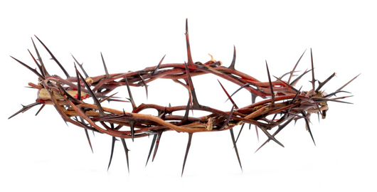
But that the world may know that I love the Father, and as the Father gave Me commandment, so I do. Arise, let us go from here.
John 14:31

Slide 3
Complacency
Stagnation
Worldly Consumption
Evangelists
Elders
Deacons
Christians
Evangelism
Bible Classes
Personal Work
Gospel Meetings
Parents

Slide 4
God didn’t call us to be idlers / sitters / standers
He called us to action!
“Arise, take the young child . . ., flee to Egypt” (Matt 2:13)
“Arise and go toward the south . . . to Gaza” (Acts 8:26)
“Arise and be baptized, and wash away your sins” (Acts 22:16)
“Arise, let us go from here” (John 14:31)

