Slide 1
Scripture Reading: Hebrews 1:2-3

Slide 4
(Luke 2:8-9)
In the same region there were some shepherds staying out in the fields and keeping watch over their flock by night. And an angel of the Lord suddenly stood before them, and the glory of the Lord shone around them; and they were terribly frightened.

Slide 5
(Psalm 19:1)
The heavens are telling of the glory of God;
And their expanse is declaring the work of His hands.

Slide 6
(1 Corinthians 10:31)
Whether, then, you eat or drink or whatever you do, do all to the glory of God.

Slide 7
(Romans 3:23)
or all have sinned and fall short of the glory of God

Slide 8
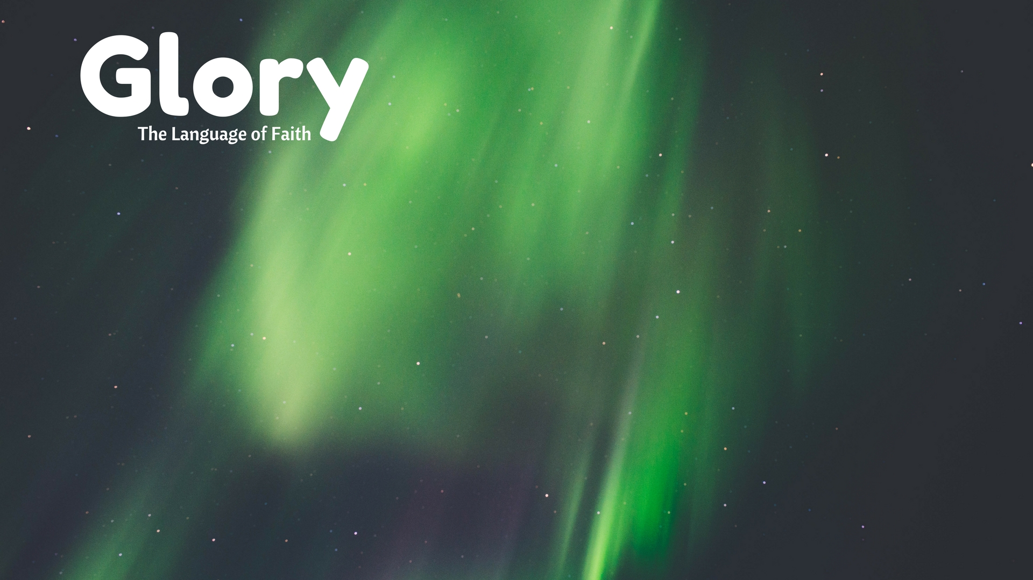
“glory” = Hebrew kavod
Literal Meaning: heaviness, weight
(1 Samuel 4:18)
When he mentioned the ark of God, Eli fell off the seat backward beside the gate, and his neck was broken and he died, for he was old and kavod. Thus he judged Israel forty years.

Slide 9
“glory” = Hebrew kavod
Literal Meaning: heaviness, weight
Metaphoric Meaning: importance, reputation, honor
(Psalm 7:5)
Let the enemy pursue my soul and overtake it;
And let him trample my life down to the ground
And lay my kavod in the dust.

Slide 10
“glory” = Hebrew kavod
Literal Meaning: heaviness, weight
Metaphoric Meaning: importance, reputation, honor
Physical Manifestation of importance
A person’s kavod: wealth & possessions

Slide 11
(2 Chronicles 32:27-28)
Now Hezekiah had immense riches and kavod; and he made for himself treasuries for silver, gold, precious stones, spices, shields and all kinds of valuable articles, storehouses also for the produce of grain, wine and oil, pens for all kinds of cattle and sheepfolds for the flocks.

Slide 12
“glory” = Hebrew kavod
Literal Meaning: heaviness, weight
Metaphoric Meaning: importance, reputation, honor
Physical Manifestation of importance
A person’s kavod: wealth & possessions
God’s kavod: creation & humans

Slide 13
(Psalm 19:1)
The heavens are telling of the glory of God;
And their expanse is declaring the work of His hands.

Slide 14
(Psalm 8:3-8)
When I consider Your heavens, the work of Your fingers,
The moon and the stars, which You have ordained;
What is man that You take thought of him,
And the son of man that You care for him?
Yet You have made him a little lower than God,
And You crown him with honor and majesty!
You make him to rule over the works of Your hands;
You have put all things under his feet,
All sheep and oxen,
And also the beasts of the field,
The birds of the heavens and the fish of the sea,
Whatever passes through the paths of the seas.

Slide 15
(Genesis 1:26-27)
Then God said, “Let Us make man in Our image, according to Our likeness; and let them rule over the fish of the sea and over the birds of the sky and over the cattle and over all the earth, and over every creeping thing that creeps on the earth.” God created man in His own image, in the image of God He created him; male and female He created them.

Slide 16
“glory” = Hebrew kavod
Literal Meaning: heaviness, weight
Metaphoric Meaning: importance, reputation, honor
Physical Manifestation of importance
A person’s kavod: wealth & possessions
God’s kavod: creation & humans
Sin: vandalization of God’s image

Slide 17
(Romans 3:23)
or all have sinned and fall short of the glory of God

Slide 18
“glory” = Hebrew kavod
Literal Meaning: heaviness, weight
Metaphoric Meaning: importance, reputation, honor
Physical Manifestation of importance
A person’s kavod: wealth & possessions
God’s kavod: creation & humans
Sin: vandalization of God’s image
Jesus: perfect reflection of God’s image

Slide 19
(2 Cor. 4:4b; cf. Heb. 1:3; Phil. 2:6; Col. 1:15)
…the light of the gospel of the glory of Christ, who is the image of God.
(2 Corinthians 3:18)
But we all, with unveiled face, beholding as in a mirror the glory of the Lord, are being transformed into the same image from glory to glory, just as from the Lord, the Spirit.

