Slide 1
Scripture Reading:
Deuteronomy 6:16-25

Slide 3
TEMPTATION

Slide 4
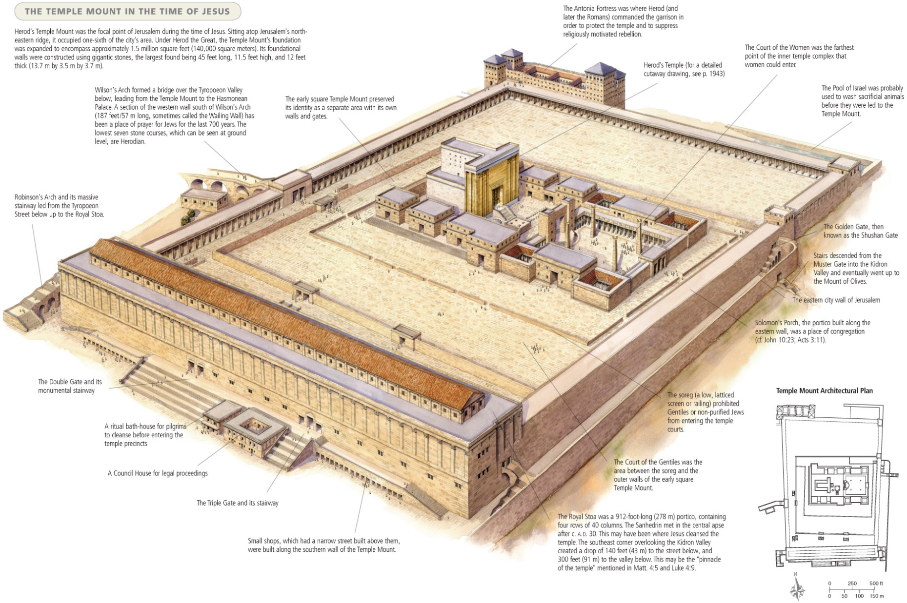

Slide 5
TEMPTATION
The temple setting (v.5)
1

Slide 6
TEMPTATION
By the sweat of your face
You will eat bread,
Till you return to the ground,
Because from it you were taken;
For you are dust,
And to dust you shall return.
(Gen. 3:19)

Slide 7
TEMPTATION
Therefore, He had to be made like His brethren in all things, so that He might become a merciful and faithful high priest in things pertaining to God, to make propitiation for the sins of the people.
(Heb. 2:17)

Slide 8
TEMPTATION
The temple setting (v.5)
God met His people at the temple
God was served by priests at the temple
The devil tempted Jesus to forfeit His role as priest & servant of God
1

Slide 9
TEMPTATION
The devil’s use of Scripture (v.6)
2

Slide 10
TEMPTATION
…And [the serpent] said to the woman, “Indeed, has God said, ‘You shall not eat from any tree of the garden’?”
…The serpent said to the woman, “You surely will not die!”
(Gen. 3:1-4)

Slide 11
TEMPTATION
The devil’s use of Scripture (v.6)
Just because Scripture is being quoted doesn’t mean truth is being taught
2

Slide 12
TEMPTATION
Be diligent to present yourself approved to God as a workman who does not need to be ashamed, accurately handling the word of truth.
(2 Tim. 2:15)

Slide 13
TEMPTATION
The devil’s use of Scripture (v.6)
Just because Scripture is being quoted doesn’t mean truth is being taught
An apathetic view of Scripture will cause us to fall to temptation
2

Slide 14
TEMPTATION
Now these were more noble-minded than those in Thessalonica, for they received the word with great eagerness, examining the Scriptures daily to see whether these things were so.
(Acts 17:11)

Slide 15
TEMPTATION
Beloved, do not believe every spirit, but test the spirits to see whether they are from God, because many false prophets have gone out into the world.
(1 Jn. 4:1)

Slide 16
TEMPTATION
The devil’s use of Scripture (v.6)
Just because Scripture is being quoted doesn’t mean truth is being taught
An apathetic view of Scripture will cause us to fall to temptation
We must avoid using Scripture to push our own agenda
2

Slide 17
TEMPTATION
as also in all his letters, speaking in them of these things, in which are some things hard to understand, which the untaught and unstable distort, as they do also the rest of the Scriptures, to their own destruction. You therefore, beloved, knowing this beforehand, be on your guard so that you are not carried away by the error of unprincipled men and fall from your own steadfastness, but grow in the grace and knowledge of our Lord and Savior Jesus Christ...
(2 Pet. 3:16-18)

Slide 18
TEMPTATION
The response of Jesus (v.7)
Scripture doesn’t contradict itself
We must study “the whole purpose of God”
3

Slide 19
TEMPTATION
…“Sirs, what must I do to be saved?” They said, “Believe in the Lord Jesus, and you will be saved, you and your household.” And they spoke the word of the Lord to him together with all who were in his house. And he took them that very hour of the night and washed their wounds, and immediately he was baptized, he and all his household. And he brought them into his house and set food before them, and rejoiced greatly, having believed in God with his whole household.
(Acts 16:30-34)

Slide 20
TEMPTATION
The response of Jesus (v.7)
Scripture doesn’t contradict itself
We must study “the whole purpose of God”
We must never test God!
3

Slide 21
TEMPTATION
You shall not put the Lord your God to the test, as you tested Him at Massah.
(Deut. 6:16; cf. Ex. 17:1-7)

Slide 22
TEMPTATION
Although He was a Son, He learned obedience from the things which He suffered. And having been made perfect, He became to all those who obey Him the source of eternal salvation
(Heb. 5:8-9; cf. Jdg. 6:11ff)

