Slide 1
Scripture Reading:
Luke 20:23-26

Slide 3
AUTHORITY
inference
truth
truth
God’s implication in Scripture
truth
truth
truth
truth
truth
truth
truth
truth
truth

Slide 4
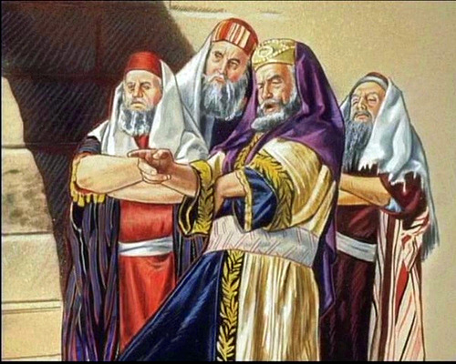
AUTHORITY
Sadducees influential minority mainly consisting of priests & aristocrats; only Torah was accepted as Scripture; rejected resurrection, life after death &
existence of angels

Slide 5
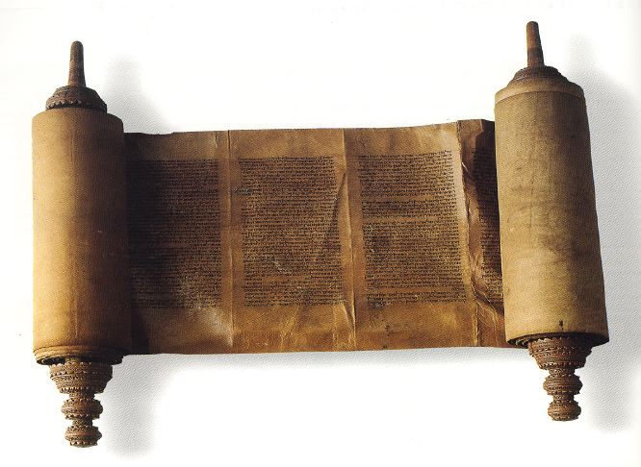
AUTHORITY
How Jesus reasoned from the Scriptures: INFERENCES
The appeal to Law (vv.23-24)
The “what if” scenario (vv.25-28)
Jesus’ accusations (v.29)
Jesus’ defense of His accusations (vv.30-33)

Slide 6
AUTHORITY
How Jesus reasoned from the Scriptures: INFERENCES
The Sadducees:
underestimated God’s power
Resurrection metaphor “new birth” (Mt. 19:28)
palingenesia
“again, another time”
“beginning, birth”

Slide 7
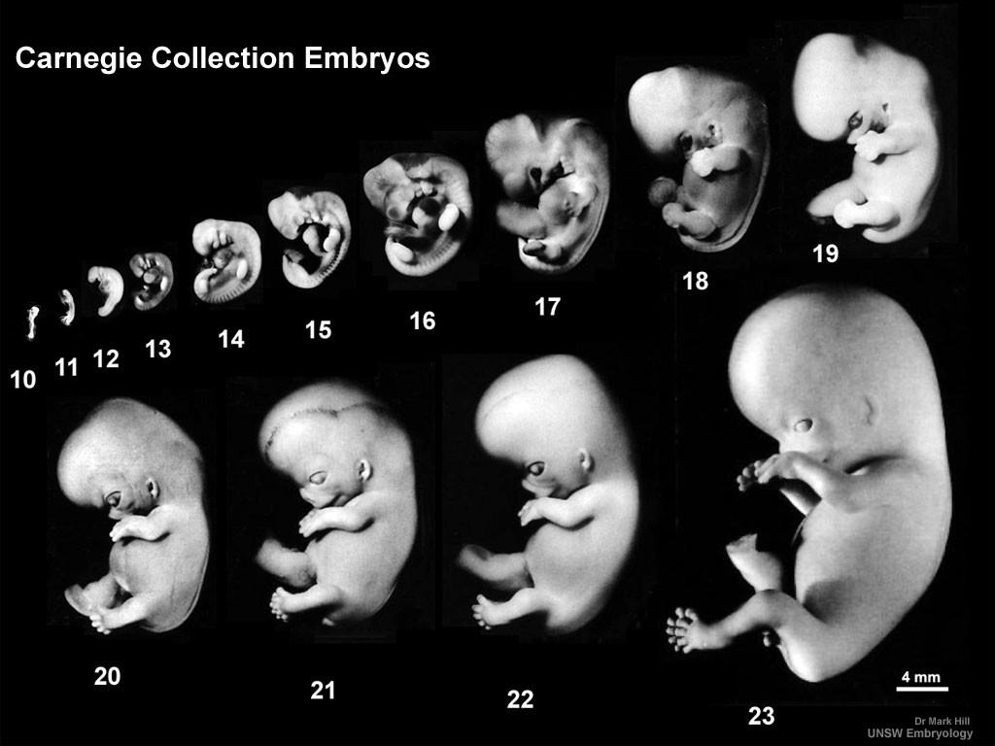
AUTHORITY

Slide 8
AUTHORITY
How Jesus reasoned from the Scriptures: INFERENCES
The Sadducees:
underestimated God’s power
Resurrection metaphor “new birth” (Mt. 19:28)
Marriage facilitates the continuation of life
Marriage symbolizes God’s love for humanity

Slide 9
AUTHORITY
How Jesus reasoned from the Scriptures: INFERENCES
The Sadducees:
underestimated God’s power
misunderstood God’s story
Present tense (“I AM”) implies continued existence of the physically dead
Continued existence of a disembodied spirit necessitates that spirit rejoining a body at some future time

Slide 10
AUTHORITY
“The patriarchs are still alive, and therefore, will be raised in the future. Prove the first, and (within the worldview of assumed by both parties in the debate, and any listening Pharisee) you have proved the second.”
- N.T. Wright (The Resurrection of the Son of God, 425)

Slide 11
AUTHORITY
“‘Man’ as God made him is an ‘embodied’ being. If ‘man’ is to survive as ‘man’ he must be embodied. So plain is this to Jesus and his opponents that all he has to do is show that Abraham has survived death and lives unto God in order to establish the resurrection of the dead.”
- Jim McGuiggan (The Book of 1 Corinthians, 265)

Slide 12
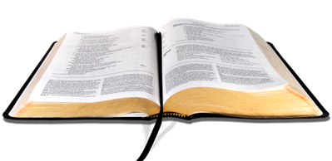
AUTHORITY
APPLICATION
The new birth is the future event
to which the Bible is pointing
1

Slide 13
AUTHORITY
APPLICATION
The new birth includes all of God’s creation
2

Slide 14
AUTHORITY
APPLICATION
The new birth begins now!
3

