Slide 1
Scripture Reading:
James 1:12-18

Slide 3
AUTHORITY
How Jesus relied on Scripture

Slide 4
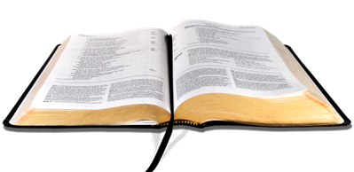
AUTHORITY
How Jesus relied on Scripture
God tests us for our spiritual benefit
test designed by God for
our spiritual development
recognizing the difference will help us endure!
peirazo
temptation designed by Satan
for our spiritual destruction
1

Slide 5
AUTHORITY
How Jesus relied on Scripture
Testing reveals the truth about our hearts
“God tested Abraham…” “now I know that you fear God” (Gen. 22)
“God has led you these 40 years… testing you…” “you have brought us out into this wilderness to kill this whole assembly with hunger” (Deut. 8:3; Ex. 16:3)
2

Slide 6
AUTHORITY
How Jesus relied on Scripture
The devil attempts to provoke doubt & rebellion
The devil questions our identity by pointing out our circumstances
God’s word, not our earthly circumstances, define who we are!
3

Slide 7
AUTHORITY
How Jesus relied on Scripture
Human beings need spiritual food to truly live
JESUS
4

Slide 8
AUTHORITY
Our fathers ate the manna in the wilderness; as it is written, ‘He gave them bread out of heaven to eat.’” Jesus then said to them, “Truly, truly, I say to you, it is not Moses who has given you the bread out of heaven, but it is My Father who gives you the true bread out of heaven. For the bread of God is that which comes down out of heaven, and gives life to the world.” Then they said to Him, “Lord, always give us this bread.”
Jesus said to them, “I am the bread of life; he who comes to Me will not hunger, and he who believes in Me will never thirst.
(John 6:31-35)

