Slide 1
Scripture Reading:
Exodus 34:27-28

Slide 3
AUTHORITY
Why is the Bible authoritative?

Slide 4
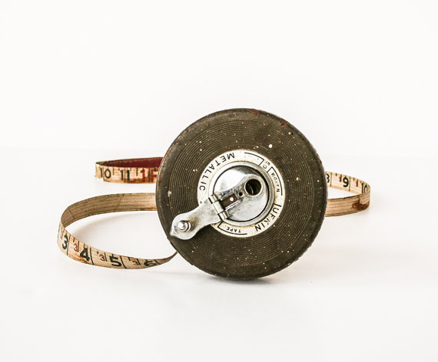
AUTHORITY
Then the Lord said to Moses, “Write this in a book as a memorial and recite it to Joshua, that I will utterly blot out the memory of Amalek from under heaven.”
(Exodus 17:14)

Slide 5
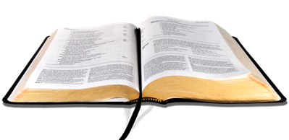
AUTHORITY
Why is the Bible authoritative?
The Bible is telling the story
of how God rescued His people

Slide 6
AUTHORITY
Then the Lord said to Moses, “Write down these words, for in accordance with these words I have made a covenant with you and with Israel.” So he was there with the Lord forty days and forty nights; he did not eat bread or drink water. And he wrote on the tablets the words of the covenant, the Ten Commandments.
(Exodus 34:27-28)

Slide 7
AUTHORITY
Why is the Bible authoritative?
The Bible records the terms of
God’s covenant with His people

Slide 8
AUTHORITY
Now then, if you will indeed obey My voice and keep My covenant, then you shall be My own possession among all the peoples, for all the earth is Mine; and you shall be to Me a kingdom of priests and a holy nation.’ These are the words that you shall speak to the sons of Israel.”
(Exodus 19:5-6)

Slide 9
AUTHORITY
Then Moses came and recounted to the people all the words of the Lord and all the ordinances; and all the people answered with one voice and said, “All the words which the Lord has spoken we will do!” Moses wrote down all the words of the Lord. Then he arose early in the morning, and built an altar at the foot of the mountain with twelve pillars for the twelve tribes of Israel. He sent young men of the sons of Israel, and they offered burnt offerings and sacrificed young bulls as peace offerings to the Lord…
(Exodus 24:3-8)

Slide 10
AUTHORITY
…Moses took half of the blood and put it in basins, and the other half of the blood he sprinkled on the altar. Then he took the book of the covenant and read it in the hearing of the people; and they said, “All that the Lord has spoken we will do, and we will be obedient!” So Moses took the blood and sprinkled it on the people, and said, “Behold the blood of the covenant, which the Lord has made with you in accordance with all these words.”
(Exodus 24:3-8)

Slide 11
AUTHORITY
Why is the Bible authoritative?
The Bible records Israel’s voluntary
submission to God’s authority based on God’s rescue

Slide 12
AUTHORITY
Then Moses came and recounted to the people all the words of the Lord and all the ordinances; and all the people answered with one voice and said, “All the words which the Lord has spoken we will do!”
Then he took the book of the covenant and read it in the hearing of the people; and they said, “All that the Lord has spoken we will do, and we will be obedient!”
(Exodus 24:3, 7)

Slide 13
AUTHORITY
Why is the Bible authoritative?
The Bible tells the story of how Jesus has provided the ultimate rescue for all humanity

Slide 14
AUTHORITY
And He said to him, “‘You shall love the Lord your God with all your heart, and with all your soul, and with all your mind.’ This is the great and foremost commandment. The second is like it, ‘You shall love your neighbor as yourself.’ On these two commandments depend the whole Law and the Prophets.”
(Matthew 22:37-40)

Slide 15
AUTHORITY
Why is the Bible authoritative?
The Bible records the terms of God’s
New Covenant Jesus came to establish

Slide 16
AUTHORITY
While they were eating, Jesus took some bread, and after a blessing, He broke it and gave it to the disciples, and said, “Take, eat; this is My body.” And when He had taken a cup and given thanks, He gave it to them, saying, “Drink from it, all of you; for this is My blood of the covenant, which is poured out for many for forgiveness of sins.
(Matthew 26:26-28)

Slide 17
AUTHORITY
Whatever you do in word or deed, do all in the name of the Lord Jesus, giving thanks through Him to God the Father.
(Colossians 3:17)

Slide 18
AUTHORITY
Therefore there is now no condemnation for those who are in Christ Jesus.
(Romans 8:1)

Slide 19
AUTHORITY
God, after He spoke long ago to the fathers in the prophets in many portions and in many ways, in these last days has spoken to us in His Son, whom He appointed heir of all things, through whom also He made the world. And He is the radiance of His glory and the exact representation of His nature, and upholds all things by the word of His power.
(Hebrews 1:1-3a)

