Slide 1
Scripture Reading:
Matthew 28:18

Slide 3
AUTHORITY
What is Biblical authority?
Isaiah 52:7

Slide 4
AUTHORITY
What is authority?
General definition: “the power to make & enforce laws, to command, determine, judge or exact obedience”
Position: One can have authority based upon the position that he/she holds
Delegated: One can be given permission to exercise authority from another who has the power to grant it

Slide 5
AUTHORITY
Who has authority?
Creator
All earthly governments & human institutions
All families
Church
God’s ideal government-family

Slide 6
AUTHORITY
Why do we need authority?
God gives us choice, freewill
Submitting to God’s authority brings blessing, freedom & life
Rebelling against God’s authority brings pain, slavery & death
Jesus succeeded where we failed & has become King through the resurrection

Slide 7
AUTHORITY
How do we receive authority?
God revealed His mind through His Spirit to apostles & prophets
God delegates authority through the Scriptures written by inspired apostles & prophets
God’s will is communicated in the Scriptures in an understandable way providing us with a standard of unity

Slide 8
AUTHORITY
How do we know what God wants?
How communication works:
Tell others what you want
Show others what you want
Imply what you expect others to understand by what you say or show
Question of origin
How communication works!

Slide 9
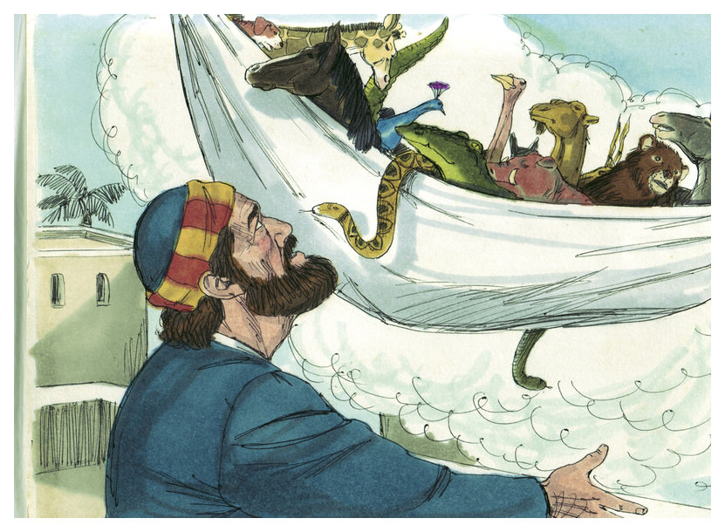
AUTHORITY
Peter’s Vision (Acts 10)
God showed Peter a vision intended to teach an important lesson
God told Peter to go with the Gentiles
Peter inferred he should accept the Gentiles into God’s family

Slide 10
AUTHORITY
For the grace of God has appeared, bringing salvation to all men, instructing us to deny ungodliness and worldly desires and to live sensibly, righteously and godly in the present age
(Titus 2:11-12)

