Slide 1
Scripture Reading:
Colossians 3:17

Slide 3
AUTHORITY
freedom through submission
1 Peter 2:11-17

Slide 4
AUTHORITY
I.
Christians are suspect strangers

Slide 5
AUTHORITY
II.
Christians are submissive servants

Slide 6
AUTHORITY
III.
Christians are the
Savior’s slaves

Slide 7
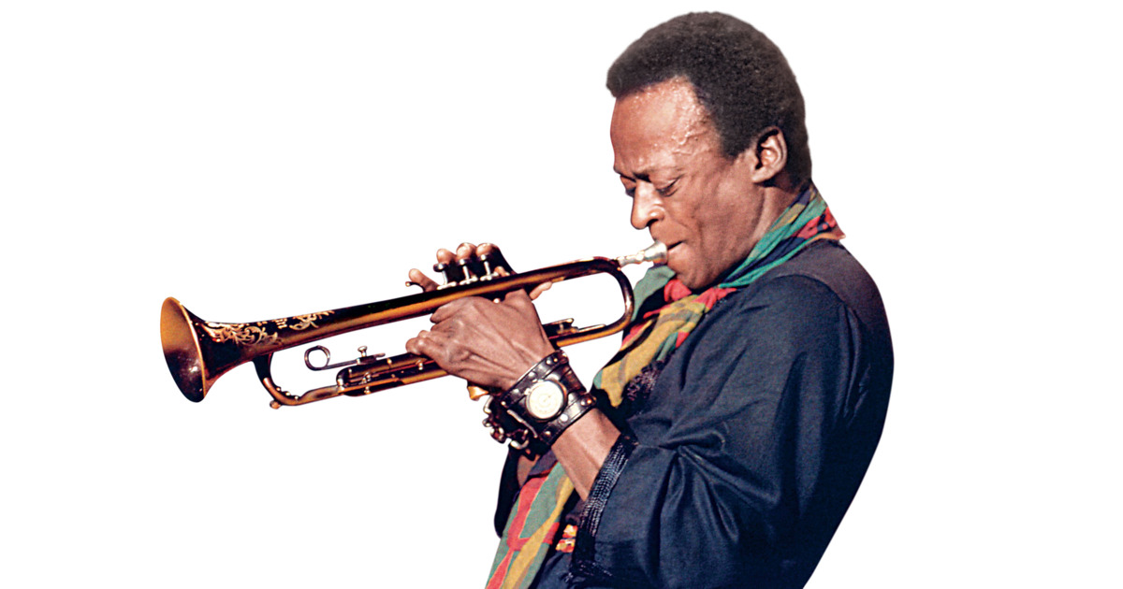
AUTHORITY
Rolling Stone described Miles Davis as "the most revered jazz trumpeter of all time, not to mention one of the most important musicians of the 20th century."
There are some kinds of FREEDOM
that only come by accepting
limitations, giving up personal
rights & submitting to authority

Slide 8
AUTHORITY
Have this attitude in yourselves which was also in Christ Jesus, who, although He existed in the form of God, did not regard equality with God a thing to be grasped, but emptied Himself, taking the form of a bond-servant, and being made in the likeness of men. Being found in appearance as a man, He humbled Himself by becoming obedient to the point of death, even death on a cross.
(Philippians 2:5-8)

Slide 9
AUTHORITY
Law of King Jesus
Forgiveness is freedom from the slavery of anger
Generosity is freedom from the slavery of materialism
Service is freedom from the slavery of selfishness
Sexual purity is freedom from the slavery of bodily lust
FREEDOM!

Slide 10
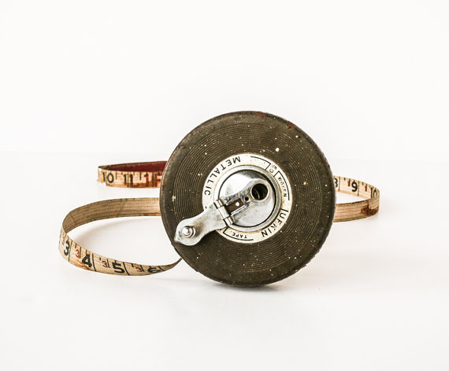
AUTHORITY
For we are His workmanship, created in Christ Jesus for good works, which God prepared beforehand so that we would walk in them.
(Ephesians 2:10)

