Slide 1
Scripture Reading:
Jeremiah 10:23

Slide 3
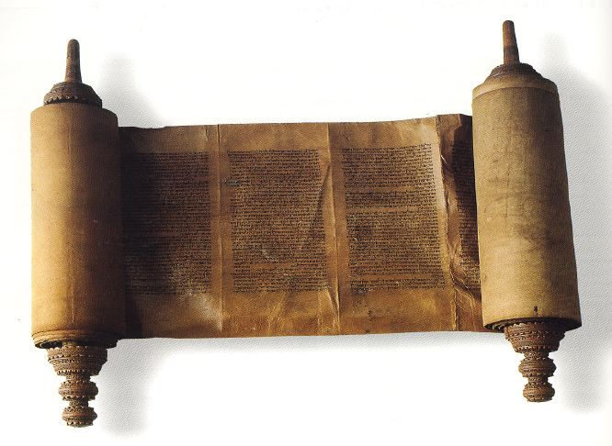
AUTHORITY
How Jesus reasoned from the Scriptures: COMMANDS
The Leading Question (vv.1-2)
“tradition” Grk. ‘paradosis’ lit. “handing down or over,” oral interpretations of Torah
“Mishnah” Heb. “study by repetition,” accepted interpretation of Law
“traditions” acted like a fence around Law to keep Jews from breaking God’s commands
“traditions” were considered as authoritative as Scripture

Slide 4
AUTHORITY
How Jesus reasoned from the Scriptures: COMMANDS
The Leading Question (vv.1-2)
Issue: ceremonial hand washing (cf. Ex. 30:17-21)
“break” denotes continual action

Slide 5
AUTHORITY
How Jesus reasoned from the Scriptures: COMMANDS
The Leading Question (vv.1-2)
The Counter Question (v.3)
God’s Command (v.4)
Man’s Command (vv.5-6)
Resulting Hypocrisy (vv.7-10)

Slide 6
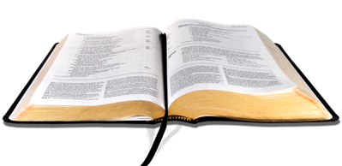
AUTHORITY
APPLICATION
We must learn to distinguish
between our traditions and God’s word
1

Slide 7
AUTHORITY
APPLICATION
Throwing out tradition
is not always the answer
2

Slide 8
AUTHORITY
APPLICATION
When we see our traditions as the only way to
do things we condemn ourselves
3

Slide 9
AUTHORITY
APPLICATION
We must recognize that traditions can change without affecting our relationship with God
4

Slide 10
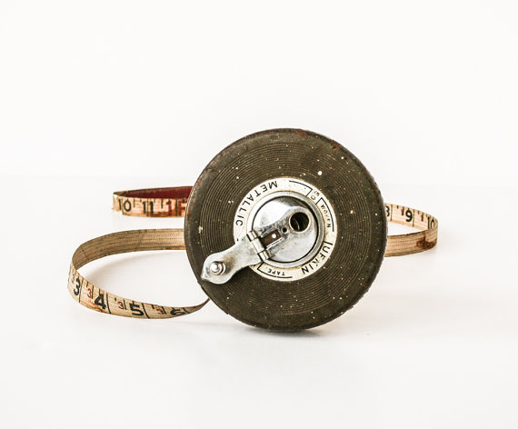
AUTHORITY
and let us consider how to stimulate one another to love and good deeds, not forsaking our own assembling together, as is the habit of some, but encouraging one another; and all the more as you see the day drawing near.
(Hebrews 10:24-25)

Slide 11
AUTHORITY
APPLICATION
No one is bound by
the traditions of men!
5

Slide 12
AUTHORITY
For if because of food your brother is hurt, you are no longer walking according to love. Do not destroy with your food him for whom Christ died.
(Romans 14:15)

Slide 13
AUTHORITY
APPLICATION
Our traditions can cause us
to break God’s commands
6

Slide 14
AUTHORITY
APPLICATION
If our traditions hinder us from keeping
God’s commands we must reject them
7

Slide 15
AUTHORITY
There is a way which seems right to a man,
But its end is the way of death.
(Proverbs 16:25)

Slide 16
AUTHORITY
I know, O Lord, that a man’s way is not in himself,
Nor is it in a man who walks to direct his steps.
(Jeremiah 10:23)

