Slide 1
Scripture Reading:
Psalm 95:1-6

Slide 3
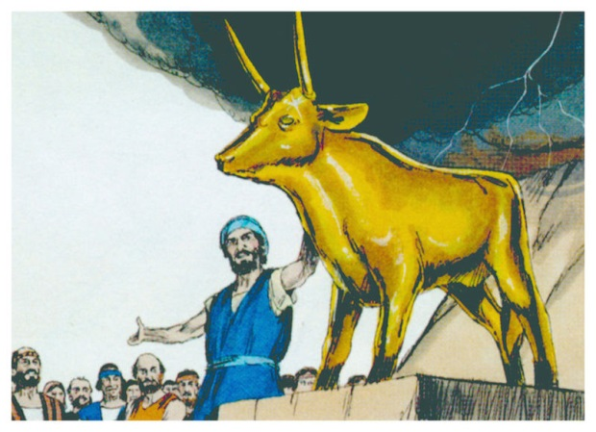
idolatry
Definition of Idolatry: Exchanging Incorruption for Corruption
Idolatry is anything that is more important to you than God

Slide 4
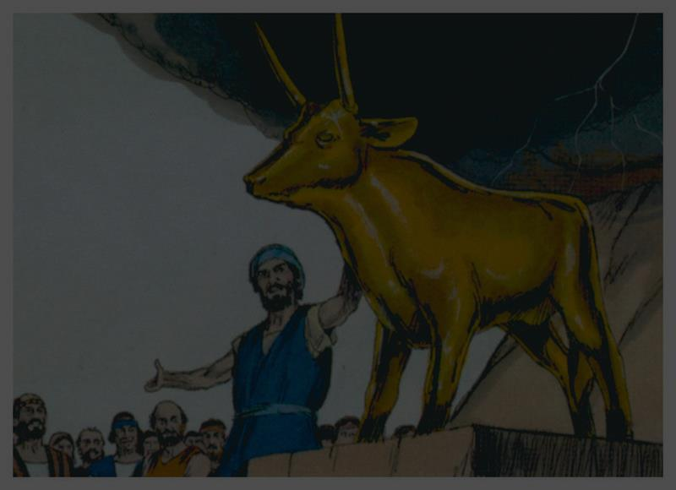
Exodus 20:3
You shall have no other gods before Me.

Slide 5
idolatry
Definition of Idolatry: Exchanging Incorruption for Corruption
Idolatry is anything that is more important to you than God
Idolatry is making a created thing an object of worship
We worship that which we believe to be worthy of praise, love, sacrifice, devotion, etc.
We worship that which we believe will save or satisfy us

Slide 6
idolatry
Definition of Idolatry: Exchanging Incorruption for Corruption
Ancient Idolatry: Deification of Desire
Ex: “Aphrodite” personification of love, beauty, procreation
Christianity can be perverted into idolatry by using God to gain our selfish desires

Slide 7
James 4:3-4
You ask and do not receive, because you ask with wrong motives, so that you may spend it on your pleasures. You adulteresses, do you not know that friendship with the world is hostility toward God? Therefore whoever wishes to be a friend of the world makes himself an enemy of God.

Slide 8
idolatry
Definition of Idolatry: Exchanging Incorruption for Corruption
Ancient Idolatry: Deification of Desire
Seed & Fruit of Idolatry: Romans 1:18-32

Slide 9
Psalm 135:15-18
The idols of the nations are but silver and gold,
The work of man’s hands.
They have mouths, but they do not speak;
They have eyes, but they do not see;
They have ears, but they do not hear,
Nor is there any breath at all in their mouths.
Those who make them will be like them,
Yes, everyone who trusts in them.

Slide 10
idolatry
Definition of Idolatry: Exchanging Incorruption for Corruption
Ancient Idolatry: Deification of Desire
Seed & Fruit of Idolatry: Romans 1:18-32
Solution to Idolatry: King Jesus

