Slide 1
Scripture Reading:
Ezekiel 16:8

Slide 3
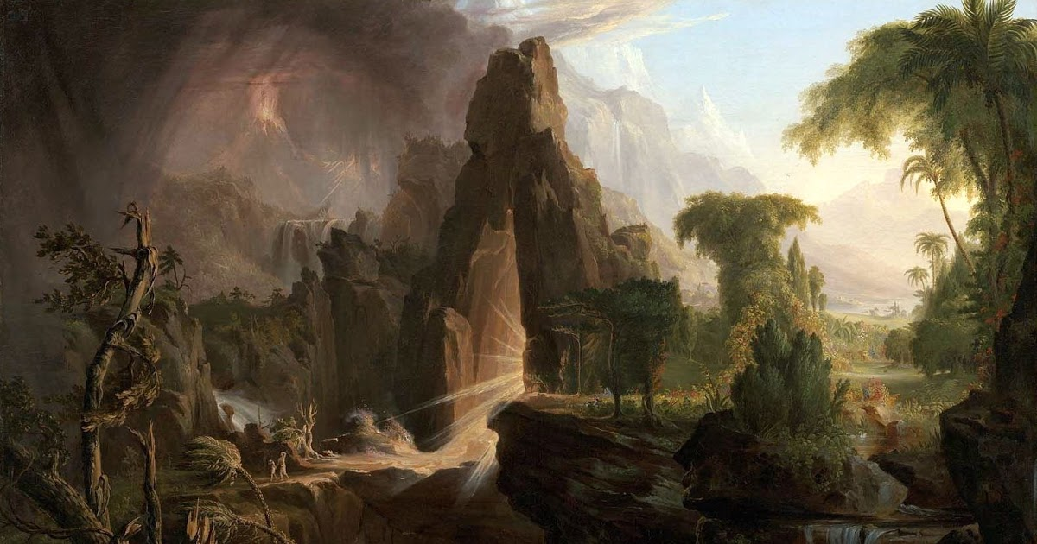
Clothed
— The Origin of the Shame of Nakedness —

Slide 4
Clothed
— The Origin of the Shame of Nakedness —
Humankind was created to reflect God’s image
Reflect God’s image in their rule over creation—(Gen. 1:26; 2:20; cf. Psa. 8)
Reflect God’s image within the marriage relationship—(Gen. 2:18-24)

Slide 5
Clothed
— The Origin of the Shame of Nakedness —
Humankind was created to reflect God’s image
Humankind was placed in the Garden sanctuary
Adam’s was to “cultivate” & “keep” the paradise—(Gen. 2:8-15)
Priests were to “serve” & “keep” the tabernacle—(Num. 3:7-8; 18:7)
Both the Garden of Eden & the tabernacle were a meeting place between God & man in which they could “walk” with one another in rich fellowship—(Gen. 3:8)

Slide 6
Clothed
— The Origin of the Shame of Nakedness —
Humankind was created to reflect God’s image
Humankind was placed in the Garden sanctuary
Humankind was given a covenant with God
God supplied blessing including law concerning “good & evil”—(Gen. 2:16-17)
By deception, Satan overthrew God’s perfect created order—(Gen. 3:1-5)

Slide 7
Clothed
— The Origin of the Shame of Nakedness —
GOD’S WAY
LIFE

Slide 8
Clothed
— The Origin of the Shame of Nakedness —
MAN’S (SATAN’S) WAY
DEATH

Slide 9
Clothed
— The Origin of the Shame of Nakedness —
Humankind was created to reflect God’s image
Humankind was placed in the Garden sanctuary
Humankind was given a covenant with God
Humankind perverted God’s created order, covenant, & image & was ejected from Garden
Enmity replaced peace/fellowship in God’s created order—(Gen. 3:15-19)
The sinners’ first reaction was to “cover” their nakedness—(Gen. 2:25; 3:7)

Slide 10
Clothed
— The Origin of the Shame of Nakedness —
Humankind’s innocence was transformed into guilt; nakedness became something shameful
After “knowing good & evil” by experience instead of wisdom, humankind attempted to “hide” from God—(Gen. 3:8-11)
That which was “good” was turned into an instrument of “evil”

Slide 11
Clothed
— The Origin of the Shame of Nakedness —
Humankind’s innocence was transformed into guilt; nakedness became something shameful
Open nakedness connected with sin, shame & dishonor
To witness a person’s nakedness is to witness their shame—(Gen. 9:22-23; Ex. 20:26; Lev. 18:6-18; Rev. 3:17-18; 16:15)
Publicly exposing a person’s nakedness was considered a form of punishment—(Isa. 47:3; Hos. 2:3; Nah. 3:5)
Idolatry was considered uncovering one’s spiritual nakedness—(Ezek. 16; 23:18)
Covering another’s nakedness is considered an act of righteous mercy—(Ezek. 16:8; 18:7,16; Hos. 2:9; Mt. 25:36)

Slide 12
Application
We can never “cover” our nakedness
& “hide” our sin from God
(Gen. 2:25; Heb. 4:13; Gen. 3:21)

Slide 13
Application
God can “cover” our nakedness & sin by sacrifice
(Gen. 3:7, 21; 2:9; Rev. 22:1; 1 Pet. 2:24; Gal. 3:27)

