Slide 1
Scripture Reading: Genesis 27:30-41

Slide 3
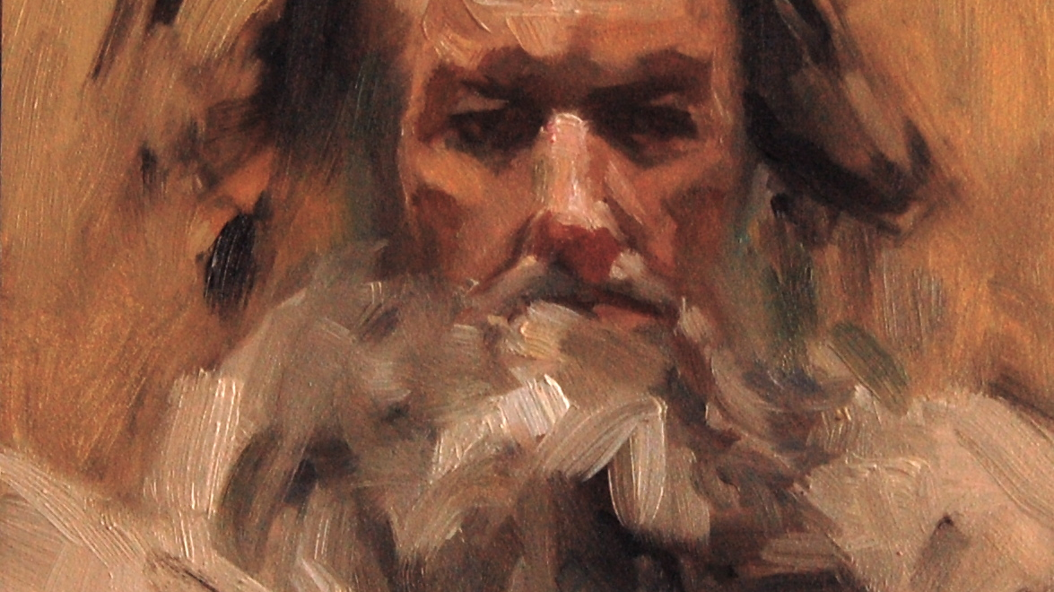
Introduction
shortest OT book
The Vision of Obadiah

Slide 4
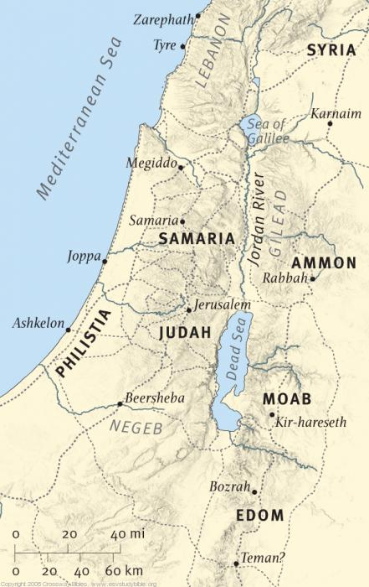
Introduction
shortest OT book
series of divine judgment poems against Israel’s neighbor Edom
The Vision of Obadiah

Slide 5
Introduction
shortest OT book
series of divine judgment poems against Israel’s neighbor Edom
there is much more to Obadiah’s prophecy than the length suggests
The Vision of Obadiah

Slide 6
Backstory: Family Feud
Abraham Sarah
Isaac Rebekah
Esau
Jacob
Gen. 25-27

Slide 7
Backstory: Family Feud
Abraham Sarah
Isaac Rebekah
Esau
Jacob
A.K.A.
A.K.A.
Gen. 25-27
cf. Num. 20:14-21
Saul’s war (1 Sam. 14:47)
David’s victory (2 Sam. 8:14)
Rebel against Solomon (1 Kgs. 11:1-25)
Rebel against Jehoram (2 Kgs. 8:20)
Rebel against Amaziah (2 Kgs. 14:7-10)
“Edom”
Edomites
“Israel”
Israelites

Slide 8
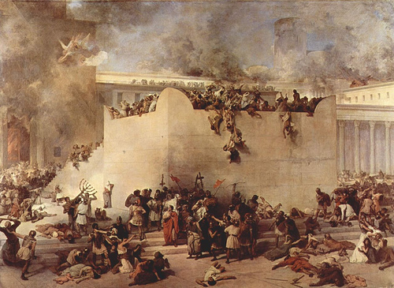
Backstory: Family Bond Broken
Instead of aiding Israel, Edom plundered her cities & abused refugees
2 Kings 25:1-21

Slide 9
Backstory: Family Bond Broken
Instead of aiding Israel, Edom plundered her cities & abused refugees
2 Kings 25:1-21
Psa. 137:7; 83:6

Slide 10
Backstory: Family Bond Broken
Instead of aiding Israel, Edom plundered her cities & abused refugees
2 Kings 25:1-21
Psa. 137:7; 83:6
Amos 1:6-9, 11-12

Slide 11
Backstory: Family Bond Broken
Instead of aiding Israel, Edom plundered her cities & abused refugees
2 Kings 25:1-21
Psa. 137:7; 83:6
Amos 1:6-9, 11-12
Ezek. 35

Slide 12
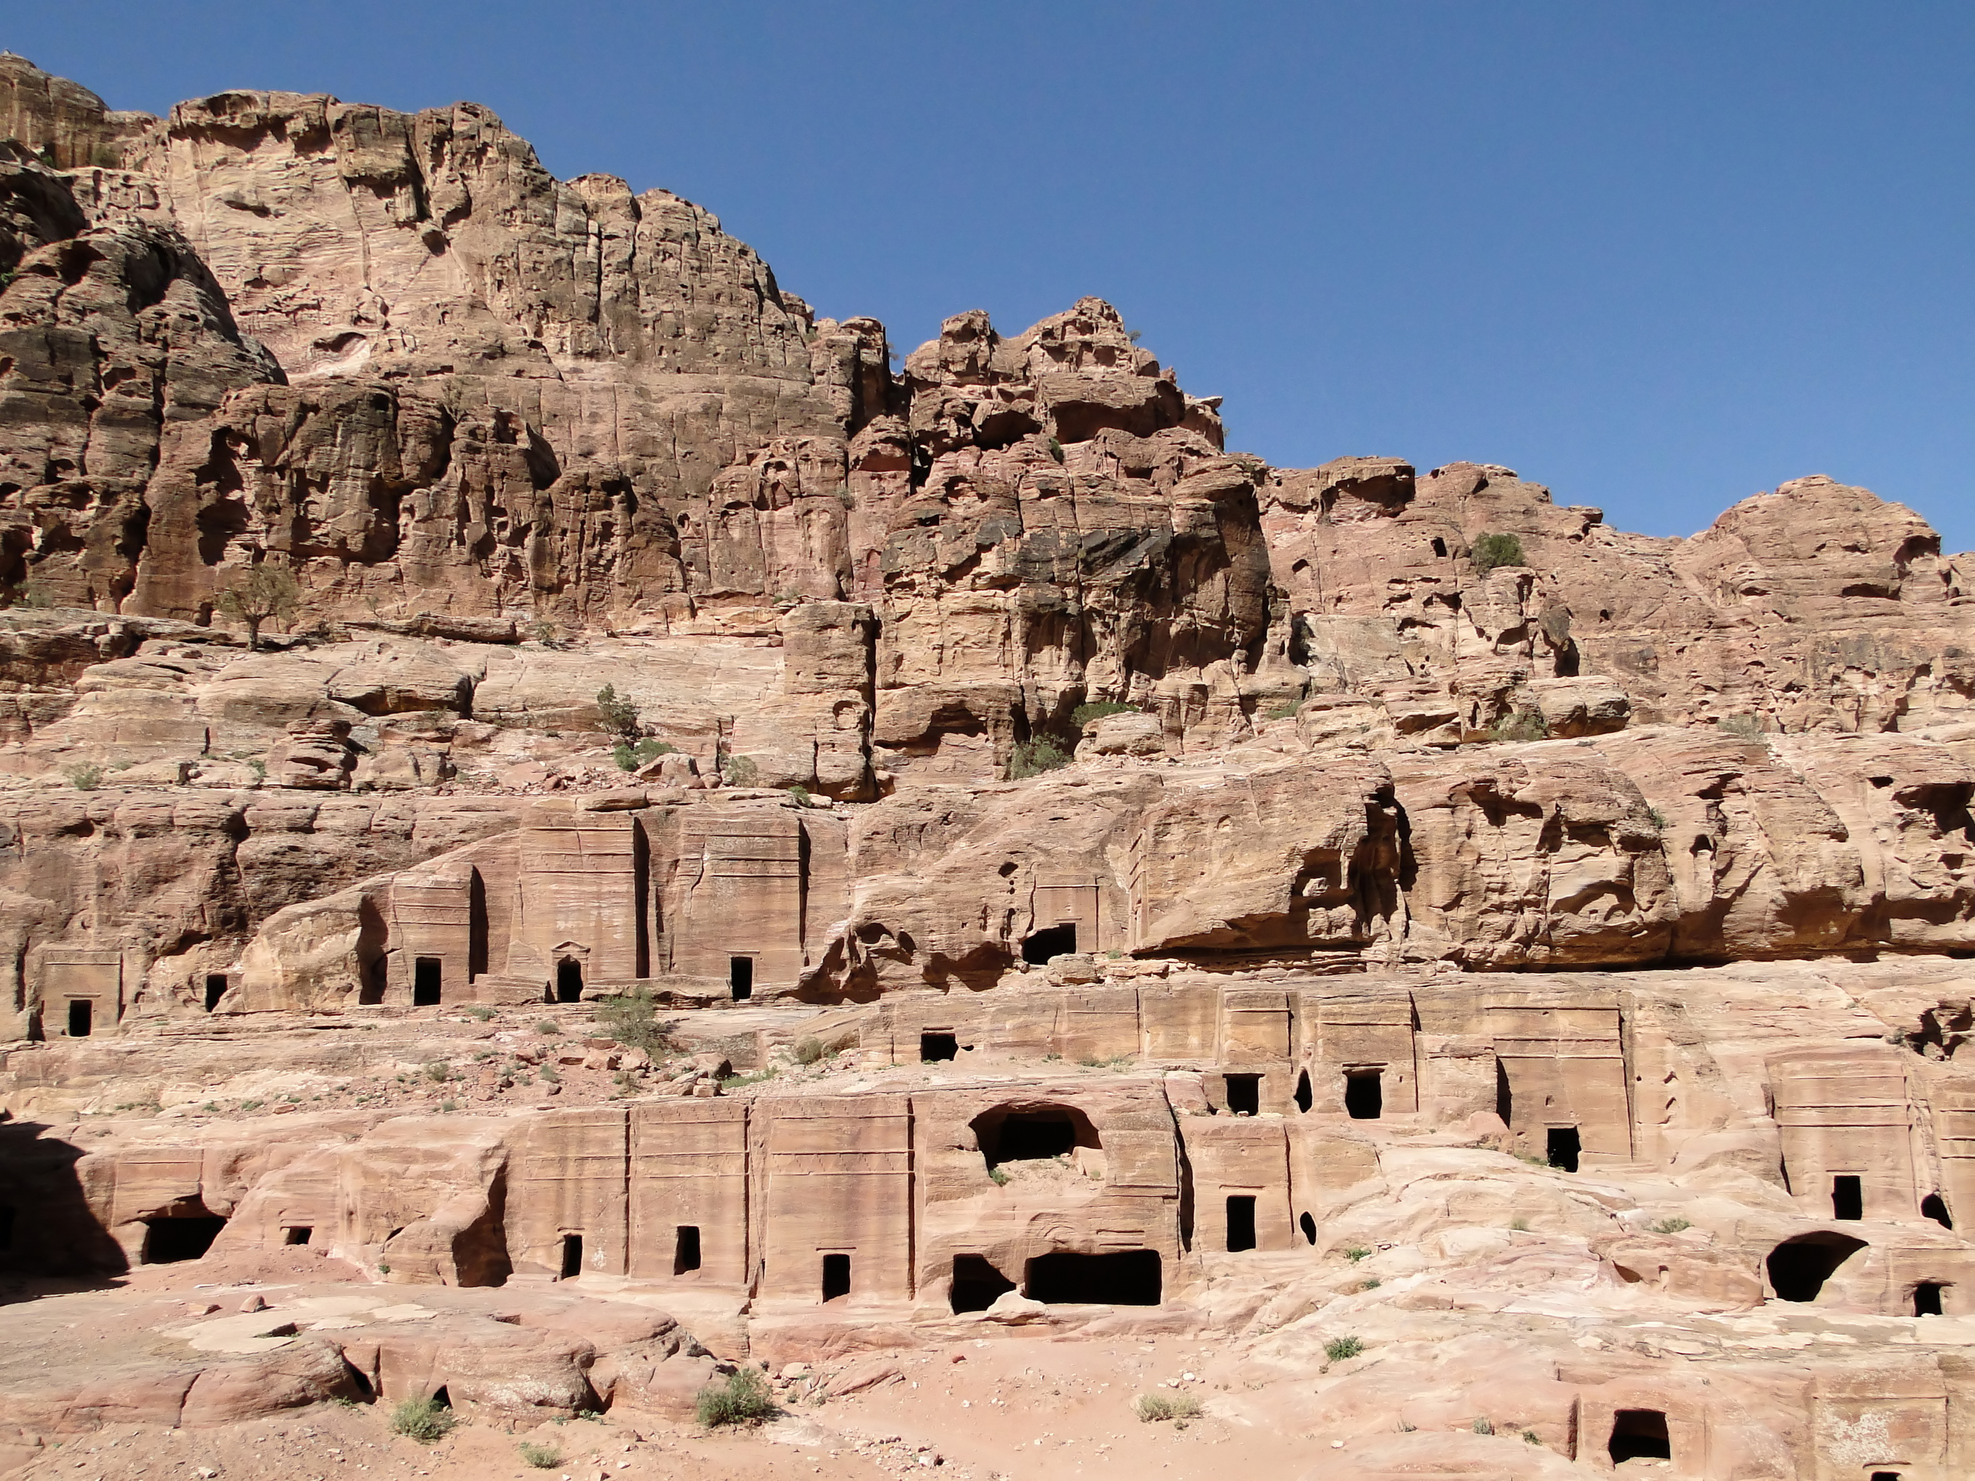
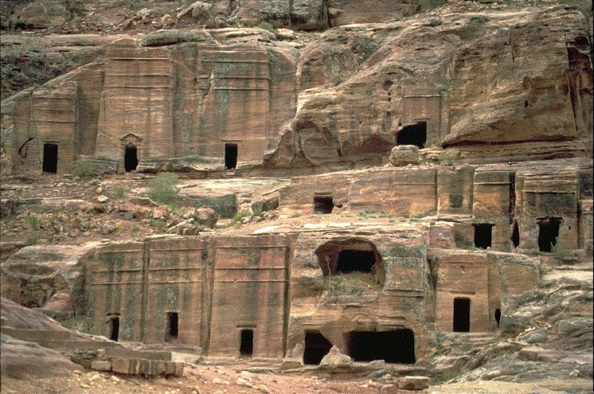
vv.1-14
Accusations Against Edom
Focus: Edom’s Pride & Self-Exaltation
Literally lived in desert cliffs
Metaphorically believed above Israel
vv.3-4

Slide 13
vv.1-14
Accusations Against Edom
v.15
Bridging 2 Sections
v.15
all nations
Edom
vv.16-21
vv.1-14
Shift Focus: from Edom to “all nations”

Slide 14
vv.1-14
Accusations Against Edom
v.15
Bridging 2 Sections
vv.16-21
The Day of Lord for All Nations
(vv.17-21) After the “Day of the Lord”
Edom as an Example
“Edom” אָדַם
“Adam” אָדָם
v.16
Because just as you drank on My holy mountain, All the nations will drink continually

Slide 15
vv.1-14
Accusations Against Edom
v.15
Bridging 2 Sections
vv.16-21
The Day of Lord for All Nations
(vv.17-21) After the “Day of the Lord”
Joel 2:28-32—Spirit poured out/all who call on His name saved (Acts 2)
Edom as an Example
“Edom” אָדַם
“Adam” אָדָם
v.16
Because just as you drank on My holy mountain, All the nations will drink continually

Slide 16
vv.1-14
Accusations Against Edom
v.15
Bridging 2 Sections
vv.16-21
The Day of Lord for All Nations
(vv.17-21) After the “Day of the Lord”
Joel 2:28-32—Spirit poured out/all who call on His name saved (Acts 2)
Amos 9:11-15—David’s line restored & all nations included in kingdom
Edom as an Example
“Edom” אָדַם
“Adam” אָדָם
v.16
Because just as you drank on My holy mountain, All the nations will drink continually

Slide 17
vv.1-14
Accusations Against Edom
v.15
Bridging 2 Sections
vv.16-21
The Day of Lord for All Nations
(vv.17-21) After the “Day of the Lord”
Joel 2:28-32—Spirit poured out/all who call on His name saved (Acts 2)
Amos 9:11-15—David’s line restored & all nations included in kingdom
Obadiah vv.17-21—Kingdom established in Jerusalem & expands outward
Edom as an Example
“Edom” אָדַם
“Adam” אָדָם
v.16
Because just as you drank on My holy mountain, All the nations will drink continually

Slide 18
Edom’s
Fall
Edom’s
Pride
points to the coming of God’s Kingdom for all nations
paradigm for the sins of humanity
The Vision of Obadiah

