Slide 1
Scripture Reading: Isaiah 35:3-6

Slide 2
(Isaiah 35:3-6)
Strengthen the weak hands, And make firm the feeble knees. Say to those who are fearful-hearted, “Be strong, do not fear! Behold, your God will come with vengeance, With the recompense of God; He will come and save you.” Then the eyes of the blind shall be opened, And the ears of the deaf shall be unstopped. Then the lame shall leap like a deer, And the tongue of the dumb sing. For waters shall burst forth in the wilderness, And streams in the desert.

Slide 4
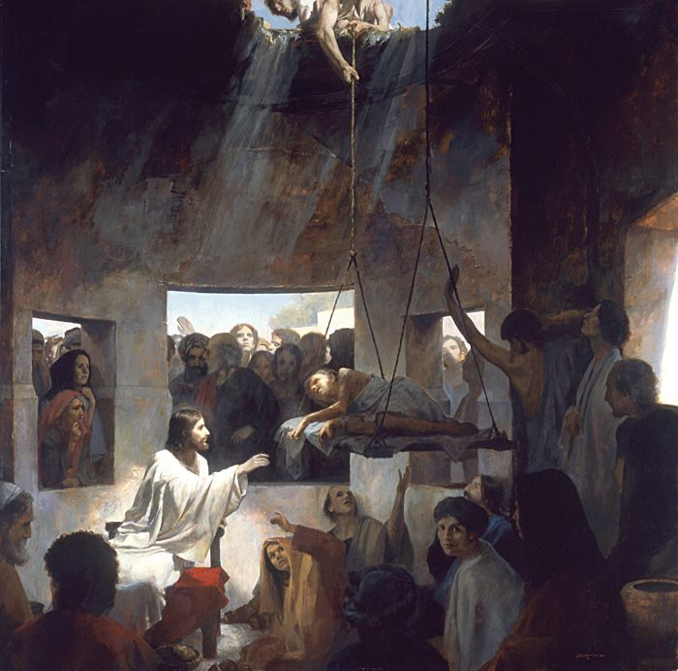
“When Jesus Saw Their Faith”
The Healing of the Paralytic (Mk. 2:1-12)
Faith does whatever it takes to get to Jesus
James 2:20
But are you willing to recognize, you foolish fellow, that faith without works is useless?

Slide 5
“When Jesus Saw Their Faith”
The Healing of the Paralytic (Mk. 2:1-12)
Faith does whatever it takes to get to Jesus
Hebrews 3:12
Take care, brethren, that there not be in any one of you an evil, unbelieving heart that falls away from the living God.

Slide 6
“When Jesus Saw Their Faith”
The Healing of the Paralytic (Mk. 2:1-12)
Faith does whatever it takes to get to Jesus
Hebrews 3:19
So we see that they were not able to enter because of unbelief.

Slide 7
“When Jesus Saw Their Faith”
The Healing of the Paralytic (Mk. 2:1-12)
Faith does whatever it takes to get to Jesus
Our greatest need in this life is spiritual not physical
Hebrews 9:27
…it is appointed for men to die once and after this comes judgment

Slide 8
“When Jesus Saw Their Faith”
The Healing of the Paralytic (Mk. 2:1-12)
Faith does whatever it takes to get to Jesus
Our greatest need in this life is spiritual not physical
Matthew 6:33
But seek first His kingdom and His righteousness, and all these things will be added to you.

Slide 9
“When Jesus Saw Their Faith”
The Healing of the Paralytic (Mk. 2:1-12)
Faith does whatever it takes to get to Jesus
Our greatest need in this life is spiritual not physical
Matthew 10:28
Do not fear those who kill the body but are unable to kill the soul; but rather fear Him who is able to destroy both soul and body in hell.

Slide 10
“When Jesus Saw Their Faith”
The Healing of the Paralytic (Mk. 2:1-12)
Faith does whatever it takes to get to Jesus
Our greatest need in this life is spiritual not physical
Matthew 23:25-26
Woe to you, scribes and Pharisees, hypocrites! For you clean the outside of the cup and of the dish, but inside they are full of robbery and self-indulgence. You blind Pharisee, first clean the inside of the cup and of the dish, so that the outside of it may become clean also.

Slide 11
“When Jesus Saw Their Faith”
The Healing of the Paralytic (Mk. 2:1-12)
Faith does whatever it takes to get to Jesus
Our greatest need in this life is spiritual not physical
2 Corinthians 4:16
Therefore we do not lose heart, but though our outer man is decaying, yet our inner man is being renewed day by day.

Slide 12
“When Jesus Saw Their Faith”
The Healing of the Paralytic (Mk. 2:1-12)
Faith does whatever it takes to get to Jesus
Our greatest need in this life is spiritual not physical
2 Corinthians 4:17-18
For momentary, light affliction is producing for us an eternal weight of glory far beyond all comparison, while we look not at the things which are seen, but at the things which are not seen; for the things which are seen are temporal, but the things which are not seen are eternal.

Slide 13
“When Jesus Saw Their Faith”
The Healing of the Paralytic (Mk. 2:1-12)
Faith does whatever it takes to get to Jesus
Our greatest need in this life is spiritual not physical
Ephesians 1:3
Blessed be the God and Father of our Lord Jesus Christ, who has blessed us with every spiritual blessing in the heavenly places in Christ

Slide 14
“When Jesus Saw Their Faith”
The Healing of the Paralytic (Mk. 2:1-12)
Faith does whatever it takes to get to Jesus
Our greatest need in this life is spiritual not physical
The truth about Jesus is near but we can still be far away

Slide 15
“When Jesus Saw Their Faith”
The Healing of the Paralytic (Mk. 2:1-12)
Faith does whatever it takes to get to Jesus
Our greatest need in this life is spiritual not physical
The truth about Jesus is near but we can still be far away
The power of Jesus’ word proves that He is the Son of God

Slide 16
“When Jesus Saw Their Faith”
The Healing of the Paralytic (Mk. 2:1-12)
Psalm 148:5
Let them praise the name of the Lord,
For He commanded and they were created.

Slide 17
“When Jesus Saw Their Faith”
The Healing of the Paralytic (Mk. 2:1-12)
Isaiah 55:11
So will My word be which goes forth from My mouth; It will not return to Me empty, Without accomplishing what I desire, And without succeeding in the matter for which I sent it.

Slide 18
“When Jesus Saw Their Faith”
The Healing of the Paralytic (Mk. 2:1-12)
Psalm 19:7a
The law of the Lord is perfect, restoring the soul…

Slide 19
“When Jesus Saw Their Faith”
The Healing of the Paralytic (Mk. 2:1-12)
James 1:21
Therefore, putting aside all filthiness and all that remains of wickedness, in humility receive the word implanted, which is able to save your souls.

Slide 20
“When Jesus Saw Their Faith”
The Healing of the Paralytic (Mk. 2:1-12)
Romans 1:16
For I am not ashamed of the gospel, for it is the power of God for salvation to everyone who believes, to the Jew first and also to the Greek.

Slide 21
“When Jesus Saw Their Faith”
The Healing of the Paralytic (Mk. 2:1-12)
2 Corinthians 4:6
For God, who said, “Light shall shine out of darkness,” is the One who has shone in our hearts to give the Light of the knowledge of the glory of God in the face of Christ.

