Slide 1
Scripture Reading: Luke 6:23-25

Slide 2
(Luke 6:43-45)
For a good tree does not bear bad fruit, nor does a bad tree bear good fruit. For every tree is known by its own fruit. For men do not gather figs from thorns, nor do they gather grapes from a bramble bush. A good man out of the good treasure of his heart brings forth good; and an evil man out of the evil treasure of his heart brings forth evil. For out of the abundance of the heart his mouth speaks.

Slide 4
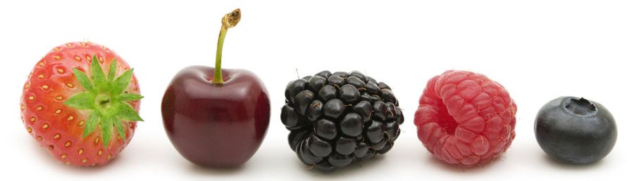
The Fruit of the Spirit

Slide 5
The Fruit of the Spirit
is the evidence of an individual abiding in Christ
No one can bear fruit outside of Christ
John 15:5
I am the vine, you are the branches; he who abides in Me and I in him, he bears much fruit, for apart from Me you can do nothing.

Slide 6
The Fruit of the Spirit
is the evidence of an individual abiding in Christ
No one can bear fruit outside of Christ
It is fair to judge a tree by its fruits
Matthew 3:8
Therefore bear fruit in keeping with repentance

Slide 7
The Fruit of the Spirit
is the evidence of an individual abiding in Christ
No one can bear fruit outside of Christ
It is fair to judge a tree by its fruits
Attributes cannot be taken on & off

Slide 8
The Fruit of the Spirit
is the product of the Holy Spirit dwelling in you
1st century Christians had different measures of H.S.
Acts 1:8
but you will receive power when the Holy Spirit has come upon you; and you shall be My witnesses both in Jerusalem, and in all Judea and Samaria, and even to the remotest part of the earth.”

Slide 9
The Fruit of the Spirit
is the product of the Holy Spirit dwelling in you
1st century Christians had different measures of H.S.
Hebrews 2:3-4; cf. Acts 8:14-18
…After it was at the first spoken through the Lord, it was confirmed to us by those who heard, God also testifying with them, both by signs and wonders and by various miracles and by gifts of the Holy Spirit according to His own will.

Slide 10
The Fruit of the Spirit
is the product of the Holy Spirit dwelling in you
1st century Christians had different measures of H.S.
Jesus promised the Holy Spirit to every believer
John 7:39
But this He spoke of the Spirit, whom those who believed in Him were to receive; for the Spirit was not yet given, because Jesus was not yet glorified.

Slide 11
The Fruit of the Spirit
is the product of the Holy Spirit dwelling in you
1st century Christians had different measures of H.S.
Jesus promised the Holy Spirit to every believer
Acts 2:38-39
Peter said to them, “Repent, and each of you be baptized in the name of Jesus Christ for the forgiveness of your sins; and you will receive the gift of the Holy Spirit. For the promise is for you and your children and for all who are far off, as many as the Lord our God will call to Himself.”

Slide 12
The Fruit of the Spirit
is the product of the Holy Spirit dwelling in you
1st century Christians had different measures of H.S.
Jesus promised the Holy Spirit to every believer
1 Corinthians 6:19
Or do you not know that your body is a temple of the Holy Spirit who is in you, whom you have from God, and that you are not your own?

Slide 13
The Fruit of the Spirit
is the product of the Holy Spirit dwelling in you
1st century Christians had different measures of H.S.
Jesus promised the Holy Spirit to every believer
Romans 8:9
However, you are not in the flesh but in the Spirit, if indeed the Spirit of God dwells in you. But if anyone does not have the Spirit of Christ, he does not belong to Him.

Slide 14
The Fruit of the Spirit
is the product of the Holy Spirit dwelling in you
1st century Christians had different measures of H.S.
Jesus promised the Holy Spirit to every believer
Spirit still at work within us today by His word
1 Corinthians 2:12-13
Now we have received, not the spirit of the world, but the Spirit who is from God, so that we may know the things freely given to us by God, which things we also speak, not in words taught by human wisdom, but in those taught by the Spirit, combining spiritual thoughts with spiritual words.

Slide 15
The Fruit of the Spirit
is the product of the Holy Spirit dwelling in you
1st century Christians had different measures of H.S.
Jesus promised the Holy Spirit to every believer
Spirit still at work within us today by His word
Holy Spirit
Testifies (John 15:26)………………………….
Saves (Titus 3:5)………………………………..
Teaches (1 Corinthians 2:13)……………….
Comforts (Acts 9:31)………………………….
Sanctifies (1 Corinthians 6:11)…………….
Reproves (John 16:8)………………………….
God’s Word
…………………………..Testifies (John 5:39)
………………………………Saves (James 1:21)
……………Teaches (2 Thessalonians 2:15)
…………Comforts (1 Thessalonians 4:18)
………………………..Sanctifies (John 17:17)
………………….Reproves (2 Timothy 3:16)

Slide 16
The Fruit of the Spirit
cannot be self-manufactured
Matthew 23:27-28
Woe to you, scribes and Pharisees, hypocrites! For you are like whitewashed tombs which on the outside appear beautiful, but inside they are full of dead men’s bones and all uncleanness. So you, too, outwardly appear righteous to men, but inwardly you are full of hypocrisy and lawlessness.

Slide 17
The Fruit of the Spirit
cannot be self-manufactured
1 Corinthians 13:1-3
If I speak with the tongues of men and of angels, but do not have love, I have become a noisy gong or a clanging cymbal. If I have the gift of prophecy, and know all mysteries and all knowledge; and if I have all faith, so as to remove mountains, but do not have love, I am nothing. And if I give all my possessions to feed the poor, and if I surrender my body to be burned, but do not have love, it profits me nothing.

Slide 18
The Fruit of the Spirit
is produced in all its parts in the believer
“fruit” collective noun designating a harvest
Not 9 individual fruits but 9 parts of the harvest
The Holy Spirit does not make lopsided Christians!
The Spirit’s work is to produce the fully integrated character of Jesus Christ in your life.

Slide 19
The Fruit of the Spirit
Philippians 1:6
being confident of this very thing, that He who has begun a good work in you will complete it until the day of Jesus Christ

