Slide 1
Scripture Reading: 1 John 4:9

Slide 2
(1 John 4:9)
In this the love of God was manifested toward us, that God has sent His only begotten Son into the world, that we might live through Him.

Slide 4
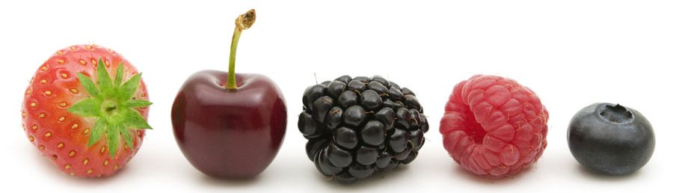
LOVE

Slide 5
LOVE
is the greatest commandment
(Mt. 22:34-40; cf. Deut. 6:5; Lev. 19:18)

Slide 6
LOVE
is the greatest commandment
is the fulfillment of the Law
(Rom. 13:8-10)

Slide 7
LOVE
is the greatest commandment
is the fulfillment of the Law
is the eternal debt we owe
(Rom. 13:8)

Slide 8
LOVE
is the greatest commandment
is the fulfillment of the Law
is the eternal debt we owe
is the defining kingdom characteristic
(1 Cor. 13:1-3; Jn. 13:34-35)

Slide 9
LOVE
is what exactly?
AGAPE
ATTITUDE
ACTION
“Love is unconquerable goodwill”
–Barclay

Slide 10
LOVE
how is it perfected in me?
“AGAPE” must be taught by God
(1 Pet. 1:22-23; 1 Thess. 4:9)

Slide 11
LOVE
how is it perfected in me?
The real test of perfect “AGAPE”
is whether or not I love people who hate me
(Mt. 5:43-48)

Slide 12
LOVE
“perfect”
TELEIOS
MATURE
COMPLETE
(1 Jn. 4:7-12)

Slide 13
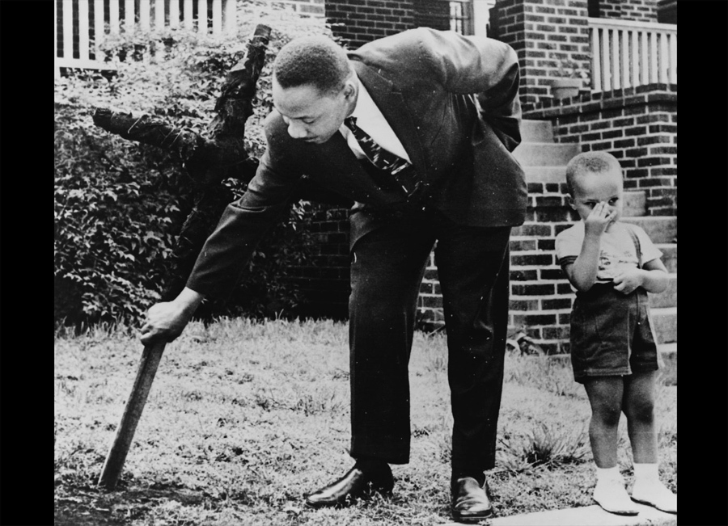
“The ultimate weakness of violence is that it is a descending spiral, begetting the very thing it seeks to destroy. Instead of diminishing evil, it multiplies it. Through violence you may murder the liar, but you cannot murder the lie, nor establish the truth…

Slide 14
Through violence you may murder the hater, but you do not murder hate. In fact, violence merely increases hate. So it goes. Returning violence for violence multiplies violence, adding deeper darkness to a night already devoid of stars. Darkness cannot drive out darkness: only light can do that. Hate cannot drive out hate: only love can do that.”
Dr. Martin Luther King, Jr.

