Slide 1
Scripture Reading: Mt.1:18-25

Slide 2
Matthew 1:18-25
Now the birth of Jesus Christ was as follows: After His mother Mary was betrothed to Joseph, before they came together, she was found with child of the Holy Spirit. Then Joseph her husband, being a just man, and not wanting to make her a public example, was minded to put her away secretly. But while he thought about these things, behold, an angel of the Lord appeared to him in a dream, saying, “Joseph, son of David, do not be afraid to take to you Mary your wife, for that which is conceived in her is of the Holy Spirit.

Slide 3
Matthew 1:18-25
And she will bring forth a Son, and you shall call His name Jesus, for He will save His people from their sins.” So all this was done that it might be fulfilled which was spoken by the Lord through the prophet, saying: “Behold, the virgin shall be with child, and bear a Son, and they shall call His name Immanuel,” which is translated, “God with us.” Then Joseph, being aroused from sleep, did as the angel of the Lord commanded him and took to him his wife, and did not know her till she had brought forth her firstborn Son. And he called His name Jesus.

Slide 5
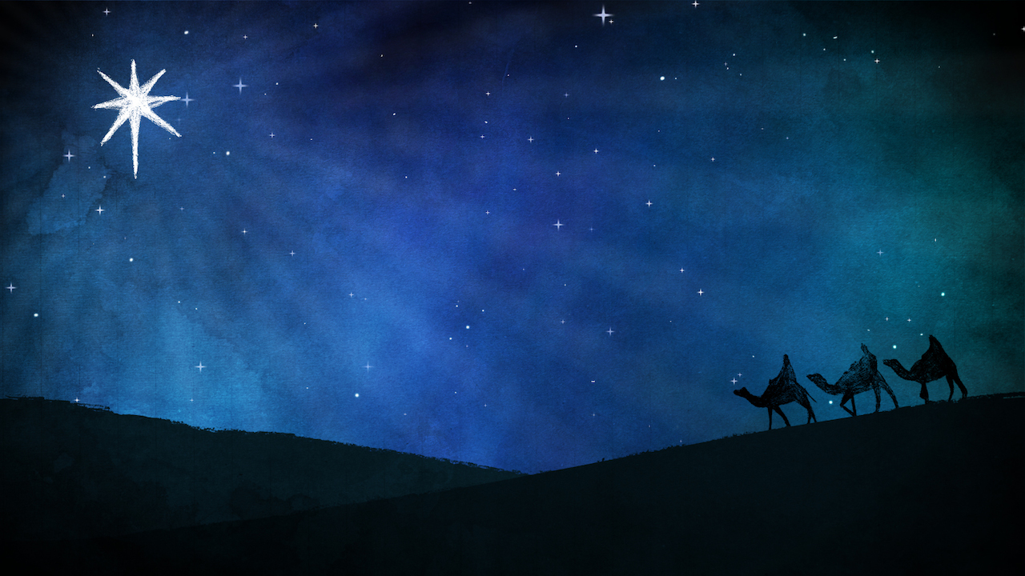
Christmas & the Bible
What year was Jesus born?
Presently: December 25, Anno Domini (AD) 2016
So… 2016 years ago, right?
0
AD 2016

Slide 6
Christmas & the Bible
What year was Jesus born?
Dionysius Exeguus (inventor of the “Anno Domini” system) placed the birth of Jesus at 753 AUS (‘Ab Urbe Condita’) which is our year zero (0)
… but Exeguus made a calendar error in AD 526
0
AD 2016

Slide 7
Christmas & the Bible
What year was Jesus born?
History verifies that Herod the Great (Mt. 2) died in 4 BC
4 BC
0
AD 2016

Slide 8
Christmas & the Bible
What year was Jesus born?
Cannot verify with specificity the date of the census of Caesar Augustus (Lk. 2:1)
6 BC
4 BC
0
AD 2016

Slide 9
Christmas & the Bible
What year was Jesus born?
Cannot verify with specificity the date of the census of Caesar Augustus (Lk. 2:1)
8 BC
4 BC
0
AD 2016

Slide 10
Christmas & the Bible
What year was Jesus born?
We don’t know but it probably wasn’t our year zero (0)
8 BC
4 BC
0
AD 2016

Slide 11
Christmas & the Bible
What about the month & the day?
Luke 2:8
Jan
Feb
Mar
Apr
May
Jun
Jul
Aug
Sep
Oct
Nov
Dec

Slide 12
Christmas & the Bible
What about the month & the day?
“According to this statement, Jesus cannot have been born in December, in the middle of the rainy season, as has been since the fourth century supposed. According to Jewish history, the driving forth of flocks took place in March, the bringing in of them in November.”
- ‘Critical and Exegetical Handbook to the Gospels of Mark and Luke,’ H.A.W. Meyer, pg. 273
Jan
Feb
Mar
Apr
May
Jun
Jul
Aug
Sep
Oct
Nov
Dec

Slide 13
“It was the custom among the Jews to send out their sheep to the deserts, about the Passover, and bring them home at the commencement of the first rain; during the time they were out, the shepherds watched them night and day. As the Passover occurred in the spring, and the first rain began in the month of Marchesvan, which answers to our part of October and November, we find that the sheep were kept out in the open country during the whole summer. And as these shepherds had not yet brought home their flocks, it is a presumptive argument that October had not yet commenced, and that, consequently, our Lord was not born on the 25th of December, when no flocks were out in the fields.”
-Adam Clarke’s Commentary, pg. 857

Slide 14
Christmas & the Bible
What about the month & the day?
We don’t know but it probably wasn’t December 25th
Jan
Feb
Mar
Apr
May
Jun
Jul
Aug
Sep
Oct
Nov
Dec

Slide 15
Christmas & the Bible
When was this “holy day” first observed?
Rome
0
AD 354

Slide 16
Christmas & the Bible
When was this “holy day” first observed?
Rome
Constantinople
0
AD 354
AD 379

Slide 17
Christmas & the Bible
When was this “holy day” first observed?
Rome
Constantinople
Antioch
0
AD 354
AD 379
AD 388

Slide 18
Christmas & the Bible
When was this “holy day” first observed?
John Chrysostom (A.D. 349-407, Archbishop of Constantinople) said in A.D. 386 “It is not ten years since the day was clearly known to us…”
-Unger Bible Dictionary, pg. 196

Slide 19
Christmas & the Bible
When was this “holy day” first observed?
“Christmas was not among the earliest festivals of the church, and before the fifth century there was no general consensus of opinion as to when it should come in the calendar, whether January 6th, March 25th, or December 25th.”
-Encyclopedia Britannica, Vol. 5, pg. 641

Slide 20
Christmas & the Bible
Revealing commentary from theologians…
“The exact time of His birth is unknown. There is no way to ascertain it. By different learned men it has been fixed at each month of the year. Nor is it of consequence to know the time. If it were, God would have preserved the record of it. Matters of moment are clearly revealed. Those which He regards as of no importance are concealed.”
-Albert Barnes (Presbyterian)

Slide 21
Christmas & the Bible
Revealing commentary from theologians…
“Christmas was not among the earliest festivals of the church.”
-Catholic Encyclopedia (Approved)

Slide 22
Christmas & the Bible
Revealing commentary from theologians…
“The time in which Christ was born has been considered a subject of great importance by Christians. However, the matter has been considered of no moment by Him who inspired the evangelist as not one hint is dropped on the subject by which it might be possible to guess nearly to the time. Learned and pious men have trifled egregiously on this subject making of importance that which the Holy Spirit by his silence has plainly informed is of none.”
-Adam Clarke (Methodist)

Slide 23
Christmas & the Bible
Why was December 25th chosen?
4th Century A.D., people began to observe a festival known as Epiphany (appearing) on January 6th

Slide 24
Christmas & the Bible
Why was December 25th chosen?
In order to distinguish themselves from this heretical teaching about the divinity of Jesus, others began to celebrate the birthday of Jesus—thus declaring his deity from birth

Slide 25
Christmas & the Bible
Why was December 25th chosen?
A.D. 325, Constantine makes peace btw Roman Empire & Christianity, and begins to Christianize old pagan festivals

Slide 26
Christmas & the Bible
Why was December 25th chosen?
Romans used winter solstice (when days begin to get longer) as a yearly marker

Slide 27
Christmas & the Bible
Why was December 25th chosen?
Bishop Liberius (bishop of Rome), on December 25th, A.D. 360, “Consecrated one Marcella who was a sister of Ambrose, a nun or bride of Christ and addressed her with these words: ‘You see what multitudes are come to the birth festival of your bridegroom.’”
-Schaff’s History of the Christian Church

Slide 28
Christmas & the Bible
Why was December 25th chosen?
“Numerous theories have been put forward through the last 2,000 years to explain December 25th as Christmas Day. The most likely one however, the one most generally accepted by scholars now is that the birth of Christ was assigned to the date of the winter solstice. This date is December 21st in our calendar, but was December 25th in the Julian calendar which predated our own.

Slide 29
Christmas & the Bible
Why was December 25th chosen?
“The solstice, when days begin to lengthen in the northern hemisphere was referred to by pagans as ‘The Birthday of the Unconquered Sun.’ During the third century, the Emperor Aurelian proclaimed December 25th as a special day dedicated to the Sun-god, whose cult was very strong in Rome at that time. Even before this time, Christian writers had already begun to refer to Jesus as the Sun of Justice.

Slide 30
Christmas & the Bible
Why was December 25th chosen?
“It seemed quite logical, therefore, that as Christianity began to dominate the Roman Empire, the date of the ‘new-born Sun’ should be chosen as the birthdate of Christ. Apparently, it bothers some people that the date for Christmas has its roots in a pagan feast. Be that as it may, it’s the best explanation we have for the choice of December 25th to celebrate the birth of Jesus.”
- “The Question Box,” Catholic Catechism, pg. 28-29

Slide 31
Christmas & the Bible
Why was December 25th chosen?
“Christmas” = Christ-mass

Slide 32
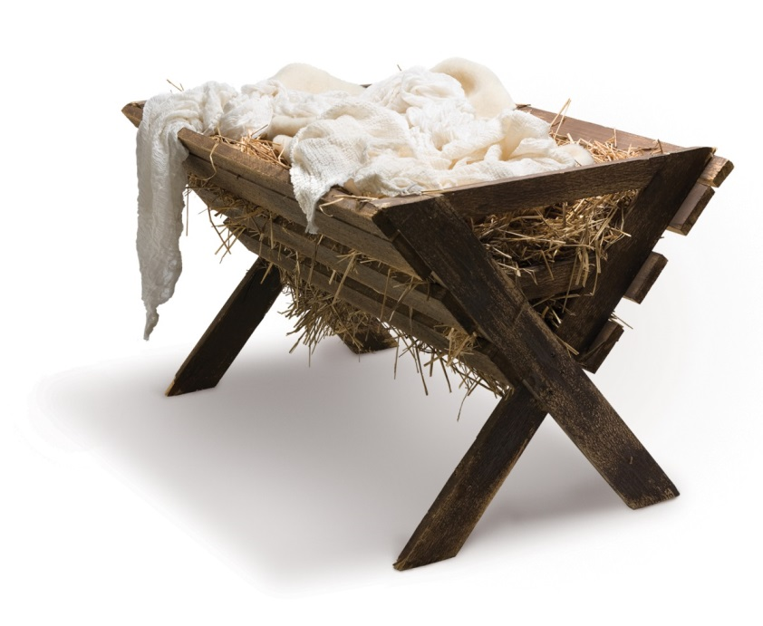
Christmas & the Bible
Where was Jesus born?
(Mt. 2:1)—Bethlehem
(Lk. 2:6-7)—Manger outside the inn

Slide 33
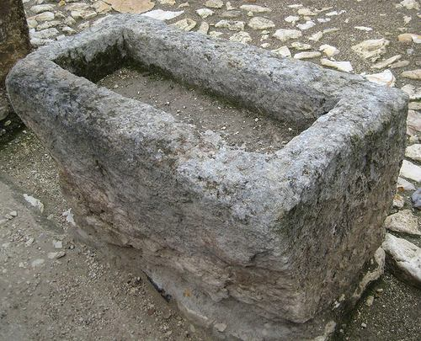
Christmas & the Bible
Where was Jesus born?
(Mt. 2:1)—Bethlehem
(Lk. 2:6-7)—Manger outside the inn

Slide 34
Christmas & the Bible
Where was the manger?
Jerome records that the cave had been “defiled” from the time of Hadrian (AD 135) to the time of Constantine
“Finding no place in the town, Joseph took his portage in a certain cave in the village.”
-Justin Martyr c. AD 160

Slide 35
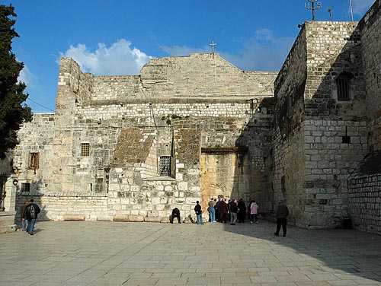
Christmas & the Bible
Where was the manger?
The Church of the Nativity
constructed over traditional
cave in Bethlehem

Slide 36
Christmas & the Bible
Comparing Biblical Accounts to Christmas Story
Matthew tells of the wise men & Luke tells of the shepherds
Lk. 2:8-14
Angel Visits Shepherds
Lk. 2:21
Infant Christ Circumcised
? days
8 days
41 days
Birth
Lk. 2:1-7
Mt. 1:18-25
Lk. 2:15-20
Shepherds Visit Infant Christ
in Bethlehem
Lk. 2:22-38; Lev. 12:1-8
Infant Christ
Presented to Lord at Temple

Slide 37
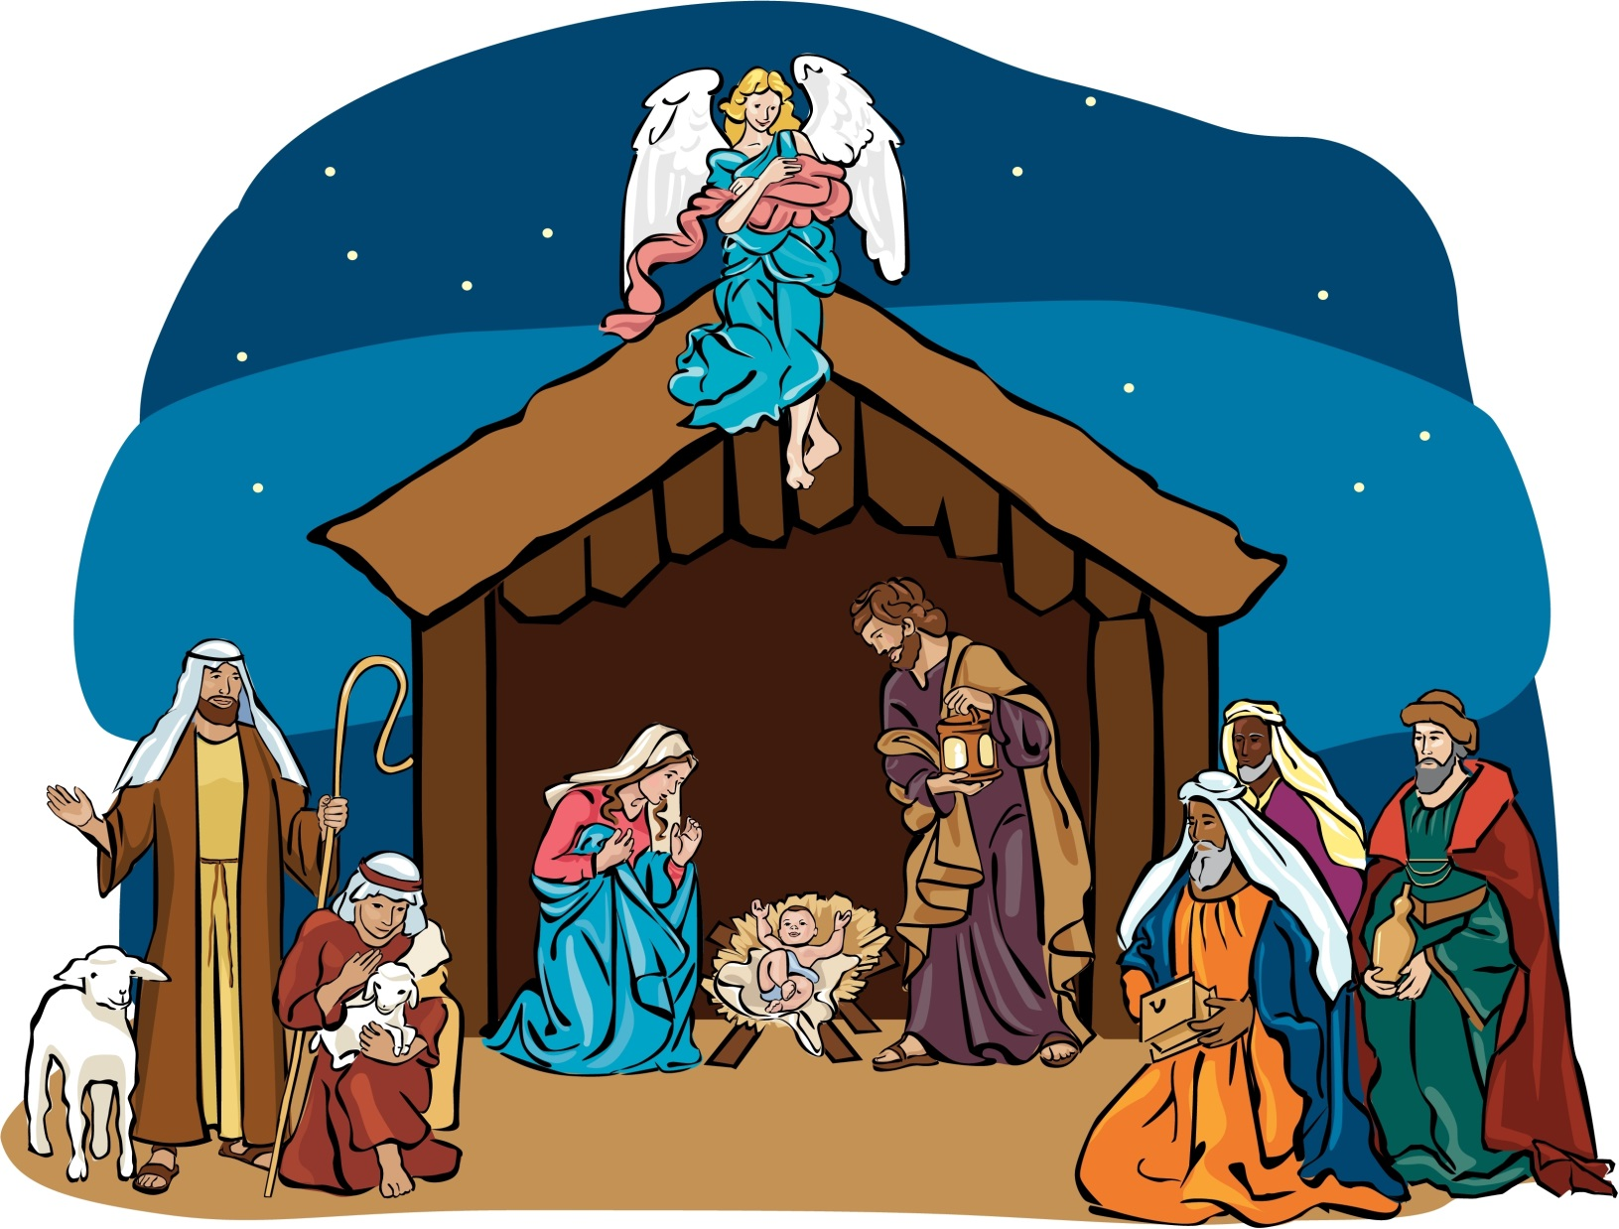

Slide 38
Christmas & the Bible
Comparing Biblical Accounts to Christmas Story
shows that the story didn’t happen the way so many millions of people take for granted
Lk. 2:8-14
Angels Visit Shepherds
Lk. 2:21
Infant Christ Circumcised
Mt. 2:1-16
“Child” Christ Visited by Magi
? days
8 days
41 days
Less than 2 years
Birth
Lk. 2:1-7
Mt. 1:18-25
Lk. 2:15-20
Shepherds Visit Infant Christ
in Bethlehem
Lk. 2:22-38; Lev. 12:1-8
Infant Christ
Presented to Lord at Temple

Slide 39
1 Timothy 3:16
Great indeed, we confess, is the mystery of godliness:
He was manifested in the flesh,
vindicated by the Spirit,
seen by angels,
proclaimed among the nations,
believed on in the world,
taken up in glory.

Slide 40
Hebrews 10:5-7
Consequently, when Christ came into the world, he said, “Sacrifices and offerings you have not desired, but a body have you prepared for me; in burnt offerings and sin offerings you have taken no pleasure. Then I said, ‘Behold, I have come to do your will, O God, as it is written of me in the scroll of the book.’”

Slide 41
Galatians 4:4-5
But when the fullness of time had come, God sent forth his Son, born of woman, born under the law, to redeem those who were under the law, so that we might receive adoption as sons.

