Slide 1
Scripture Reading: Hebrews 9:1-10

Slide 3
L e v i t i c u s
- an outline -

Slide 4
Paradox: God’s Holiness & Mankind’s Sin
Then the cloud covered the tent of meeting, and the glory of the Lord filled the tabernacle. Moses was not able to enter the tent of meeting because the cloud had settled on it, and the glory of the Lord filled the tabernacle.
Exodus 40:34-35

Slide 5
Paradox: God’s Holiness & Mankind’s Sin
Then the Lord called to Moses and spoke to him from the tent of meeting…
Leviticus 1:1

Slide 6
“Holy”
set apart, unique
God
Leviticus
Israel
sin, corruption

Slide 7
L e v i t i c u s
Leviticus: Israel Dwelling in God’s Presence
1-7
8-10
11-15
16-17
18-20
21-22
23-25
Ritual
Purity
Priesthood
Purity
Priesthood
Ritual

Slide 8
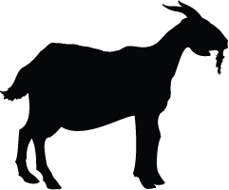
R i t u a l
1-7
“Atonement”
blood symbolically covers sin
1-7; 23-25
“Thank You”
Grain offering
Fellowship offering
“I’m Sorry”
Burnt offering
Sin offering
Guilt offering
Ritual Sacrifices

Slide 9
R i t u a l
1-7
23-25
1-7; 23-25
Remembrance
Passover
Unleavened Bread
First Fruits
Feast of Weeks/Pentecost
Day of Atonement
Tabernacles
Ritual Sacrifices
Ritual Feasts

Slide 10
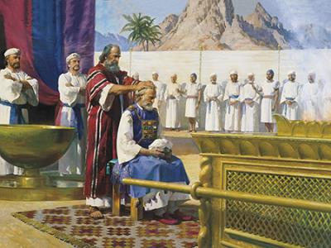
P r i e s t h o o d
8-10
8-10; 21-22
Priesthood Ordained

Slide 11
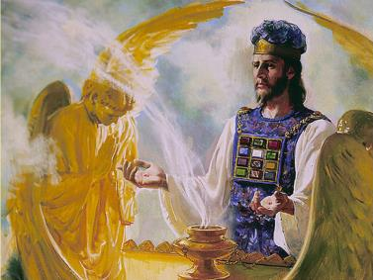
P r i e s t h o o d
8-10
21-22
8-10; 21-22
Priesthood Ordained
Priest Qualifications
YHWH
ISRAEL

Slide 12
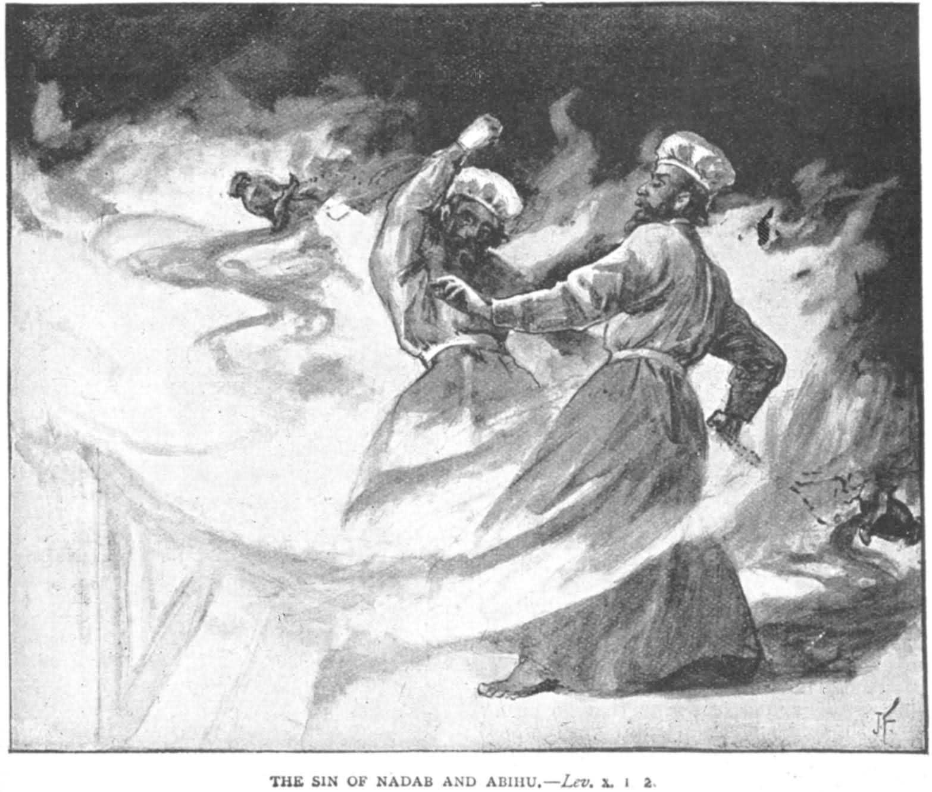
P r i e s t h o o d
8-10
21-22
8-10; 21-22
Priesthood Ordained
Priest Qualifications
Nadab & Abihu destroyed for disregarding God’s holiness

Slide 13
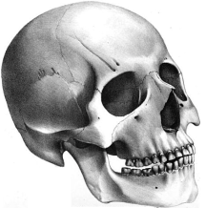
P u r i t y
11-15
11-15; 18-20
Laws
Skin disease
Touching mold/fungus
Contact w/ dead bodies
Dealing w/ bodily fluids
Death
Ritual Purity

Slide 14
P u r i t y
11-15
11-15; 18-20
Important:
Being ritually impure/unclean
is not sinful/wrong.
Ritual states are temporary.
Ritual Purity

Slide 15
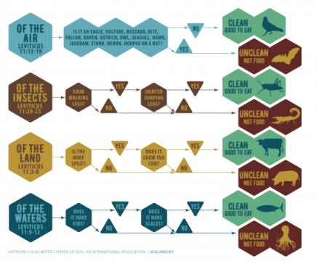
P u r i t y
11-15
11-15; 18-20
?
Ritual Purity
Clear:
God’s holiness affects every aspect of life, even diet.

Slide 16
P u r i t y
11-15
18-20
11-15; 18-20
Exodus 19:3-6
‘You yourselves have seen what I did to the Egyptians, and how I bore you on eagles’ wings, and brought you to Myself. Now then, if you will indeed obey My voice and keep My covenant, then you shall be My own possession among all the peoples, for all the earth is Mine; and you shall be to Me a kingdom of priests and a holy nation.’
Moral Purity
Ritual Purity

Slide 17
P u r i t y
11-15
18-20
11-15; 18-20
Sanctified
Israel
Care for poor; Promote social justice; Healthy relationships; Sexual integrity
Moral Purity
Ritual Purity

Slide 18
L e v i t i c u s
1-7
8-10
11-15
16-17
18-20
21-22
23-25
?
Ritual
Purity
Priesthood
Purity
Priesthood
Ritual

Slide 19
D a y o f A t o n e m e n t
16-17
Leviticus 17:11
For the life of the flesh is in the blood, and I have given it to you on the altar to make atonement for your souls; for it is the blood by reason of the life that makes atonement
Purification Offering

Slide 20
D a y o f A t o n e m e n t
16-17
Animal
Sacrifices?
Really??!!
Purification Offering
Scapegoat

Slide 21
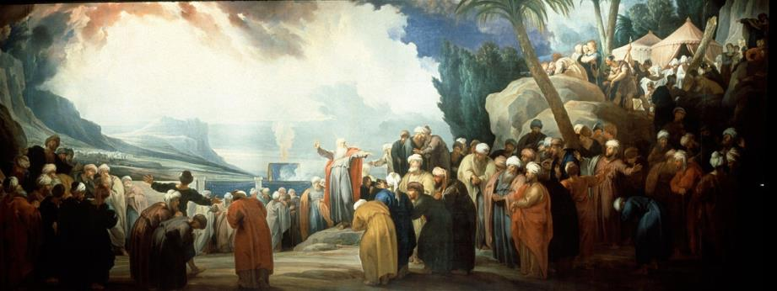
C o n c l u s i o n
26-27
Obedience → Blessing Disobedience → Cursing

Slide 22
Then the cloud covered the tent of meeting, and the glory of the Lord filled the tabernacle. Moses was not able to enter the tent of meeting because the cloud had settled on it, and the glory of the Lord filled the tabernacle.
Exodus 40:34-35

Slide 23
Then the Lord called to Moses and spoke to him from the tent of meeting
Leviticus 1:1

Slide 24
Then the Lord spoke to Moses in the wilderness of Sinai, in the tent of meeting…
Numbers 1:1

