Slide 1
Scripture Reading: Psalm 50:7-15

Slide 2
(Psalm 50:7-15)
“Hear, O My people, and I will speak; O Israel, I will testify against you; I am God, your God. I do not reprove you for your sacrifices, And your burnt offerings are continually before Me. I shall take no young bull out of your house Nor male goats out of your folds. For every beast of the forest is Mine, The cattle on a thousand hills. I know every bird of the mountains, And everything that moves in the field is Mine. If I were hungry I would not tell you, For the world is Mine, and all it contains. Shall I eat the flesh of bulls Or drink the blood of male goats? Offer to God a sacrifice of thanksgiving And pay your vows to the Most High; Call upon Me in the day of trouble; I shall rescue you, and you will honor Me.”

Slide 4
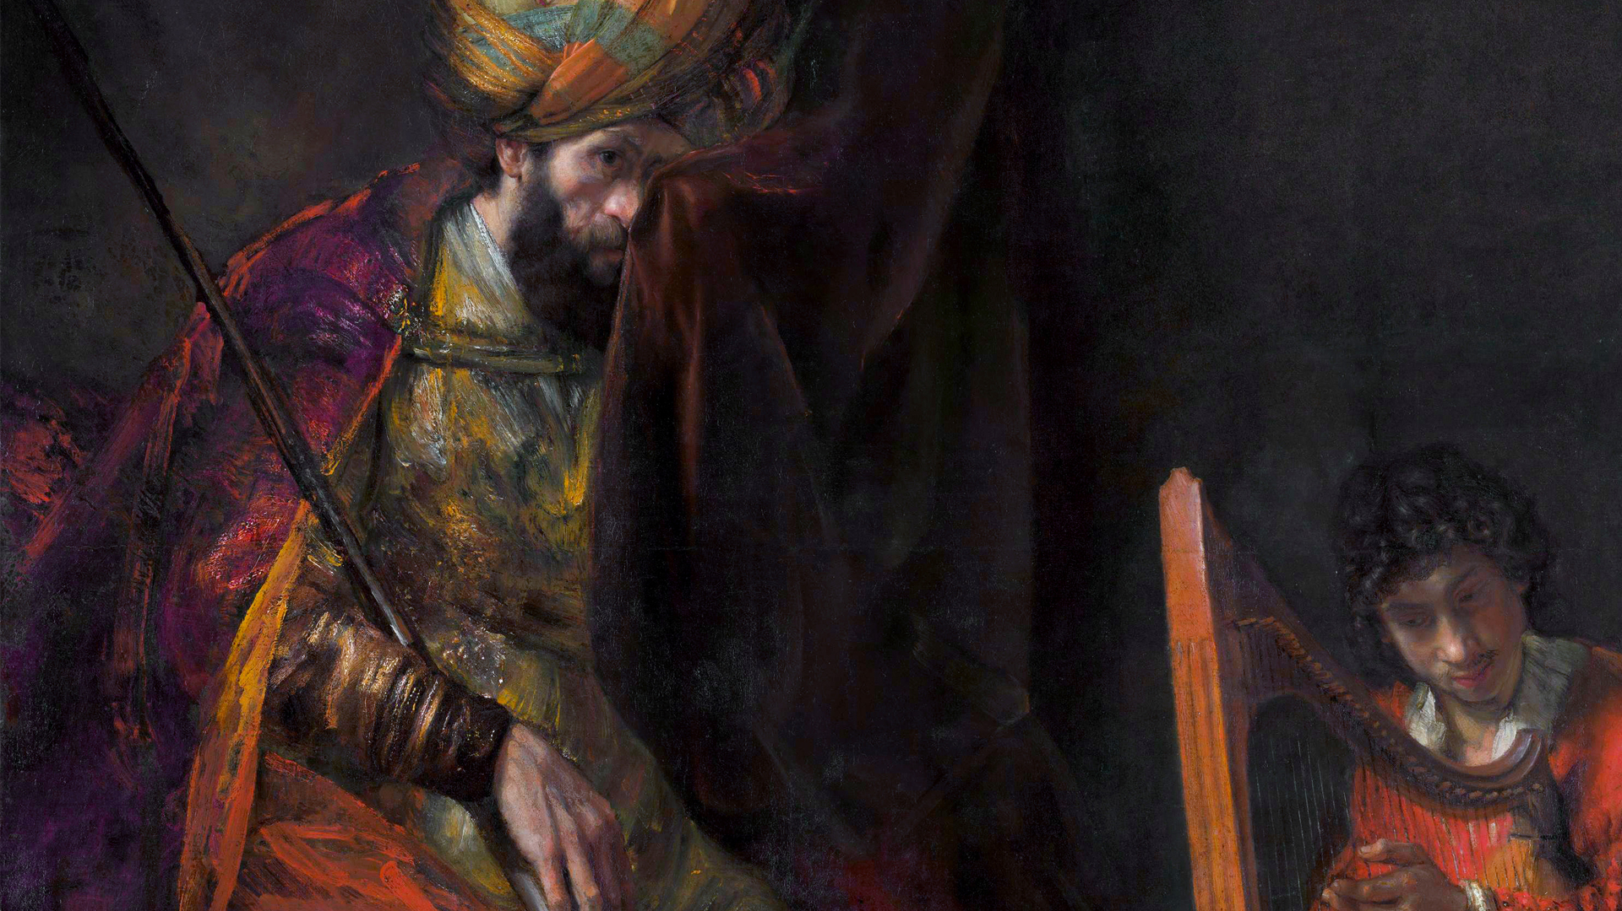
A Troubled king
The Legacy of King Saul

Slide 5
A Troubled King
The Legacy of King Saul
Saul’s Presumption (1 Samuel 13:8-15)
Naaman supposed leprosy healed a certain way (2 Kgs. 5:11)
Joseph & Mary supposed Jesus with them in caravan (Lk. 2:44)
Disciples on the sea supposed they saw Jesus’ ghost (Mk. 6:49)
Jews at Lystra supposed Paul was stoned dead (Acts 14:19)
Philippians jailer supposed prisoners escaped (Acts 16:27)
Jews at Jerusalem supposed Paul defiled temple (Acts 21:29)

Slide 6
A Troubled King
The Legacy of King Saul
Saul’s Presumption (1 Samuel 13:8-15)
(1 Thessalonians 5:21)
But examine everything carefully… (NASB)
Test everything… (ESV)

Slide 7
A Troubled King
The Legacy of King Saul
Saul’s Presumption cost him the kingdom!
What might we lose by our presumptive behavior?

Slide 8
A Troubled King
The Legacy of King Saul
Saul’s Foolishness (1 Samuel 14:24-33)
(Jeremiah 10:23)
I know, O Lord, that a man’s way is not in himself,
Nor is it in a man who walks to direct his steps.

Slide 9
A Troubled King
The Legacy of King Saul
Saul’s Foolishness (1 Samuel 14:24-33)
(Proverbs 16:25)
There is a way which seems right to a man,
But its end is the way of death.

Slide 10
A Troubled King
The Legacy of King Saul
Saul’s Foolishness (1 Samuel 14:24-33)
(Proverbs 20:24)
Man’s steps are ordained by the Lord,
How then can man understand his way?

Slide 11
A Troubled King
The Legacy of King Saul
Saul’s Foolishness (1 Samuel 14:24-33)
(Psalms 119:9, 105)
How can a young man keep his way pure?
By keeping it according to Your word.
Your word is a lamp to my feet
And a light to my path.

Slide 12
A Troubled King
The Legacy of King Saul
Saul’s Foolishness (1 Samuel 14:24-33)
God’s will is accessible (1 Cor. 2:10)
God’s will leads to life (Rom. 8:2)
God’s will is understandable (Eph. 5:17)
God expects His will to be followed (Rom. 1:5; 16:26)
(Romans 1:6; cf. 16:26)
…we have received grace and apostleship to bring about the obedience of faith among all the Gentiles for His name’s sake

Slide 13
A Troubled King
The Legacy of King Saul
Saul’s Foolishness led others into sin!
What destruction might we cause by our foolish choices?

Slide 14
A Troubled King
The Legacy of King Saul
Saul’s Disobedience (1 Samuel 15:1-35)
(Deuteronomy 25:17-19)
Remember what Amalek did to you along the way when you came out from Egypt, how he met you along the way and attacked among you all the stragglers at your rear when you were faint and weary; and he did not fear God. Therefore it shall come about when the Lord your God has given you rest from all your surrounding enemies, in the land which the Lord your God gives you as an inheritance to possess, you shall blot out the memory of Amalek from under heaven; you must not forget.

Slide 15
A Troubled King
The Legacy of King Saul
Saul’s Disobedience (1 Samuel 15:1-35)
(Amos 5:21-24; cf. Psalm 50:7-15)
I hate, I reject your festivals, Nor do I delight in your solemn assemblies. Even though you offer up to Me burnt offerings and your grain offerings, I will not accept them; And I will not even look at the peace offerings of your fatlings. Take away from Me the noise of your songs; I will not even listen to the sound of your harps. But let justice roll down like waters And righteousness like an ever-flowing stream.

Slide 16
A Troubled King
The Legacy of King Saul
Saul’s Disobedience (1 Samuel 15:1-35)
(Psalm. 51:16-17)
For You do not delight in sacrifice, otherwise I would give it; You are not pleased with burnt offering. The sacrifices of God are a broken spirit; A broken and a contrite heart, O God, You will not despise.

Slide 17
A Troubled King
The Legacy of King Saul
Saul’s Disobedience caused God to reject him!
Our disobedience will also cause us to fall from grace.

Slide 18
A Troubled King
The Legacy of King Saul
Saul’s legacy is one of tragedy, the inevitable outcome of a life lived according to the flesh.
(Romans 8:6-8)
For the mind set on the flesh is death, but the mind set on the Spirit is life and peace, because the mind set on the flesh is hostile toward God; for it does not subject itself to the law of God, for it is not even able to do so, and those who are in the flesh cannot please God.

