Slide 1
Scripture Reading: Proverbs 27:5-6

Slide 2
(Proverbs 27:5-6)
Open rebuke is better Than love carefully concealed.
Faithful are the wounds of a friend, But the kisses of an enemy are deceitful.

Slide 4
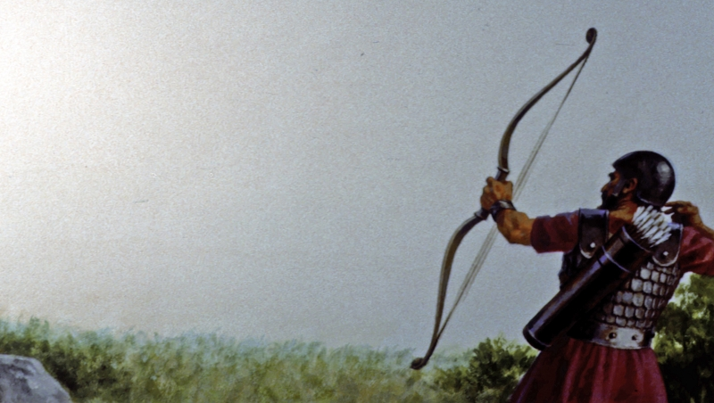
God’s Prophet Micaiah
5 unchanging truths in an ever-changing world

Slide 5
God’s Prophet Micaiah
It is better to be divided by truth than to be united by error.
5 unchanging truths in an ever-changing world

Slide 6
God’s Prophet Micaiah
It is better to speak the truth, which may hurt at first but heals later, than to tell a lie, which may comfort at first but destroys later.
5 unchanging truths in an ever-changing world

Slide 7
God’s Prophet Micaiah
It is better to be hated for telling the truth than to be loved for telling a lie.
5 unchanging truths in an ever-changing world

Slide 8
God’s Prophet Micaiah
It is better to stand alone with the truth than to be wrong with the multitude.
5 unchanging truths in an ever-changing world

Slide 9
God’s Prophet Micaiah
It is better to ultimately succeed with the truth than to temporarily succeed with a lie.
5 unchanging truths in an ever-changing world

