Slide 2
(1 John 1:7-9)
⁷ But if we walk in the light as He is in the light, we have fellowship with one another, and the blood of Jesus Christ His Son cleanses us from all sin. ⁸ If we say that we have no sin, we deceive ourselves, and the truth is not in us. ⁹ If we confess our sins, He is faithful and just to forgive us our sins and to cleanse us from all unrighteousness.

Slide 4
“I Am Willing; be cleansed"

Slide 5
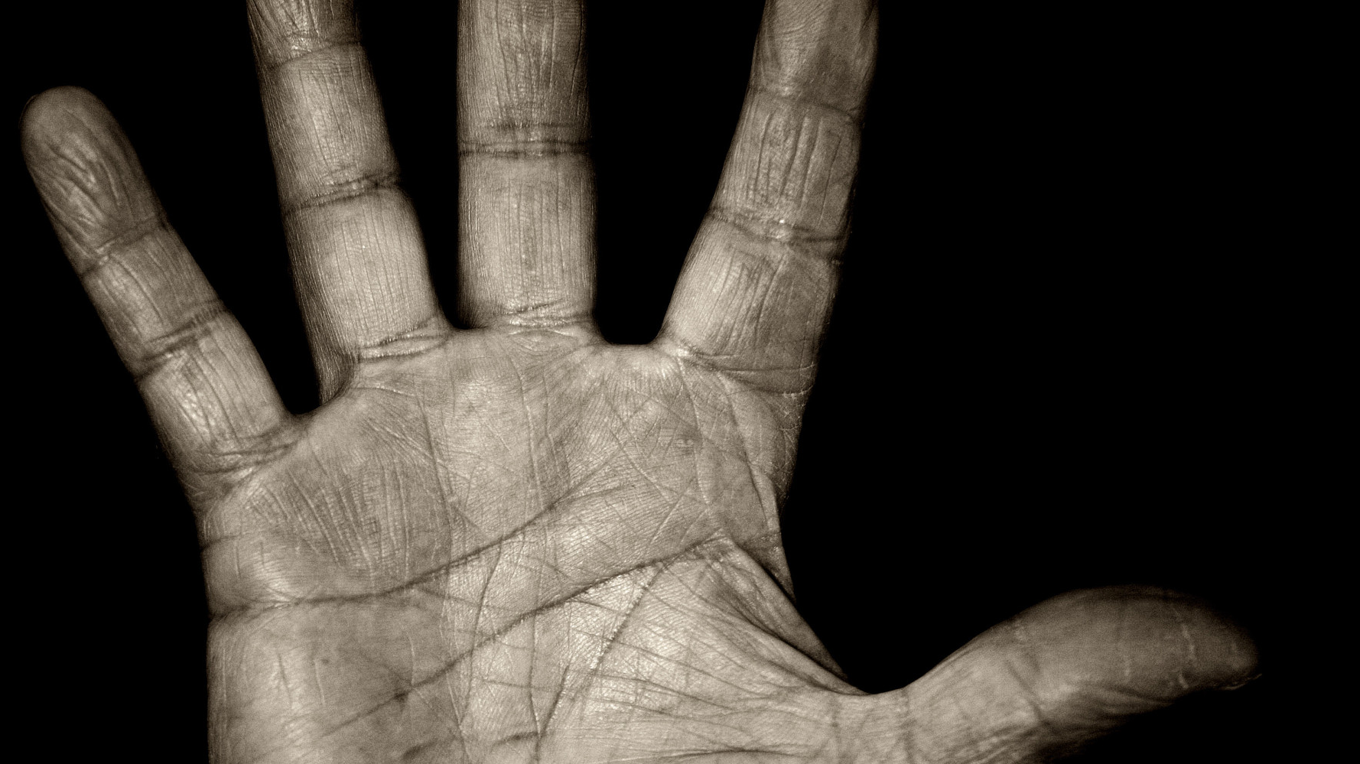
Jesus always practiced what he preached
(Mt. 8:1)
(Mt. 23:1-4)
(1 Cor. 9:27)

Slide 6
The leper came to Jesus in humility truly believing
(Mt. 8:2)
(2 Kgs. 5:7; Lev. 13:44ff; Lk. 5:12)

Slide 7
Jesus is always willing to cleanse us
(Mt. 8:3a)
(Mk. 1:41; Titus 2:5a; Jas. 1:15; Eph. 2:1; Num. 12:12)

Slide 8
The cleansing of jesus is immediate
(Mt. 8:3b-4)
(Mt. 10:8; 1 Jn. 1:7,9, Rom. 3:23-25; Lev. 14:2ff)

