Slide 1
Today’s Reading: 2 CORINTHIANS 13:7-14

Slide 2
2 Corinthians 13:7-14
⁷ Now I pray to God that you do no evil, not that we should appear approved, but that you should do what is honorable, though we may seem disqualified. ⁸ For we can do nothing against the truth, but for the truth. ⁹ For we are glad when we are weak and you are strong. And this also we pray, that you may be made complete. ¹⁰ Therefore I write these things being absent, lest being present I should use sharpness, according to the authority which the Lord has given me for edification and not for destruction. ¹¹ Finally, brethren, farewell. Become complete. Be of good comfort, be of one mind, live in peace; and the God of love and peace will be with you. ¹² Greet one another with a holy kiss. ¹³ All the saints greet you. ¹⁴ The grace of the Lord Jesus Christ, and the love of God, and the communion of the Holy Spirit be with you all. Amen.

Slide 4
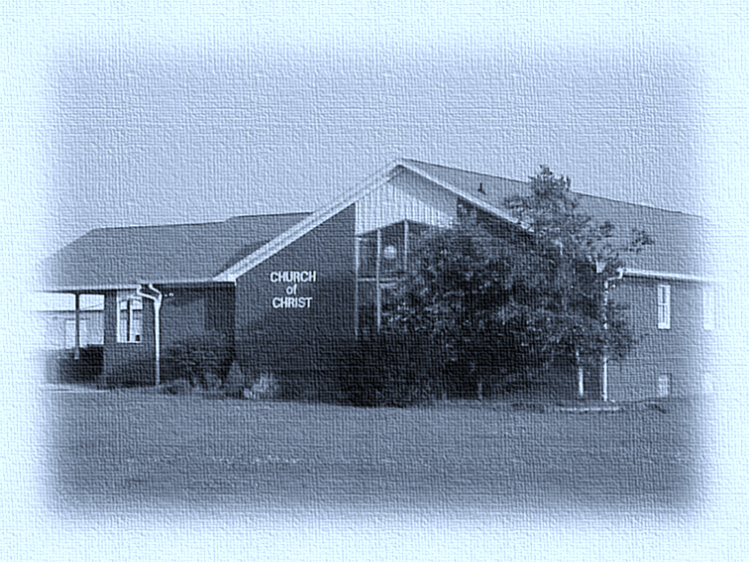

Slide 5
Finally, brethren, farewell. Become complete. Be of good comfort, be of one mind, live in peace; and the God of love and peace will be with you.
2 Corinthians 13:11
First Sermon: South End church of Christ—May 1974
“Appointment” preaching, Louisville, KY—1974
Shepherdsville church of Christ—Fall of 1974—Spring 1975
Willisburg church of Christ—1975—1978
Byrdstown church of Christ—1978—1979
Hickory Grove church of Christ—1979-1982
Lakeview church of Christ—1982—1987
Traders Point church of Christ—1987—2000
Danville church of Christ—Dec 3, 2000—Aug 21, 2016
Gospel Meetings in 21 States
Evangelism work in Nigeria, Ethiopia, Philippines

Slide 6
Now I beg you, brethren, through the Lord Jesus Christ, and through the love of the Spirit, that you strive together with me in prayers to God for me,
Romans 15:30
Together—we have witnessed many obey the gospel of Christ,
Together—we have seen the erring restored to the Lord,
Together—we have, with sorrow, disciplined the disorderly,
Together—we have said “goodbye” to those who have moved away,
Together—we have seen children born and grow up,
Together—we have watched as our young people married,
Together—we have buried our dead,
Together—we have weathered storms,
Together—we have created lasting memories—Phil 1:3, “I thank my God upon every remembrance of you. . .”

Slide 7
And I, brethren, when I came to you . . .
1 Corinthians 2:1
(vs 1) did not come with excellence of speech . . .
(vs 1) or of wisdom (of the world) declaring to you the testimony of God . . .
(vs 3) I was with you in weakness, in fear, and in much trembling . . .
(vs 4) And my speech and my preaching were not with persuasive words of human wisdom . . .
(vs 5) that your faith should not be in the wisdom of men but in the power of God.

Slide 9
For I bear him witness that he has a great zeal for you. . .
Colossians 4:13
Jerome & Rachael Sasanecki
(1 Thess 5:12-13) Give him recognition and respect . . .
(1 Cor 3:6-7) Give him understanding & patience . . .
(Acts 4:36) Give him “Barnabas” encouragement . . .
(Mk 9:17) Give him opportunities to evangelize . . .
(1 Cor 9:14) Give him adequate wages . . .
(1 Tim 4:12) Do not despise his youthfulness.

Slide 10
Finally, brethren, farewell. Become complete. Be of good comfort, be of one mind, live in peace; and the God of love and peace will be with you.
2 Corinthians 13:11
It’s not about me (or any man) [1 Cor 3:5; 2 Cor 4:7]
Continue to mature, grow [Acts 20:32]
Build up one another [1 Thess 5:11]
Maintain unity [Eph 4:1-3]
Be at peace [Rom 8:6; Rom 12:18; Matt 5:9]
God will bless and prosper you [Eph 3:19]

