Slide 1
Today’s Reading: MATTHEW 3:14-17

Slide 2
Matthew 3:13-17
¹³ Then Jesus came from Galilee to John at the Jordan to be baptized by him. ¹⁴ And John tried to prevent Him, saying, I need to be baptized by You, and are You coming to me? ¹⁵ But Jesus answered and said to him, permit it to be so now, for thus it is fitting for us to fulfill all righteousness. Then he allowed Him. ¹⁶ When He had been baptized, Jesus came up immediately from the water; and behold, the heavens were opened to Him, and He saw the Spirit of God descending like a dove and alighting upon Him. ¹⁷ And suddenly a voice came from heaven, saying, this is My beloved Son, in whom I am well pleased.

Slide 4

The Holy Spirit and the birth of Jesus
And the angel answered and said to her, the Holy Spirit will come upon you, and the power of the Highest will overshadow you; therefore, also, that Holy One who is to be born will be called the Son of God.
Luke 1:35

Slide 5


Slide 6


Slide 7
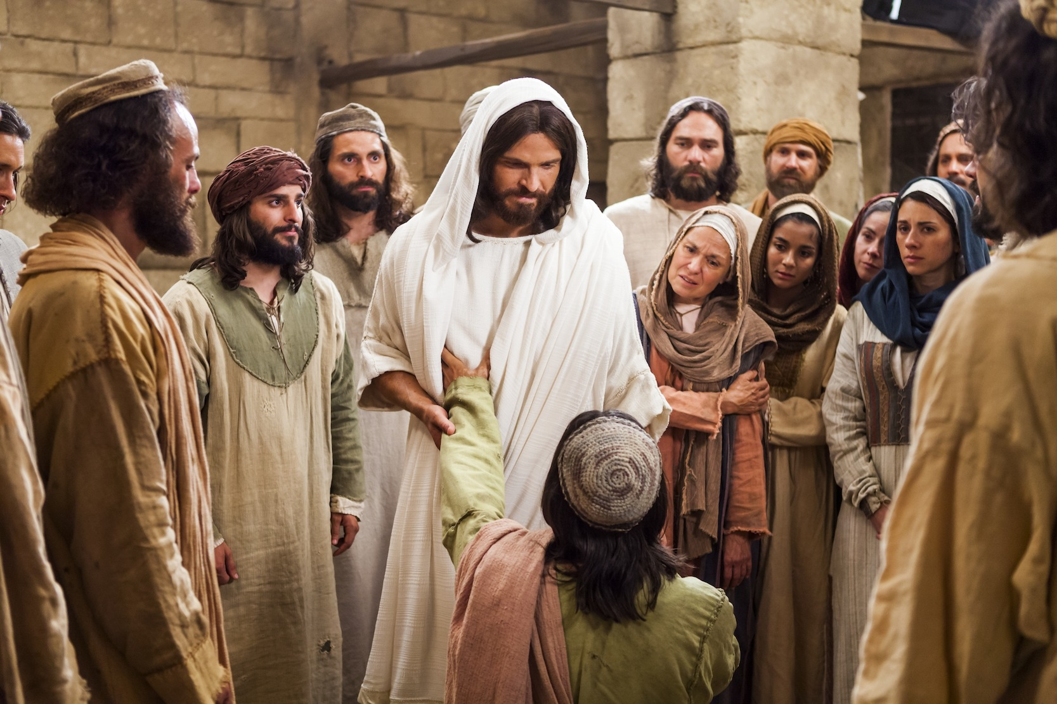
The Intrinsic Power of Jesus
Mk 2:10-11
Mk 1:23-25
Matt 8:2-3
Jn 10:17-18
Forgive Sins
Heal all Sick
Cast out Demons
Give & Reclaim His life

Slide 8


Slide 9
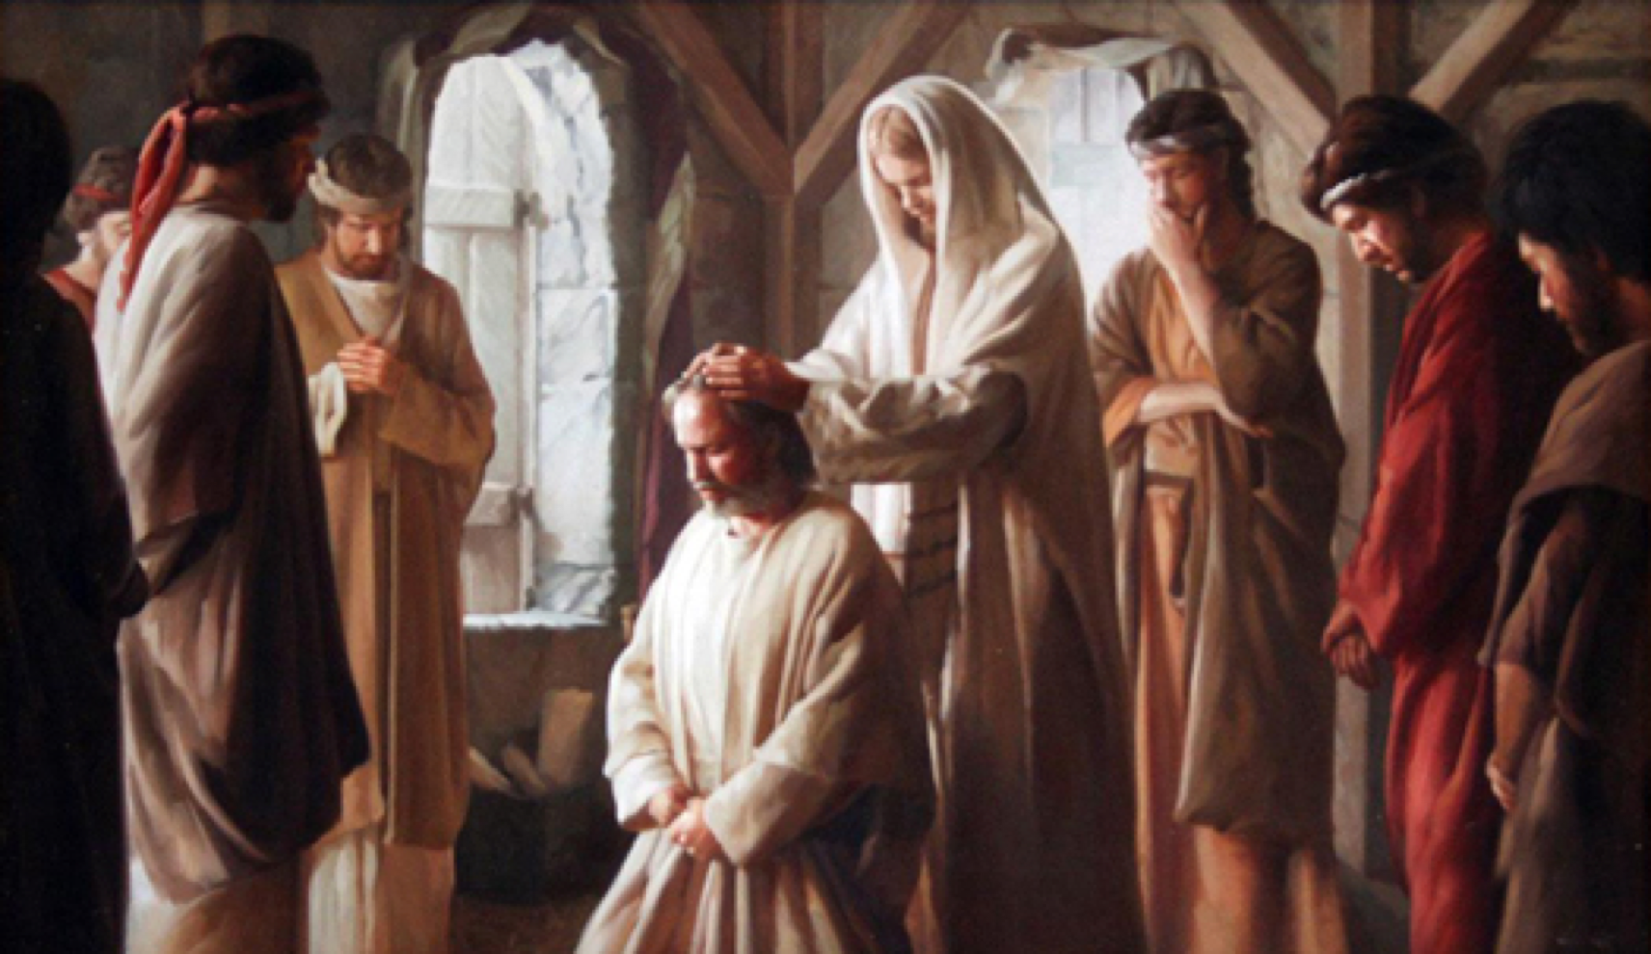
The Apostles’ and the Holy Spirit
Word of Wisdom
Word of Knowledge
Faith
Healings
Working of Miracles
Prophecy
Discerning of Spirts
Tongues
Interpretations of Tongues

