Slide 1
Today’s Reading: Acts 5:1-4

Slide 3
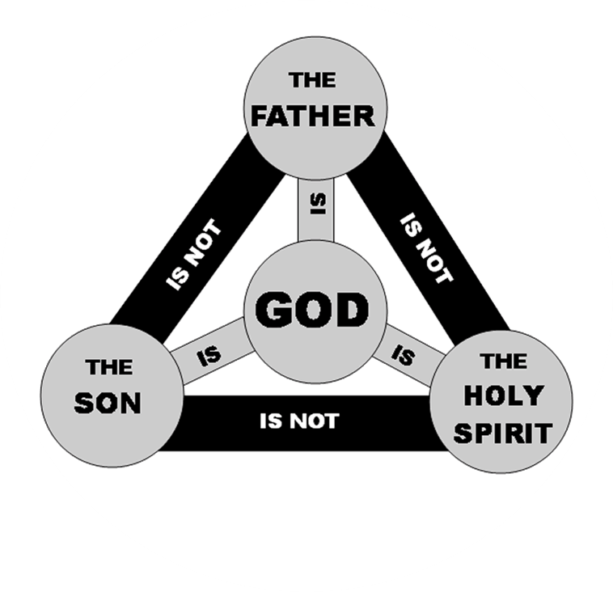
Col 2:9, “For in Him dwells all the fullness of the Godhead bodily . . .”

Slide 5
Eternal: (Heb 9:14)
Omnipresent: (Psa 139:7-10)
Omniscient: (1 Cor 2:10-11)
Omnipotent (1 Cor 12:8-11)

Slide 10
The Intrinsic Power of Jesus
Mk 2:10-11
Mk 1:23-25
Matt 8:2-3
Jn 10:17-18
Forgive Sins
Heal all Sick
Cast out Demons
Give & Reclaim His life

Slide 12
The Apostles’ and the Holy Spirit
Word of Wisdom
Word of Knowledge
Faith
Healings
Working of Miracles
Prophecy
Discerning of Spirts
Tongues
Interpretations of Tongues

