Slide 1
Today’s Reading: 2 TIMOTHY 2:14-19

Slide 2
2 Timothy 2:14-19
¹⁴ Remind them of these things, charging them before the Lord not to strive about words to no profit, to the ruin of the hearers. ¹⁵ Be diligent to present yourself approved to God, a worker who does not need to be ashamed, rightly dividing the word of truth. ¹⁶ But shun profane and idle babblings, for they will increase to more ungodliness. ¹⁷ And their message will spread like cancer. Hymenaeus and Philetus are of this sort, ¹⁸ who have strayed concerning the truth, saying that the resurrection is already past; and they overthrow the faith of some. ¹⁹ Nevertheless the solid foundation of God stands, having this seal: The Lord knows those who are His, and, let everyone who names the name of Christ depart from iniquity.

Slide 4
The Second Coming of Christ Occurred More Than 1900 Year Ago
Also, At That Same Time Jesus Inaugurated The Eternal Kingdom
At That Time The Resurrection Of All The Dead Happened
And, At That Time The Final Judgment Took Place
And, The World Ended More Than 1900 Years Ago in 70 AD

Slide 5
“The Holy Scriptures teach that the second coming of Christ, including the establishment of the eternal kingdom, the day of judgment, the end of the world and the resurrection of the dead occurred with the fall of Judaism in A.D. 70.” (Max King, July 1973)
“The holy Scriptures teach that the second coming of Christ, including the establishment of the eternal kingdom, the day of judgment, the end of the world and the resurrection of the dead occurred with the fall of Jerusalem in 70 A.D.” (Charles Geiser)

Slide 6
The A.D. 70 Doctrine
Realized Eschatology
Full / Hyper Preterism
“Kingism”
Max King

Slide 7
That which has been is what will be, that which is done is what will be done, and there is nothing new under the sun (Eccl 1:9).
145 B.C. (1 Maccabees 1:54-55)
On the fifteenth day of Chislev in the year 145 the king built the appalling abomination on top of the altar of burnt offering; and altars were built in the surrounding towns of Judah and incense offered at the doors of houses and in the streets.
1st Century AD. (2 Tim 2:17-18)
And their message will spread like cancer. Hymenaeus and Philetus are of this sort, who have strayed concerning the truth, saying that the resurrection is already past; and they overthrow the faith of some.
17th Century: Luis de Alcazar
1878: James S. Russell
1971: Max R. King

Slide 8
Militant Movement
“Becoming a Preterist was not something that I just decided to do one day . . . When (a friend) told me about it, I thought he had lost his mind . . . I made every attempt I could to find cracks in his theology . . . Since all my attempts to destroy it failed, I was then sold out and had to believe what the scriptures say.” (a personal letter to me, jrb)

Slide 9
Thousands of Websites

Slide 10
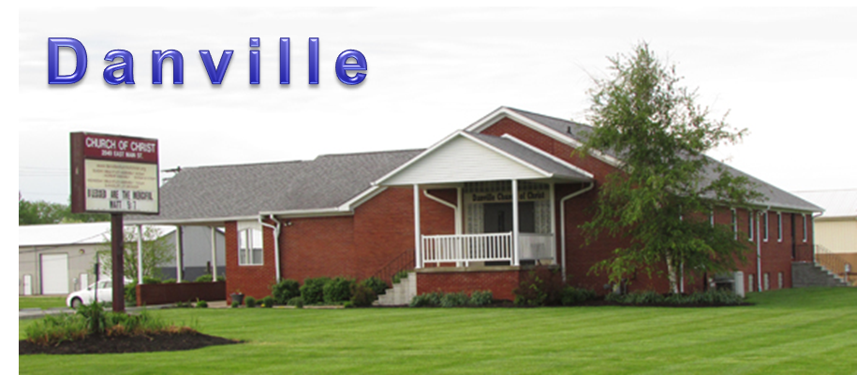
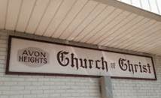
Area Churches

Slide 11
70AD
Earth continues eternally
eschaton
From 70 AD onward—all are living “in the resurrection,” & after the return of Christ.
No future resurrection
No future judgment
No souls in Hades
Messianic Reign
40-Years
“Kingdom of Christ”
Destruction of Jerusalem
2nd Coming
“Kingdom of God”
[full glory & power]
Resurrection
Final Judgment
End of the World
This means that during the eschaton (climax of history, jrb) the believers lived in a tension of experienced and anticipated eschatology; between “the already” and “the not yet.” They were already in the kingdom of Christ (Col 1:13), but still waiting for the coming of the kingdom of God (1 Cor 15:24-28). (Max King, “The Cross and the Parousia of Christ,” p32)

Slide 12
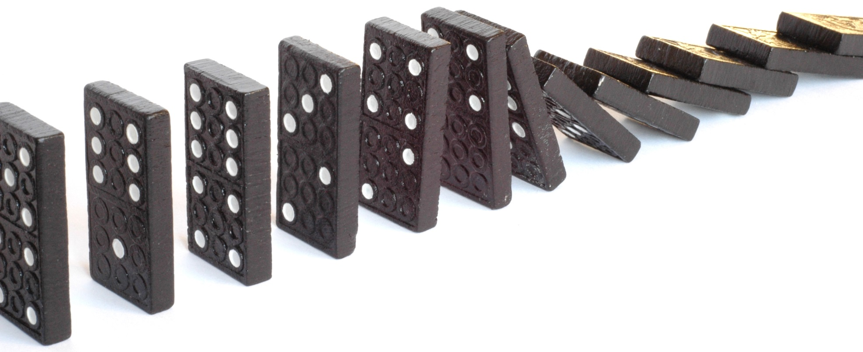
Consequences
It cannot be simply a matter of opinion (Gal 1:6-9)
It denies the one hope of believers (Eph 4:4; Rom 8:23-25)
It renders Pentecost irrelevant (Acts 2: Acts 11:15)
It totally rejects a coming day of Judgment (Jn 12:48; Acts 17:31)
It denies a future resurrection of the dead (1 Cor 15:12; Jn 11:23-24)

Slide 13
Says, the Kingdom of God came with glory and power in 70 AD not on the day of Pentecost in Acts 2.
Daniel 2:44
Luke 2:1-2
Galatians 4:4
2 Sa 7:12-16
Acts 2:29-36
Luke 1:32-37
But the Scriptures teach that it came with glory and power on the Day of Pentecost in Acts 2!

Slide 14
But, the Kingdom of God came with glory and power on the day of Pentecost in Acts 2, NOT 70 AD.
2 Sam 7:
12 When your days are fulfilled and you rest with your fathers, I will set up your seed after you, who will come from your body, and I will establish his kingdom.
13 He shall build a house for My name, and I will establish the throne of his kingdom forever.
14 I will be his Father, and he shall be My son.
Acts 2:
30 Therefore, being a prophet, and knowing that God had sworn with an oath to him that of the fruit of his body, according to the flesh, He would raise up the Christ to sit on his throne,
31 he, foreseeing this, spoke concerning the destruction of Jerusalem, that His soul was not left in Hades, nor did His flesh see corruption.
32 This Jesus God has raised up, of which we are all witnesses.
Acts 2:
30 Therefore, being a prophet, and knowing that God had sworn with an oath to him that of the fruit of his body, according to the flesh, He would raise up the Christ to sit on his throne,
31 he, foreseeing this, spoke concerning the resurrection of the Christ, that His soul was not left in Hades, nor did His flesh see corruption.
32 This Jesus God has raised up, of which we are all witnesses.
A Perversion

Slide 15
Says, the Second coming of Christ is past, having happened in 70 AD, and will not occur in the future.
“There is no time period between the fall of Jerusalem and the second coming of Christ. They are synchronous events time-wise . . . There is no scriptural basis for extending the second coming of Christ beyond the fall of Judaism.” (Max King - The Spirit of Prophecy, p 81, 105).
All 2nd coming passages point to the destruction of Jerusalem in A.D. 70.
There will NOT be a return of Christ beyond His “coming” at the destruction of Jerusalem in A.D. 70.
How do they reach such a conclusion?

Slide 16
Says, the Second coming of Christ is past, having happened in 70 AD, and will not occur in the future.
It is absolutely true that Jesus “came in judgment” upon Jerusalem, this is what the Bible says.
Matt 24:30-31
30 Then the sign of the Son of Man will appear in heaven, and then all the tribes of the earth will mourn, and they will see the Son of Man coming on the clouds of heaven with power and great glory.
31 And He will send His angels with a great sound of a trumpet, and they will gather together His elect from the four winds, from one end of heaven to the other.
Matt 10:23
23 When they persecute you in this city, flee to another. For assuredly, I say to you, you will not have gone through the cities of Israel before the Son of Man comes.
Luke 21:24,27
24 And they will fall by the edge of the sword, and be led away captive into all nations. And Jerusalem will be trampled by Gentiles until the times of the Gentiles are fulfilled.
27 Then they will see the Son of Man coming in a cloud with power and great glory.

Slide 17
The many "Comings” of
Jesus Christ

Slide 18
The birth of Jesus was a "coming"
Malachi 3:1 & 4:5
Behold, I send My messenger, and he will prepare the way before Me. And the Lord, whom you seek, will suddenly come to His temple, even the Messenger of the covenant, in whom you delight. Behold, He is coming, says the LORD of hosts.
Behold, I will send you Elijah the prophet before the coming of the great and dreadful day of the LORD.

Slide 19
There are representative "comings" of Christ
He “comes” in Spiritual Fellowship
Revelation 3:20
Behold, I stand at the door and knock. If anyone hears My voice and opens the door, I will come in to him and dine with him, and he with Me.
He “comes” through His Word
John 14:23
Jesus answered and said to him, if anyone loves Me, he will keep My word; and My Father will love him, and We will come to him and make Our home with him.
He “comes” in local church judgment
Church at Pergamos Revelation 2:16
Repent, or else I will come to you quickly and will fight against them with the sword of My mouth.

Slide 20
There are conditional "comings" of Christ
Repentance could prevent His “coming”
Revelation 2:5
Remember therefore from where you have fallen; repent and do the first works, or else I will come to you quickly and remove your lampstand from its place-- unless you repent.

Slide 21
There was the "coming" of Christ upon Jerusalem
Matthew 24:30
Then the sign of the Son of Man will appear in heaven, and then all the tribes of the earth will mourn, and they will see the Son of Man coming on the clouds of heaven with power and great glory.
Matthew 22:7
But when the king heard about it, he was furious. And he sent out his armies, destroyed those murderers, and burned up their city.

Slide 22
There is a future coming of Jesus
Hebrews 9:28
John 14:1-3
Acts 1:9-11
1 John 3:2
1 Cor 15:23-26
1 Thess 4:16-17

Slide 23
If Jesus has already appeared/come . . .
Why do Christians eat the Lord's Supper?
1 Corinthians 11:26
For as often as you eat this bread and drink this cup, you proclaim the Lord's death till He comes.

Slide 24
Says, the Resurrection of the dead came in A.D. 70, and no believer will have a bodily resurrection.
Max King (The Spirit of Prophecy, pg 212) “The author sincerely believes that the general resurrection belongs to the same time and event as given to the coming of Christ . . .” (The destruction of Jerusalem in 70 AD).
Max King said in his debate with Gus Nichols, “I deny John 5:28 is a literal grave in the cemetery somewhere.”
Three stages of “resurrection”:
Stage 1 – Resurrection of Christ and the beginning of His Messianic (age ending) reign.
Stage 2 – Dying to the “old age” and the “rising” to the new in 70 A.D.
Stage 3 – “Resurrection” of each believer at the moment of death.
“Resurrection also has to be a continuous, ongoing process . . . What the futurist overlooks is resurrection is not a one-time event. Resurrection, like judgment, continues as long as the earth remains and men are born unto women. There was a harvest resurrection in A.D. 70, but we have not yet entered into the process. We will, but not yet.” (Arthur Melanson)

Slide 25
First Century Deniers of a Future Resurrection.
“Sadducees say that there is no resurrection” (Acts 23:6-8)
“Hymenaeus and Philetus are of this sort” (2 Tim 2:17)
Corinthians, “some among you say that there is no resurrection of the dead” (1 Cor 15:12)
Thessalonians, were told don’t “sorrow as others who have no hope” (1 Thess 4:13-18)
Last Day ~ John 6:40-54
Last Day ~ John 11:24-25
Last Day ~ John 12:48

Slide 26
If the Resurrection is past . . .
Why do people continue to marry?
Matthew 22:30
For in the resurrection they neither marry nor are given in marriage, but are like angels of God in heaven.

Slide 27
Says, the End of the world & the Day of Judgment came in 70 A.D., and there will be NO future judgment day.
Max King in commenting on Matt 24:1-3 said (The Spirit of Prophecy, pg 68), “This was the end of the world, the destruction of the temple, and the coming of Christ. This was when heaven and earth passed away.”
We know the earth abides forever. (Ec. 1:4) So as men are born—men die, and judgment is an ongoing continuing process. Judgment by Jesus Christ began in A.D. 70, but it is obviously not a one-time event. (Arthur Melanson)
The futurist fails to realize the world that ended was not a literal planet but an age—a Jewish age. The works burned up were the weak and beggarly elements of the Old Covenant—the Law. (Arthur Melanson)

Slide 28
2 Peter 3:6-7
⁶ by which the world that then existed perished, being flooded with water. ⁷ But the heavens and the earth which are now preserved by the same word, are reserved for fire until the day of judgment and perdition of ungodly men.
kosmos
Orderly arrangement, by implication the world including its inhabitants.
thēsaurizō
Lay up, treasure (1 Cor 16:2), “On the first day of the week let each one of you lay something aside, storing up . . .”
apollumi
To perish, to be lost, ruined, destroyed (Mk 2:22), “ The wineskins are ruined.”
The Flood Proves the Fire

Slide 29
2 Peter 3:10-11
¹⁰ But the day of the Lord will come as a thief in the night, in which the heavens will pass away with a great noise, and the elements will melt with fervent heat; both the earth and the works that are in it will be burned up. ¹¹ Therefore, since all these things will be dissolved, what manner of persons ought you to be in holy conduct and godliness,
Live Godly:
The world will end, and we all will be judged: “For we must all appear before the judgment seat of Christ, that each one may receive the things done in the body, according to what he has done, whether good or bad” (2 Cor 5:10).
Melt, (luo): Loose or dissolve
Fervent heat, (kausoō): To burn up, set fire to.
stoicheion
Any first thing, from which the others belonging to some series or composite whole take their rise, an element [building blocks]
The Lord’s second coming
(1 Thess 4:16 - 5:2)
katakaiō
To burn up, consume by fire.
gē
Arable land, the ground, the earth as a standing place.
ouranos
The vaulted expanse of the sky with all things visible in it, the universe, the world.

Slide 30
How should we view the 70 AD Doctrine?
2 Timothy 2:16-18
Saying the resurrection is past is:
Vs 16 ~ Profane and idle babblings.
Vs 16 ~ Ungodliness.
Vs 17 ~ A spreading cancer.
Vs 18 ~ A straying from the truth.
Vs 18 ~ An overthrowing of the faith of some.

