Slide 1
Today’s Reading: NUMBERS 13:26-33

Slide 2
Numbers 13:26-33
²⁶ Now they departed and came back to Moses and Aaron and all the congregation of the children of Israel in the Wilderness of Paran, at Kadesh; they brought back word to them and to all the congregation, and showed them the fruit of the land. ²⁷ Then they told him, and said: We went to the land where you sent us. It truly flows with milk and honey, and this is its fruit. ²⁸ Nevertheless the people who dwell in the land are strong; the cities are fortified and very large; moreover we saw the descendants of Anak there. ²⁹ The Amalekites dwell in the land of the South; the Hittites, the Jebusites, and the Amorites dwell in the mountains; and the Canaanites dwell by the sea and along the banks of the Jordan. ³⁰ Then Caleb quieted the people before Moses, and said, let us go up at once and take possession, for we are well able to overcome it. ³¹ But the men who had gone up with him said, we are not able to go up against the people, for they are stronger than we. ³² And they gave the children of Israel a bad report of the land which they had spied out, saying, the land through which we have gone as spies is a land that devours its inhabitants, and all the people whom we saw in it are men of great stature. ³³ There we saw the giants (the descendants of Anak came from the giants); and we were like grasshoppers in our own sight, and so we were in their sight.

Slide 4
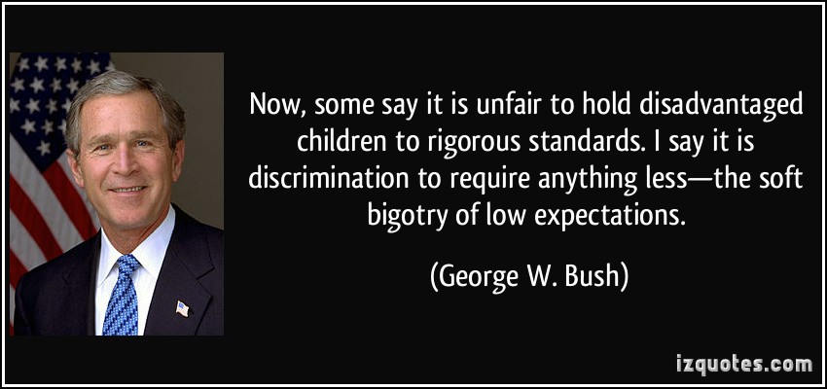

Slide 5
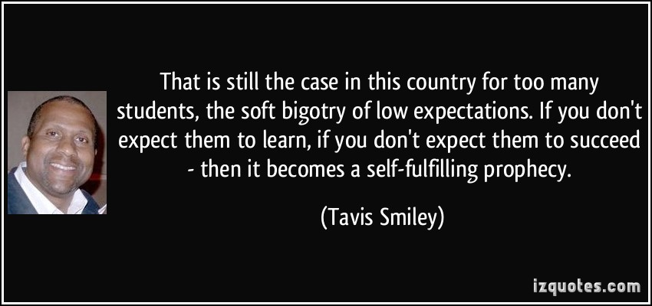

Slide 6


Slide 7

During their Developmental Years
Relating to their Modesty
Regarding their Loyalty to the local Church
Low Expectations
For our Youth

Slide 8

I have been crucified with Christ; it is no longer I who live, but Christ lives in me; and the life which I now live in the flesh I live by faith in the Son of God, who loved me and gave Himself for me (Galatians 2:20).

