Slide 1
Today’s Reading: MARK 16:16-20

Slide 2
MARK 16:16-20:
¹⁶ Whoever believes and is baptized will be saved, but whoever does not believe will be condemned. ¹⁷ And these signs will accompany those who believe: in my name they will cast out demons; they will speak in new tongues; ¹⁸ they will pick up serpents with their hands; and if they drink any deadly poison, it will not hurt them; they will lay their hands on the sick, and they will recover. ¹⁹ So then the Lord Jesus, after he had spoken to them, was taken up into heaven and sat down at the right hand of God. ²⁰ And they went out and preached everywhere, while the Lord worked with them and confirmed the message by accompanying signs.

Slide 5
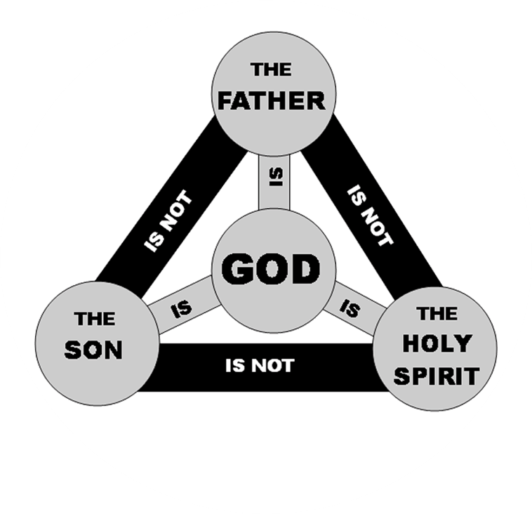
Col 2:9, “For in Him dwells all the fullness of the Godhead bodily . . .”

