Slide 2
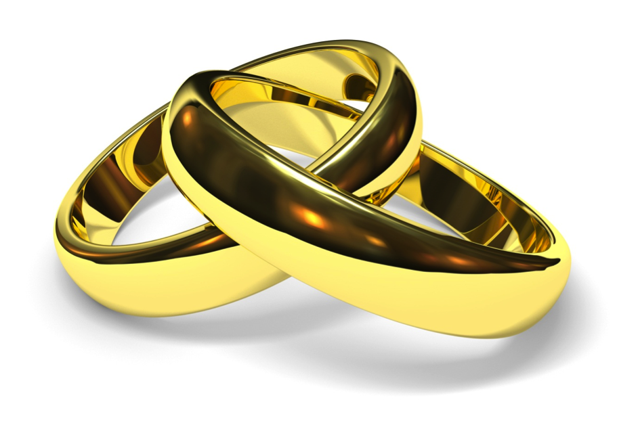
Does God really care who gets married?

Slide 3
Gender was
God’s Idea

Slide 4
(Genesis 1:27-28)
²⁷ So God created man in his own image, in the image of God he created him; male and female he created them.
(Genesis 1:27-28)
²⁷ So God created man in his own image, in the image of God he created him; male and female he created them.
²⁸ And God blessed them. And God said to them, “Be fruitful and multiply and fill the earth and subdue it, and have dominion over the fish of the sea and over the birds of the heavens and over every living thing that moves on the earth.”

Slide 5
God Linked 2
Genders in Marriage

Slide 6
(Genesis 1:27-28)
²⁷ So God created man in his own image, in the image of God he created him; male and female he created them.
(Genesis 2:23-24)
²³ Then the man said,
“This at last is bone of my bones and flesh of my flesh; she shall be called Woman, because she was taken out of Man.” ²⁴ Therefore a man shall leave his father and his mother and hold fast to his wife, and they shall become one flesh.

Slide 7
Jesus Linked Creation-Genders-Lifelong Covenant Where God Does The Joining

Slide 8
(Genesis 1:27-28)
²⁷ So God created man in his own image, in the image of God he created him; male and female he created them.
(Matthew 19:3-6)
³ And Pharisees came up to him and tested him by asking, “Is it lawful to divorce one's wife for any cause?” ⁴ He answered, “Have you not read that he who created them from the beginning made them male and female,

Slide 9
(Genesis 1:27-28)
²⁷ So God created man in his own image, in the image of God he created him; male and female he created them.
(Matthew 19:3-6)
⁵ and said, ‘Therefore a man shall leave his father and his mother and hold fast to his wife, and the two shall become one flesh’? ⁶ So they are no longer two but one flesh. What therefore God has joined together, let not man separate.”

Slide 10
Paul Reveals the Deepest Meaning of Marriage

Slide 11
(Genesis 1:27-28)
²⁷ So God created man in his own image, in the image of God he created him; male and female he created them.
(Ephesians 5:22-33)
²² Wives, submit to your own husbands, as to the Lord. ²³ For the husband is the head of the wife even as Christ is the head of the church, his body, and is himself its Savior. ²⁴ Now as the church submits to Christ, so also wives should submit in everything to their husbands.

Slide 12
(Genesis 1:27-28)
²⁷ So God created man in his own image, in the image of God he created him; male and female he created them.
(Ephesians 5:22-33)
²⁵ Husbands, love your wives, as Christ loved the church and gave himself up for her, ²⁶ that he might sanctify her, having cleansed her by the washing of water with the word, ²⁷ so that he might present the church to himself in splendor, without spot or wrinkle or any such thing, that she might be holy and without blemish.

Slide 13
(Genesis 1:27-28)
²⁷ So God created man in his own image, in the image of God he created him; male and female he created them.
(Ephesians 5:22-33)
²⁸ In the same way husbands should love their wives as their own bodies. He who loves his wife loves himself. ²⁹ For no one ever hated his own flesh, but nourishes and cherishes it, just as Christ does the church, ³⁰ because we are members of his body. ³¹ “Therefore a man shall leave his father and mother and hold fast to his wife, and the two shall become one flesh.”

Slide 14
(Genesis 1:27-28)
²⁷ So God created man in his own image, in the image of God he created him; male and female he created them.
(Ephesians 5:22-33)
³² This mystery is profound, and I am saying that it refers to Christ and the church. ³³ However, let each one of you love his wife as himself, and let the wife see that she respects her husband.

Slide 15
God…
Created genders with distinctive natures
Defined their distinctive roles so that…
Within marriage relationship, they might multiply the human race & est. family
Serve as a model of God’s covenant with His people
Uniquely display the relationship of Christ and his blood-bought purified church

Slide 16
Who is God willing to
join together in
“holy matrimony?”

Slide 17
One who has never been married
(1 Corinthians 7:8-9)
⁸ To the unmarried and the widows I say that it is good for them to remain single as I am. ⁹ But if they cannot exercise self-control, they should marry. For it is better to marry than to burn with passion.

Slide 18
One who has never been married
(1 Corinthians 7:28)
But if you do marry, you have not sinned, and if a betrothed woman marries, she has not sinned. Yet those who marry will have worldly troubles, and I would spare you that.

Slide 19
One whose spouse has died
(Romans 7:1-3)
¹ Or do you not know, brothers—for I am speaking to those who know the law—that the law is binding on a person only as long as he lives? ² For a married woman is bound by law to her husband while he lives, but if her husband dies she is released from the law of marriage.

Slide 20
One whose spouse has died
(Romans 7:1-3)
³ Accordingly, she will be called an adulteress if she lives with another man while her husband is alive. But if her husband dies, she is free from that law, and if she marries another man she is not an adulteress.

Slide 21
One who divorces his/her spouse for sexual immorality
(Matthew 19:9)
And I say to you: whoever divorces his wife, except for sexual immorality, and marries another, commits adultery.

Slide 22
One who reconciles with his/her spouse
(1 Corinthians 7:10-11)
¹⁰ To the married I give this charge (not I, but the Lord): the wife should not separate from her husband ¹¹ (but if she does, she should remain unmarried or else be reconciled to her husband), and the husband should not divorce his wife.

Slide 23
-One who has never been
married
-One whose spouse has died
-One who divorces his/her
spouse for sexual immorality
-One who reconciles with
his/her spouse

Slide 24
A man and woman may be “married” in the eyes of society but that does not mean it is “lawful” for them to be together.
(Mark 6:14-18)
¹⁴ King Herod heard of it, for Jesus' name had become known. Some said, “John the Baptist has been raised from the dead. That is why these miraculous powers are at work in him.” ¹⁵ But others said, “He is Elijah.” And others said, “He is a prophet, like one of the prophets of old.”

Slide 25
A man and woman may be “married” in the eyes of society but that does not mean it is “lawful” for them to be together.
(Mark 6:14-18)
¹⁶ But when Herod heard of it, he said, “John, whom I beheaded, has been raised.” ¹⁷ For it was Herod who had sent and seized John and bound him in prison for the sake of Herodias, his brother Philip's wife, because he had married her.

Slide 26
A man and woman may be “married” in the eyes of society but that does not mean it is “lawful” for them to be together.
(Mark 6:14-18)
¹⁸ For John had been saying to Herod, “It is not lawful for you to have your brother's wife.”

Slide 27
Same-sex couples may be “married” in the eyes of society but that does not make their union “natural.”
(Romans 1:18-27)
¹⁸ For the wrath of God is revealed from heaven against all ungodliness and unrighteousness of men, who by their unrighteousness suppress the truth. ¹⁹ For what can be known about God is plain to them, because God has shown it to them.

Slide 28
Same-sex couples may be “married” in the eyes of society but that does not make their union “natural.”
(Romans 1:18-27)
²⁰ For his invisible attributes, namely, his eternal power and divine nature, have been clearly perceived, ever since the creation of the world, in the things that have been made. So they are without excuse.

Slide 29
Same-sex couples may be “married” in the eyes of society but that does not make their union “natural.”
(Romans 1:18-27)
²¹ For although they knew God, they did not honor him as God or give thanks to him, but they became futile in their thinking, and their foolish hearts were darkened. ²² Claiming to be wise, they became fools, ²³ and exchanged the glory of the immortal God for images resembling mortal man and birds and animals and creeping things.

Slide 30
Same-sex couples may be “married” in the eyes of society but that does not make their union “natural.”
(Romans 1:18-27)
²⁴ Therefore God gave them up in the lusts of their hearts to impurity, to the dishonoring of their bodies among themselves, ²⁵ because they exchanged the truth about God for a lie and worshiped and served the creature rather than the Creator, who is blessed forever! Amen.

Slide 31
Same-sex couples may be “married” in the eyes of society but that does not make their union “natural.”
(Romans 1:18-27)
²⁶ For this reason God gave them up to dishonorable passions. For their women exchanged natural relations for those that are contrary to nature; ²⁷ and the men likewise gave up natural relations with women and were consumed with passion for one another, men committing shameless acts with men and receiving in themselves the due penalty for their error.

Slide 32
All such disregard is a symptom of our broken world and universal alienation from God
(Isaiah 5:20)
Woe to those who call evil good and good evil, who put darkness for light and light for darkness, who put bitter for sweet and sweet for bitter!

Slide 33
All such disregard is a symptom of our broken world and universal alienation from God
(Romans 3:23; 6:23)
for all have sinned and fall short of the glory of God
For the wages of sin is death…

Slide 34
All such disregard is a symptom of our broken world and universal alienation from God
(1 Corinthians 6:9-10)
⁹ Or do you not know that the unrighteous will not inherit the kingdom of God? Do not be deceived: neither the sexually immoral, nor idolaters, nor adulterers, nor men who practice homosexuality, ¹⁰ nor thieves, nor the greedy, nor drunkards, nor revilers, nor swindlers will inherit the kingdom of God.

Slide 35
To approve of sin, whether by silence or endorsement, contradicts love.
(Romans 1:32)
Though they know God's righteous decree that those who practice such things deserve to die, they not only do them but give approval to those who practice them.

Slide 36
To approve of sin, whether by silence or endorsement, contradicts love.
(Galatians 4:16)
Have I then become your enemy by telling you the truth?

Slide 37
(Acts 2:37-38)
³⁷ Now when they heard this they were cut to the heart, and said to Peter and the rest of the apostles, “Brothers, what shall we do?” ³⁸ And Peter said to them, “Repent and be baptized every one of you in the name of Jesus Christ for the forgiveness of your sins, and you will receive the gift of the Holy Spirit.

Slide 38
(1 Corinthians 6:11)
And such were some of you. But you were washed, you were sanctified, you were justified in the name of the Lord Jesus Christ and by the Spirit of our God.

