Slide 1
Today’s Reading: Ecclesiastes 7:1-6

Slide 2
Ecclesiastes 7:1-6
¹ A good name is better than precious ointment, and the day of death than the day of one’s birth; ² better to go to the house of mourning than to go to the house of feasting, for that is the end of all men; and the living will take it to heart. ³ Sorrow is better than laughter, for by a sad countenance the heart is made better. ⁴ The heart of the wise is in the house of mourning, but the heart of fools is in the house of mirth. ⁵ It is better to hear the rebuke of the wise than for a man to hear the song of fools. ⁶ For like the crackling of thorns under a pot, so is the laughter of the fool. This also is vanity.

Slide 4
“the belief that pleasure or happiness is the most important goal in life”
A Refusal to take life seriously (We only live once—so live it up, have fun!)
The Use / Abuse of intoxicants (alcohol, drugs)!
Materialism—bigger is better, more is best (eat your heart out, loser)!
Entertainment (Camping out to buy tickets to see Captain America)!
Sports Involvement—(Pay to play, almost a religion—taking precedence)!
Sensuality, (LGBT, nudity, sex, pornography)!
Self-esteem (No one loses, everyone gets a trophy, no valedictorian)!

Slide 5
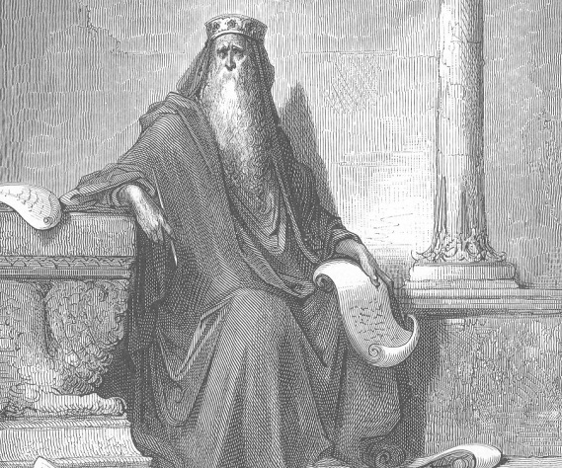
Solomon’s search for pleasure thrust him to God
Better to go to the house of mourning than to go to the house of feasting, for that is the end of all men; and the living will take it to heart. Sorrow is better than laughter, for by a sad countenance the heart is made better. The heart of the wise is in the house of mourning, but the heart of fools is in the house of mirth. (Eccl 7:2-4)
Let us hear the conclusion of the whole matter: Fear God and keep His commandments, for this is man’s all. (Eccl 12:13)

Slide 6
Some Benefits of Grief
Brings eternity into Focus (vs 2)
Reminds us of what is Real (vs 3)
Tells us to get Serious (vs 4)
Affirms that we too are Mortal (vs 1)

