Slide 1
Today’s Reading: 1 Timothy 1:12-17

Slide 2
1 Timothy 1:12-17
¹² And I thank Christ Jesus our Lord who has enabled me, because He counted me faithful, putting me into the ministry, ¹³ although I was formerly a blasphemer, a persecutor, and an insolent man; but I obtained mercy because I did it ignorantly in unbelief. ¹⁴ And the grace of our Lord was exceedingly abundant, with faith and love which are in Christ Jesus. ¹⁵ This is a faithful saying and worthy of all acceptance, that Christ Jesus came into the world to save sinners, of whom I am chief. ¹⁶ However, for this reason I obtained mercy, that in me first Jesus Christ might show all longsuffering, as a pattern to those who are going to believe on Him for everlasting life. ¹⁷ Now to the King eternal, immortal, invisible, to God who alone is wise, be honor and glory forever and ever. Amen.

Slide 4


Slide 5
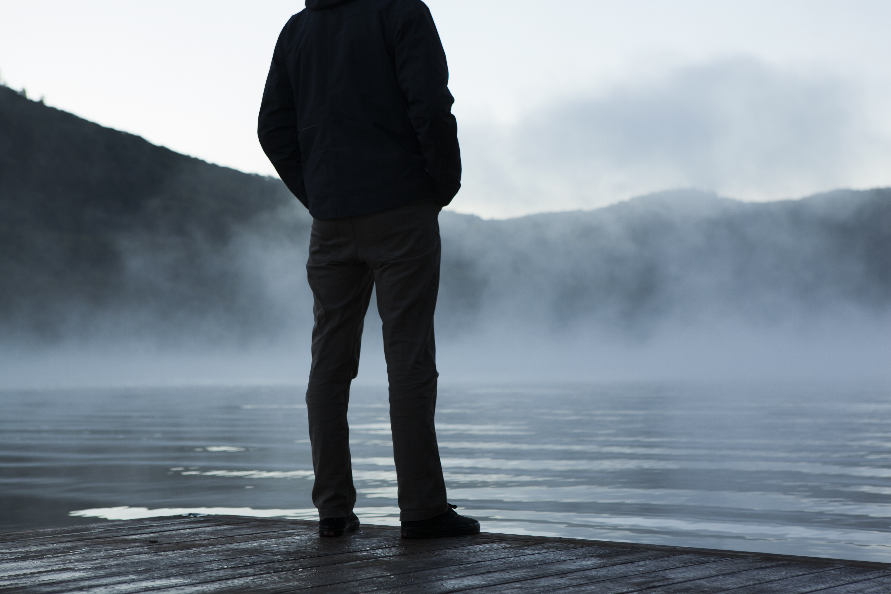
Everyone Has a Story
Let the redeemed of the Lord tell their story (Psa 107:2, NIV).
Restore to me the joy of Your salvation, and uphold me by Your generous Spirit. Then I will teach transgressors Your ways, and sinners shall be converted to You (Psa 51:12-13).
Do I have a past—of which I am regretful? (Acts 26:9-11; 1 Tim 1:15).
Do I have “skeletons” in my family closet? (Matt 1:1-5; Jn 8:41).
Have I caved at a crucial time in my life, and grieved? (Matt 26:69-75).
Have my “weaknesses” devastated my family? (2 Sam 11; 2 Sam 12:10).
Have I disappointed those who trusted me? (Acts 13:13).
Sinfulness
Mercy/Grace
Forgiveness

Slide 6
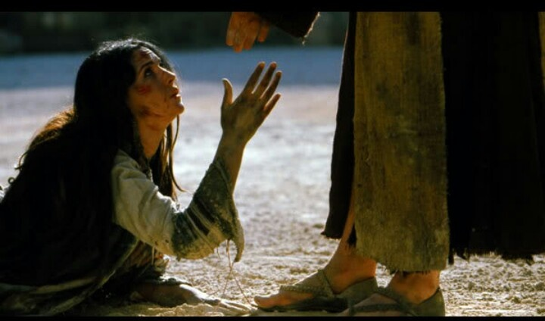
Then You have a Story
“And when the scribes and Pharisees saw Him eating with the tax collectors and sinners, they said to His disciples, how is it that He eats and drinks with tax collectors and sinners? When Jesus heard it, He said to them, those who are well have no need of a physician, but those who are sick. I did not come to call the righteous, but sinners, to repentance”
(Mark 2:16-17).
Rahab the harlot (Josh 6:17; Jas 2:25; Heb 11:31).
Adulterous Woman (Jn 8:1-11).
Sinful Woman (Lk 7:36-48).
Saul of Tarsus (1 Tim 1:12-17).
Christians of Corinth (1 Cor 6:9-11).
And, MY Checkered Past (“Just as I am”).

Slide 7
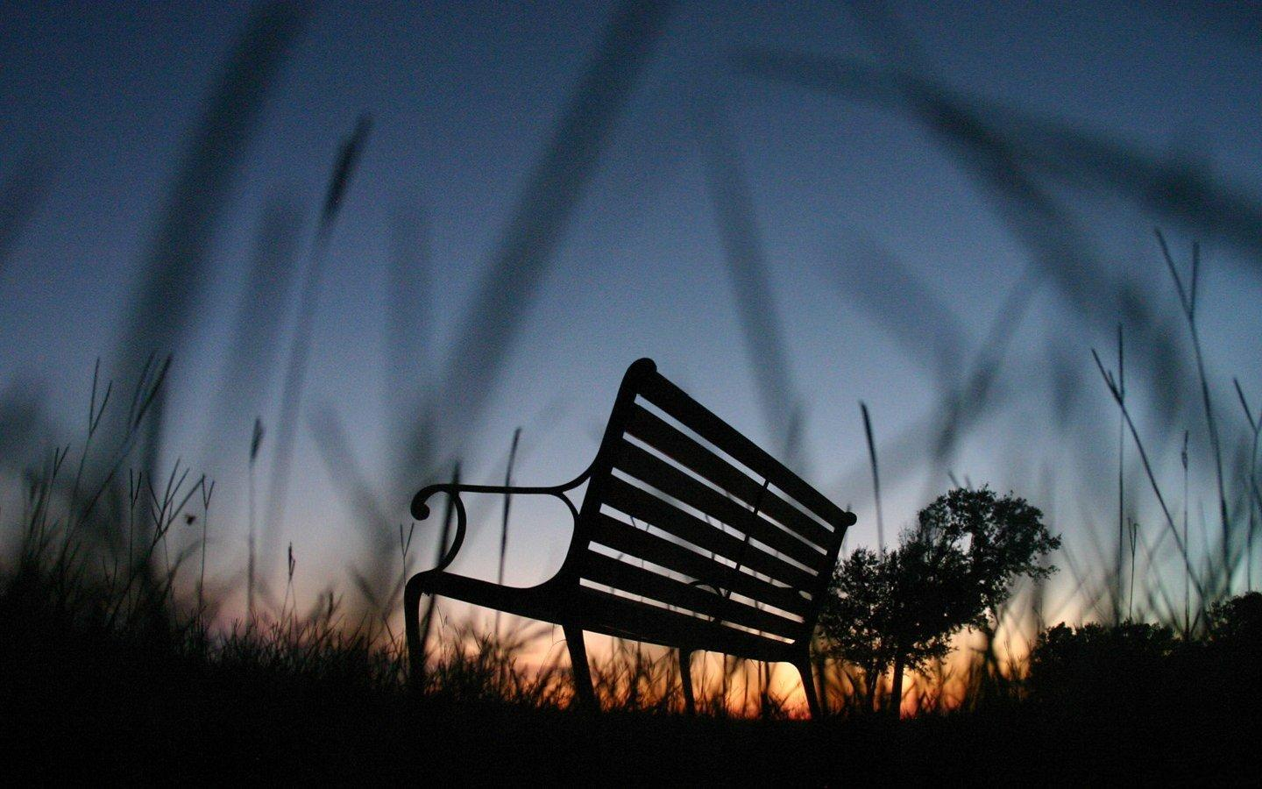
Your Story . . .
. . . Reveals your Belief about Grace,
. . . Reveals your Moral Values,
. . . Reveals that you Conquered your Past.

Slide 8
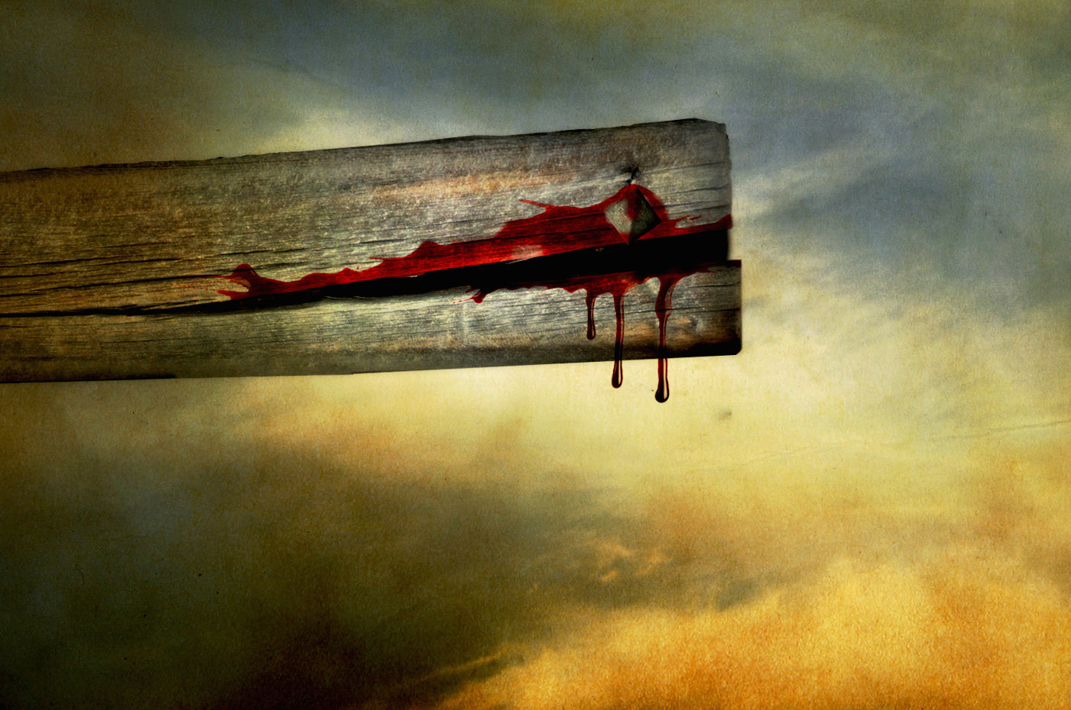
Just as I am
I come broken to be minded,
I come wounded to be healed,
I come desperate to be rescued,
I come empty to be filled.

