Slide 1
Today’s Reading: Luke 10:25-28

Slide 2
Luke 10:25-28
²⁵ And behold, a certain lawyer stood up and tested Him, saying, teacher, what shall I do to inherit eternal life? ²⁶ He said to him, what is written in the law? What is your reading of it? ²⁷ So he answered and said, you shall love the Lord your God with all your heart, with all your soul, with all your strength, and with all your mind, and your neighbor as yourself. ²⁸ And He said to him, you have answered rightly; do this and you will live.

Slide 4
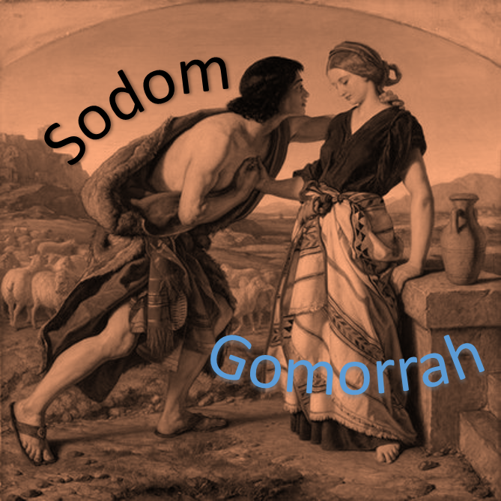
Bible Knowledge Is Declining
Name the first three Israelite kings?
In what city did Jesus grow up?
Who was Jacob’s twin brother?
What was Timothy’s grandmother’s name?
Who said: “Sirs, what must I do to be saved”?
Give two verses that emphasize baptism is essential for salvation?
What two verses teach that we are to sing psalms, hymns and spiritual songs?

Slide 5
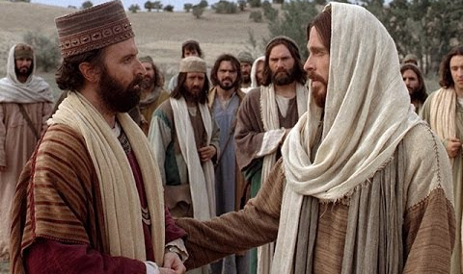
Lawyer: “Teacher, what shall I do to inherit eternal life?”
Jesus: “What is written in the law? What is your reading of it?”
Lawyer: “You shall love the Lord your God with all your heart, with all your soul, with all your strength, and with all your mind, and your neighbor as yourself.”
Jesus: “You have answered rightly; do this and you will live.”
Luke 10:25-28
Four Unavoidable Conclusions Drawn From This Dialogue
The Bible holds the answer to any question about eternal life!
Each person is responsible for reading the Bible to find answers!
The answer will be the same for all who read the Bible!
The Scriptures are understandable to those who read them!

Slide 6
“So Philip ran to him, and heard him reading the prophet Isaiah, and said, do you understand what you are reading?”
(Acts 8:30)
Luke 10:26,
What is your reading of it?
Any understanding of the Bible will depend on the “way” it is read!
How Do You Read The Bible?

Slide 7
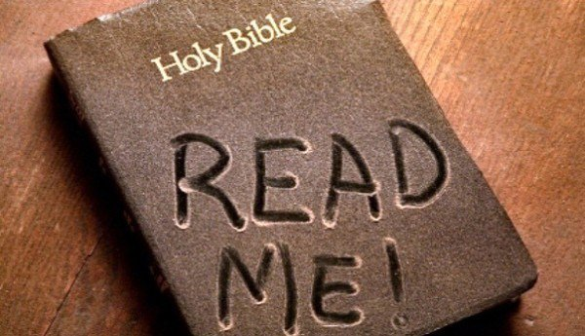
Do I even read the Bible?
My people are destroyed for lack of knowledge. Because you have rejected knowledge, I also will reject you . . . (Hosea 4:6).
Luke 10:26,
What is your reading of it?
Or have you not read in the law that on the Sabbath the priests in the temple profane the Sabbath, and are blameless? (Matt 12:5).
“Have you not read that He who made them at the beginning made them male and female? (Matt 19:4).
But concerning the resurrection of the dead, have you not read what was spoken to you by God? (Matt 22:31).
Have you not even read this Scripture: The stone which the builders rejected Has become the chief cornerstone? (Mk 12:10).

Slide 8
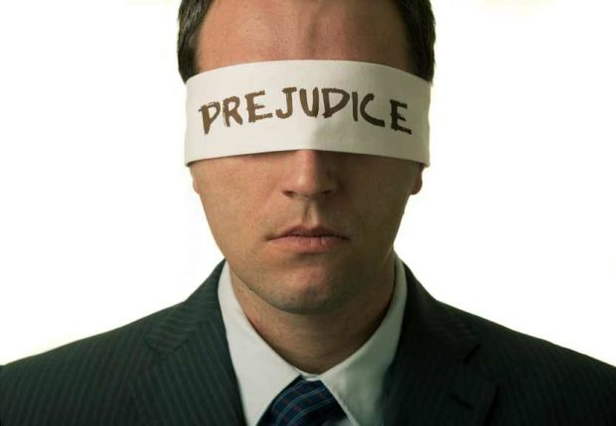
Do I read the Bible
with prejudice?
You search the Scriptures . . . But you are not willing to come to Me that you may have life. (John 5:39-40).
Luke 10:26,
What is your reading of it?
That’s not what I have always been taught!
That’s just YOUR interpretation, my interpretation is different!
Now, I don’t read it that way!
The Bible may not say to me what it does to you!
I’m sorry, I just don’t see it like you do!

Slide 9
Do I read the Bible
with farsightedness?
For what is your life? It is even a vapor that appears for a little time and then vanishes away. (James 5:14).
Luke 10:26,
What is your reading of it?
These are unable to see any IMMEDIATE need—Acts 24:25.
These are always focused on the ever illusive tomorrow—James 4:13-15.
These mistakenly believe they see a time when they will seek God—Luke 12:19-20.

Slide 10
Do I read the Bible
with nearsightedness?
For he who lacks these things is shortsighted, even to blindness, and has forgotten that he was cleansed from his old sins. (2 Pet 1:9).
Luke 10:26,
What is your reading of it?
These are unable to see beyond the here and now—Gen 13:10; Matt 13:22.
These have no sight beyond job, recreation, relationships– Matt 10;37; Lk 14:33.
These have no ability to see any need to depend upon God—Deut 8:12-14.

Slide 11
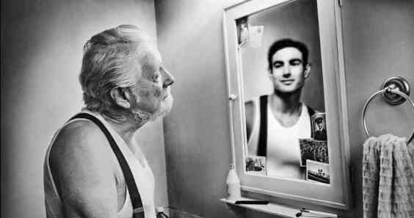
Do I read the Bible
unable to see myself?
. . . he is like a man observing his natural face in a mirror . . . (James 1:23).
Luke 10:26,
What is your reading of it?
These cannot see themselves as they really are—James 1:22-24.
These lack the vision to make a needed application—Matt 13:15
These see the sins of everyone else—Rom 2:21-24.
These cannot recognize their sins because of being self-righteous—Jn 8:1-11; Jn 18:28; Matt 23:24; Lk 18:9-11.

Slide 12
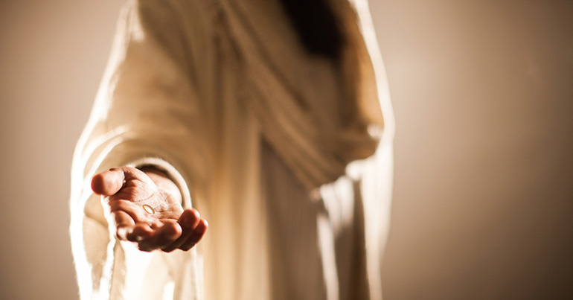
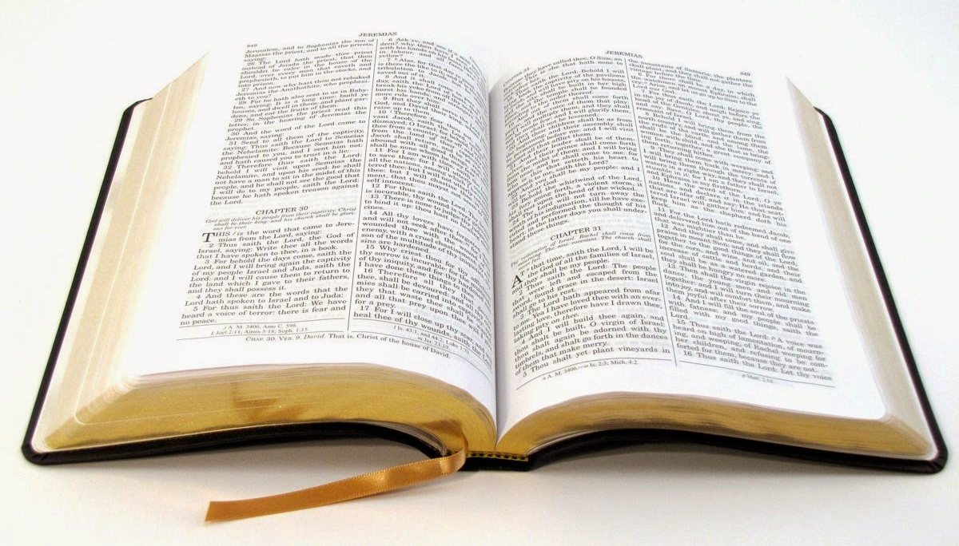
Do I read the Bible
to come to Christ?
Take My yoke upon you and learn from Me, for I am gentle and lowly in heart, and you will find rest for your souls. (Matt 11:29).
Luke 10:26,
What is your reading of it?
“You search the Scriptures, for in them you think you have eternal life; and these are they which testify of Me. But you are not willing to come to Me that you may have life”
John 5:39-40
“But as many as received Him, to them He gave the right to become children of God, to those who believe in His name”
John 1:12

