Slide 2
2 Corinthians 9:6-11
⁶ But this I say: He who sows sparingly will also reap sparingly, and he who sows bountifully will also reap bountifully. ⁷ So let each one give as he purposes in his heart, not grudgingly or of necessity; for God loves a cheerful giver. ⁸ And God is able to make all grace abound toward you, that you, always having all sufficiency in all things, may have an abundance for every good work. ⁹ As it is written: He has dispersed abroad, He has given to the poor; His righteousness endures forever. ¹⁰ Now may He who supplies seed to the sower, and bread for food, supply and multiply the seed you have sown and increase the fruits of your righteousness, ¹¹ while you are enriched in everything for all liberality, which causes thanksgiving through us to God.

Slide 6
29 % Taxes (Romans 13:7)
34% Housing
13 % Food
07% Healthcare
(1 Timothy 5:8)

Slide 7
FACT:
We usually have the money to spend on what we want!
$5.77 (pack)
(1 pack per day)
$2,106 in a year!
$42,120 (20 yr.)

Slide 8
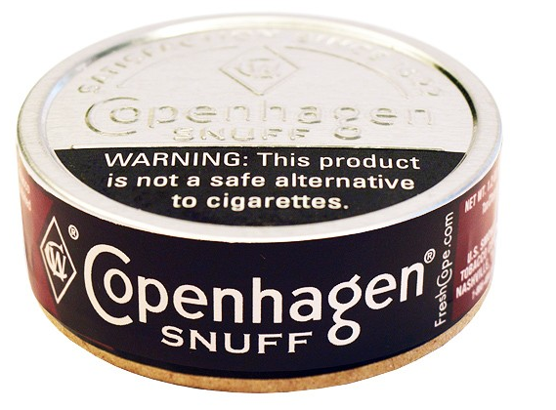
$5.00 (can)
(1 can per day)
$1,825 in a year!
$36,500 (20 yr.)
FACT:
We usually have the money to spend on what we want!

Slide 9
FACT:
We usually have the money to spend on what we want!
$8.00 (pouch)
(1 pouch per day)
$2,920 in a year!
$58,400 (20 yr.)

Slide 10
$8.61 (ticket)
(2 tickets mo.)
$206 in a year!
FACT:
We usually have the money to spend on what we want!

Slide 11
FACT:
We usually have the money to spend on what we want!
Average American spends 9% of his income on lottery tickets.

Slide 12
Cable-- $123.00 mo.
$1,476 in a year!
FACT:
We usually have the money to spend on what we want!

Slide 13
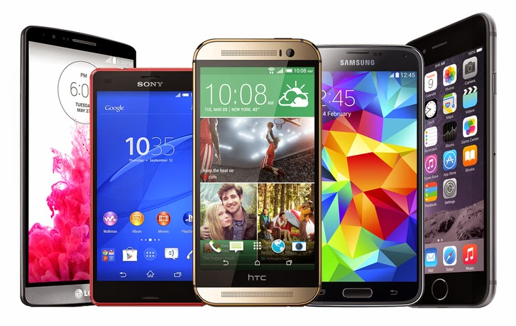
Phone-- $100.00 mo.
$1,200 in a year!
FACT:
We usually have the money to spend on what we want!

Slide 14
$50,000 per year
(5%)
$2,500 in a year!
$49.00 per week
(less than we spend on phone & cable)
FACT:
We usually have the money to spend on what we want!

Slide 15
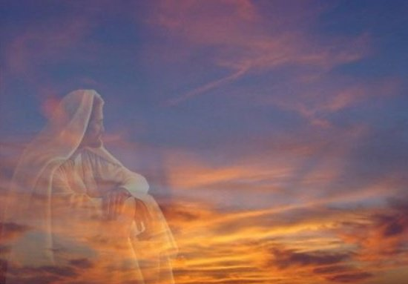
Is not measured in a percentage or a set dollar amount.
My giving is to be in abundance (2 Corinthians 8:7).
My giving is to be in proportion to my success (1 Cor 16:2).
From a willing mind—2 Cor 8:3, 12
From a purposeful heart—2 Cor 9:7
With a cheerful spirit—2 Cor 9:7
From a liberal attitude—Rom 12:8
My giving is to be enough to honor God (Prov 3:9-10).

Slide 16
Am I giving in proportion to what I have been prospered (1 Cor 16:2)?
Do I focus on the cross when I give (Col 3:1)?
Have I planned before arriving what I am going to give (2 Cor 9:7)?
Does my giving signify that I am offering my “firstfruits” to God (Prov 3:9)?
What excuses do I comfort myself with for not giving (Lk 14:18)?

