Slide 1
Today’s Reading: Colossians 3:1-11

Slide 2
Colossians 3:1-11
¹ If then you were raised with Christ, seek those things which are above, where Christ is, sitting at the right hand of God. ² Set your mind on things above, not on things on the earth. ³ For you died, and your life is hidden with Christ in God. ⁴ When Christ who is our life appears, then you also will appear with Him in glory. ⁵ Therefore put to death your members which are on the earth: fornication, uncleanness, passion, evil desire, and covetousness, which is idolatry. ⁶ Because of these things the wrath of God is coming upon the sons of disobedience, ⁷ in which you yourselves once walked when you lived in them. ⁸ But now you yourselves are to put off all these: anger, wrath, malice, blasphemy, filthy language out of your mouth. ⁹ Do not lie to one another, since you have put off the old man with his deeds, ¹⁰ and have put on the new man who is renewed in knowledge according to the image of Him who created him, ¹¹ where there is neither Greek nor Jew, circumcised nor uncircumcised, barbarian, Scythian, slave nor free, but Christ is all and in all.

Slide 4
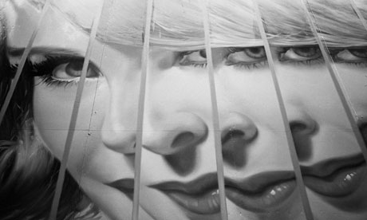

Slide 5
. . . does an elder in the church leave his wife for another woman?
. . . does a gospel preacher decide to live openly as a homosexual?
. . . does a bible teacher carry on a clandestine affair with her coworker?
. . . does a church treasurer embezzle money from the church treasury?
. . . do so many men in the church access pornography on regular basis?
. . . do many in the church consistently dress scantly while on vacation?

Slide 6
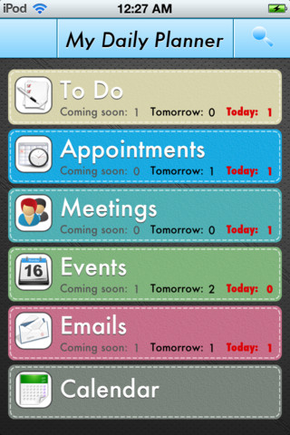
1.
2.
3.
4.
5.
6.
7.
8.
Pack kids’ lunches
Check Facebook
Pay house payment
Car pool kids
Pick up milk & bread
Call mom
Bible study
ME time

Slide 7
Put God First Bro.
God
Family
Friends
Work
Volunteering
Neighbors
Self-improvement

Slide 8
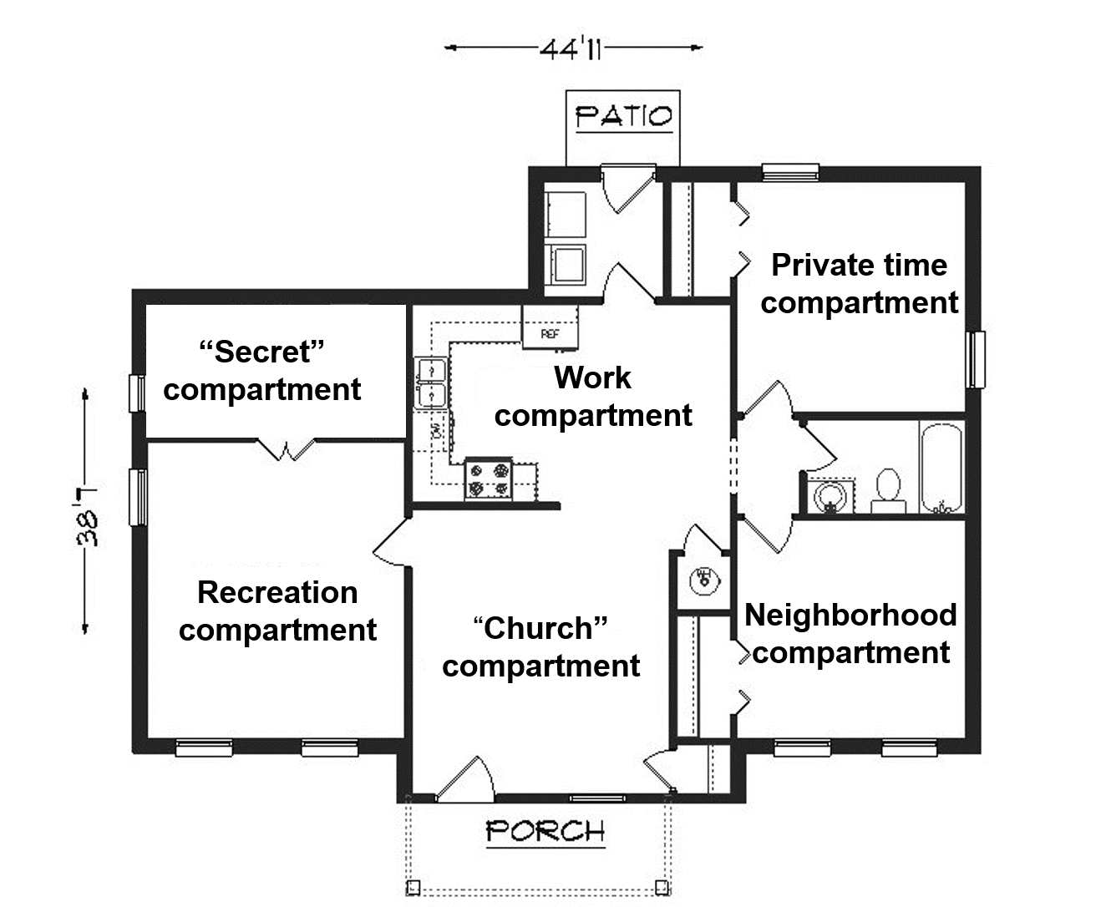
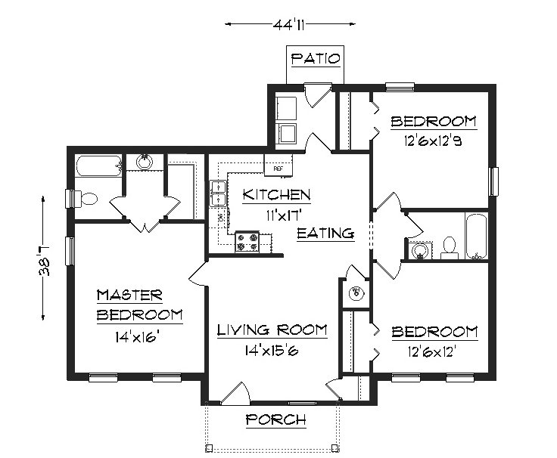
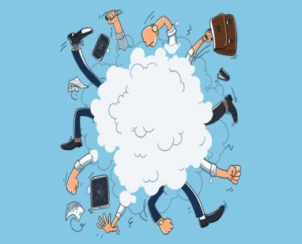

Slide 9
Faith – Hope – Love
We give thanks to the God and Father of our Lord Jesus Christ, praying always for you, since we heard of your faith in Christ Jesus and of your love for all the saints; because of the hope which is laid up for you in heaven . . .
(Col 1:3-5).

Slide 10
Faith – Hope – Love
Influences my moral compass (Col 3:5-10)
Impacts my relationship with others (Col 3:12-15)
Controls my life at home (Col 3:18-21)
Inspires my worship (Col 3:16-17)
Will attend me as I walk my last mile (Col 3:3-4)

