Slide 2
2 Corinthians 8:1-7
¹ Moreover, brethren, we make known to you the grace of God bestowed on the churches of Macedonia: ² that in a great trial of affliction the abundance of their joy and their deep poverty abounded in the riches of their liberality. ³ For I bear witness that according to their ability, yes, and beyond their ability, they were freely willing, ⁴ imploring us with much urgency that we would receive the gift and the fellowship of the ministering to the saints. ⁵ And not only as we had hoped, but they first gave themselves to the Lord, and then to us by the will of God. ⁶ So we urged Titus, that as he had begun, so he would also complete this grace in you as well. ⁷ But as you abound in everything—in faith, in speech, in knowledge, in all diligence, and in your love for us—see that you abound in this grace also.

Slide 4
“See that you make all things according to the pattern . . ..”
Hebrews 8:5
“The seed is the word of God.”
Luke 8:11
“I urge you, imitate me . . . Timothy . . . will remind you of my ways in Christ, as I teach everywhere in every church.”
1 Corinthians 4:16-17

Slide 5
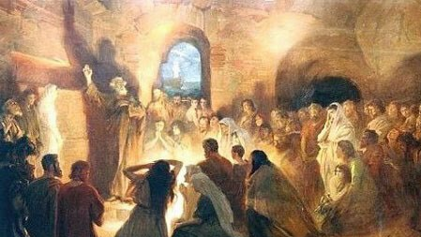
The 21st Century Church Must . . .
Restore the N.T. means of Salvation (Mk 16:16; Acts 2:38; 1 Cor 12:13)
Restore the N.T. model of Worship (Acts 2:42; Acts 20:7; Eph 5:19; 1 Cor 16:1-2)
Restore the N.T. design of Work (Matt 28:19-20; 1 Cor 9:14; 1 Cor 16:1-2; Eph 4:16)
Considering the Generosity of the Early Christians
Acts 2:45, (They) “sold their possessions and goods, and divided them among all, as anyone had need.”
Acts 4:34-35, “for all who were possessors of lands or houses sold them, and brought the proceeds of the things that were sold, and laid them at the apostles’ feet; and they distributed to each as anyone had need.”
2 Cor 8:3, “For I bear witness that according to their ability, yes, and beyond their ability, they were freely willing,”

Slide 6
The Generosity
of the
Early Church
For some it was their religious background
All Christians were zealous new converts
The church had a clear vision of its mission
They sincerely believed the words of Jesus
They lived in the “shadow” of the cross
They first gave themselves to the Lord

Slide 7
Have I restored the spirit of first century generosity?
Does my Contribution indicate
A fiery passion for the Lord (Rev 3:19)?
An understanding of our mission (Lk 19:10)?
An unwavering trust in the Lord (Prov 3:5)?
I’m living in the shadow of the Cross (Gal 6:4)?
I’ve given myself to Christ (Rom 12:1)?

