Slide 2
Matthew 5:1-16
¹ And seeing the multitudes, He went up on a mountain, and when He was seated His disciples came to Him. ² Then He opened His mouth and taught them, saying: ³ Blessed are the poor in spirit, for theirs is the kingdom of heaven. ⁴ Blessed are those who mourn, for they shall be comforted. ⁵ Blessed are the meek, for they shall inherit the earth. ⁶ Blessed are those who hunger and thirst for righteousness, for they shall be filled. ⁷ Blessed are the merciful, for they shall obtain mercy. ⁸ Blessed are the pure in heart, for they shall see God. ⁹ Blessed are the peacemakers, for they shall be called sons of God. ¹⁰ Blessed are those who are persecuted for righteousness’ sake, for theirs is the kingdom of heaven. ¹¹ Blessed are you when they revile and persecute you, and say all kinds of evil against you falsely for My sake. ¹² Rejoice and be exceedingly glad, for great is your reward in heaven, for so they persecuted the prophets who were before you. ¹³ You are the salt of the earth; but if the salt loses its flavor, how shall it be seasoned? It is then good for nothing but to be thrown out and trampled underfoot by men. ¹⁴ You are the light of the world. A city that is set on a hill cannot be hidden. ¹⁵ Nor do they light a lamp and put it under a basket, but on a lampstand, and it gives light to all who are in the house. ¹⁶ Let your light so shine before men, that they may see your good works and glorify your Father in heaven.

Slide 5
For everyone will be seasoned with fire, and every sacrifice will be seasoned with salt. Salt is good, but if the salt loses its flavor, how will you season it? Have salt in yourselves, and have peace with one another.
Mark 9:49-50
Salt is good; but if the salt has lost its flavor, how shall it be seasoned? It is neither fit for the land nor for the dunghill, but men throw it out. He who has ears to hear, let him hear!
Luke 14:34-35

Slide 6
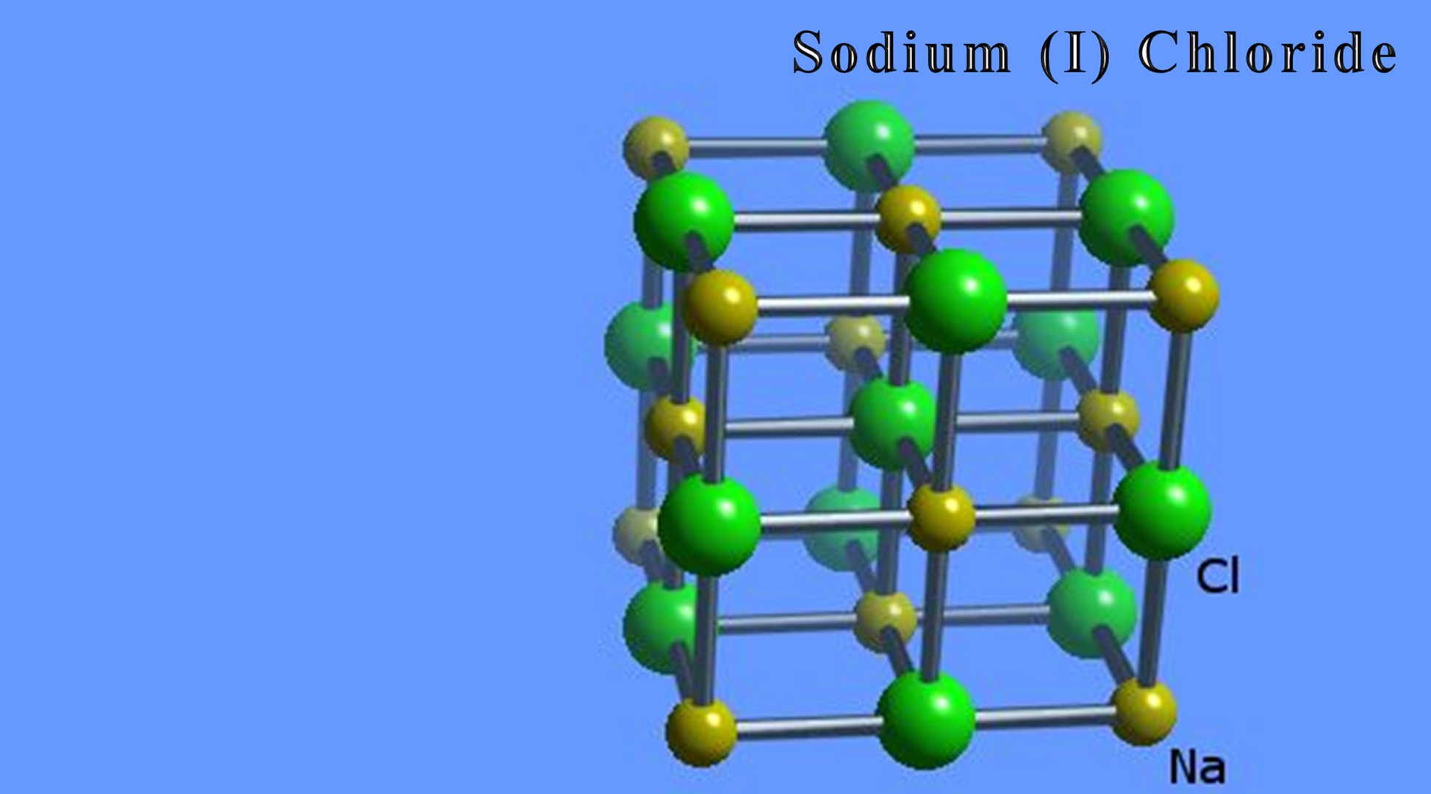
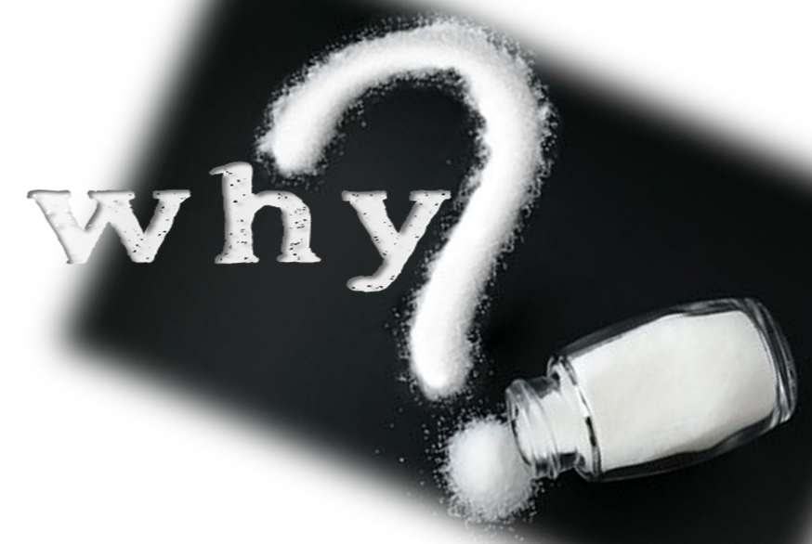
Without enough sodium in your body, your cellular function and neural communication shut down.
Sodium is critical to absorbing certain nutrients from the digestive tract, and also allows some molecules that couldn’t otherwise pass through the cell membrane to cross.
It’s also one of the chemicals that helps establish the resting membrane potential. This produces a negative charge inside cells relative to the fluid surrounding them, which allows for transport of molecules and cellular communication.
Dr. Gary Thibodeau (“Anatomy and Physiology”).
Salt preserves the purity of meat; it was to be offered w/sacrifices (Lev 2:13).
Salt was used as an antiseptic for newborns (Ezek 16:4).
Salt was used for seasoning food (Job 6:6).
Salt is essential for life!

Slide 7
He is worth his salt.
Those folks are the salt of the earth.
She uses salty language.
Those tickets to the game were salty.
We need to salt away something for retirement.
Taken with a grain of salt.

Slide 8
Salt Seasons
Salt Preserves
Salt Irritates
Salt Causes Thirst

