Slide 2
Hebrews 13:1-6
¹ Let brotherly love continue. ² Do not forget to entertain strangers, for by so doing some have unwittingly entertained angels. ³ Remember the prisoners as if chained with them—those who are mistreated—since you yourselves are in the body also. ⁴ Marriage is honorable among all, and the bed undefiled; but fornicators and adulterers God will judge. ⁵ Let your conduct be without covetousness; be content with such things as you have. For He Himself has said, I will never leave you nor forsake you. ⁶ So we may boldly say: the Lord is my helper; I will not fear. What can man do to me?

Slide 5
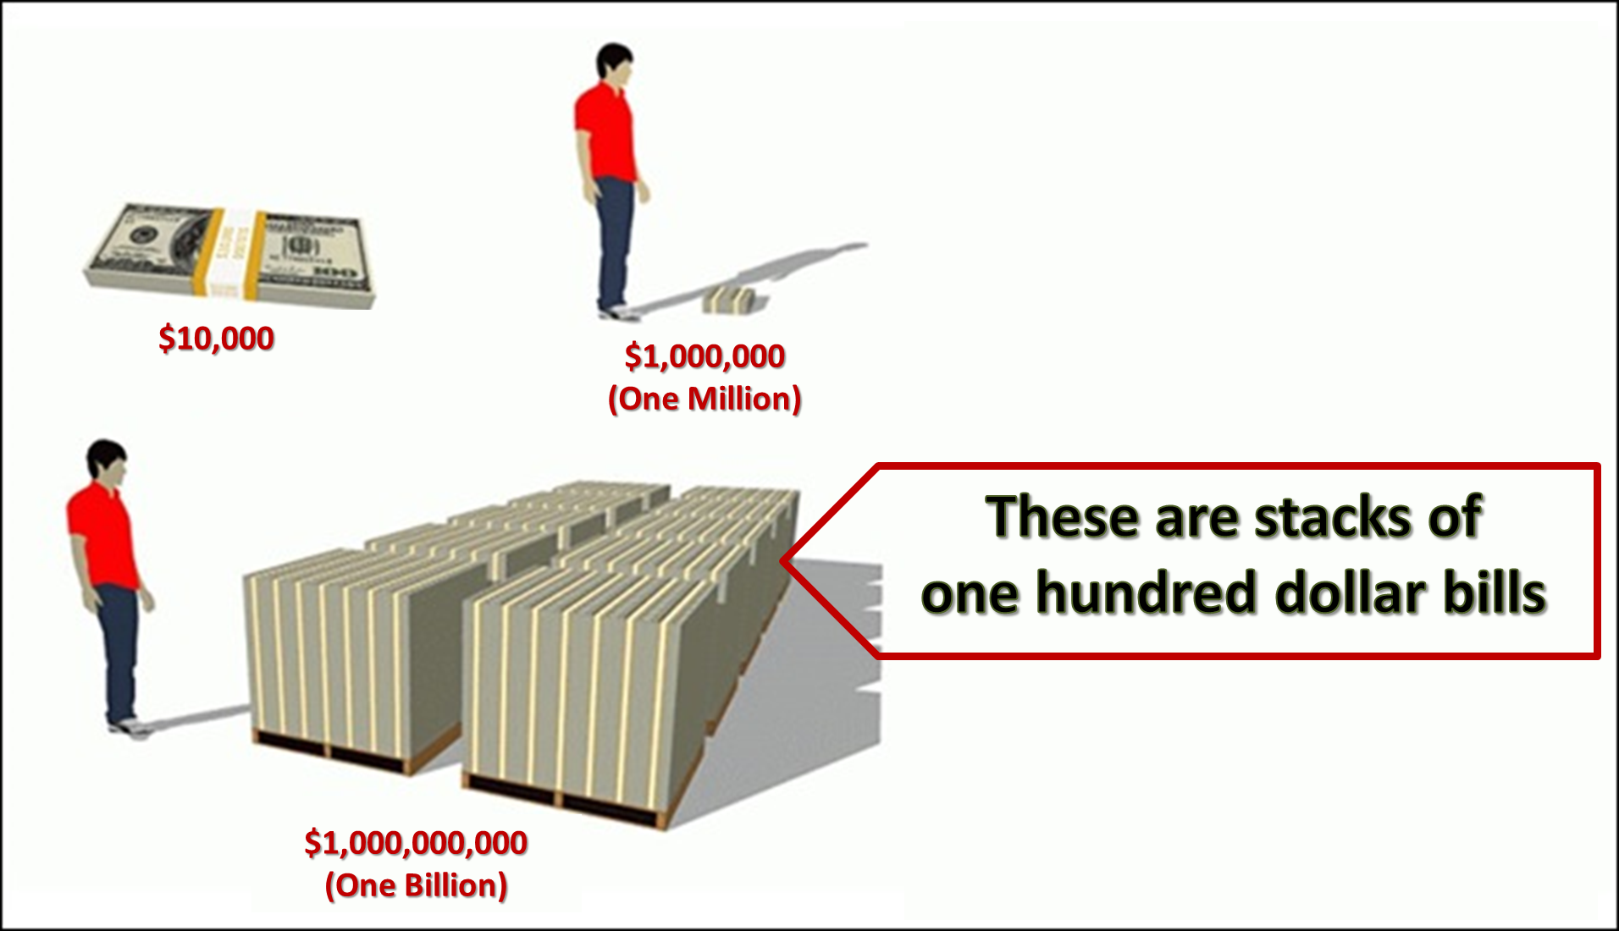
The Day America Told The Truth (James Paterson & Peter Kim) ~ Book is 25 years-old
3% said they would put their kids up for adoption.
4% said they would have a sex change.
6% said they would change their race.
7% said they would murder a stranger.
10% said they would withhold testimony and let a murderer go free.
16% said they would leave their spouse.
16% said they would give up their citizenship.
23% said they would become a prostitute for a week or more.
25% said they would abandon their families.
25% said they would abandon their church.

Slide 6
Greed is covetousness: “inordinate [beyond what is usual, proper] desire for wealth or possessions or for another’s possessions.”
Greed is the love of money: “For the love of money is a root of all kinds of evil, for which some have strayed from the faith in their greediness, and pierced themselves through with many sorrows” (1 Tim 6:10).
Greed is never commended: Consider the Old Testament—10th Commandment (Exod 20:17); Psa 119:36, “Incline my heart to Your testimonies, and not to covetousness.”
Condemned in the New Testament:
Lk 12:15, “And He said to them, take heed and beware of covetousness, for one’s life does not consist in the abundance of the things he possesses.”
2 Tim 3:2, “For men will be lovers of themselves, lovers of money, boasters, proud, blasphemers, disobedient to parents, unthankful, unholy”
Heb 13:5, “Let your conduct be without covetousness; be content with such things as you have.”
Lk 16:13-14, “You cannot serve God and mammon. Now the Pharisees, who were lovers of money, also heard all these things, and they derided Him.”

Slide 7
More N.T. Condemnations:
1 Cor 6: 9-10, “Do not be deceived. Neither fornicators, nor idolaters, nor adulterers, nor homosexuals, nor sodomites, nor thieves, nor covetous, nor drunkards, nor revilers, nor extortioners will inherit the kingdom of God.”
Eph 5:5, “For this you know, that no fornicator, unclean person, nor covetous man, who is an idolater, has any inheritance in the kingdom of Christ and God.”
The Covetous are to be Withdrawn From:
1 Cor 5:9-11, “I wrote to you in my epistle not to keep company with sexually immoral people. Yet I certainly did not mean with the sexually immoral people of this world, or with the covetous, or extortioners, or idolaters, since then you would need to go out of the world. But now I have written to you not to keep company with anyone named a brother, who is sexually immoral, or covetous, or an idolater, or a reviler, or a drunkard, or an extortioner—not even to eat with such a person.”

Slide 8
Society views covetousness as a virtue: (1996 film “Jerry Maguire,” & an ABC game show hosted by William Shatner; “Show me the Money”).
Or, an amusing flaw: (Maybe money can’t buy happiness, but I’d rather cry in a mansion).
I’m not greedy: Instead I’m frugal, thrifty, penny-wise—after all “A fool and his money are soon parted.”
Ask yourself: When is the last time you heard of a church disciplining a covetous member, or of someone confessing the sin of covetousness?

Slide 9
Covetousness is a sin known
by what it causes us to do!
Achan: Joshua 7:21
Gehazi: 2 Kings 5:20-25
Ananias & Sapphira: Acts 5:3-4
Covetousness can lead to Robbery, Embezzlement, Tax Fraud, Insurance Fraud, Business Dishonesty, or just taking $5.00 from Mom’s purse.
Can lead to “robbing God” (Malachi 3:8).

Slide 10
Conquering Covetousness
Understand that all that we think is ours belongs to God (Psa 24:1; Psa 50:10).
Know we are mere “stewards” of what God has granted us to use (Lk 16:1-13).
By being content with what God has granted to us (Heb 13:5).
Remember we will be held accountable to God for the way we use wealth (Rom 14:12; 1 Tim 6:17-19); (“Give an account of your stewardship . . .,” Lk 16:1).
Learn God’s principle for earning: “. . . let him labor, working with his hands what is good, that he may have something to give him who has need” (Eph 4:28).

Slide 11
Give by caring for our family—1 Tim 5:8.
Give by paying honest wages—Jas 5:1-5.
Give by paying restitution—Lk 19:5-8.
Give to help the poor—Eph 4:28; 1 Jn 3:16-17.
Give to the local treasury—1 Cor 16:1-2.

Slide 12
Does my giving reflect an attitude of covetousness (Deut 6:10-12)?
Does my giving reflect an attitude of generosity (2 Cor 9:6-7)?
Does my giving reflect an attitude of trust in the Lord (1 Tim 6:17; Matt 6:31-33)?
Does my giving reflect an attitude of “currency conversion” (Matt 6:19-20)?
Does my giving reflect the attitude of a faithful steward (Lk 16:10-13)?
Does my giving reflect an attitude of having first given myself completely to the Lord (2 Cor 8:5)?
Does the amount I give reflect an “abundance” or a mere pittance (2 Cor 8:7)?

Slide 13
Our next Study:
Restoring the
liberality of the
early church!

