Slide 2
2 Corinthians 8:1-7
¹ Moreover, brethren, we make known to you the grace of God bestowed on the churches of Macedonia: ² that in a great trial of affliction the abundance of their joy and their deep poverty abounded in the riches of their liberality. ³ For I bear witness that according to their ability, yes, and beyond their ability, they were freely willing, ⁴ imploring us with much urgency that we would receive the gift and the fellowship of the ministering to the saints. ⁵ And not only as we had hoped, but they first gave themselves to the Lord, and then to us by the will of God. ⁶ So we urged Titus, that as he had begun, so he would also complete this grace in you as well. ⁷ But as you abound in everything—in faith, in speech, in knowledge, in all diligence, and in your love for us—see that you abound in this grace also.

Slide 4
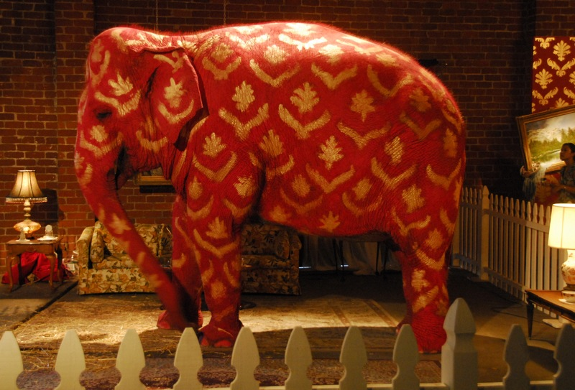
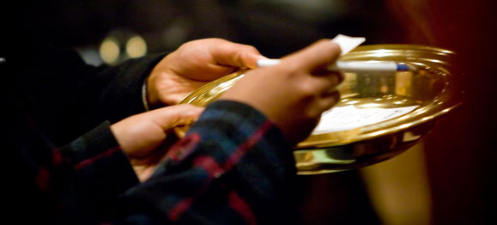
First day of the week contribution
The “Elephant in the Room”
Collection: (logeia) from the verb “I collect.” It’s primary usage was for a religious collection—this is how the Holy Spirit uses it here!
This text reveals the ONLY WAY money can be raised; not the only way it can be spent (2 Cor 11:8; Phil 4:14-16)!
Now concerning the collection for the saints, as I have given orders to the churches of Galatia, so you must do also: On the first day of the week let each one of you lay something aside, storing up as he may prosper, that there be no collections when I come, (1 Cor 16:1-2).

Slide 5
First day of the week contribution
COMMAND: A command given to the church at Corinth as well as the churches of Galatia.
A uniform practice (1 Cor 4:17).
Including the Danville church!
Now concerning the collection for the saints, as I have given orders to the churches of Galatia, so you must do also: On the first day of the week let each one of you lay something aside, storing up as he may prosper, that there be no collections when I come, (1 Cor 16:1-2).

Slide 6
First day of the week contribution
SUNDAY: This phrase (kata mian sabbatou) means EVERY 1st day of the week (NIV, “On the first day of every week . . .”).
[Lk 18:12].
Now concerning the collection for the saints, as I have given orders to the churches of Galatia, so you must do also: On the first day of the week let each one of you lay something aside, storing up as he may prosper, that there be no collections when I come, (1 Cor 16:1-2).

Slide 7
First day of the week contribution
PERSONAL: This means every member of this (or any) local church!
If you are a Christian—if you have earned anything (prospered) then YOU are to contribute!
Now concerning the collection for the saints, as I have given orders to the churches of Galatia, so you must do also: On the first day of the week let each one of you lay something aside, storing up as he may prosper, that there be no collections when I come, (1 Cor 16:1-2).

Slide 8
First day of the week contribution
THIS IS NOT A STORING UP AT HOME: This “storing up” is the same as the “collection.”
This is a collection of the local band of believers (church)!
Now concerning the collection for the saints, as I have given orders to the churches of Galatia, so you must do also: On the first day of the week let each one of you lay something aside, storing up as he may prosper, that there be no collections when I come, (1 Cor 16:1-2).

Slide 9
First day of the week contribution
NOT A SET AMOUNT (10%): But the gift (giving) should be in proportion to how much you have been prospered (financially increased).
But it is to be generous—2 Cor 9:6-7.
Now concerning the collection for the saints, as I have given orders to the churches of Galatia, so you must do also: On the first day of the week let each one of you lay something aside, storing up as he may prosper, that there be no collections when I come, (1 Cor 16:1-2).

Slide 10
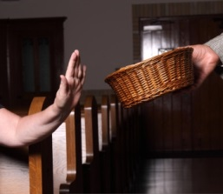
The “Elephant in the Room”
is not discussed!
Because of the abuse of the subject by “televangelists” & religious hucksters!
Because we fear it leaves the impression, all churches want is your money!
We wish to avoid appearing mercenary!
It is known that it is a “touchy” issue with some church members—often because of their perception of money!
An unscriptural perception of money results in NOT GIVING!
Weekly Giving

Slide 11
Money will bring contentment
Money is to provide
a better standard . . .
Money defines our worth
Money is to be made at all costs

Slide 12
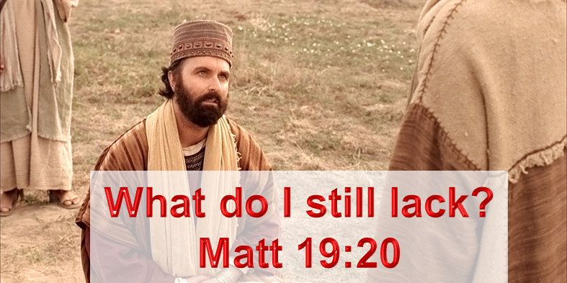
The Bible, Jesus and Money
There are at last 350 Scriptures in the Bible referring to money; “A good name is more desirable than great riches; to be esteemed is better than silver or gold” (Prov 22:1).
Jesus talked about money 15% of the time during His 3 years of preaching; “Now these are the ones sown among thorns; they are the ones who hear the word, and the cares of this world, the deceitfulness of riches, and the desires for other things entering in choke the word, and it becomes unfruitful. ” (Mk 4:18-19).
WHY?

Slide 13
Word Association
Two kingdoms: Kingdom of God—Kingdom of Satan
Two Realms: Domain of Light—Domain of Darkness
Two Masters: God—Satan
Matthew 6:24, No one can serve two masters; for either he will hate the one and love the other, or else he will be loyal to the one and despise the other. You cannot serve God and ____________.
Mammon
Satan

Slide 14
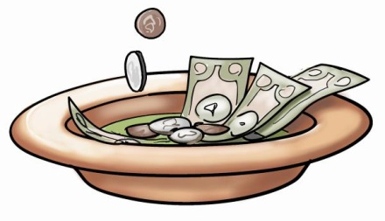
Developing a Proper Attitude Toward Money

