Slide 2
Luke 9:51-56
⁵¹ Now it came to pass, when the time had come for Him to be received up, that He steadfastly set His face to go to Jerusalem, ⁵² and sent messengers before His face. And as they went, they entered a village of the Samaritans, to prepare for Him. ⁵³ But they did not receive Him, because His face was set for the journey to Jerusalem. ⁵⁴ And when His disciples James and John saw this, they said, Lord, do You want us to command fire to come down from heaven and consume them, just as Elijah did? ⁵⁵ But He turned and rebuked them, and said, you do not know what manner of spirit you are of. ⁵⁶ For the Son of Man did not come to destroy men’s lives but to save them. And they went to another village.

Slide 4
We All Need A Place
WHERE’S
YOUR
Special Place?

Slide 5
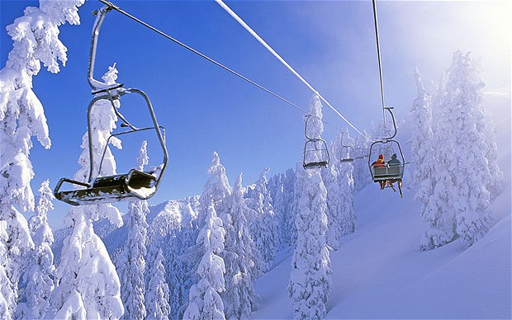
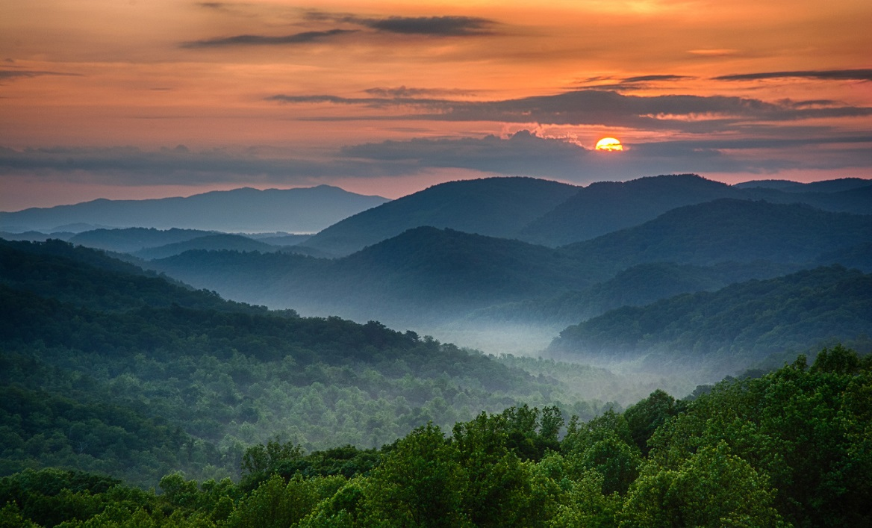
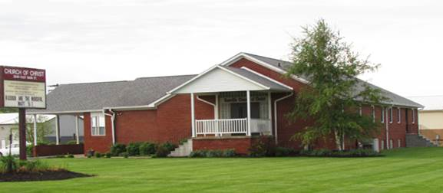
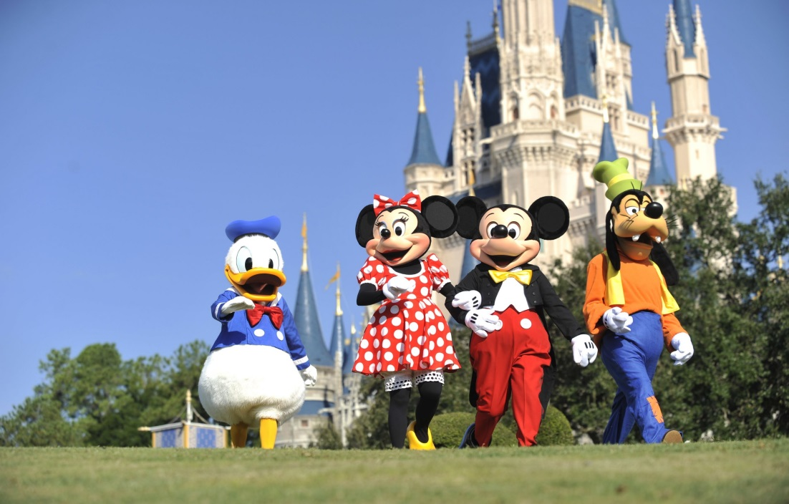
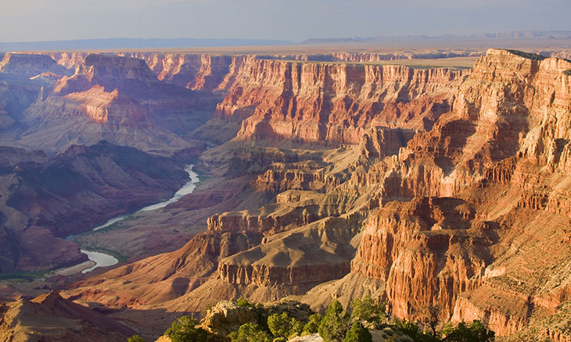
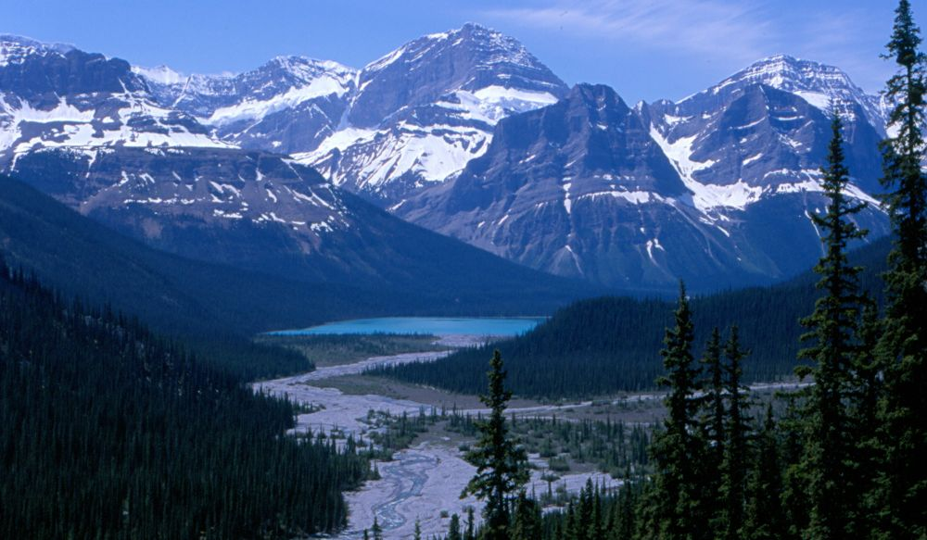
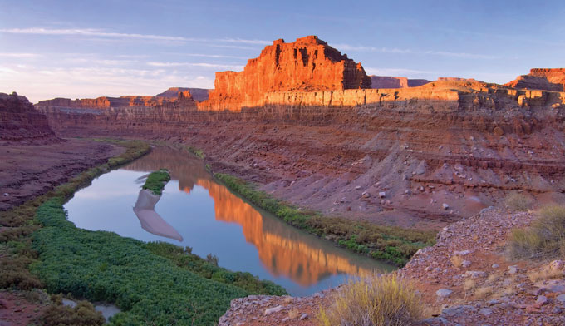
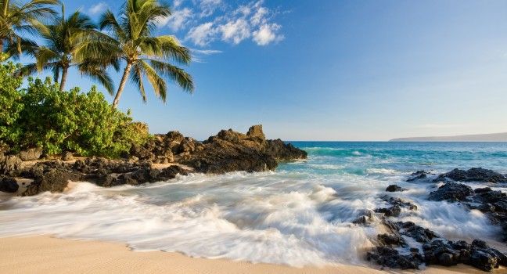
We All Need A Place

Slide 6
For God’s People
it was Jerusalem!
Jerusalem has played a significant role throughout the Bible for God’s people.
Abraham offered Isaac here on Mt. Moriah – Genesis 22
David captures Zion as God’s city – 2 Samuel 5:1-10
David buys the threshing floor – 2 Samuel 24:18-24
Here, Solomon builds God’s House (Temple) – 1 Kings 6
The Gospel and the Church began here – Acts 2

Slide 7
For God’s People
it was Jerusalem!
God always expected His people to think of Jerusalem, and what it represented, as special.
“I was glad when they said to me, let us go into the house of the Lord.” – Psalm 122:1
It was God’s “House of Prayer” – Isaiah 56:7
Jesus was outraged at its abuse – Matthew 21:12-13
God has no tolerance for those who abuse the special places He has established – Luke 19:41-44; Matthew 23:37-38

Slide 8
WHERE’S Your
Jerusalem?
We all have places that stir memories.
Probably most of us have fond memories of home.
In this way the church should be a very “special place” for us.
Because the church is our Jerusalem: Hebrews 12:22-24

Slide 9
WHERE’S Your
Jerusalem?
The Church is a Special Place Where . . .
We are added upon being saved – Acts 2:38, 47; 1 Cor 12:12
We are loved – 1 John 4:21; 2 Peter 1:7-10
We are cared for – 1 Corinthians 12:25-26
We are helped – Acts 4:32-37; Acts 20:35; 1 John 3:17-18
We can develop spiritually – 2 Peter 3:18; Romans 14:19
We can worship a loving God – Matt 4:10; Jn 4:24; Heb 10:25

Slide 10
WHERE’S Your
Jerusalem?
Do not love the world or the things in the world . . . And the world is passing away, and the lust of it; but he who does the will of God abides forever (1 Jn 2:15-17).
Now I saw a new heaven and a new earth, for the first heaven and the first earth had passed away. Also there was no more sea. Then I, John, saw the holy city, New Jerusalem, coming down out of heaven from God, prepared as a bride adorned for her husband (Rev 21:1-2).

