Slide 2
Matthew 7:24-29
²⁴ Therefore whoever hears these sayings of Mine, and does them, I will liken him to a wise man who built his house on the rock: ²⁵ and the rain descended, the floods came, and the winds blew and beat on that house; and it did not fall, for it was founded on the rock. ²⁶ But everyone who hears these sayings of Mine, and does not do them, will be like a foolish man who built his house on the sand: ²⁷ and the rain descended, the floods came, and the winds blew and beat on that house; and it fell. And great was its fall. ²⁸ And so it was, when Jesus had ended these sayings, that the people were astonished at His teaching, ²⁹ for He taught them as one having authority, and not as the scribes.

Slide 5
Three Schools Of Thought Regarding Human Moral Responsibility
Absolutism:
This affirms that there is an absolute, objective standard of right and wrong.
And that this “code of moral conduct” is set forth in the Bible—the Word of God!
That is: there are some things that MUST be done or avoided!
Relativism:
Joseph Fletcher’s “situation ethics.”
All conduct is relative to the circumstances and not based upon any “fixed” law!
Nihilism:
There is NO God—no laws, no rules for human conduct!
Each one is a law unto himself!

Slide 6
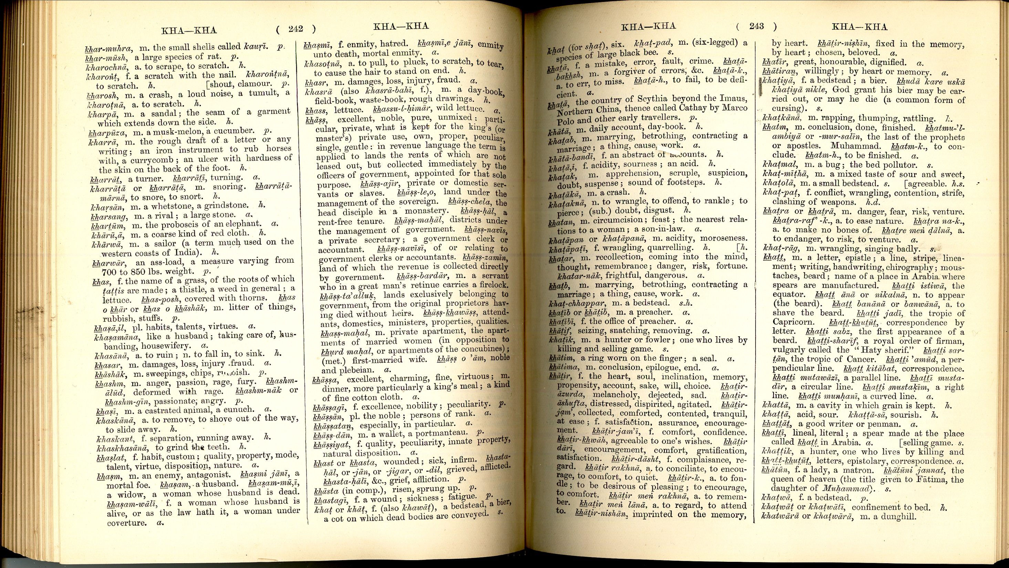
MUST:
“A Command; required by law!”
OPTION:
“a choice; an opinion, either/or!”

Slide 7
“The Lord God took the man and put him in the Garden of Eden to work it and take care of it. And the Lord God commanded the man, you are free to eat from any tree in the garden; but you must not eat from the tree of the knowledge of good and evil, for when you eat from it you will certainly die.” (Gen 2:15-17, NIV)
“For the generations to come every male among you who is eight days old must be circumcised, including those born in your household or bought with money from a foreigner—those who are not your offspring. 13 Whether born in your household or bought with your money, they must be circumcised. ” (Gen 17:12-13, NIV)
Must is NOT an Option

Slide 8
We Must Be Born Again (Jn 3:1-7)
We Must Endure Tribulation (Ac 14:22)
We Must Forgive Others (Col 3:13)
We Must Face The Judgment (2 Cor 5:10)
For we must all appear before the judgment seat of Christ, that each one may receive the things done in the body, according to what he has done, whether good or bad.
. . . exhorting them to continue in the faith, and saying, we must through many tribulations enter the kingdom of God.
Bearing with one another, and forgiving one another, if anyone has a complaint against another; even as Christ forgave you, so you also must do.
Do not marvel that I said to you, you must be born again.

