Slide 2
Exodus 1:15-22
¹⁵ Then the king of Egypt spoke to the Hebrew midwives, of whom the name of one was Shiphrah and the name of the other Puah; ¹⁶ and he said, when you do the duties of a midwife for the Hebrew women, and see them on the birthstools, if it is a son, then you shall kill him; but if it is a daughter, then she shall live. ¹⁷ But the midwives feared God, and did not do as the king of Egypt commanded them, but saved the male children alive. ¹⁸ So the king of Egypt called for the midwives and said to them, why have you done this thing, and saved the male children alive? ¹⁹ And the midwives said to Pharaoh, because the Hebrew women are not like the Egyptian women; for they are lively and give birth before the midwives come to them. ²⁰ Therefore God dealt well with the midwives, and the people multiplied and grew very mighty. ²¹ And so it was, because the midwives feared God, that He provided households for them. ²² So Pharaoh commanded all his people, saying, every son who is born you shall cast into the river, and every daughter you shall save alive.

Slide 4
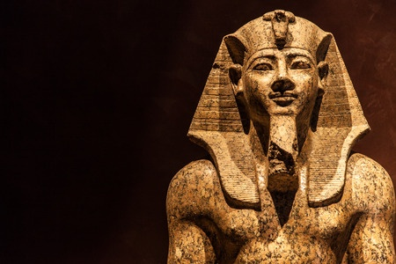
Hardening of Pharaoh’s Heart
And I will harden Pharaoh’s heart, and multiply My signs and My wonders in the land of Egypt (Exod 7:3).
Then the magicians of Egypt did so with their enchantments; and Pharaoh’s heart grew hard, and he did not heed them, as the Lord had said (Exod 7:22).
But when Pharaoh saw that there was relief, he hardened his heart and did not heed them, as the Lord had said (Exod 8:15).
God’s Role in hardening his Heart (7:3; 4:21-23; 5:2)
Magicians Role in hardening his Heart (7:8-13, 22)
Pharaoh hardened his own Heart (8:15; 8:32)

