Slide 2
Acts 11:19-26
¹⁹ Now those who were scattered after the persecution that arose over Stephen traveled as far as Phoenicia, Cyprus, and Antioch, preaching the word to no one but the Jews only. ²⁰ But some of them were men from Cyprus and Cyrene, who, when they had come to Antioch, spoke to the Hellenists, preaching the Lord Jesus. ²¹ And the hand of the Lord was with them, and a great number believed and turned to the Lord. ²² Then news of these things came to the ears of the church in Jerusalem, and they sent out Barnabas to go as far as Antioch. ²³ When he came and had seen the grace of God, he was glad, and encouraged them all that with purpose of heart they should continue with the Lord. ²⁴ For he was a good man, full of the Holy Spirit and of faith. And a great many people were added to the Lord. ²⁵ Then Barnabas departed for Tarsus to seek Saul. ²⁶ And when he had found him, he brought him to Antioch. So it was that for a whole year they assembled with the church and taught a great many people. And the disciples were first called Christians in Antioch.

Slide 4
Are you a...
CHRISTIAN?

Slide 5
How about now?
CHRIST AN

Slide 6
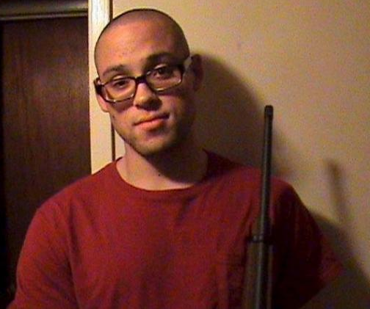
Are you a. . .
Chris Harper-Mercer
CHRIST AN

Slide 7
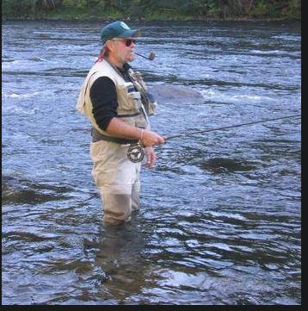
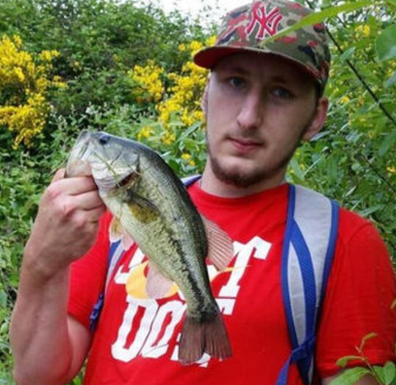
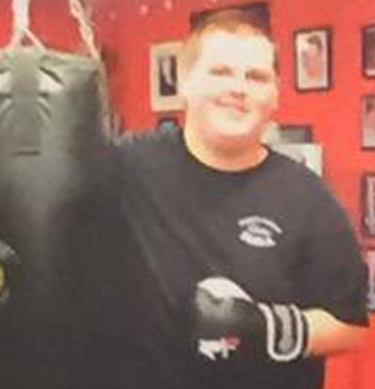
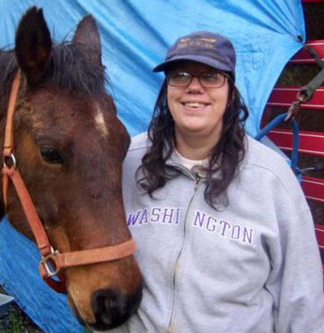
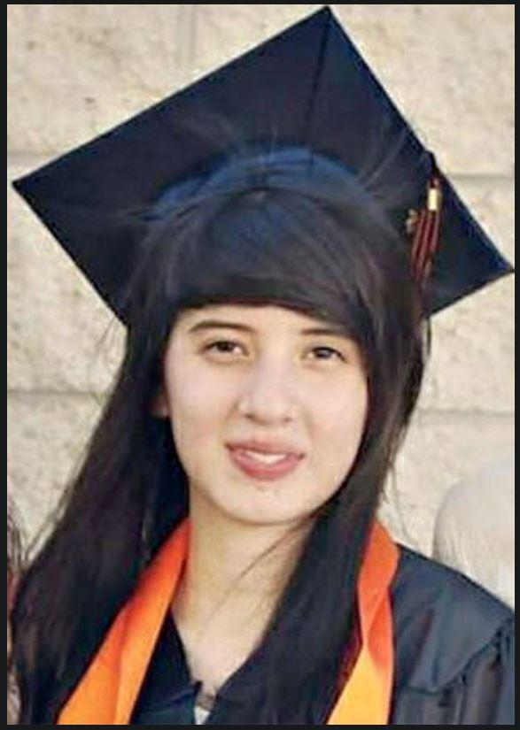
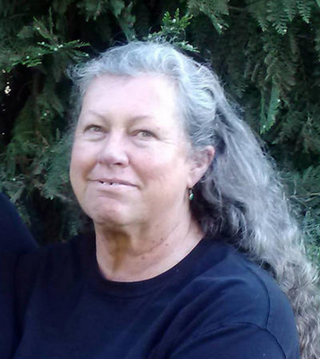
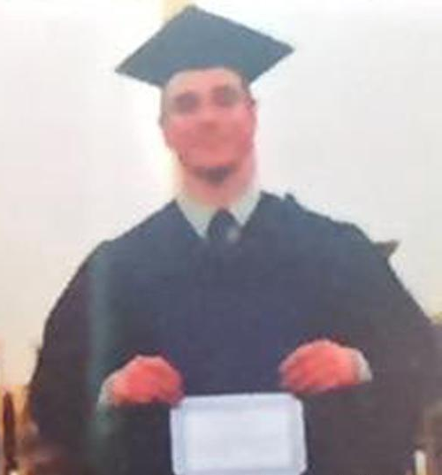
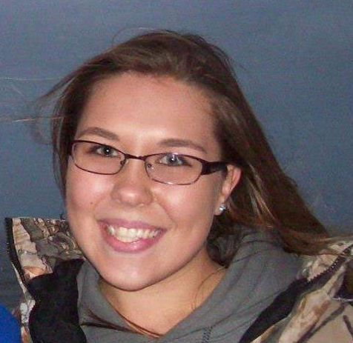
Lawrence Levine, 67
Quinn Cooper, 18
Treven Anspach, 20
Are you a...
Sarena Moore, 44
CHRIST AN?
Kim Dietz, 59
Lucero Alcaraz, 19
Jason Johnson, 34
Lucas Eibel, 18
Rebecka Carnes, 18

Slide 8
Matthew 23:34
Ephesians 6:12
1 Peter 5:8-9
2 Timothy 3:12

Slide 9
And do not fear those who kill the body but cannot kill the soul. But rather fear Him who is able to destroy both soul and body in hell. Are not two sparrows sold for a copper coin? And not one of them falls to the ground apart from your Father’s will. But the very hairs of your head are all numbered. Do not fear therefore; you are of more value than many sparrows. Therefore whoever confesses Me before men, him I will also confess before My Father who is in heaven. But whoever denies Me before men, him I will also deny before My Father who is in heaven. Do not think that I came to bring peace on earth. I did not come to bring peace but a sword.
Matthew 10:28-34
And do not fear those who kill the body but cannot kill the soul. But rather fear Him who is able to destroy both soul and body in hell. Are not two sparrows sold for a copper coin? And not one of them falls to the ground apart from your Father’s will. But the very hairs of your head are all numbered. Do not fear therefore; you are of more value than many sparrows. Therefore whoever confesses Me before men, him I will also confess before My Father who is in heaven. But whoever denies Me before men, him I will also deny before My Father who is in heaven. Do not think that I came to bring peace on earth. I did not come to bring peace but a sword.
Matthew 10:28-34
Are you a...
CHRIST AN?

Slide 10
“So they called them and commanded them not to speak at all nor teach in the name of Jesus. But Peter and John answered and said to them, whether it is right in the sight of God to listen to you more than to God, you judge. For we cannot but speak the things which we have seen and heard” (Ac 4:18-20).
“When they heard these things they were cut to the heart, and they gnashed at him with their teeth . . . And they stoned Stephen as he was calling on God and saying, Lord Jesus, receive my spirit” (Ac 7:57-59).
“Did we not strictly command you not to teach in this name? And look, you have filled Jerusalem with your doctrine, and intend to bring this Man’s blood on us! But Peter and the other apostles answered and said: we ought to obey God rather than men” (Ac 5:28-29).
Are you a...
“Herod the king . . . killed James the brother of John with the sword . . . he proceeded further to seize Peter also . . .” (Ac 12:1-3).
CHRIST AN?

Slide 11
“Then Paul answered, what do you mean by weeping and breaking my heart? For I am ready not only to be bound, but also to die at Jerusalem for the name of the Lord Jesus” (Ac 21:13).
“For if I am an offender, or have committed anything deserving of death, I do not object to dying” (Ac 25:11).
“I know your works, and where you dwell, where Satan’s throne is. And you hold fast to My name, and did not deny My faith even in the days in which Antipas was My faithful martyr, who was killed among you, where Satan dwells” (Rev 2:13).
“You have not yet resisted to bloodshed, striving against sin. And you have forgotten the exhortation which speaks to you as to sons” (Heb 12:4-5).
Are you a...
CHRIST AN?

Slide 12
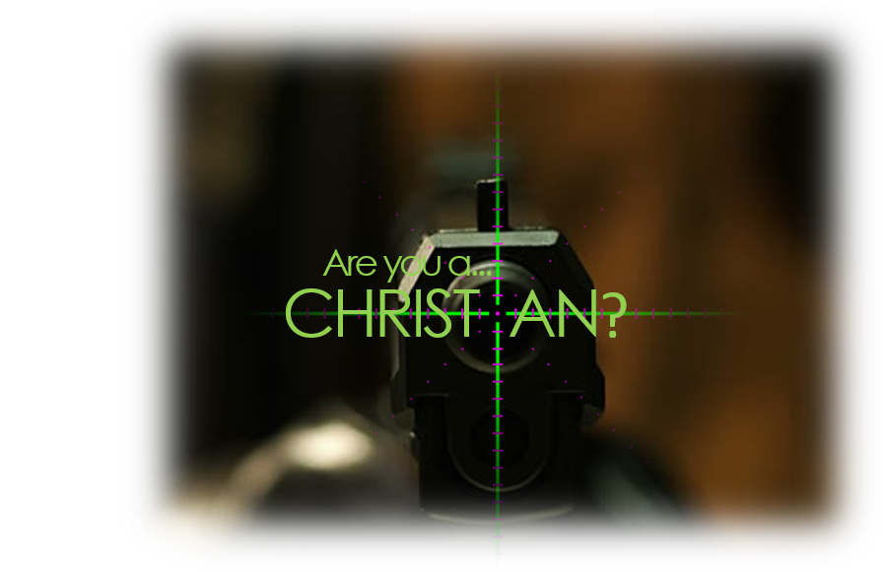
What would YOU do?
Would you deny the Lord and live or confess the Lord and die? (Matt 10:32-33)

Slide 13
What would YOU do?
Would you alienate friends by holding to Christian values? (1 Pet 4:3-4)

Slide 14
What would YOU do?
Would you put yourself in jeopardy by teaching the lost? (Acts 5:29)

Slide 15
What would YOU do?
Would you anger an unbelieving spouse by worshiping regularly? (1 Pet 3:1)

Slide 16
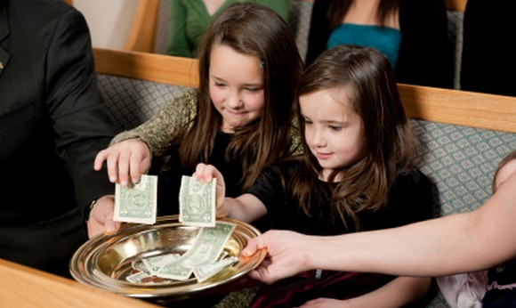
What would YOU do?
Would you sacrifice a desired object in order to give a weekly offering? (1 Cor 16:1-2)

Slide 17
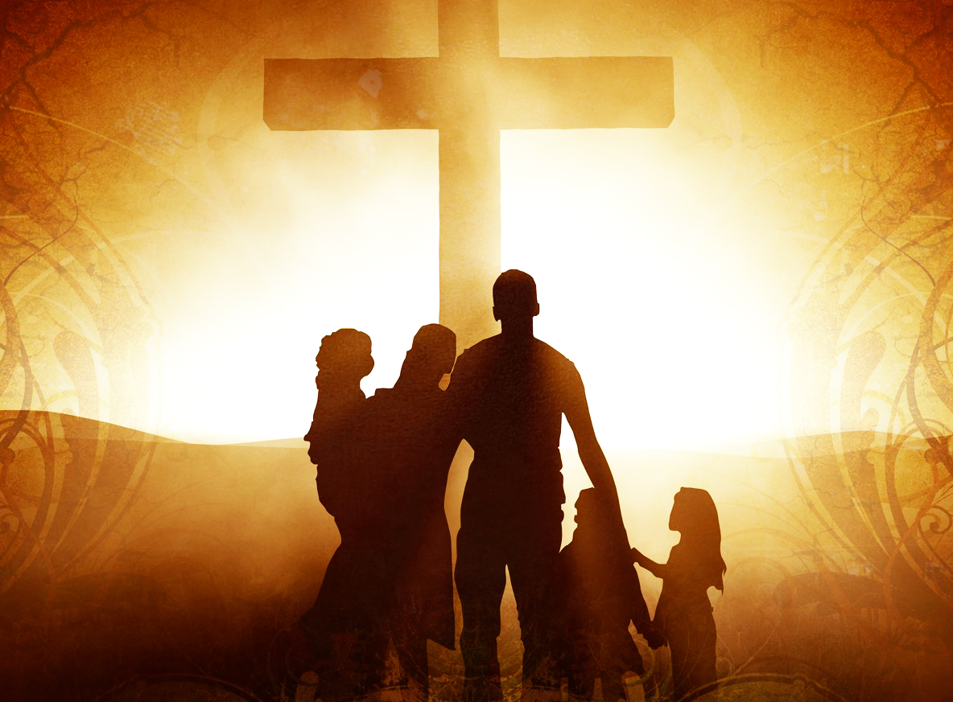
What would YOU do?
Would you forgo social events in order to be with the saints of God? (Heb 10:24-25)

Slide 18
Are you a. . .
CHRIST AN

