Slide 2
Judges 2:10-14
¹⁰ When all that generation had been gathered to their fathers, another generation arose after them who did not know the Lord nor the work which He had done for Israel. ¹¹ Then the children of Israel did evil in the sight of the Lord, and served the Baals; ¹² and they forsook the Lord God of their fathers, who had brought them out of the land of Egypt; and they followed other gods from among the gods of the people who were all around them, and they bowed down to them; and they provoked the Lord to anger. ¹³ They forsook the Lord and served Baal and the Ashtoreths. ¹⁴ And the anger of the Lord was hot against Israel. So He delivered them into the hands of plunderers who despoiled them; and He sold them into the hands of their enemies all around, so that they could no longer stand before their enemies.

Slide 4
Those that are slowly disappearing!

Slide 5
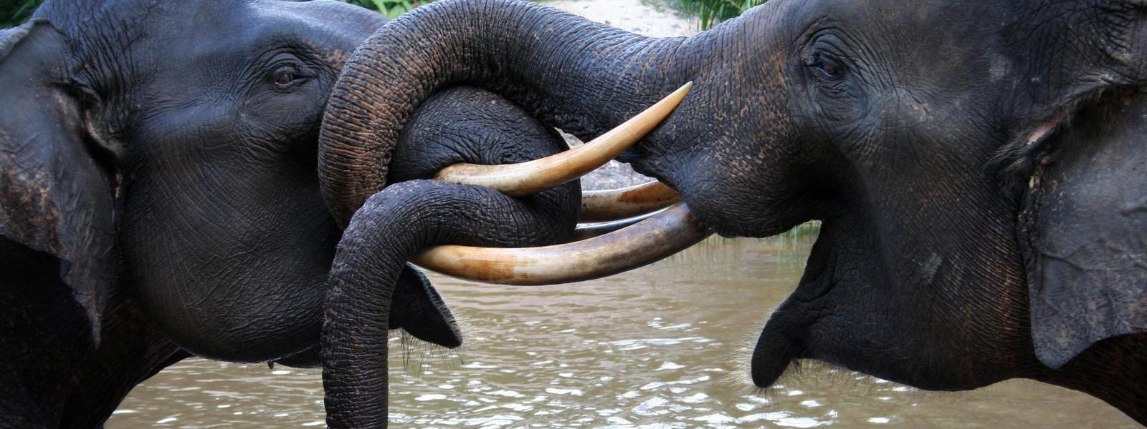
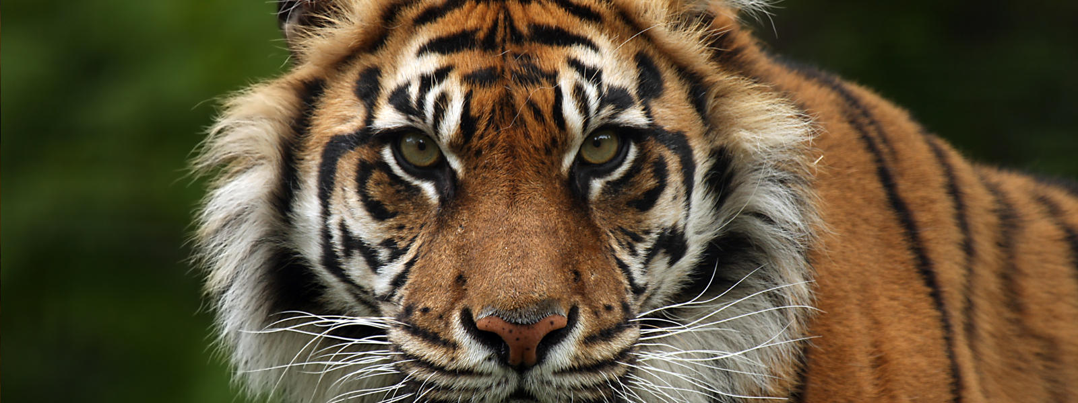
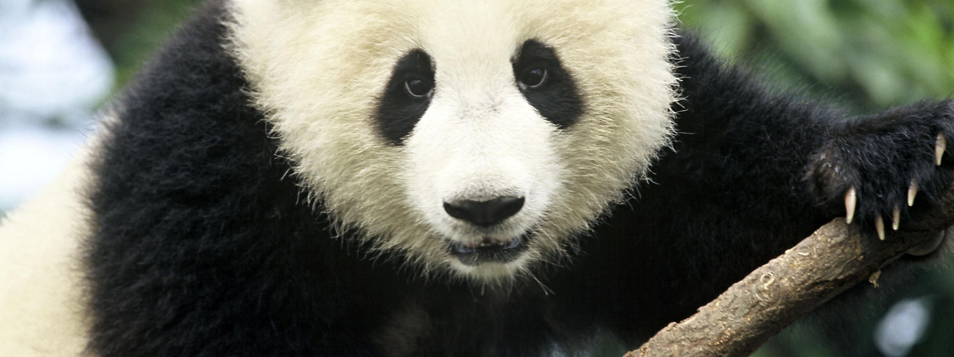
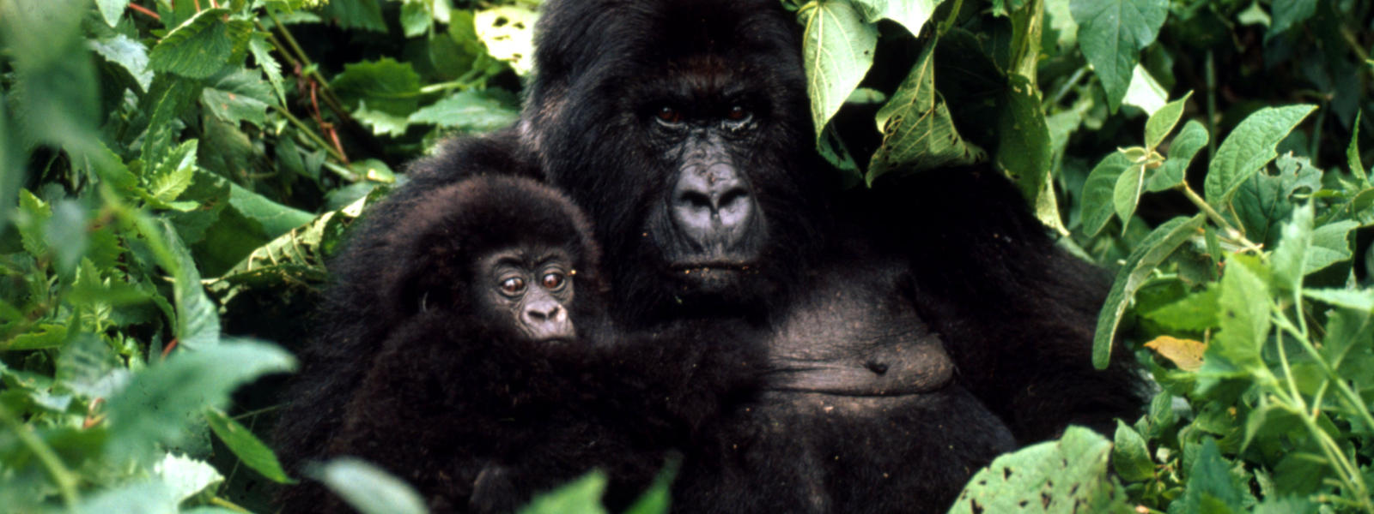
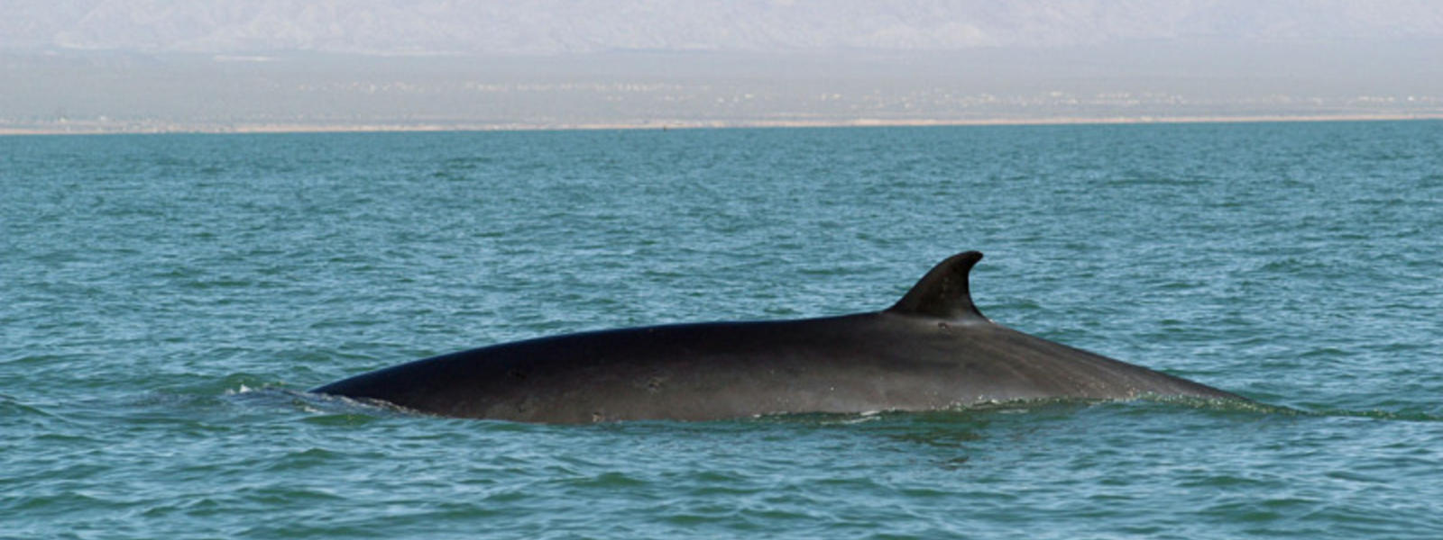
Sumatran Elephants
Mountain Gorillas
Sumatran Tigers
Fin Whales
Giant Pandas

Slide 6
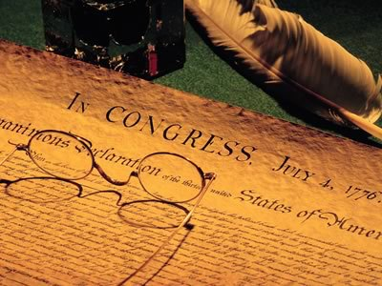
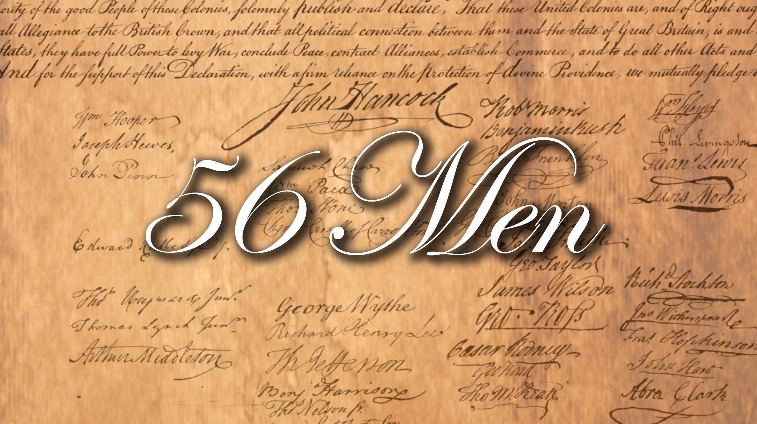
Statesmen
American Patriots

Slide 10
Those who implant
the Word of God into the
hearts of their children

