Slide 2
2 Corinthians 4:7-12
⁷ But we have this treasure in earthen vessels, that the excellence of the power may be of God and not of us. ⁸ We are hard-pressed on every side, yet not crushed; we are perplexed, but not in despair; ⁹ persecuted, but not forsaken; struck down, but not destroyed— ¹⁰ always carrying about in the body the dying of the Lord Jesus, that the life of Jesus also may be manifested in our body. ¹¹ For we who live are always delivered to death for Jesus’ sake, that the life of Jesus also may be manifested in our mortal flesh. ¹² So then death is working in us, but life in you.

Slide 4
“You therefore must endure hardship as a good soldier of Jesus Christ” (2 Tim 2:3).

Slide 5
BUT NOT
2 Corinthians 4:7-12

Slide 6
We are hard-pressed on every side, yet not crushed; we are perplexed, but not in despair; persecuted, but not forsaken; struck down, but not destroyed— always carrying about in the body the dying of the Lord Jesus, that the life of Jesus also may be manifested in our body. (2 Cor 4:8-10)
hard-pressed
perplexed
persecuted
struck down

Slide 7
A young Christian couple’s child is born dead !
A Christian wife discovers her husband of 11 years is unfaithful !
A 19-year-old son confesses that he is homosexual !
News from the department of defense: Your son has been killed in action !
There has been an accident and your daughter has been fatally injured !
The test results show that it is terminal—I’m sorry !

Slide 8
For I was envious of the boastful, when I saw the prosperity of the wicked . . . Behold, these are the ungodly, who are always at ease; They increase in riches. (Psa 73:2, 12)
I have seen everything in my days of vanity: There is a just man who perishes in his righteousness, and there is a wicked man who prolongs life in his wickedness. (Eccl 7:15)

Slide 9
Taylor & Danielle were in love and planning to get married upon his return from a tour in Afghanistan.

Slide 10
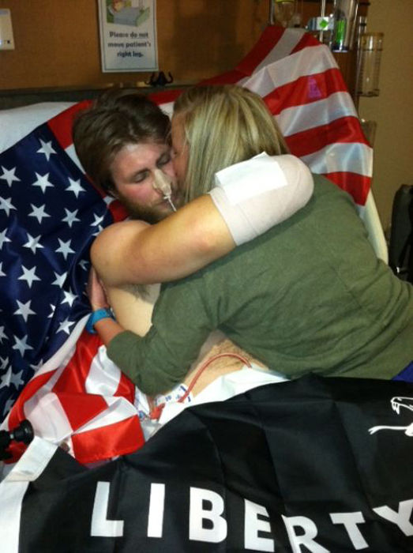
Give Comfort To Others
2 Corinthians 1:3-4
Miserable Comforters (Job 16:2)
Eliphaz: God is disciplining you—but good will come from this (Job 22).
Bildad: Now is the time to examine your priorities and return to God (Job 18).
Zophar: Man up, quit whining—it could be worse (Job 20).
Encouraging Comforters (2 Cor 1:4)
Be there in person (Acts 11:23).
Express empathy (1 Thess 4:16).
Don’t try to “fix it” (Job 2:9).
“Taylor is determined to conquer anything, and this won’t be any different,” Danielle said. “He will continue to be the Taylor that we all know and love. His recovery is going to be long and grueling, but hard work and determination is nothing that Taylor has ever shied away from . . . We try to continue to work hard each day to ensure the best possible life . . . We are still so young and have so much life ahead of us, we want it to be everything we have imagined, even before the accident.”

Slide 11
Give Hope To Others
Heb 12:1-2; Psa 90:15-17

Slide 12
Give Hope To Others
Heb 12:1-2; Psa 90:15-17
We are all the walking wounded (2 Cor 5:2-4).
Our wounds do not have to be fatal (Phil 1:21-23).
We are staying in the battle (2 Tim 4:6-8).

Slide 13
Refocus your attention on Heaven
Heb 11:13-16; Psa 121:1-2
This world is not my home I'm just passing through my treasures are laid up somewhere beyond the blue the angels beckon me from Heaven's open door and I can't feel at home in this world anymore . . .
2 Corinthians 4:17-18
John 16:33
John 14:1-3

Slide 14
Defeat doesn’t finish a man, quit does. A man is not finished when he's defeated. He’s finished when he quits.
I am hurt, but I am not slain; I’ll lay me down and bleed a while, and then I’ll rise and fight again.
Richard M. Nixon
“We are just two typical 23-year-olds that had an idea of what the rest of our life was supposed to look like. On May 3 our life got turned upside down. (Now) we figure out a way to make sure we have everything that we dreamed about beforehand.”
Taylor & Danielle Morris
Joseph, Gen 50:20
Become stepping stones to spiritual greatness
James 1:2-3
Job, Job 23:10
Paul, 2 Cor 4:17

