Slide 2
1 Samuel 15:10-14
¹⁰ Now the word of the Lord came to Samuel, saying, ¹¹ I greatly regret that I have set up Saul as king, for he has turned back from following Me, and has not performed My commandments. And it grieved Samuel, and he cried out to the Lord all night. ¹² So when Samuel rose early in the morning to meet Saul, it was told Samuel, saying, Saul went to Carmel, and indeed, he set up a monument for himself; and he has gone on around, passed by, and gone down to Gilgal. ¹³ Then Samuel went to Saul, and Saul said to him, blessed are you of the Lord! I have performed the commandment of the Lord. ¹⁴ But Samuel said, what then is this bleating of the sheep in my ears, and the lowing of the oxen which I hear?

Slide 4
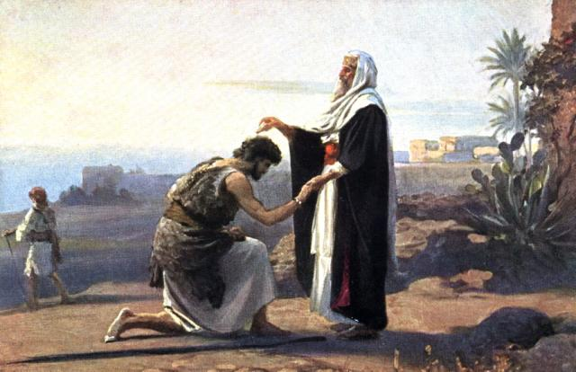
There was a man of Benjamin whose name was Kish the son of Abiel, the son of Zeror, the son of Bechorath, the son of Aphiah, a Benjamite, a mighty man of power. And he had a choice and handsome son whose name was Saul. There was not a more handsome person than he among the children of Israel. From his shoulders upward he was taller than any of the people.
1 Samuel 9:1-2
Then Samuel took a flask of oil and poured it on his head, and kissed him and said: Is it not because the Lord has anointed you commander over His inheritance?
1 Samuel 10:1

Slide 5
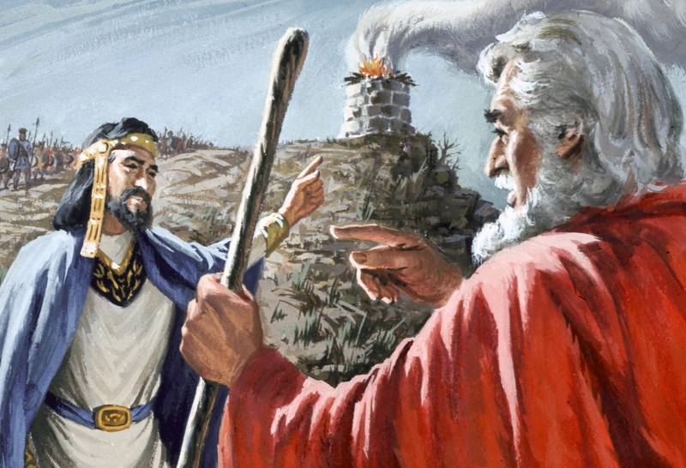
“What then is this bleating
of the sheep in my ears,
and the lowing of the oxen which I hear?”

Slide 6
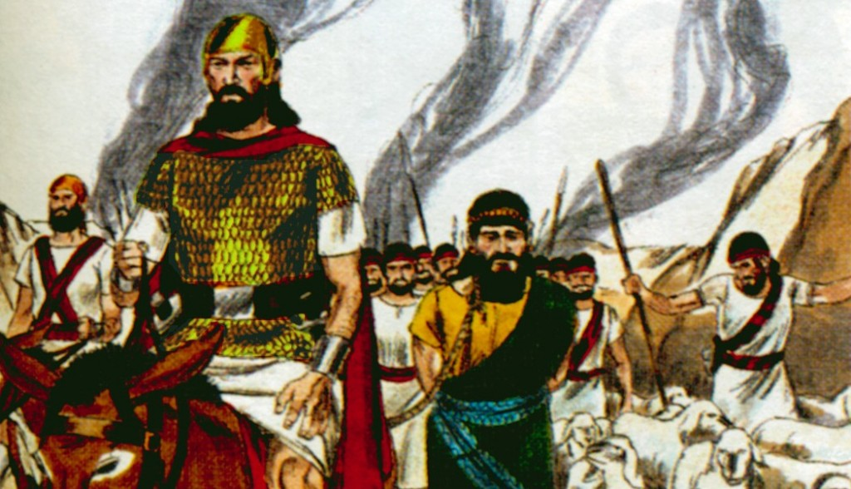
REJECTED
God Was Disobeyed
His Humility Was Lost
He Shifted the Blame to Others
He Feared People not God
Tried to improve God’s Order

Slide 7
