Slide 2
Job 4:12-17
¹² Now a word was secretly brought to me, and my ear received a whisper of it. ¹³ In disquieting thoughts from the visions of the night, when deep sleep falls on men, ¹⁴ Fear came upon me, and trembling, which made all my bones shake. ¹⁵ Then a spirit passed before my face; the hair on my body stood up. ¹⁶ It stood still, but I could not discern its appearance. A form was before my eyes; there was silence; then I heard a voice saying: ¹⁷ Can a mortal be more righteous than God? Can a man be more pure than his Maker?

Slide 5
Represents God’s Holiness & Justice—Psa 112:9; Rom 3:24-25
Can be known only through the Word of God—Rom 1:16-17
The righteous do what is right as revealed in Word—1 Jn 3:7

Slide 6
Those “More Righteous” than God
Are those seeking to invalidate the scriptures and establish their own brand of super-righteousness.
For they being ignorant of God’s righteousness, and seeking to establish their own righteousness, have not submitted to the righteousness of God. (Rom 10:3)

Slide 7
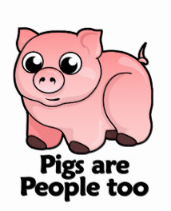
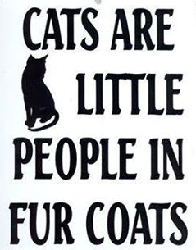
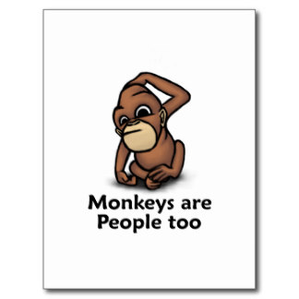
The “animals are people too” crowd

Slide 9
Those in favor of
Homosexual Marriage

Slide 10
Climate
Change
Advocates

Slide 11
. . . wants me to be happy!
. . . would never burn a human!
. . . would save one who couldn’t make it to the water!

