Slide 2
Matthew 24:36-42
³⁶ But of that day and hour no one knows, not even the angels of heaven, but My Father only. ³⁷ But as the days of Noah were, so also will the coming of the Son of Man be. ³⁸ For as in the days before the flood, they were eating and drinking, marrying and giving in marriage, until the day that Noah entered the ark, ³⁹ and did not know until the flood came and took them all away, so also will the coming of the Son of Man be. ⁴⁰ Then two men will be in the field: one will be taken and the other left. ⁴¹ Two women will be grinding at the mill: one will be taken and the other left. ⁴² Watch therefore, for you do not know what hour your Lord is coming.

Slide 4
The Promised Return of Jesus
Now when He had spoken these things, while they watched, He was taken up, and a cloud received Him out of their sight. And while they looked steadfastly toward heaven as He went up, behold, two men stood by them in white apparel, who also said, men of Galilee, why do you stand gazing up into heaven? This same Jesus, who was taken up from you into heaven, will so come in like manner as you saw Him go into heaven. (Acts 1:9-11)

Slide 5
Broken Images of Christ’s Return

Slide 6
The Date Setters

Slide 7
The “Secret” Coming & The Rapture

Slide 8
The Second Coming & Armageddon

Slide 9
Jesus Coming as the Holy Spirit

Slide 10
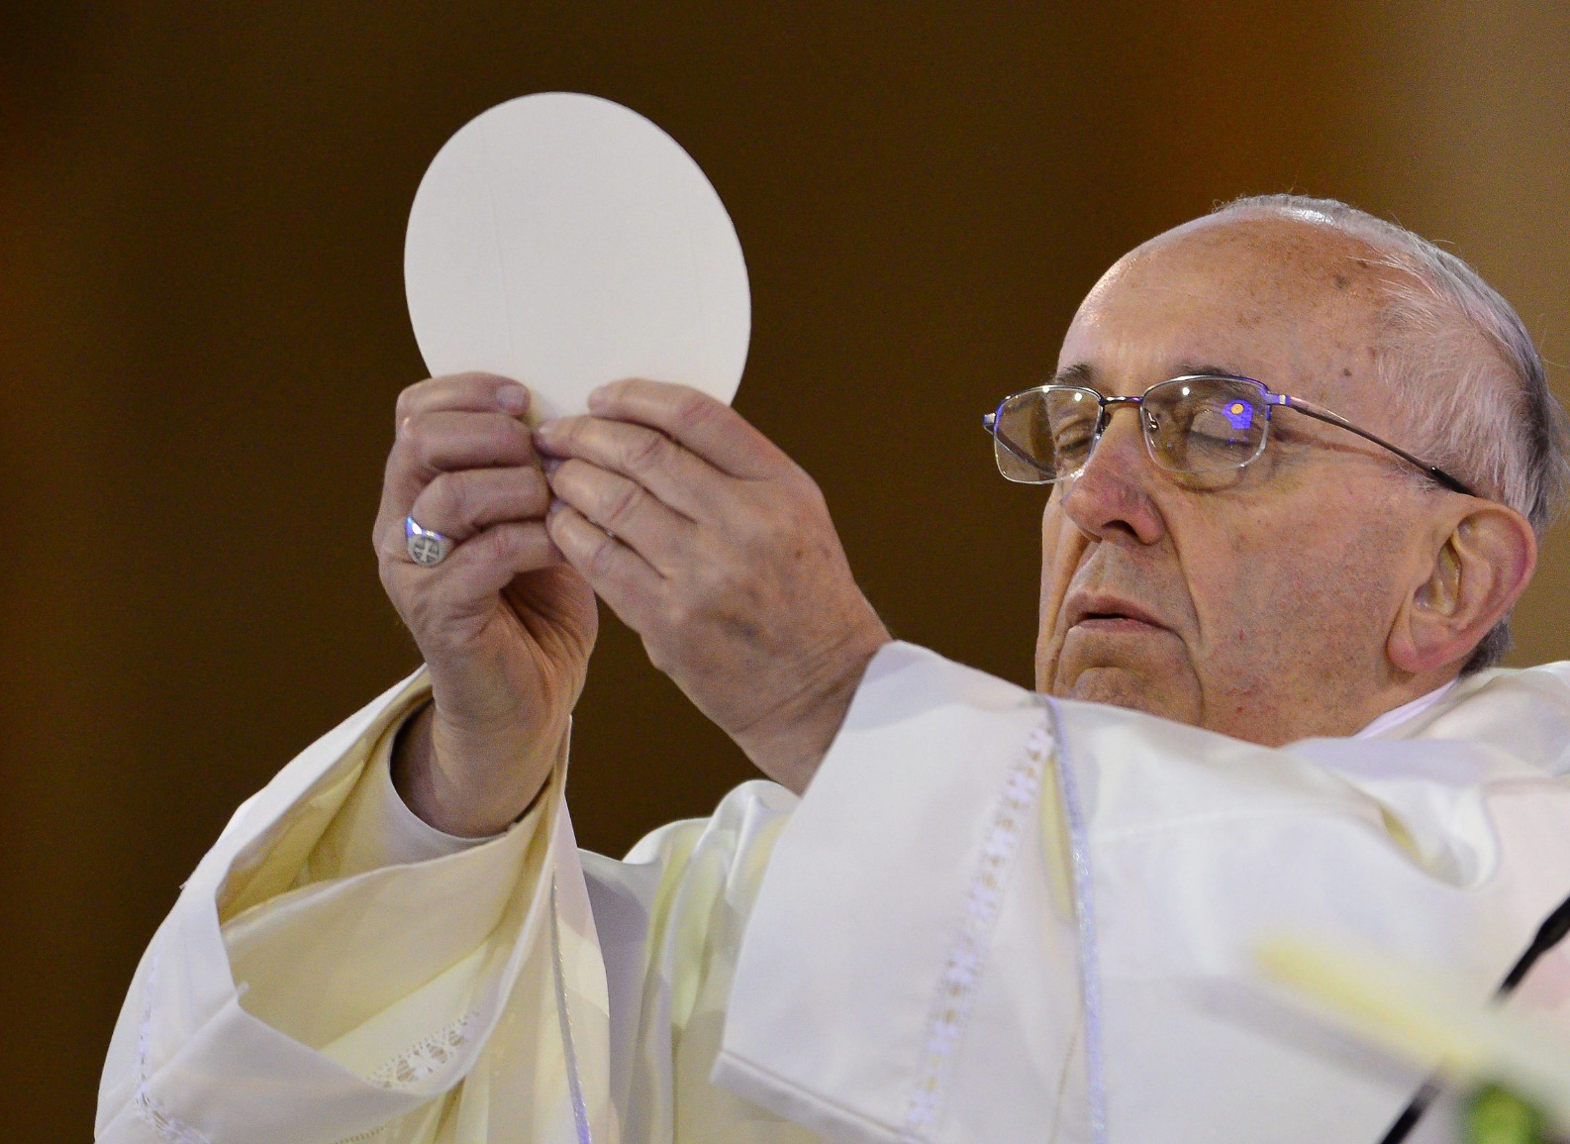
Jesus Coming & Roman Catholicism
“Then the Son of Man will come upon the clouds in the sky with great power and glory”. The “Son of Man” is Jesus himself, who links the present with the future; the ancient words of the prophets have finally found a center in the person of the Messiah of Nazareth: he is the central event that, in the midst of the troubles of the world, remains the firm and stable point.
For this reason Jesus does not describe the end of the world and when he uses apocalyptic images he does not conduct himself like a “visionary.”

Slide 11
Jesus 2nd Coming Occurred in 70 A.D.
All Jesus “coming” passages point to the destruction of Jerusalem in A.D. 70.
North Indianapolis church of Christ
Area churches affected:
Biltmore Gardens (late ‘90’s)
Danville (late ’90’s)
Traders Point (early 2000’s)
Avon Heights (recently)
Greencastle (recently)
There will NOT be a return of Christ beyond His “coming” at the destruction of Jerusalem in A.D. 70.

Slide 12
Jesus 2nd Coming Occurred in 70 A.D.
Matt 24:30-31
30 Then the sign of the Son of Man will appear in heaven, and then all the tribes of the earth will mourn, and they will see the Son of Man coming on the clouds of heaven with power and great glory.
31 And He will send His angels with a great sound of a trumpet, and they will gather together His elect from the four winds, from one end of heaven to the other.
Luke 21:24,27
24 And they will fall by the edge of the sword, and be led away captive into all nations. And Jerusalem will be trampled by Gentiles until the times of the Gentiles are fulfilled.
27 Then they will see the Son of Man coming in a cloud with power and great glory.
How can they reach such a conclusion?

Slide 13
Understanding the “comings” of Jesus

Slide 14
Understanding the “comings” of Jesus
He “comes” in local church judgment
Church at Pergamum Revelation 2:16
Repent, or else I will come to you quickly and will fight against them with the sword of My mouth.
He “comes” in Spiritual Fellowship
Revelation 3:20
Behold, I stand at the door and knock. If anyone hears My voice and opens the door, I will come in to him and dine with him, and he with Me.

Slide 15
Understanding the “comings” of Jesus

Slide 16
Understanding the “comings” of Jesus
Matthew 22:7
But when the king heard about it, he was furious. And he sent out his armies, destroyed those murderers, and burned up their city.

Slide 17
Jesus Will Come Again
But the day of the Lord will come as a thief in the night, in which the heavens will pass away with a great noise, and the elements will melt with fervent heat; both the earth and the works that are in it will be burned up. Therefore, since all these things will be dissolved, what manner of persons ought you to be in holy conduct and godliness, (1 Pet 3:10-11)
For the Lord Himself will descend from heaven with a shout, with the voice of an archangel, and with the trumpet of God. And the dead in Christ will rise first. (1 Thess 4:16)
For as in Adam all die, even so in Christ all shall be made alive. But each one in his own order: Christ the firstfruits, afterward those who are Christ’s at His coming. (1 Cor 15:22-23)
Let not your heart be troubled; you believe in God, believe also in Me. In My Father’s house are many mansions; if it were not so, I would have told you. I go to prepare a place for you. And if I go and prepare a place for you, I will come again and receive you to Myself; that where I am, there you may be also. (Jn 14:1-3)
So Christ was offered once to bear the sins of many. To those who eagerly wait for Him He will appear a second time, apart from sin, for salvation. (Hebrews 9:27)
Beloved, now we are children of God; and it has not yet been revealed what we shall be, but we know that when He is revealed, we shall be like Him, for we shall see Him as He is. (1 Jn 3:2)

